Slide 1
OCL Visualization
A Reality Check
Edward Willink
Willink Transformations Ltd
Eclipse Foundation
MMT Component co-Lead
OCL Project Lead
QVTd Project Lead
QVTo Committer
OMG (Model Driven Solutions)
OCL 2.3, 2.4, 2.5 RTF Chair
QVT 1.2, 1.3, 1.4 RTF Chair
OCL 2019 @ MODELS 2019
16th September 2019

Slide 2

Overview
Background
Traditional AST visualization
vOCL 2018 problems
Fixed vOCL
Eclipse QVTs visualization
Constraint Diagram
Visual OCL
Summary / Conclusion

Slide 3

Background
Text can be good
Pictures can be good
Text can be better
Pictures can be better
Text dominant for expressions (except SDL)
UML graphical – why no graphical OCL ?
OCL 2018 => vOCL paper worth discussion
  reviewer's / audience criticisms not rebutted

Slide 4
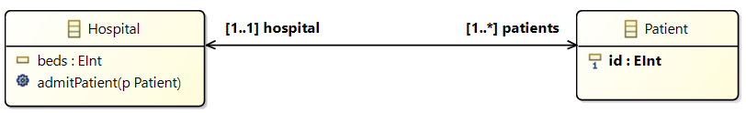
Running Example
Example constraint
context Hospital
inv uniquePatientId:
self.patients->forAll(p1, p2 |
p1 <> p2 implies p1.id <> p2.id)
Equivalent to
context Hospital
inv uniquePatientId:
self.patients->isUnique(id)

Slide 5
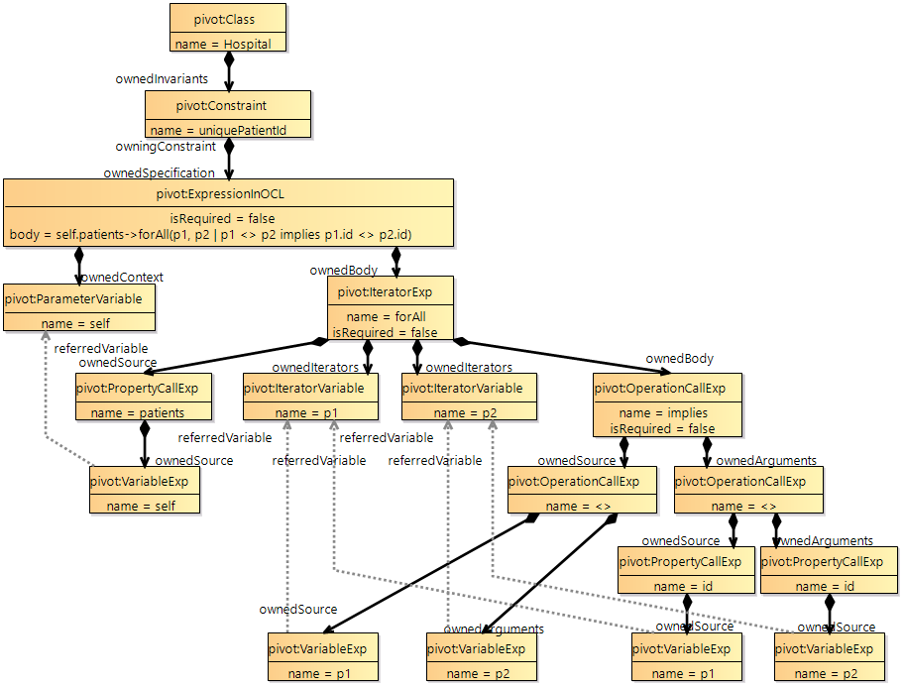
Traditional AST
Visualization
UML-like
  solid containment
  dashed references
  18 nodes, 22 edges

Slide 6

vOCL
Traditional AST is instance-based
  instances of OCL metamodel
    requires knowledge of OCL internals
  references by name to user metamodel
vOCL is class-based
  re-uses user metamodel to define variables
  mnemonic icons for common OCL operations
  vOCL constraint is a doodle on the class diagram
    new doodling semantics

Slide 7
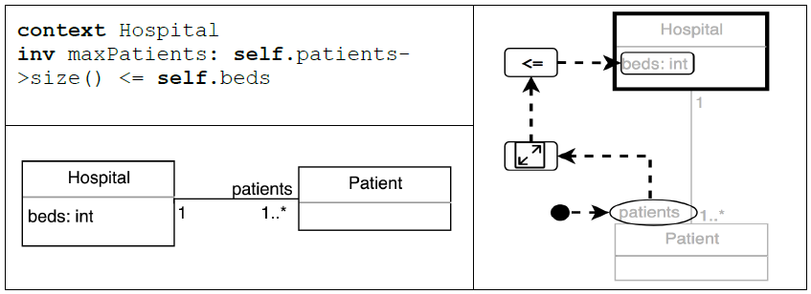
vOCL example from 2018 paper
blob is the self instance of the not-grayed class
ellipses use Class-typed reference properties
rounded rectangles use DataType properties
additional icons for OCL operations
arrows denote 'reading order'
  vague semantics

Slide 8
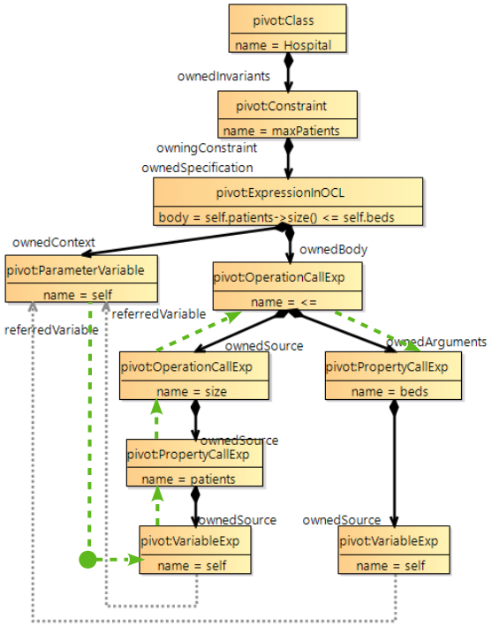
AST visualization of vOCL example
green reading order markup
blob - self - ok
....patients - ok
....size() - ok
....<= - lhs ok
<= ... - rhs inverted
pragmatic
self.beds backwards

Slide 9
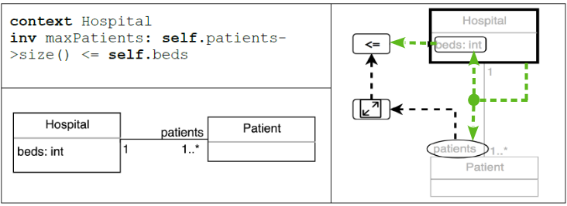
Fixed vOCL example
Multiple paths for multiple instances/evaluations
Blob now starts two paths
  black path as in original paper to read the LHS
  self.patients.size() <=
  new green path to read the RHS
  self.beds >=
  both paths read towards the binary <= operation

Slide 10
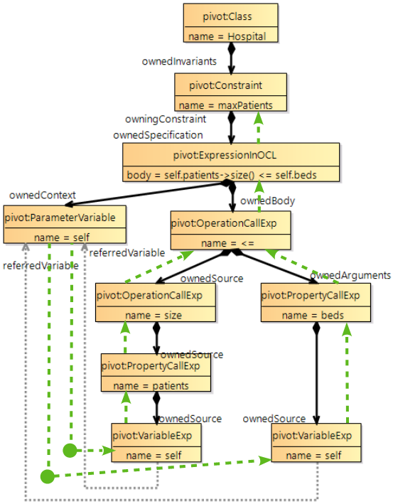
AST visualization of fixed vOCL example
two blobs
two bottom-up paths
'reading order' is
now AST evaluation
  blob defines 'self' value
  edge passes value
  node computes value

Slide 11
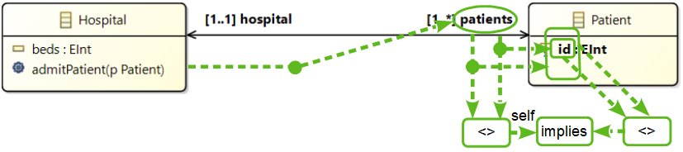
Running example using Fixed vOCL
Blobs identify three variables starting five paths
  self.patients
  self.patients.id <> implies
  self.patients.id <> implies
  self.patients <> implies
  self.patients <> implies
Nested rounded rectangles for multiple uses
9 nodes + 12 edges (AST: 18 nodes, 22 edges)

Slide 12

Eclipse QVTs OCL visualization
AST visualization
  Object Diagram: instances of OCL metamodel
vOCL
  Class Diagram: doodle on user metamodel
Eclipse QVTs patterns
  Object Diagram: instances of user metamodel
  auto-generated debug aid for matching schedule
  example embedded in QVTr

Slide 13
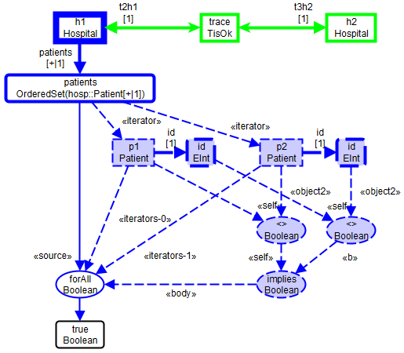

Running Example using Eclipse QVTs
Rectangles
=> class instances
Rounded rectangles
=> DataType values
Ellipses
=> OCL operations
edges have <<roles>>
Solid edges
=> unit value matching
Dashed edges
=> [0..*] values matching
11 nodes and 15 edges

Slide 14
Constraint Diagrams
Stuart Kent, OOPSLA 1997
Constraint Diagrams: Visualizing Invariants in Object-Oriented Models.
Visual Set membership
  blobs for members
  shapes for types
  blobs within shapes for membership
  edges for relationships
  ... Venn Diagrams
Not OCL
  related concepts ... better perspective

Slide 15
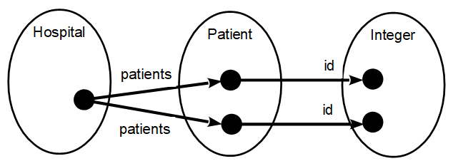
Running example - Constraint Diagram
Ellipses - user metamodel types
Blobs - distinct instances typed by background
Edges - metamodel relationships
Powerful set concepts align well to OCL
  some OCL concepts hard to represent
8 nodes, 4 edges

Slide 16

Visual OCL
Christiane Kiesner, Gabriele Taentzer, Jessica Winkelmann TU Berlin Technical Report 2002/23
Visual OCL: A Visualization of the Object Constraint Language
A new 'UML' diagram
  re-uses statechart idioms
  hierachy of decorated compartments

Slide 17
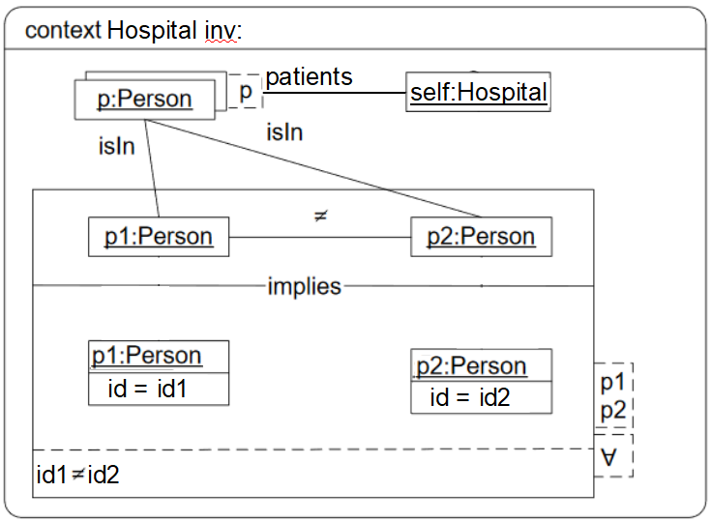
Running Example - Visual OCL
? Draw as:
12 nodes / compartments
3 edges
10 text tokens

Slide 18
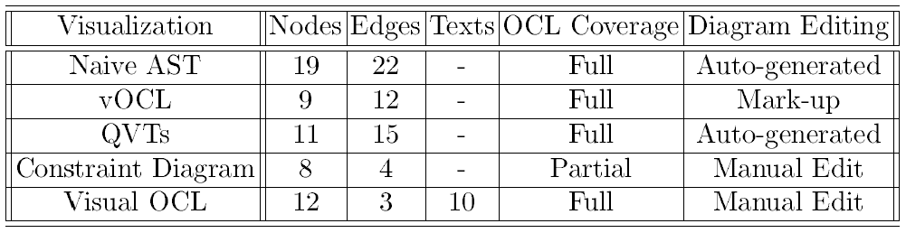
Summary / Comparison
Naive AST - verbose, uses OCL metamodel
vOCL - user-friendly, may become cluttered
QVTs - patterns, variables avoid clutter
Constraint Diagram - can be very good
  beware: running example hits a 'sweet spot'
Visual OCL - adequate

Slide 19
Summary / Reality
Text can be better, Pictures can be better
Text dominant for expressions
Complex expressions need the 'best' exposition
  patterns
Text tooling unavoidable - ASCII compatibility
Visual tooling specialized - UMLDI is a 'future'
AST / QVTs visualization - a helpful debug aid
Other Visual OCL editors unlikely to happen

Slide 20
Future Work ?
Eclipse QVTs - adequate, complete
  node => metamodel instance / operation
  edge => metamodel relationship / operation role
Constraint Diagram - compact, partial
  node => metamodel instance
  edge => metamodel relationship
  background => set membership / typing
?? Merge the two ??
?? Questions ??

