Slide 1
A Validity Analysis to Reify
2-valued Boolean Constraints
Edward Willink
Willink Transformations Ltd
Eclipse Foundation
MMT Component co-Lead
OCL Project Lead
QVTd Project Lead
QVTo Committer
MoDisco Project Lead
OMG (Model Driven Solutions)
OCL 2.3, 2.4, 2.5 RTF Chair
QVT 1.2, 1.3, 1.4 RTF Chair
OCL 2021 @ STAF 2021
25th June 2021

Slide 2



When OCL goes wrong ...
Crashes
    desirable / undesirable
Goal
    all desirable crashes crash
    no undesirable crashes
  and/or short-circuit/commutativity conflict
Symbolic Program Analysis
Running example
Corollaries of an analysis
Current status
Conclusion

Slide 3
OCL Execution Reality
Metamodel and Constraints
  Domain-Specific Utopia
  nothing goes wrong
OCL as Model-Oriented Pseudo-Code
  nothing goes wrong
  problems glossed over by ad hoc semantics
OCL as Executable Specification Language
  crashes are unavoidable
  crash behavior must be useful and predictable

Slide 4
Crash Mechanisms
Many languages - Exception
  out-of-band value uses alternative return mechanism
  regular and irregular return
OCL - invalid
  in-band return value
  expands regular return
functionally equivalent
  OCL approach arguably better

Slide 5
2-valued Constraint
Idealized Constraint
  two way verdict required: satisfied / not-satisfied
Practical Constraint Evaluation
  three outcomes: satisfied / not-satisfied / crash
If Crash uses exception
  caller perceives 2 outcomes
If Crash uses invalid
  caller must handle 3 outcomes
    convert invalid to exception
Misunderstanding of 3 outcome API

Slide 6
Catastrophic / Desirable Crashes
PowerFail, StackOverflow, MemoryAllocationFail
  at almost any time
FileAccess, Network, DataBase Failure
  almost any model element NavigationCallExp may fail
Catastrophic external execution failure
  normal OCL cannot remedy failure
Desirable to crash and provide a helpful diagnosis
  user may then resolve the issue
  failure to crash may be unsound/confusing/unethical

Slide 7

Careless / Undesirable Crashes
  null reifies the content of a [?] model element
  invalid reifies the result of a failure
internal programming crashes
  null.doSomething() -- strictness violation
    use of null or invalid generally crashes
  5/0 -- divide-by-zero crashes
  ord->at(0) -- bad ordered-collection index crashes
  seq->indexOf('y') -- missing content crashes
  'yes'.toBoolean() -- bad conversion crashes
bad / careless programming
  undesirable - eliminate by analysis

Slide 8

Crash Avoidance
handle crash
  exception - try / catch
  invalid - oclIsInvalid()
guard
if ... then ... else ... endif
short-circuit
(var != null) || var.doSomething() // C or Java
(var <> null) or var.doSomething() -- OCL
    pseudo-short-circuit

Slide 9
Model Transformation
OCL-based
crashes problematic
  matches do not match
    non-trivial semantics for crashed matches
  result may be deficient
  dishonest - untrustworthy result
crash must be fatal
  hard to accurately implement all crashes
  crash is fatal so why bother
  instant crash much simpler, faster, better
force user to eliminate crash hazards

Slide 10
When OCL goes wrong ...
Crashes
    desirable / undesirable
Goal
    all desirable crashes crash
    no undesirable crashes
  and/or short-circuit/commutativity conflict
Running example
Symbolic Program Analysis
Corollaries of an analysis
Current status
Conclusion

Slide 11
Broken Specification of 'undefined'
Boolean connectives - and/or
  OCL 1: logic of {true,false,anything-else}
    vague: does 'anything' include null (nothing) / crash ?
  Amsterdam: logic of not-yet-computed {true,false,future}
    sound, arguably strict,
    null, invalid are not true/false/future so presumably bypass
  OCL 2: logic of actuals {true,false,null,invalid}
    unsound, not-strict
    null, invalid are handled
    any crash treated as invalid

Slide 12
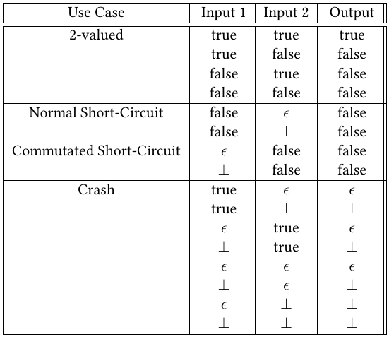
OCL 2 and
ε - null
┴ - invalid
all inputs always required, crashes may be guarded
  no short-circuit functionality specified by OCL
  OCL specification makes extensive use of 'short circuits'

Slide 13
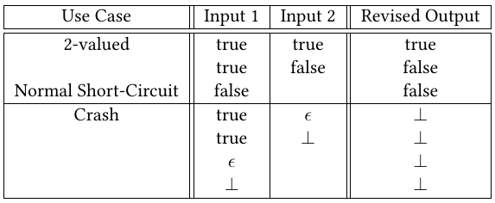
Compromise OCL and
short-circuit
  no redundant evaluation
  any crash always crashes
@run-time: incompatible Commutated Short Circuit
  crashable and crash-proof
  validity analysis must resolve
@compile-time: crash-proof commutativity

Slide 14
and/or recursion conflict
and/or are commutative - tradition/elegant
and/or are short-circuit - pragmatic
context Integer
def: isPrimeNumber() : Boolean =
(0 < self) and ((self < 4)
or ((self.div(2) * 2) <> self)
and self.isPrimeNumber(3))
def: isPrimeNumber(candidateFactor:Integer) : Boolean =
((self.div(candidateFactor) * candidateFactor) <> self)
and ((candidateFactor*candidateFactor > self)
or self.isPrimeNumber(candidateFactor+2))
recursion-guards and/or recursive-call
but commute: recursive-call and/or recursion-guards
Amsterdam: recursive future never happens

Slide 15


Compatible resolution of OCL 2 conflict
OCL 2: recursive first actual gives stack overflow
  non-short-circuit gives stack overflow
  respecify away - no recursion/no commutativity
  analyze away - avoid problem cases
Using Validity Analysis to detect crash hazards
  @run-time
    sensible tooling selects an argument to evaluate first
      obviously the first, users always guard first
  @compile-time
    mandatory commutation for crash-proof first argument
    optional heuristic commutation of crash-proof arguments
    diagnosis of indeterminate double crash hazard
    set flag in AST if run-time may parallelize/commute

Slide 16
Commutativity is not necessary
Numeric commutativity
  useful for mental arithmetic 3*15 vs 15*3
  useful to refactor to avoid precision challenges
Boolean commutativity
  true/false equally easy
  need to optimize multiple terms - 2-term idempotence
    A&B&C&B&A to A&B&C or C&B&A or ...
    loses guard-first ordering
  repeated term redundancy
    A&B&C&B&A to just A&B&C
    preserves guard-first ordering

Slide 17
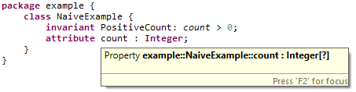
Running Example
Pedantic Desirable Crash
  network failure while evaluating self.count
  desirable crash
Careless Undesirable Crash
  NaiveExample::count may be null
  static analysis can diagnose crash hazard
    simple fix - change metamodel multiplicity to [1]

Slide 18

Fixed Running Example
    more complex fix - tolerate null value
implies operator guards the null access
naive static analysis still diagnoses hazard
  analysis needs to understand program flow
    self.count > 0
    can only execute if
    self.count <> null
    is true

Slide 19
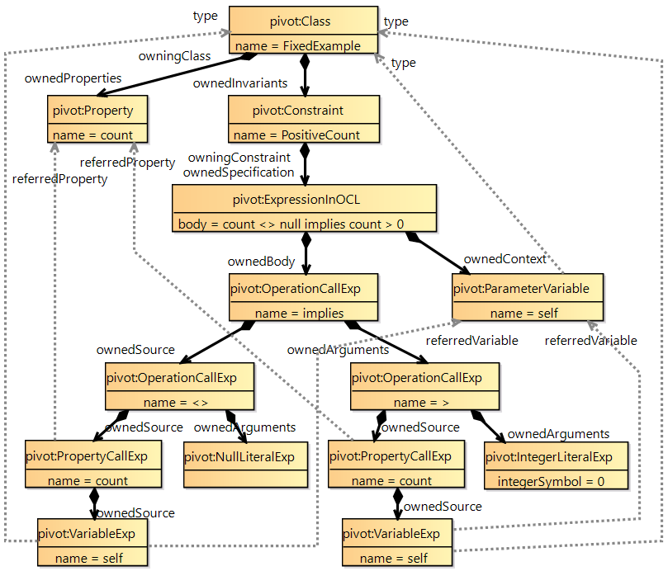
Forward
Evaluation
1
18
17
2
9
10
3
6
7
8
11
14
16
15
4
5
12
13

Slide 20
Conventional Evaluation
at Run-Time
  input values known
  determinstic result
Ordered-First Traversal of AST
  leaves provide known values
  propagate up the tree to result at root
Control Path known
  only need to visit then/else child of IfExp

Slide 21
Basic Symbolic Evaluation
at Compile-time
  many input values unknown
  some partial knowledge available
    {Is,MayBe,IsNot} {Null,Invalid,Zero, ....}
Ordered-First Traversal of AST
  propagate partial knowledge up the tree
Control Path unknown
  must visit both then and else children of IfExp

Slide 22
Symbolic Re-Evaluation
basic evaluation may identify many MayBeInvalid
  each MayBeInvalid is a potential undesirable crash
  need to refine MayBeInvalid to IsNotInvalid
hypothesize that MayBeInvalid element IsInvalid
  enforce control path to ensure IsInvalid crashes
re-evaluate
  hope for a contradiction
    eliminate impossible crash from notified hazards

Slide 23
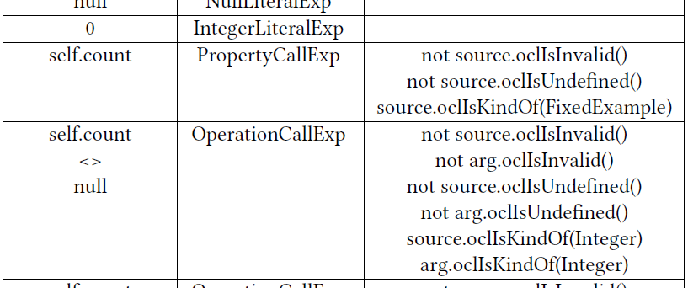
Example Symbolic Evaluation (inputs)
self.count <> null implies self.count > 0
allocate symbolic variable for symbolic input
identify all preconditions

Slide 24
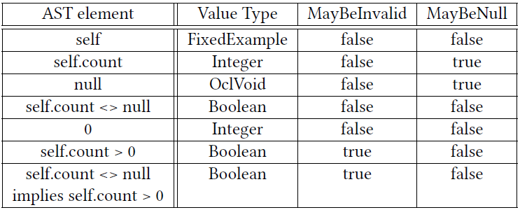
Example Symbolic Evaluation (propagate)
self.count <> null implies self.count > 0
propagate from leaves

Slide 25

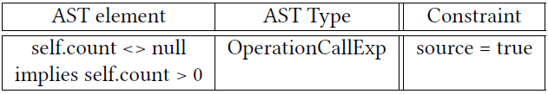

Example Symbolic Evaluation (hypothesize)
self.count <> null implies self.count > 0
self.count > 0 has 6 preconditions
  5 trivially satisfied
  1 not satisfied: source MayBeNull
hypothesize that the crash hazard can happen
enforce the ancestral control path
  self.count > 0 crashes so implies source true

Slide 26

Example Symbolic Evaluation (contradiction)
self.count <> null implies self.count > 0
hypothesis: self.count is null
re-evaluate: self.count <> null is false
path constraint: self.count <> null is true
=> contradiction
update: self.count
  MayBeNull false
re-re-evaluate: self.count > 0
  MayBeInvalid false
...

Slide 27
Practical Symbolic Evaluations
Boolean Symbolic Evaluation
  MayBeNull, MayBeInvalid => strictness violation
Numeric Symbolic Evaluation
  MayBeZero => divide-by-zero
Aggregate Symbolic Evaluation
  off-by-one ordered collection indexes
  size tracking
  seq->notEmpty() and (seq->first() <> null)
  content tracking
  seq->select(e | e.name <> null)
  ->forAll(f | f.name.length() > 0)

Slide 28

Impractical Symbolic Evaluations
Contradictions can resolve many common cases
  no tool can prove everything
Many complex cases may be obscure bugs
else 'redundant' help needed
  add a more explicit guard
  add an additional more explicit (global) invariant
  (new) assert a more explicit local invariant
  source.oclAssert(invariant, justification)
    invariant is an OCL expression
    justification is an ad hoc String / URL
Need to ensure pain of 'redundant' help
less than gain of no undesirable crashes

Slide 29
Corrolaries
preconditions
  expensive to check at run-time - embarrassment
    USE can, Eclipse OCL doesn't
  now prove no undesirable crashes at edit/compile-time
    needed, specification omits too many
    used. so too-strong / too-weak diagnosed
postconditions
  expensive to check at run-time - embarrassment
    USE can, Eclipse OCL doesn't
  body-expressions better for results - executable
    needed for secondary results
    post: result->size() = self->size() + 1
  worth a build-time exercise / test

Slide 30
Static Single Assignment
OCL side effect free
  immutable / stable Common-Sub-Expression
    far superior to other languages
  inherently Static Single Assignment
    no need for internal compiler conversions
    far superior to other languages
Can you prove that Java code does not crash?
Can you prove that OCL code does not crash?
  possible - may need a few assertions

Slide 31
Multiple Invariants
      context X
      inv NonEmptyName:
      name.length() > 0
      inv UCFirstLetter:
      let c = name.at(1)
      in c.toUpperCase() = c
Minimal exposition (above)
  UCFirstLetter crashes for empty name
Safe exposition
      inv UCFirstLetter:
      name.length() > 0 implies
      let c = name.at(1)
      in c.toUpperCase() = c
  less readable, repeated content
Edit/compile-time CSEs consider totality
  first/simplest failure is the result

Slide 32
Operating System / Scheduler OCL
Normal OCL
  never crashes undesirably
  cannot handle desirable crash
OS OCL
  OS never ever crashes (except perhaps PowerFail)
  need to react to catastrophic application crash
    use oclIsInvalid() to enter handler
    add new asException() to unpack crash details

Slide 33
Current Status
Boolean / Numeric Symbol Evaluation
  uses contradictions at edit/compile-time
    main operations coded, many still-to-do
    future - auto-generate from OCL preconditions
  many pre-existing tests fail
    test did not use the unsafe domain
Aggregate Symbol Evaluation
  'half'-implemented
    symbolic size/content tracking non-trivial
Real world - impact on OCL embedded in UML 2.5
  every tooling improvement reveals latent issues

Slide 34
Summary
Crashes omitted from OCL specification
  desirable crashes should crash unhindered
  undesirable crashes should never happen
    detected by validity analysis
    constraints are '2-valued'
and / or inconsistent with strictness
  always short-circuit sound
  qualified true/false commutativity
    commutability ensured by validity analysis
OCL can be programmer-crash-proof
  use of 0-based rather than 1-based indexes detectable
??? Questions ???

