Slide 1
OCL 2.5 Plans
Edward Willink
Willink Transformations Ltd
Eclipse Foundation
MMT Component co-Lead
OCL Project Lead
QVTd Project Lead
QVTo Committer
OMG (Model Driven Solutions)
OCL 2.3, 2.4 (2.5) RTF Chair
QVT 1.2, 1.3 RTF Chair
OCL 2014 @ MODELS 2014
30th September 2014

Slide 2



Overview
Background, OMG
User visible changes
    Critical omission
      'include'/'import', URI-qualification
    'No' changes - reify implied functionality
      Templates, Lambdas, Reflection
    Easy changes - syntax sugar
      elseif, safe-navigation, collection completion, patterns
Tooling changes
    Hard changes, XMI ... AS
Modularity / extensibility / semantics / exposition

Slide 3

Simple Black Box view of OCL
U
s
e
r
s
Concrete Syntax
OCL
Standard Library
Semantics
Specification exposition imperfect
  Precise Concrete Syntax Grammar
More functionality

Slide 4
White Box view of OCL
U
s
e
r
s
Concrete Syntax
OCL
M
o
d
e
l
s
Loader
Standard Library
Abstract
Syntax
XMI
Semantics
Saver
Specification totally inadequate
  Missing / Unimplementable
Rewrite / Design

Slide 5



Background to OCL 2.5 RFP
OCL 1.x specified as part of UML 1.x
    specifies that parts that need formal words
OCL 2.0 split off from UML 2.0
    OCL useable in its own right
    No resources available to complete specification
QVT 1.0 specified as an extension of OCL
    OCL 2.0 draft approved TBDs and all
OCL 2.1/2.2, 2.3, 2.4 provides limited improvements
consistency needs
    needs major editorial changes
    needs model-driven automation

Slide 6
OMG Revision
Revisions
  small fixes (Revision Task Force)
  issue, resolution, ballot, update, approval
    significant textual activity (one page/hour per typo)
  cannot have a 'replace entire chapter' resolution
Submissions
  Request for Proposal
  Competing submissions ... merge/conflict/ballot
  final revision (Finalization Task Force)
  can make 100% change; it's a new specification

Slide 7
OCL 2.5 RFP
http://doc.omg.org/ad/2014-3-5
Rewrite the OCL specification
Achieve the long overdue UML (2.5) alignment
'No' breakage of OCL as used in UML 2.5
  OCL in UML 2.5 was checked with modern tooling
Necessary changes to
  make OCL Abstract Syntax interchangeable in XMI
  resolve numerous magic/inconsistent areas
Improve useability/extensibility

Slide 8
OCL 2.5 Timeline
Letter of Intent (LOI) deadline 10 November 2014
Initial Submission deadline 10 February 2015
Voter registration closes 20 February 2015
Initial Submission presentations 25 March 2015
Revised Submission deadline 18 May 2015
Revised Submission presentations 10 June 2015
... Finalization Task Force ...
... ? approval late 2016
Prototyped in Eclipse OCL (Mars, June 2015)

Slide 9

Critical Omissions - Model Import
Complete OCL
    document complements what?
    implementation-specific solutions
import 'mm-package-uri'
import alias : 'mm-package-uri'
library 'lib-package-uri'
Essential OCL
    text is the dominant OCL persistence
    no import possible
oclIsKindOf('package-uri'::MyType)
    first namespace qualifier may be a quoted URI

Slide 10
Implied Functionality - Lambdas
s->forAll(a, b | a + b <> 0)
a+b<>0 specified in OCL 2.4 as a textual macro
a+b<>0 is a lambda expression in OCL 2.5
library modeling needs a lambda type
allow assignment to variables
let f(p : Real, q : Real) = p + q <> 0
in s->forAll(a, b | f(a,b))
let f(p : Real, q : Real) :
Lambda(p : Real, q : Real) : Boolean = p + q <> 0
in s->forAll(a : Real, b : Real | f(a,b))
no 'letrec' - forward lambda references allowed

Slide 11
Implied Functionality - Templates
Set(String) Set(T)
collection types have a magic T in OCL 2.4
T is a type template parameter in OCL 2.5
supports UML templates
  templated types/operations but not packages/...
  parameterised by types/literals but not operations/...
(T) rather than <T> in OCL expressions
  experimental use of <> had grammar challenges

Slide 12
Implied Functionality - Reflection
Classifier::allInstances() : Set(T) in OCL 2.4
OclAny::oclType() : Classifier in OCL 2.4
informal declarations, magic T
MyType::allInstances().myProperty
unspecified apparent type utility
OclAny::oclType() : typeof(OclSelf) in OCL 2.5
OclAny::allInstances() : Set(OclSelf) in OCL 2.5
OclSelf - the apparent type of self
typeof(X) - Class with instance lowerbound of X
myType.oclType().ownedOperations

Slide 13
Implied functionality - type construction
object construction would be useful
  Tuple syntax re-useable Tuple{name:type=value}
object construction has a side effect - not OCL
def: f(n:String): MyType = MyType{n=name}
inv: f('me') = f('me')
constructions must create 'shared' object
'shadow' object construction is possible
  shadow is a Tuple with same named properties
  distinct Tuples equal by value
  real object created when exploited by QVT

Slide 14
Implied functionality - multi-returns
UML supports multiple function returns
  OCL 2.4 doesn't
Solution, wrap multiple returns up as a Tuple
'UML': f(in a:A, in b:B, inout c:C, out d:D)
becomes
OCL: f(a:B, b:B, c:C) : Tuple{c:C, d:D}
body: Tuple{c = ..., d = ...}
post: result.c = ...
post: result.d = ...
post: result = Tuple{c = ..., d = ...}

Slide 15
Syntax sugar - elseif
OCL 2.4 cumbersome endifs
if c1 then v1
else if c2 then v2
else if c3 then v3
else v4
endif
endif
endif
OCL 2.5 simpler
if c1 then v1
elseif c2 then v2
elseif c3 then v3
else v4
endif
just a CS rewrite

Slide 16
Syntax sugar - typesafe if
OCL 2.4 cumbersome re-typing
if x.oclIsKindOf(MyType) then
let t : MyType = x.oclAsType(MyType) in f(t)
else ...
endif
OCL 2.5 simpler
if t : MyType = x then
f(t)
else ...
endif
special case of a pattern match

Slide 17
Syntax sugar - safe navigation
OCL 2.4 vulnerable to navigation on nulls
x.ys.z x.ys->collect(z)
is invalid if x or any x.ys is null
if x <> null then x.ys->excluding(null).z else null endif
OCL 2.5 offers safe navigation
x.?ys.?z x.?ys->?collect(z)
simple CS rewrite

Slide 18
Syntax sugar - iterator alternatives
OCL 2.4 source->iteration(iterators | body)
e.g. s->forAll(body)
s->forAll(i | body)
s->forAll(i : Integer | body)
OCL 2.5 iterator may instead have domain
forAll(i in s | body)
forAll(i : Integer in s | body)
OCL 2.5 iterator may be allInstances
forAll(c in Class | body)
Class::allInstances()->forAll(c | body)
  type/property ambiguity resolved to type

Slide 19
Iteration co-indexes
OCL 2.4 cumbersome to obtain iteration index
parameters->forAll(p |
let i = parameters->indexOf(p),
a = arguments->at(i)
in a.type->conformsTo(p.type))
For ordered collections
parameters->forAll(p[i] |
let a = arguments->at(i)
in a.type->conformsTo(p.type))
Implementation can be better than syntax sugar
    add coIndexName to AS

Slide 20
Syntax sugar - collection comprehension
OCL 2.4 iterations
source->iteration(iterator : T | body)
OCL 2.5 iteration alternative with initializer
iteration(iterator : T in source | body)
OCL 2.4 collection literal
Set{1, 4, 9, 16}
OCL 2.5 collection comprehension
Sequence{1..4}->Set{i | i*i}
Set{i in Sequence{1..4} | i*i}
rewrite of
Sequence{1..4}->collect(i | i*i)->asSet()

Slide 21
Syntax sugar - varargs
OCL 2.4 invocation arguments must match
f(a : Integer, b : String[*])
may be invoked as
f(1, Set{'a'})
OCL 2.5 allows enumeration of final collection
f(1) f(1, 'a') f(1, 'a', 'b')
WFRs prohibit overload ambiguities

Slide 22
Library - inadequate extensibility
OCL 2.4 Standard Library - mandatory
    not a model, not referenceable, not extensible
OCL 2.5 Standard Library - replaceable
    OCL Pivot model, referenceable, extensible
    open market to domain-specific libraries
OCL 2.4 Monolith
OCL 2.5 Modular, extensible
    at least States, Messages optional
    probably Reflection optional
    optional => tooling regeneration for changes

Slide 23
Library - Map
OCL 2.4 cumbersome
let myMap = Set{Tuple{key:String=...,value:Integer=...}}
in myMap->includes{Tuple{key='five',value=5})
  inaccurate Set{Tuple} not Set{String}
OCL 2.5 Map (and OrderedMap)
let myMap : Map(String,Integer) = ...
in myMap->includes('five',5)
Obvious, but not quite so obvious
  OCL-like coherent interface design welcome

Slide 24
Library - selectCollect
QVTo (imperative):
source->xcollectselect(iterators; result := body | guard)
OCL 2.5
source->selectCollect(iterators | guard | body)
rewrite of
source->select(iterators | guard)->collect(iterators | body)

Slide 25
Complete OCL - Package invariants
OCL 2.4 only classes have invariants
  all invariants must be allocated to a class
OCL 2.5, packages may have invariants too
package Mine
inv PackageInvariant: ....

Slide 26
A Use Case (1)
All Classes have capitalized names
OCL 2.4 correct
context Class
inv: let n = name.at(1) in n = n.toUpperCase()
naive
context Class
inv: Class::allInstances()->forAll(c |
let n = c.name.at(1) in n = n.toUpperCase())
OCL 2.5 better
package UML
inv: forAll(c in Class | c.name.isCapitalized())

Slide 27
A Use Case (2)
package UML
inv: forAll(c in Class | c.name.isCapitalized())
New: iterator syntaxes
forAll(c in Class ...
New: Package Invariants for global truths
  localizing allInstances() is an implementation detail
Old: helper function (for library type)
context String
def: isCapitalized() : Boolean =
let n = at(1) in n = n.toUpperCase()

Slide 28
A Use Case (3)
Over-engineering ....
context String
def: isUpperCase() : Boolean =
self = self.toUpperCase()
def: isCapitalized() : Boolean =
startsWithTest(isUpperCase)
def: startsWithTest
(body : Lambda String():Boolean) : Boolean =
at(1).body()

Slide 29
White Box view of OCL
U
s
e
r
s
Concrete Syntax
OCL
M
o
d
e
l
s
Loader
Standard Library
Abstract
Syntax
XMI
Semantics
Saver
Specification totally inadequate
  Missing / Unimplementable
Rewrite / Design

Slide 30
XMI Model interchange - goals
model state must be captured by objects
  no magic
every state object must be referenceable
  no holes
every state object must be persistable
  no non-derived secret objects
persisted objects must be reloadable
  no irreversible conversions
OCL-specific XMI loader/saver undesirable

Slide 31
XMI Model interchange - OCL 2.4
model state must be captured by objects
    Iterations are not modelled
    Constraint does not exist in EMOF
every state object must be referenceable
    Complete OCL objects have no URI
    OCL Standard Library elements have no URI
every state object must be persistable
    Collection/Tuple specializations are unspecified
persisted objects must be reloadable
    only if vendors provide a non-standard solution

Slide 32
OCL principle and practice
User Types
Specification Types
Specification-time,
Metamodels
don't care
CMOF::Class
Design-time,
compile-time,
User Models
EClass,
OCL-text,
OCLExpression
UML::Class,
EMOF::Class,
OCL::OCLExpression
Run-time User
Instances/Values
EObject,
int
ObjectValue
IntegerValue

Slide 33
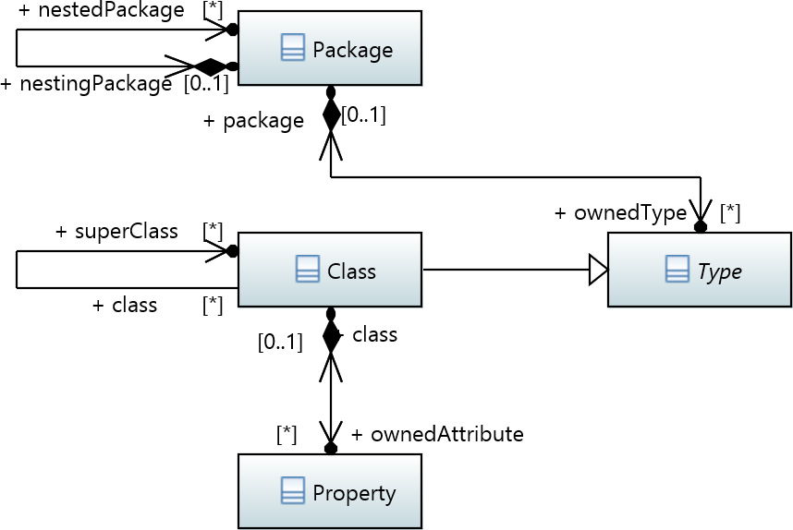
UML 2.0...2.4 Core::Basic Packages
inelegant
  Class/Type
  singular superClass
  obsolete ownedAttribute
  vague root
efficient

Slide 34
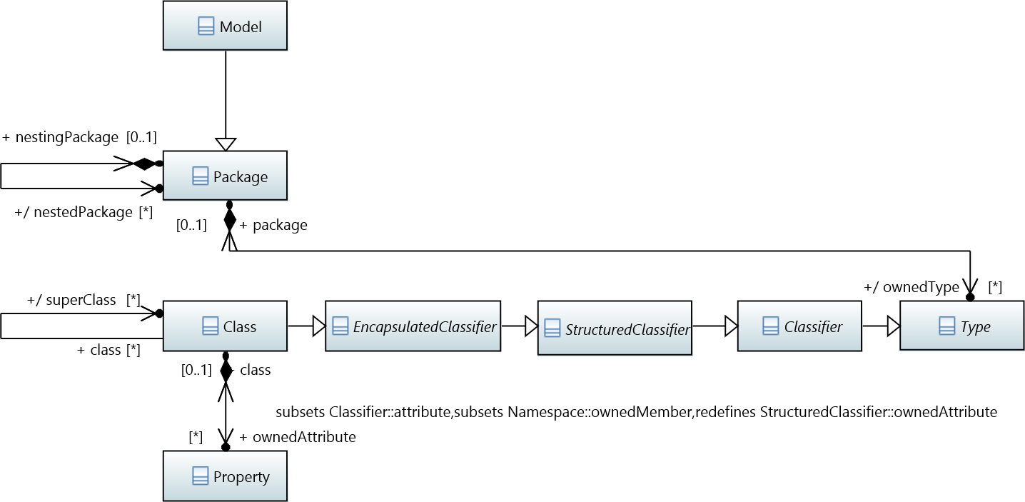
UML 2.5 Packages
same inelegancies
new inefficiencies
  extra inheritances
  multi-level property subsets
  property redefinition
  property derivation

Slide 35
OCL 2.5 Pivot
User Types
Specification Types
align
Specification-time,
Metamodels
UML::Class
MtoM
OCL::Class
MtoM
Pivot
Design-time,
compile-time,
User Models
EClass,
OCL-text,
OCLExpression
load
OCL::Class,
OCL::OCLExpression
MtoM
semantics
Run-time User
Instances/Values
EObject,
int
MtoM
ObjectValue
IntegerValue

Slide 36
Specification Time MtoM
From:
  UML 2.5 metamodel
  OCL 2.5 metamodel
  (optional vendor-specific metamodel)
Using QVTo transformation, Control Model
  delete/merge/rename/redefine Package/Class/...
To:
  OCL Pivot metamodel
    e.g. Type,Classifier,Class => Class
    Class::ownedAttribute => Class::ownedProperties

Slide 37
Compile Time MtoM
Load
  UML/EMOF/Ecore/... Model(s)
  OCL Standard Library Model(s)
  User Complete OCL Document(s)
Normalize to OCL Pivot Model
  unified PrimitiveTypes
  unified synthetic types (Collections, Tuples)
  conformance/inheritance of OclAny/OclElement
  complete classes
  make unnavigable opposites navigable
  determine stereotype properties

Slide 38
Run time 'MtoM'
Conversion to Pivot Values inefficient
  Run-time mapping defines observable semantics
Simple OCL just executes
Type-dependent expressions
  either map Pivot conformance to user type system
  or map user type system to Pivot conformance
Reflection
  load user type system as Pivot model
  reflection uses Pivot model

Slide 39
Objects to Reference
EssentialOCL is the package exposing the minimal OCL required to work with EMOF
  no Constraint or OpaqueExpression then
Note - It is expected that further revisions of this specification will provide explicitly the complete set of well-formedness rules and additional operations that apply to Core::Basic - to replace the lazy re-interpretation statement we are using here.
  UML 2.5 removes Core::Basic

Slide 40
Metamodel goals
UML - analysis / design
  powerful metamodeling capabilities
  inefficient, not executed
EMOF (or Ecore) - run-time / execution
  essential metamodeling capabilities
  efficient
OCL - executable specification
  rich metamodeling capabilities
  efficient, executable

Slide 41
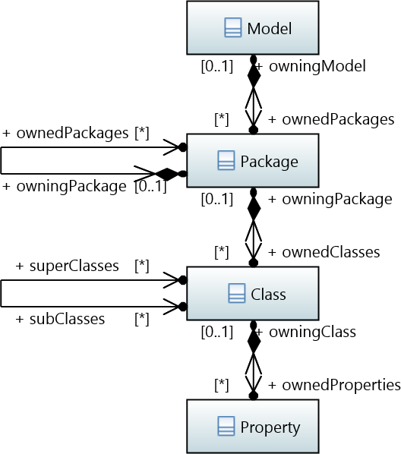
OCL '2.5' Partial Packages
plural, consistent names
  ownedProperties
explicit root
efficient
  ownedClasses
    Type only for templates
  no subsets
  no redefinition
  no primary derivation

Slide 42
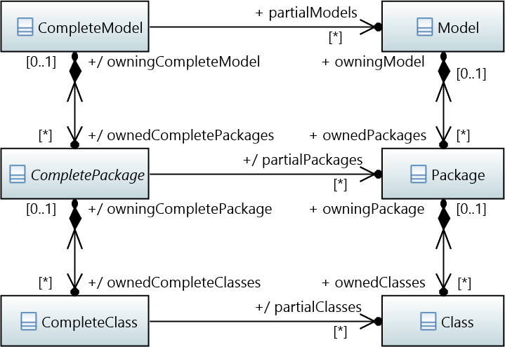
OCL '2.5' Complete Packages

Slide 43


OCL '2.5' Complete Packages
primary derived properties
additional helpful all-models derived properties e.g.
context CompleteModel
def: allClasses : Set(Class) =
partialModels->closure(ownedPackages).ownedClasses
potentially very efficient
  caches for derivations
  constant time
    name lookup
    operation overload lookup
    conformance type test

Slide 44
Inadequate OCL 2.4 AS
Open classes - Complete OCL extensions
Constraints
Lambda Types
Reflection
Iterations

Slide 45
Inadequate UML alignment
templates
bounded collections
non-navigable opposites
qualified associations
stereotype navigation
operation overloading
OclAny conformance

Slide 46
Inadequate Exposition (7)
Clause 7 - tutorial, overview
  unfortunate number of mistakes
Extract as a companion volume
  authors wanted
  ensure examples are tool checked

Slide 47
Inadequate Exposition (8)
Clause 8 - Abstract Syntax
  unforgivable number of mistakes
'8a' Auto-generate from Pivot Models
  including all the Class, CompleteClass, ...
'8b' Use of OCL Constraint in UML
'8c' compile time MtoM (loading/normalization)

Slide 48
Inadequate Exposition (9)
Clause 9 - Concrete Syntax, Grammar
  elusive grammar, optimistic disambiguation
'9a' Essential OCL: Auto-generate
  CS from CS Models
  grammar from 'Xtext' models
  CS2AS from CS2AS models
  disambiguation from CS2CS models
  lookup from Lookup models
'9b' Same again for Complete OCL

Slide 49
Inadequate Exposition (10)
Clause 10 - Semantics
  unforgivable number of mistakes
Auto-generate
  from semantics structural Models

Slide 50
Inadequate Exposition (11)
Clause 11 - OCL Standard Library
  inconsistent
Auto-generate
  from OCL Standrad Library model

Slide 51
Inadequate Exposition (11)
Clause 11 - OCL Standard Library
  inconsistent
Auto-generate
  from OCL Standrad Library model

Slide 52
Inadequate Exposition (12)
Clause 12 - Use Of OCL in UML
  inconsistent, very incomplete
Reorganise
  Complete OCL AS => Clause 8
  Complete OCL CS/grammar => Clause '9b'
  OCL in UML=> Clause '12a'

Slide 53
Inadequate Exposition (13)
Clause 13 - Basic OCL, Essential OCL
  largely a fairy story
Rewrite
  specification time MtoM (UML alignment)

Slide 54
Inadequate Exposition (A)
Annex A - Formal Semantics
  LaTeX => FrameMaker corruptions
  Out of date: OrderedSet, closure(), ...
  Needs: templates, lambdas, ...
Rewrite using Isabelle semantics
  companion document using LaTeX
    not necessarily 100% of language

Slide 55
Summary
OCL 2.5
  rewrite, 'no-change', auto-generated from models
  UML-aligned
    bounded collections
  modeling requires formality
    lambdas, templates, reflection
  enhanced concrete syntax
    elseif, safe-navogation, ...
  defined load/save activties
  interchangeable abstract syntax via XMI
  extensible

Slide 56
OCL specification claims (1)
OCL 'works with UML'
  UML 2.0...2.4 Core::Basic perhaps
  UML 2.5 inefficient
  no Complete classes
OCL 'works with EMOF'
  no OpaqueExpression - Constraints
  no unnavigable opposites
  no stereotypes
  no templates ....

Slide 57
OCL specification claims (2)
OCL 'is aligned with UML'
  'aligned' not 'identical to'
Recreate UML 2.4 Core::Basic from UML 2.5
  use a QVTo Model-to-Model transformation
  correct unhelpful aspects
  add specified OCL 2.4 aspects
  add solutions to un/under-specified aspects

