Slide 1
OCL Tooling for OMG specifications
Edward Willink
Thales representative for OMG OCL RTF
Eclipse OCL Project Lead
Thales representative for OMG QVT RTF
Eclipse QVT Declarative Project Lead
OMG Quarterly meeting
Santa Clara
13th December 2011

Slide 2


Overview
Background
  OMG OCL, Eclipse OCL, E.D.Willink
OMG/Eclipse OCL Status/Progress
  Old and New Eclipse OCL
Eclipse OCL Tools
UML.xmi syntactic/semantic errors
  smells
Summary

Slide 3
OCL Specification Background
OCL 2.0 split off from UML 2.0
  UML 2.0 not available for OCL alignment
  UML FTF lacked resources to finalize
OCL 2.0 'finalized' by QVT 1.0 team
  no significant resolution of alignment
  many incomplete areas
OCL 2.2 minor changes
OCL 2.3 minor improvements
auto-generation for major improvements

Slide 4

Eclipse OCL Background
OMG OCL 1.x within IBM
OMG OCL 2.x within Eclipse
Orginally Java API
  OCL AST MM adjusted to extend Ecore MM
    Ed Merks: "Never extend Ecore"
  OCL MM made generic (Christian Damus)
    OCL<.... Ecore .... >, OCL<.... UML ....>
    long parameter lists - 10 types
    wrong (base class) getXxx returns
  Extensibility for QVTd (EDW) and QVTo (ASBH)

Slide 5

My Background
Embedded/DSP software synthesis
UMLX - graphical model transformation
  extension of QVT relations
    based on OCL
    make Eclipse OCL extensible
      became Eclipse OCL (and QVTd) committer then leader
      became Thales OCL (and QVT) RTF representative
    modelize OCL
  modelize QVT
modelize UMLX

Slide 6
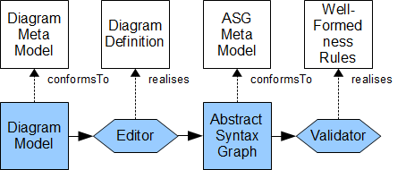
UML Specification/Implementation
Specification
Implementation
[Diagrams: not this presentation, good new work]
Abstract Syntax Graph comprehensive
WFR 50% of 50% of 50% present correct accurate
Eclipse for UML 2.2 has significant manual input
    Eclipse for UML 2.4 is a bit more automated
Direct OCL to Java for fuller automation

Slide 7

OCL Specification/Implementation
OCL specification is incomplete
  EBNF grammars
  UML models
  OCL rules
  semi-OCL mappings - perhaps QVTr

Slide 8
The Old Eclipse OCL (RSA)
Most of tool is manually coded
  distinct Ecore, UML code, ~OCL 2.3
Significant difficulties enhancing code
  many bugs categorized as too difficult
Significant difficulties exploiting OMG models

Slide 9
The New Eclipse OCL using Xtext
Xtext covers large parts of an implementation
  Xtext uses an EBNF with meta-model annotations
IfExpCS returns IfExpCS:
'if' condition=ExpCS
'then' thenExpression=ExpCS
'else' elseExpression=ExpCS
'endif';
Modest gaps between specification and tooling

Slide 10
OCL Specification work
Define consumable EBNF grammars
Define consumable CST/ASG mapping
Define complete (UML+OCL) Pivot ASG model
Define accurate (UML+OCL) WFRs
Define extensible OCL Standard Library
Autogenerate specification from models

Slide 11
Eclipse OCL Tooling Work
OCL to Java automation of WFRs
    OCL-friendly Transformation Virtual Machine
Automation of Pivot ASG creation/mapping
Automation of CST to Pivot ASG mappings
Re-useable for QVT

Slide 12
The New Eclipse OCL
OCL 2.4 prototype/candidate
Shared specification/implementation models
  UML element/type model
  OCL expression/value model
  OCL library model
Auto-generated specification
Re-useable model driven tooling
  OCL, QVT
  any EBNF/QVT/OCL defined language
OCL Transformation Virtual Machine

Slide 13
Old Eclipse OCL Tools: OCL ~2.3
Java API: parser, validator
Java API: evaluator
Model API: interpreted OCL execution
UI: heuristic Essential OCL expression editor
UI: interactive OCL console

Slide 14
New Eclipse OCL Tools : OCL 2.4...
    Java API: parser, validator
    Java API: evaluator
Java API: library model and feature dispatch
Model API: OCL 2 Java code generator
Model API: Compiled OCL execution
UI: Xtext Essential OCL expression editor
UI: Xtext Complete OCL document editor
UI: Xtext Composite OCL in Ecore model editor
UI: Xtext OCL Standard Library editor
    UI: interactive OCL console

Slide 15
OCLinEcore Editor today
model.oclinecore
Ecore
Text
Text
Text
OCL
OCL
OCLinEcore
Editor
OCL
model.pivot
OCL
XMI with embedded OCL text
Load UML, Ecore, OCLinEcore
Edit Pivot as text
Save as Ecore, OCLinEcore
('tomorrow': Save as UML)
('tomorrow': direct Pivot<>UML
model.ecore
model.uml
XMI with embedded OCL text

Slide 16
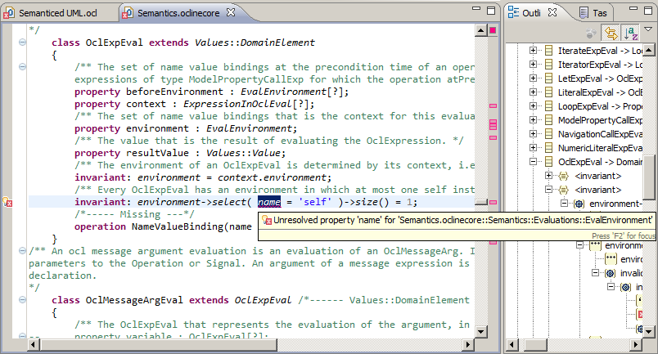
OCLinEcore Example

Slide 17
Complete OCL today
UML.ocl
Text
OCL
Ecore
Text
Text
UML.pivot
Complete
OCL Editor
UML.ecore
XMI with embedded OCL text
Custom Complete OCL splitter
Edit Pivot as text
Save as Complete OCL text
UML.xmi
XMI with embedded OCL text

Slide 18
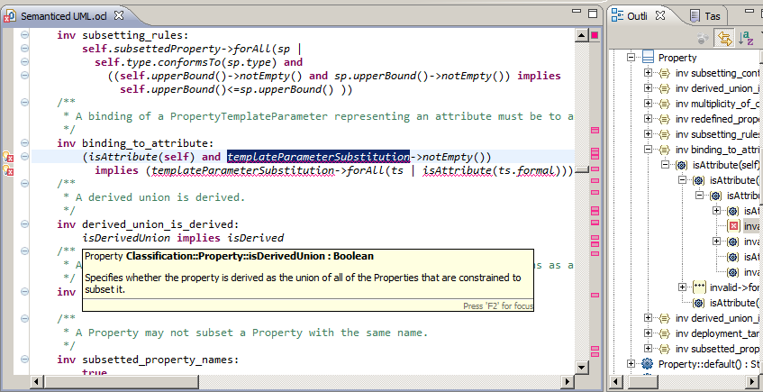
Complete OCL Example

Slide 19
Complete OCL Editor 'tomorrow'
OCL
UML
UML.ocl
Text
Text
Text
UML.pivot
Complete
OCL Editor
XMI with embedded OCL text
UML
UML.xmi
OCL
OCL
OCL
OCL
Load separate/merged UML/OCL
Edit as OCL text
Save as separate/merged UML/OCL

Slide 20
OCL in UML editor 'tomorrow'
UML
UML.ocl
Text
Text
Text
OCL
OCL
OCL
OCLinUML
Editor
OCL
UML.pivot
OCL
UML
UML.xmi
XMI with embedded OCL text
Load separate/merged UML/OCL
Edit as UML and OCL text
Save as separate/merged UML/OCL

Slide 21
UML <2.5 Syntax Errors
Problem | Wrong Text | Correct Text | Diagnosis
Bad built-in literal | #true | true | Error: [Never valid]
OCL 1.6 enum literal | #out | ParameterDirectionKind::out | Error: [Very obsolete]
Local def | inv xxx: def: defBody invBody | def: defBody inv xxx: invBody | Error:
Missing parenthesis |  |  | Error: 'endpackage' expected
Extra parenthesis |  |  | Error: red squiggle under extra
Reserved names | forAll(in | in) | forAll(_in | _in) forAll(_'in' | _'in') | OCL 2.0, 2.2 OCL >=2.3
Hyphenation | a- >b | a->b
Missing endif | if a then b else c | if a then b else c endif
Missing else endif | if a then b | a implies b
Complex endif

Slide 22
UML <2.5 Syntax Smells
Problem | Wrong Text | Correct Text | Diagnosis
Missing body | inv x: | inv x: TBD
Multi-invariant | inv multi_invariant: complex1 and complex2 | inv multi_invariant1: complex1 inv multi_invariant2: complex2 | Ok: confuses errors in complex
74 easy to fix syntax errors

Slide 23
UML <2.5 Semantic Errors
Problem | Wrong Text | Correct Text | Diagnosis
Name Qualification | Class | structuredClassifiers::Class | Error: unresolved type
Typos | isOclKindOf isComoposite associations | oclIsKindOf isComposite association | Error: unresolved operation
Result | body: result = yyy | body: yyy | Error:
Bad any | a->any() | a->any(true)
Bad - on non-Set | a - b | a->asSet() - b->asSet()
Bad String Concat | 'pfx'->union(separator()) | 'pfx' + separator() 'pfx'.concat(separator()) | OCL >= 2.2 OCL 2.0
Bad Types | Aggregation NavigableEnd | AggregationKind ????
Bad Code

Slide 24
UML <2.5 OCL 2.3 Semantic Errors
Problem | Wrong Text | Correct Text | Diagnosis
Collections | Set(Class) | Set(structuredClassifiers::Class) | Error: unresolved type
Inferred Opposites | p.informationFlow | p.InformationFlow | Make explicit
Result | body: result = yyy | body: yyy | Error:
Missing parentheses | oclType | oclType()
Extra parentheses | specification() | specification
Navigation operator | a.select(...) b->c | a->select(...) b.c
Complex parentheses
Bad navigation | self.argument.multiplicity.is(1,1) | self.input.is(1,1)

Slide 25
OCL Navigation Operators
Collections reify UML Multiplicities
Collections are not UML class instances
anObject. ... object navigation
aCollection-> ... collection navigation
Shorthands
aCollection.... aCollection->collect(...)
anObject->... anObject.oclAsSet()-> ...
 | Object | Collection
. | Navigation | ?
-> | ? | Navigation

Slide 26
UML <2.5 Complete OCL
Problem | Wrong Text | Correct Text | Diagnosis
Imports |  | structuredClassifiers::Class | Error: unresolved type
Primitive Types | types::Integer | Integer
Underspecified types | Set{}->includes(a) | Set{a} | OCL 2.3 defines an upper/lower bound
Closure | ... union ... recursive call | aClass->closure(superClass) | OCL 2.3 in RAS 8

Slide 27
UML <2.5 Semantic Smells
Problem | Suspect Text | Correct Text | Diagnosis
Redundant iterator | a->forAll(b | b.c) | a->forAll(c)
Double implication | (a implies b) and ((not a) implies (not b)) | a = b | If Boolean
Redundant self | self.input | input | Useful in iteration bodies
Over 250 semantic error regions

Slide 28
UML <2.5 Well Formedness Errors
Problem | Wrong Text | Correct Text | Diagnosis
Set{} as null | Set{} | null | OCL 1.x practice
Expect many hundreds
Expect minor easy fixes
  e.g. give each invariant a distinguishable name

Slide 29
Smells
Upper case navigation names
  low confidence in Association tooling
oclIsTypeOf (exact type comparison)
  oclIsKindOf (equivalent type comparison)
oclAsType (type cast)
  may be redundant
  may need an oclIsKindOf predicate
  perhaps the meta-model is at fault

Slide 30
Summary
OCL and UML specifications inadequate
  most problems soluble with tooled models
  tooling becoming useful
Code generation from OCL for WFR tooling
  today's activity for Eclipse OCL
UML OCL can be tooled
  RSA (old Eclipse OCL) viable
  new tooling should be complementary

