Slide 1
OCL Tooling for OMG specifications
Edward Willink
Thales representative for OMG OCL RTF
Eclipse OCL Project Lead
Thales representative for OMG QVT RTF
Eclipse QVT Declarative Project Lead
OMG Quarterly meeting
Santa Clara
13th December 2011

Slide 2


Overview
Background
  OMG OCL, Eclipse OCL, E.D.Willink
OMG/Eclipse OCL Status/Progress
  Old and New Eclipse OCL
Eclipse OCL Tools
UML.xmi syntactic/semantic errors
  smells
Summary

Slide 3
OCL Specification Background
OCL 2.0 split off from UML 2.0
  UML 2.0 not available for OCL alignment
  UML FTF lacked resources to finalize
OCL 2.0 'finalized' by QVT 1.0 team
  no significant resolution of alignment
  many incomplete areas
OCL 2.2 minor changes
OCL 2.3 minor improvements
auto-generation for major improvements

Slide 4

Eclipse OCL Background
OMG OCL 1.x within IBM
OMG OCL 2.x within Eclipse
Orginally Java API
  OCL AST MM adjusted to extend Ecore MM
    Ed Merks: "Never extend Ecore"
  OCL MM made generic (Christian Damus)
    OCL<.... Ecore .... >, OCL<.... UML ....>
    long parameter lists - 10 types
    wrong (base class) getXxx returns
  Extensibility for QVTd (EDW) and QVTo (ASBH)

Slide 5

My Background
Embedded/DSP software synthesis
UMLX - graphical model transformation
  extension of QVT relations
    based on OCL
    make Eclipse OCL extensible
      became Eclipse OCL (and QVTd) committer then leader
      became Thales OCL (and QVT) RTF representative
    modelize OCL
  modelize QVT
modelize UMLX

Slide 6
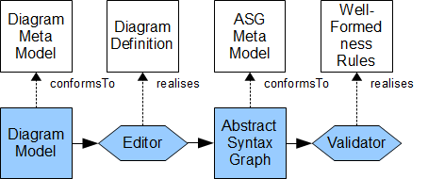
UML Specification/Implementation
Specification
Implementation
[Diagrams: not this presentation, good new work]
Abstract Syntax Graph comprehensive
WFR 50% of 50% of 50% present correct accurate
Eclipse for UML 2.2 has significant manual input
    Eclipse for UML 2.4 is a bit more automated
Direct OCL to Java for fuller automation

Slide 7

OCL Specification/Implementation
OCL specification is incomplete
  EBNF grammars
  UML models
  OCL rules
  semi-OCL mappings - perhaps QVTr

Slide 8
The Old Eclipse OCL (RSA)
Most of tool is manually coded
  distinct Ecore, UML code, ~OCL 2.3
Significant difficulties enhancing code
  many bugs categorized as too difficult
Significant difficulties exploiting OMG models

Slide 9
The New Eclipse OCL using Xtext
Xtext covers large parts of an implementation
  Xtext uses an EBNF with meta-model annotations
IfExpCS returns IfExpCS:
'if' condition=ExpCS
'then' thenExpression=ExpCS
'else' elseExpression=ExpCS
'endif';
Modest gaps between specification and tooling

Slide 10
OCL Specification work
Define consumable EBNF grammars
Define consumable CST/ASG mapping
Define complete (UML+OCL) Pivot ASG model
Define accurate (UML+OCL) WFRs
Define extensible OCL Standard Library
Autogenerate specification from models

Slide 11
Eclipse OCL Tooling Work
OCL to Java automation of WFRs
    OCL-friendly Transformation Virtual Machine
Automation of Pivot ASG creation/mapping
Automation of CST to Pivot ASG mappings
Re-useable for QVT

Slide 12
The New Eclipse OCL
OCL 2.4 prototype/candidate
Shared specification/implementation models
  UML element/type model
  OCL expression/value model
  OCL library model
Auto-generated specification
Re-useable model driven tooling
  OCL, QVT
  any EBNF/QVT/OCL defined language
OCL Transformation Virtual Machine

Slide 13
Old Eclipse OCL Tools: OCL ~2.3
Java API: parser, validator
Java API: evaluator
Model API: interpreted OCL execution
UI: heuristic Essential OCL expression editor
UI: interactive OCL console

Slide 14
New Eclipse OCL Tools : OCL 2.4...
    Java API: parser, validator
    Java API: evaluator
Java API: library model and feature dispatch
Model API: OCL 2 Java code generator
Model API: Compiled OCL execution
UI: Xtext Essential OCL expression editor
UI: Xtext Complete OCL document editor
UI: Xtext Composite OCL in Ecore model editor
UI: Xtext OCL Standard Library editor
    UI: interactive OCL console

Slide 15
OCLinEcore Editor today
model.oclinecore
Ecore
Text
Text
Text
OCL
OCL
OCLinEcore
Editor
OCL
model.pivot
OCL
XMI with embedded OCL text
Load UML, Ecore, OCLinEcore
Edit Pivot as text
Save as Ecore, OCLinEcore
('tomorrow': Save as UML)
('tomorrow': direct Pivot<>UML
model.ecore
model.uml
XMI with embedded OCL text

Slide 16
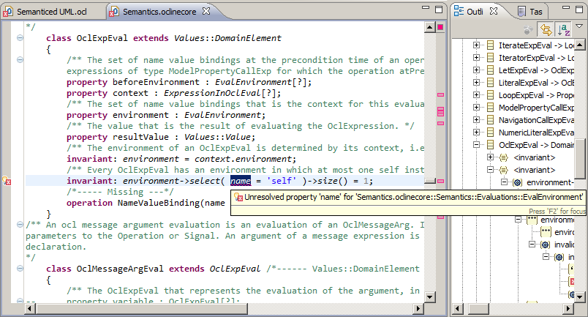
OCLinEcore Example

Slide 17
Complete OCL today
UML.ocl
Text
OCL
Ecore
Text
Text
UML.pivot
Complete
OCL Editor
UML.ecore
XMI with embedded OCL text
Custom Complete OCL splitter
Edit Pivot as text
Save as Complete OCL text
UML.xmi
XMI with embedded OCL text

Slide 18
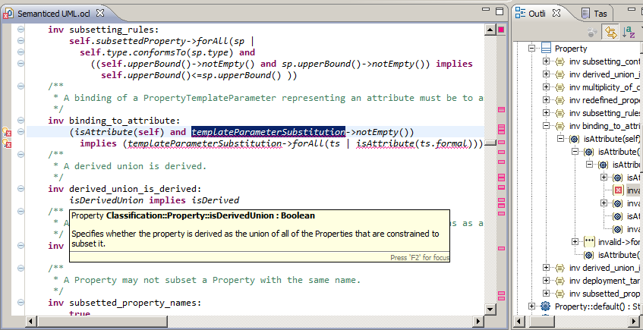
Complete OCL Example

Slide 19
Complete OCL Editor 'tomorrow'
OCL
UML
UML.ocl
Text
Text
Text
UML.pivot
Complete
OCL Editor
XMI with embedded OCL text
UML
UML.xmi
OCL
OCL
OCL
OCL
Load separate/merged UML/OCL
Edit as OCL text
Save as separate/merged UML/OCL

Slide 20
OCL in UML editor 'tomorrow'
UML
UML.ocl
Text
Text
Text
OCL
OCL
OCL
OCLinUML
Editor
OCL
UML.pivot
OCL
UML
UML.xmi
XMI with embedded OCL text
Load separate/merged UML/OCL
Edit as UML and OCL text
Save as separate/merged UML/OCL

Slide 21
UML <2.5 Syntax Errors
Problem | Wrong Text | Correct Text | Diagnosis
Bad built-in literal | #true | true | Error: [Never valid]
OCL 1.6 enum literal | #out | ParameterDirectionKind::out | Error: [Very obsolete]
Local def | inv xxx: def: defBody invBody | def: defBody inv xxx: invBody | Error:
Missing parenthesis |  |  | Error: 'endpackage' expected
Extra parenthesis |  |  | Error: red squiggle under extra
Reserved names | forAll(in | in) | forAll(_in | _in) forAll(_'in' | _'in') | OCL 2.0, 2.2 OCL >=2.3
Hyphenation | a- >b | a->b
Missing endif | if a then b else c | if a then b else c endif
Missing else endif | if a then b | a implies b
Complex endif

Slide 22
UML <2.5 Syntax Smells
Problem | Wrong Text | Correct Text | Diagnosis
Missing body | inv x: | inv x: TBD
Multi-invariant | inv multi_invariant: complex1 and complex2 | inv multi_invariant1: complex1 inv multi_invariant2: complex2 | Ok: confuses errors in complex
74 easy to fix syntax errors

Slide 23
UML <2.5 Semantic Errors
Problem | Wrong Text | Correct Text | Diagnosis
Name Qualification | Class | structuredClassifiers::Class | Error: unresolved type
Typos | isOclKindOf isComoposite associations | oclIsKindOf isComposite association | Error: unresolved operation
Result | body: result = yyy | body: yyy | Error:
Bad any | a->any() | a->any(true)
Bad - on non-Set | a - b | a->asSet() - b->asSet()
Bad String Concat | 'pfx'->union(separator()) | 'pfx' + separator() 'pfx'.concat(separator()) | OCL >= 2.2 OCL 2.0
Bad Types | Aggregation NavigableEnd | AggregationKind ????
Bad Code

Slide 24
UML <2.5 OCL 2.3 Semantic Errors
Problem | Wrong Text | Correct Text | Diagnosis
Collections | Set(Class) | Set(structuredClassifiers::Class) | Error: unresolved type
Inferred Opposites | p.informationFlow | p.InformationFlow | Make explicit
Result | body: result = yyy | body: yyy | Error:
Missing parentheses | oclType | oclType()
Extra parentheses | specification() | specification
Navigation operator | a.select(...) b->c | a->select(...) b.c
Complex parentheses
Bad navigation | self.argument.multiplicity.is(1,1) | self.input.is(1,1)

Slide 25
OCL Navigation Operators
Collections reify UML Multiplicities
Collections are not UML class instances
anObject. ... object navigation
aCollection-> ... collection navigation
Shorthands
aCollection.... aCollection->collect(...)
anObject->... anObject.oclAsSet()-> ...
 | Object | Collection
. | Navigation | ?
-> | ? | Navigation

Slide 26
UML <2.5 Complete OCL
Problem | Wrong Text | Correct Text | Diagnosis
Imports |  | structuredClassifiers::Class | Error: unresolved type
Primitive Types | types::Integer | Integer
Underspecified types | Set{}->includes(a) | Set{a} | OCL 2.3 defines an upper/lower bound
Closure | ... union ... recursive call | aClass->closure(superClass) | OCL 2.3 in RAS 8

Slide 27
UML <2.5 Semantic Smells
Problem | Suspect Text | Correct Text | Diagnosis
Redundant iterator | a->forAll(b | b.c) | a->forAll(c)
Double implication | (a implies b) and ((not a) implies (not b)) | a = b | If Boolean
Redundant self | self.input | input | Useful in iteration bodies
Over 250 semantic error regions

Slide 28
UML <2.5 Well Formedness Errors
Problem | Wrong Text | Correct Text | Diagnosis
Set{} as null | Set{} | null | OCL 1.x practice
Expect many hundreds
Expect minor easy fixes
  e.g. give each invariant a distinguishable name

Slide 29
Smells
Upper case navigation names
  low confidence in Association tooling
oclIsTypeOf (exact type comparison)
  oclIsKindOf (equivalent type comparison)
oclAsType (type cast)
  may be redundant
  may need an oclIsKindOf predicate
  perhaps the meta-model is at fault

Slide 30
Summary
OCL and UML specifications inadequate
  most problems soluble with tooled models
  tooling becoming useful
Code generation from OCL for WFR tooling
  today's activity for Eclipse OCL
UML OCL can be tooled
  RSA (old Eclipse OCL) viable
  new tooling should be complementary

Slide 31

UML Meta-Model and Models
Package
Merge
Basic
UML MM
Package
Merge
conforms to
Minimal
capabilities
for code
generation
Basic
UML MM
Basic
Merged
UML MM
Basic
Merged
UML MM
Essential
MOF
Model
Basic
UML
Basic
UML
UML
Model
Export
Advanced
UML MM
Package
Merge
Advanced
Merged
UML MM
conforms to
Complete
MOF
Model
Rich
capabilities
for meta-
modeling
UML <= 2.4 Basic packages
    no subset properties
UML <= 2.4 Advanced Construct packages
    prolific subset properties
UML 2.5 Simplification
    no Basic; model-checking of arbitrary sub-UMLs

Slide 32
OCL Meta-Model and Models
Package
Merge
Basic
UML MM
Package
Merge
conforms to
Minimal
capabilities
for code
generation
Basic
UML MM
Basic
Merged
UML MM
Basic
Merged
UML MM
Essential
MOF
Model
Basic
UML
Basic
UML
UML
Model
Export
Advanced
UML MM
Package
Merge
Advanced
Merged
UML MM
conforms to
Complete
MOF
Model
Rich
capabilities
for meta-
modeling
conforms to
Essential
OCL MM
Essential
OCL Model
Rich
capabilities
for
evaluation
Complete
OCL MM
conforms to
Complete
OCL Model
Essential OCL
    adds expressions, adds type specializations
Complete OCL
    adds features to existing classes

Slide 33
The Pivot Solution
Basic
UML MM
UML + OCL
Model
Rich capabilities
for run-time
Basic
Advanced
UML MM
Complete
OCL Model
OCL
Merge
Advanced
UML
OCL Library
Model
Essential
OCL MM
Package
Merge
OCL Pivot
MM
conforms to
OCL Pivot
Model
Complete
OCL MM
OCL '2.4' All model contributions merged
  single coherent OCL Pivot Model
  conforms to UML-aligned OCL Pivot Meta-Model
=> Rich run-time evaluation capabilities

Slide 34
OMG Pivot : Reflection
UML has no reflection
MOF adds reflection
OCL is UML-aligned
  what is the return from of OclAny::oclType() ?
OCL 2.0 : an open Enumeration of all types
OCL 2.2 : a powerset of all types
OCL '2.4' : an OCL::Class(T)
  full reflection
    optional compliance point for partial reflection
My
Class
instance of
Class
OCL Pivot
MM
conforms to

Slide 35
OMG Pivot : Unnavigable Opposites
Person
child
Person
parent
OCL allows arbitrary navigation of associations
EMOF models discard unnavigable opposites
    MOF 2.4 adds an org.omg.mof.oppositeRoleName Tag
CMOF OCL has no problem
EMOF OCL needs extra functionality
OCL 2.4 Pivot fully represents associations
    no analysis/evaluation problem
    just a meta-model loading/model access issue

Slide 36
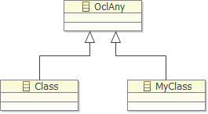
OMG Pivot : OclAny
All types conform to OclAny
  but Classifier does not generalize AnyType
  OclAny is not in any user's meta-model
  OclAny is not in the UML specification
This is a meta-model merge
Pivot Model is derived from User Model
  OclAny is merged as top classifier
    OclVoid, OclInvalid as bottom classifiers
  OclAny is not constrained by UML
UML + OCL
Model
OCL
Merge
OCL Pivot
Model

Slide 37

OMG Pivot : Standard Library
The Standard Library is not a model
The Standard Library has no URI
  cannot serialize an AST that references e.g. '+'
  XMI AST compliance is impossible
The Standard Library is a Pivot MM instance
The model and its elements have URIs
Variant libraries with distinct URIs for variant semantics
Extended libraries for extended OCL-based languages
OCL Pivot
MM
conforms to
OCL Library
Model

Slide 38


OMG Pivot : Iterators
Operations and Properties are referred by URI
Iterators and Iterate have no UML meta-class
Iterators and Iterate are referred by name
Iterators and Iterate are Operations
    owned as Class.ownedOperations
Parameters have an IteratorKind (or extend ParameterKind)
    Parameter, Iterator, Accumulator, Result
IterateExp, IteratorExp and LoopExp are obsolete
    OperationCallExp.referredOperation uniformly

Slide 39

OMG Pivot : Complete OCL
Complete OCL supports
    additional features in user classes
    additional features in the Standard Library
UML does not support addition of features
    no URI if a merge
Standard Library is not a UML model
Standard Library is a Pivot Model
Complete OCL is a Pivot Model
Complete OCL additions reified by merge

Slide 40
Eclipse Pivot : Ecore
OCL<Ecore> extends Ecore - not recommended
OCL<UML> extends UML - not recommended
OCL<?> does not work well
Separate Ecore, UML support generally required
Pivot meta-model is UML-aligned
Pivot model is derived (perhaps adapted)
from either Ecore or UML or ...

Slide 41

Eclipse Pivot : Conformance
OCL<?> has trivial spelling mistakes
  e.g. OCLExpression for OclExpression
Pivot meta-model is UML-aligned
  opportunity to correct errors

Slide 42
Eclipse Pivot : Reflection
Ecore, OCL, UML meta-model is Ecore
  *.eClass() is an EClass
EMF 2.6M4 corrected spurious EObject feature visibility
  *.eContainer() no longer readily available in OCL
Pivot meta-model is a Pivot model
  T::oclType() : Class(T)
Full uniform reflection
My
Class
instance of
ecore::
EClass
instance of
ecore::
EClass
adapts
adapts
adapts
My
Class
instance of
OCL::
Class
instance of
OCL::
Class

Slide 43
Eclipse Pivot : Ecore Mutation
Ecore meta-model cannot change dynamically
  if MM changes, model.eClass() reverts to a proxy
Prevents users enhancing OCL constraints
  must close and reopen model editors
Pivot meta-model can change dynamically
  pivot model elements adapt Ecore/UML elements
  Ecore <-> UML conversion via Pivot
  UML merge via Pivot
  (not in first release)

Slide 44
Pivot Model Adoption
May meet resistance
  OMG: ? vendors reluctant to change
  Eclipse: ? projects reluctant to migrate
Demonstrable solution
  OMG - cannot leave problems unsolved
  Eclipse - solve compliance, Ecore/UML problems
  Dresden - compatible, single new variant API
  Users - reduced Open Source supplier confusion

Slide 45
Overview
MDT/OCL Background, Evolution
Pivot Model
  solution to OMG Issues
  solution to Eclipse Problems
Some Pivot Details
Convergent Activity
  OMG specification consumability
  MDT/OCL implementation
API Ideas

Slide 46
Analysis
OCL should be UML-aligned
OCL must change UML
currently an unresolved paradox
abandon non-UML facilities
abandon UML-alignment
change UML so that OCL is UML-aligned
specify a UML-aligned enhanced UML

Slide 47
The Pivot Meta-Model
Basic UML MM
'Advanced Basic UML Constructs' MM
Package
Merge
Essential OCL MM
Pivot OCL MM
Complete OCL MM
Vendor-specific MM
Basic UML - UML alignment, no subset properties
Advanced Basic UML Constructs - potential UML alignment
  Templates etc adjusted for no subset properties
Essential, Complete OCL - UML alignment debug
MDT/OCL - Implementation conveniences - e.g. Visitors
Pivot OCL - all classes in single OCL:: package

Slide 48
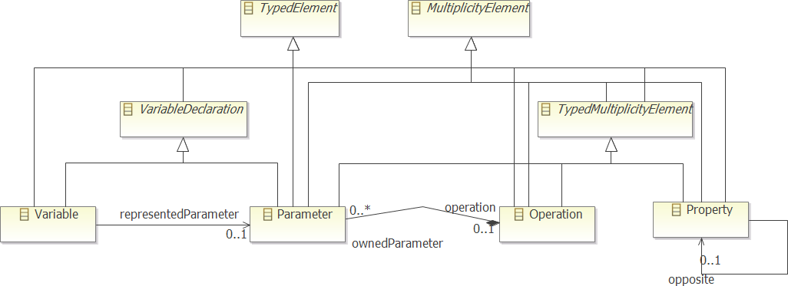
Example Merges
Extend UML meta-model
Variable Declaration
    used but not defined by OCL specification
TypedMultiplicityElement
    an implementation convenience

Slide 49
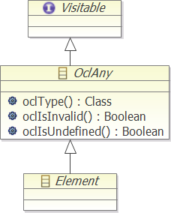
Root Merges
Visitable
  unmodelled interface
<T> T accept(Visitor<T>)
<T> T getAdapter(Class<T>)
OclAny
  UML: * generalises Element
  OCL: * conformsTo OclAny

Slide 50
Visitor
Visitor<T> interface
    T visitXXX(XXX) for every concrete model class XXX
    derived implementation corresponds to switch case
    default implementation can return null/delegate to 'super'
Visitable interface
    accept(Visitor<T> v) for every concrete model class XX
      return v.visitXXX(this);
      return v.getAdapter(MyVisitor.class).visitXXX(this)
cost 2/3 functions per node
    node.accept(myVisitor)
cf. 9 functions per node for EcoreSwitch

Slide 51
Editor Model Synchronisation
Semantic text edit
  (partial) reparse after each small text edit
  (partial) CST update/create
  small ASG update
Need to correlate new CST with old ASG

Slide 52
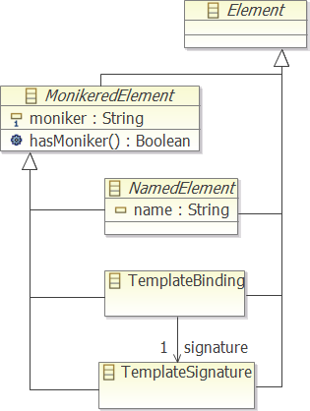
Monikers
  (a signature)
  globally unique
  consistent
    same moniker CST and ASG
      CST/ASG correlation
  hierarchical
  readable name
    debug
    xmi:id
  ?? immutable

Slide 53
The OCL Merge
UML or Ecore provides user meta-model
Essential OCL makes minor regular changes
Complete OCL makes major irregular changes
Minimize cost for the main use cases
  no Complete OCL changes
  small queries
Proportionate cost for complex use cases

Slide 54
Environment
Maps Type to usage-specific Class
references
My : UML::Class
Ref : UML::TypedElement
adapts
adapts
references
My : OCL::Class
Ref : OCL::TypedElement
completes
mapsTo
completes
My : OCL::CompleteClass
My : OCL::CompleteClass
mapsTo
My : OCL::Class
mapsTo
env1 : Environment
mapsTo
My : OCL::Class
env4 : Environment
My : OCL::Class
My : OCL::Class
env2 : Environment
env3 : Environment

Slide 55
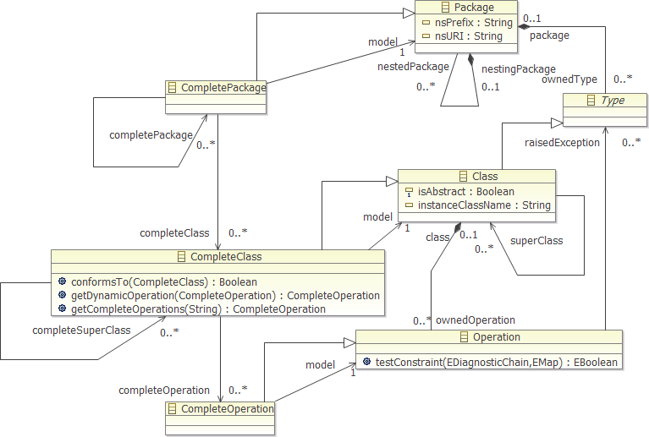
Complete Classes

Slide 56
Pivot Meta-Model Maintenance
Minimize costs (for single/small queries)
  re-use Classes across users/usages
    no usage-specific content
    TypedElements reference Classes
  usage-specific Environment
    maps shared Type to usage-specific Complete Class
  compute Compete Classes lazily
    re-use Class when Complete Class redundant
    create full Complete Class only when required
    ? create full Complete Class when caches useful

Slide 57
Overview
MDT/OCL Background, Evolution
Pivot Model
  solution to OMG Issues
  solution to Eclipse Problems
Some Pivot Details
Convergent Activity
  OMG specification consumability
  MDT/OCL implementation
API Ideas

Slide 58
Overview
MDT/OCL Background, Evolution
Pivot Model
  solution to OMG Issues
  solution to Eclipse Problems
Some Pivot Details
Convergent Activity
  OMG specification consumability
  MDT/OCL implementation
API Ideas

Slide 59
APIs
Eclipse
New
Custom
EMF
OMG
Editor
Interaction
Parser
Interaction
EMF
Validation
EMF
Access
Debug
Debug
Evaluation
Meta-Model
Access
Editor
Lexer
Parser
CST
Analyzer
Validator
Pivot
AST
Evaluator
Syntax
Extension
Semantic
Extension
Pivot
Load
Model
Access
Library
Access
eInvoke
OCL
Grammars
OCL
OCL
Standard
Library
Model
Standard
Library
OCL
Standard
Library
Implementation
OMG potentially defines many of the building blocks
Eclipse platform provides some APIs
EMF provides many more
Remainder could be shared

Slide 60
Meta-Model APIs
Pivot Model defined by OMG specification
    standard Ecore implementation for tool usage
MDT/OCL adds/merges the Visitor/Adaptable API
    pre-Pivot: all OCL classes override accept(Visitor)
    post-Pivot: all (OCL) classes override accept(Visitor)
    post-Pivot: Visitor implements getAdapter
EMF
Access
Pivot
AST

Slide 61
Evaluation APIs
AST Node Evaluation with EvaluationVisitor
    2 function call per node overhead: accept, visitXxx
    cf ~ 9 function call per node with Dresden OCL
      'Ecore'Switch is flexible but really inefficient
Meta-Model Access
    always a Pivot Model
Model Access
    mediated by EvaluationVisitor for simple values
    wrapped by a 'Collection'Adapter for complex values
Model Extent
    always a ResourceSet mediated by Model Access API
Evaluation
Debug
Debug
Meta-Model
Access
Evaluator
Model
Access
Library
Access

Slide 62
Standard Library API
Standard Library is an OMG-defined Pivot Model
    variant libraries are possible
MDT/OCL: one class per library feature
    simple binding/extensibility
    simple API: visitor, sourceValue, astNode
Object evaluate(EvaluationVisitor, Object, CallExp)
    deep inheritance hierarchy of common functionality
    sourceValue pre-determined for dynamic dispatch
Pivot
Load
Library
Access
Standard
Library
Model
Standard
Library
OCL
Standard
Library
Implementation

Slide 63
Editor API
Concrete Syntax, ASG defined by OMG
Editor Activation defined by Eclipse Platform
Model validation defined by EMF
Only a parser activation API necessary
CST internal
[Allow an EMACS editor]
Editor
Interaction
Parser
Interaction
EMF
Validation
Editor
Lexer
Parser
CST
Analyzer
Validator
Syntax
Extension
Semantic
Extension
OCL
Grammars
OCL
OCL

Slide 64
API Summary
Some APIs are inherently Eclipse defined
If OMG (RTF representatives) provide
    consumable models
    run-time Pivot model
then many APIs are inherently
    EMF defined
internal APIs migrate to align with
    EMF-generated OMG UML, OCL meta-models
external APIs are small
    non-critical
    easily aligned

Slide 65
Summary
MDT/OCL originally focussed on Java API
Evolving to provide IDE
Exploiting modeling tools
  EMF, Xtext, Acceleo, QVTo, OCL
Pivot Model needed by OMG, Eclipse
  hides Ecore/UML
Opportunities for shared low-level APIs
  advanced tools more useful
[Contributions welcome]

