Slide 1
OCL omissions and contradictions
Edward Willink
OCL RTF chair,
QVT RTF representative
Eclipse OCL Project Lead,
Eclipse QVTd Project Lead,
OMG ADTF
21st March 2012

Slide 2


Overview
Background/Goals for OCL '2.5'
Values - UML alignment
  Problems and Solutions
Types - UML alignment
  Problems and Solutions
[ Operations - UML alignment
  Problems and Solutions ]
Summary

Slide 3
OCL 2.5 Goals
UML 2.5 aligned
  consistent
Modeled OCL 'Standard' Library
  extensible, third party/domain libraries
Small Core Language + Libraries
  move Message, State support to library operations
Fully modeled
  100% auto-generated Frame specification (MOFM2T)
  auto-generated tooling (prototype in new Eclipse OCL)

Slide 4
true = true ?
OCL 2.3: No Boolean overload of OclAny::=(...)
OclAny::=(object2 : OclAny) : Boolean
True if self is the same object as object2. Infix operator.
post: result = (self = object2)
true only equal to true
  if both trues are the same object
  no requirement for singleton values
  no tool does this
OCL 2.5: Primitive types use value equality

Slide 5
1 = 1.0 ?
Set{1}->including{1.0}->size()
Set{Set{1}}->including{Set{1.0}}->size()
OCL 2.3: No numeric overload of OclAny::=(...)
[Java primitives equal, objects not equal]
OCL is a specification language
  numbers are points on an infinite number line
OCL 2.5: Numbers use numeric equality
1
2
-∞
0
1
3
4
+∞
1.0
e
π

Slide 6
1->size()
Collections reify UML Multiplicities
Collections are not UML class instances
anObject. ... object navigation
aCollection-> ... collection navigation
OCL 2.5 Specified Shorthands
aCollection.... aCollection->collect(...)
anObject->... anObject.oclAsSet()-> ...
 | Object | Collection
. | Navigation | ?
-> | ? | Navigation

Slide 7
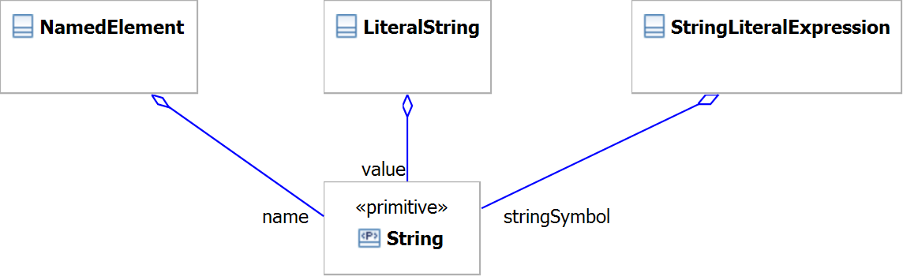
UML Primitive Usage
Primitives (Boolean, Integer, Real ...) have no
  behaviour, representation, conformance
Representation provided by host Class
Behaviour/Role defined by host Class

Slide 8
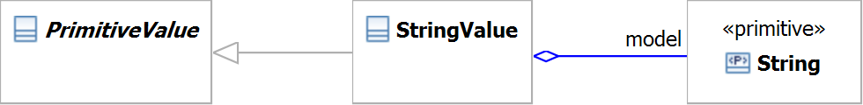

OCL Primitive Usage
StringValue hosts the String primitive
  provides a representation
OCL Standard Library defines behaviour
  operations of StringValue
    not String, not a companion class
OCL specification defines conformance

Slide 9
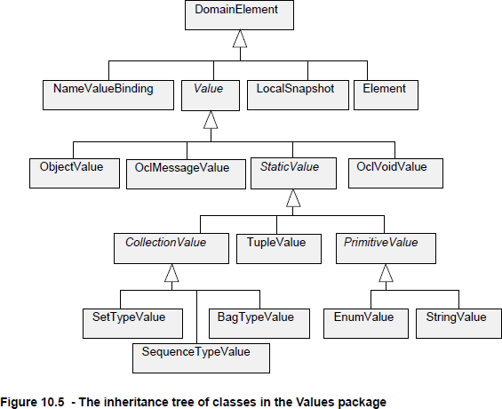
OCL normalized/pivot values
Already in OCL 2.0
  no specified API
No
  BooleanValue
  IntegerValue
  RealValue
  OrderedSetValue
Irregular
  ...TypeValue

Slide 10
OCL 2.5 Pivot Values
Add missing classes
  BooleanValue, IntegerValue, RealValue, ...
Regularize names
  TypeNameValue
Promote Values as a run-time API
  make Value class usage a Compliance Point

Slide 11
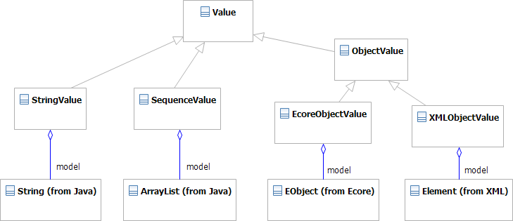
OCL Object Values in Java
ObjectValue can be polymorphic
  an indirection to a real Object representation
Foundation for a Java binding for OCL

Slide 12
OCL re-use in a Technology Space
OCL can be used in many Technology Spaces
  UML, EMOF, XML, RDB, ...
'Optimum' re-use
  use a TS-specific OCL implementation
Difficult: TS/OCL semantics differences
    1 = 1.0, Set{1,1.0} = Set{1}
Bespoke, irregular, confusing OCL
Persisted
TS
Model
Loaded
TS
Model
TS-specific
OCL Engine

Slide 13
OCL re-use for a Technology Space
Persisted
TS
Model
Loaded
TS
Model
Generic
OCL
Values
Generic
OCL Engine
Model accesses convert TS to OCL Values
  may be faster
    + no correction for non-OCL TS semantics
    - a TS to OCL value conversion
  lazy collection value conversions
OCL Values should be a conformance point

Slide 14
OCL Types, Meta-model
OCL
MetaModel
conformsTo
TS
MetaModels
Generic
OCL
Types
Generic
OCL Engine
conformsTo
Persisted
TS
Model
Loaded
TS
Model
Generic
OCL
Values
How is an OCL type aligned to a UML type?
  not currently specified

Slide 15
OCL Model Elements
Multiple sources of M2 model elements
  UML meta-model
  Essential OCL meta-model
  Complete OCL meta-model
Multiple sources of M1 model elements
  OCL 'Standard' Library
  User meta-models
  Complete OCL documents
  M2 elements by reflection - OclAny::oclType()

Slide 16
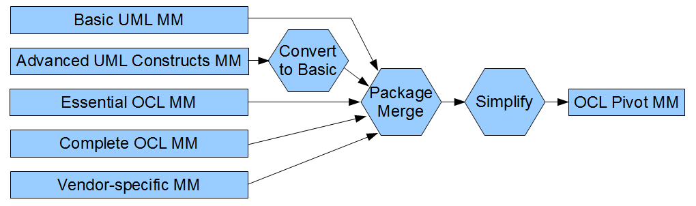
M2 Integration
MEF
Selected UML contributions for UML-alignment
[Selected] OCL contributions [for tailored OCL]
Vendor contributions support practical tooling
Merge gives single uniform package
  OCL::Class, OCL::OclExpression etc

Slide 17

Example OCL M2 'Merges'
OCL::Class = UML::Class+UML::Classifier+UML::Type
  in OCL any type can have operations
Eliminate derived unions
  simple efficient relationships as in UML Basic
Full navigability
  all association ends are Class-owned
Eliminate non-'MOF' classes
  no UseCases, Actions, ...
Re-use UML generalization as OCL conformance

Slide 18
Example OCL M1 'Merges'
Load user meta-models/libraries
  from UML/EMOF/... Complete OCL, OCLstdlib
  normalized to OCL meta-model representation
Insert OclElement as supertype of all user types
Co-ordinate package clashes by URI
Unify duplicate specialisations e.g. Set(String)

Slide 19
OCL Operations
What are the operation overloading semantics?
  OCL: aligned to UML
  UML: implementation variation point
  therefore unspecified
Proposal: Java-like invariant overloading
  A::y(Z) is overloaded by B::y(Z) if B extends A

Slide 20
OclSelf
OclSelf is the statically determinate type of self
Self-variant overloading
Boolean::=(OclSelf) overloads OclAny::=(OclSelf)
  enhanced invariant overloading: dispatch on
    dynamic most derived common type of source, argument
  handles the common binary case
  Real::+(OclSelf) always gets 2 Real arguments
  Integer::+(OclSelf) always gets 2 Integers
  no need for type checks

Slide 21
OCL Iterations
aCollection->iterate(q : String | acc : String = '';
if acc.size() > 0 then acc + ' ' else acc endif + q.toString())
How is iterate modeled?
Iteration is an Operation with extra 'parameter's
  iterator(s), q : String
  accumulator, acc : String = ''
  body is a lambda-expression if acc ... + q.toString()
Collection types are templates
Operations/Iterations may be templates
type Collection<T> : CollectionType conformsTo OclAny {
iteration iterate<Tacc>(i : T; acc : Tacc | body : Lambda T() : Tacc) : Tacc

Slide 22
Meta-Model Imports
In Complete OCL
  import a URI element
import uml : 'UML.uml#_jEB8EDoXEeCmpu-HRutBsg'
  import a URI element and its child names
import uml : 'UML.uml#_jEB8EDoXEeCmpu-HRutBsg'.*
In Essential OCL
  no mechanism to contextualize expression
  use URI as a path name element
oclIsKindOf('UML.uml#Activities'::Action)

Slide 23
Unified Collection Types
UML: bounded collection types
  String[2..4] {ordered}
  no nested collection types
OCL: nested collection types
  Set(OrderedSet(String))
  no bounded collection types
Inconsistent primary/secondary declarations
Unified Collection Types
  Set(OrderedSet(String)[2..4])

Slide 24


Reflection
OCL 2.0 Element::getMetaClass()
  MOF facility not merged to UML
OCL 2.2 OclAny::oclType() : Classifier
  No Classifier in EMOF
  Classifier at different meta-level
Does OCL support Reflection?
  (OCL 2.0) precondition for Sequence::first()
self.oclType().elementType.oclIsKindOf(CollectionType)
Yes

Slide 25
Unlimited / Plus infinity
[0..*] multiplicity upper bound can be unlimited
  * is not an Integer
  new UnlimitedNatural type (and value)
  UnlimitedNatural is not a simple subtype of Integer
    *.oclAsType(Integer) is invalid
    requires run-time test
OCL 2.5: * is plus infinity
  Integer and Real support +/- infinity
  all UnlimitedNatural values are Integer values

Slide 26
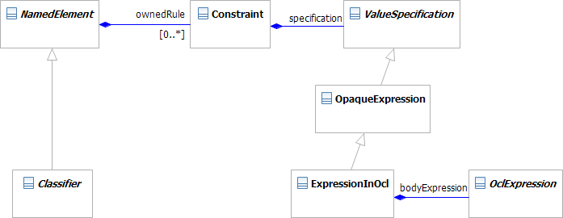
Complete OCL 2.3 Property Definition
context MyClass
def: upperCaseName : String = name.toUpper()
No Property
PropertyCallExpression.referredProperty impossible in XMI
<def>

Slide 27
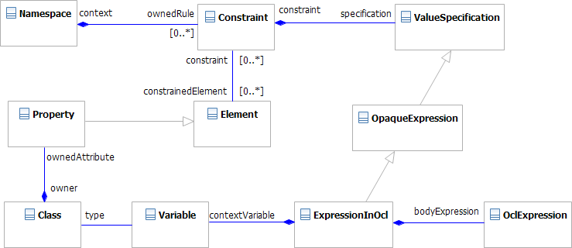
New Complete OCL Property Definition
New Complete OCL Property Definition
Property defined (can be referenced)

Slide 28
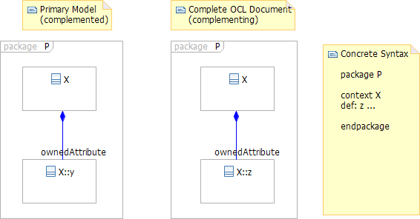
New Multiple Models Problem
  P::X::y defined by a primary UML model
  P::X::z defined by a Complete OCL document
How many P's? How Many X's?
What is the value of P::X.ownedAttribute?

Slide 29
Meta-Model Problems to solve
Library Modeling
    Reflection
    Iteration
UML alignment
    obsolete/inconsistent classes in use
    templates
EMOF (and Ecore and ...) utility
    arbitrary meta-meta-models
Complete OCL realizability
    definition of real Property/Operation
    multiple models, URIs

Slide 30
Multiple Models Solution
Simple Model Usage
  How many P's? How Many X's?
    One
  What is the value of P::X.ownedAttribute?
    Set{P::X::y, P::X::z}
Reflective Model Usage, URI Access
  How many P's? How Many X's?
    Two
  What is the value of P::X.ownedAttribute?
    depends on P::X - Set{P::X::y} or Set{P::X::z}

Slide 31

Summary- Not-new OCL Facilities
Overloading / dynamic dispatch
Reflection : oclType(), Class<T>
  was T, used in WFRs
Type-valued Expressions : Class<T>
  used in oclAsType()
Templates/Generics
  used in Collection, Collection::product, Tuples
OclSelf
  was T
Lambda Types / Expressions
  iteration bodies

Slide 34
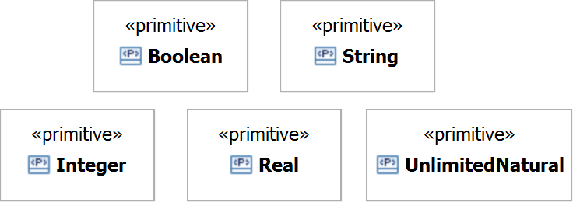
UML Primitives
UML Primitives have no representation
    ensures implementation freedom
UML Primitives have no behaviour
    cannot be used
UML Primitives have no conformance
    cannot be interchanged

Slide 35
OCL re-use
How does OCL support UML, EMOF, XML, ... ?
  Customize OCL for each technology space
    bespoke, irregular, confusing OCL
  Map each technology space to OCL
    most of OCL is technology space neutral
    just model access to align - values and types
    partial mapping gives partial support
e.g.EMOF has no Associations
    EMOF to OCL mapping may reconstruct associations
    an EMOF problem, not an OCL problem

Slide 36
Overview
OCL and UML and EMOF
  Problems
Complete OCL
  Problems and Solutions
Values
  Problems and Solutions
Summary

Slide 37
OCL Values in Java
xxxValue provides an indirection
IntegerValue/SetValue provide OCL semantics
  exploit Java for implementation not behaviour
IntegerValue may be polymorphic
  int or long or BigInteger representation
  IntegerValue-for-int similar to java.lang.Integer

Slide 38
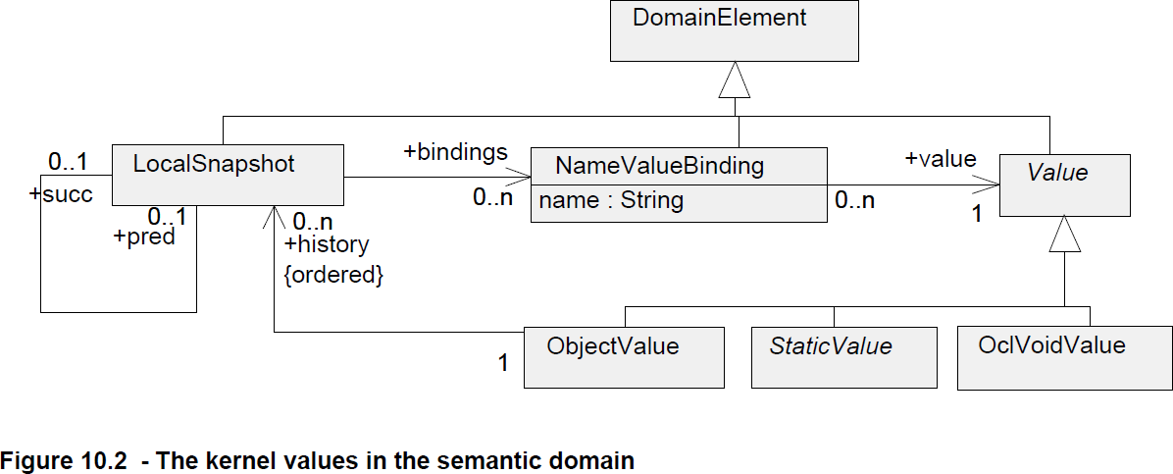
LocalSnapShots
LocalSnapShot: all names and their values
  useful for defining semantics
    N snapshots for OclMessage history
    2 snapshots necessary for @pre, not @pre
  inefficient for practical implementations

Slide 39
UML (and OCL)
UML
MOF
Complete MOF
Complete MOF
Essential MOF (≈ Ecore)
Powerful, Flexible, Big
Small, Effective, Efficient
Analysis
Design
Implementation
Complete OCL
Essential OCL
OCL

Slide 40
Significant Problem Summary
OCL for EMOF lacks essential elements
  OpaqueExpression, Constraint
  Types with features
Complete OCL incomplete
  Property/Operation definition not useable
  Property/Operation definition not persistable
OCL not UML aligned
  AssociationEnd/Property
  AssociationClass

Slide 41
Solution Summary
OCL for EMOF lacks essential elements
  support EMOF only indirectly
Complete OCL incomplete
  complete it
OCL not UML aligned
  define OCL with respect to UML

Slide 42
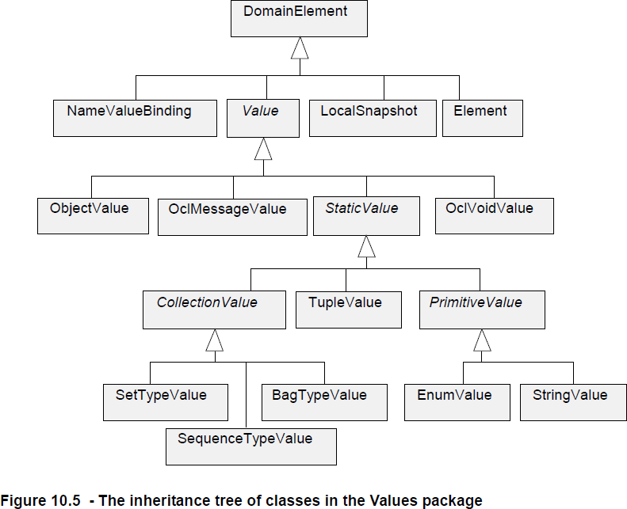
Values
Integer ??
Type ??
OrderedSet ??
*Type* ??

Slide 44
UML and OCL integration
UML
Meta-Model
OCL
Meta-Model
EMOF / Ecore
Meta-Model
conforms to
conforms to
conforms to
conforms to
UML
Model
EMOF / Ecore
Model
UML
Model
UML Edit
Export
OpaqueExpression
???
generalises
ExpressionInOcl
ExpressionInOcl
UML
Model
OCL for EMOF
Model
OCL for UML
Model
OCL Edit
Export

