Slide 1
OCL Roadmap
Edward Willink
Willink Transformations Ltd
Eclipse Foundation
MMT Component co-Lead
OCL Project Lead
QVTd Project Lead
QVTo Committer
OMG (Model Driven Solutions)
OCL 2.3, 2.4, 2.5 RTF Chair
QVT 1.2, 1.3, (1.4) RTF Chair
ADTF @ OMG Dec 2015
9th December 2015

Slide 2

Overview
What we have
How we got here
Where we go now

Slide 3

Simple Black Box view of OCL
U
s
e
r
s
Concrete Syntax
OCL
Standard Library
Semantics
Specification exposition imperfect
  Precise Concrete Syntax Grammar
More functionality

Slide 4
White Box view of OCL
U
s
e
r
s
Concrete Syntax
OCL
M
o
d
e
l
s
Loader
Standard Library
Abstract
Syntax
XMI
Semantics
Saver
Specification totally inadequate
  Missing / Unimplementable
Rewrite / Design

Slide 5



OCL History
OCL 1.3 specified as part of UML 1.3
    specifies that parts that need formal words
OCL 2.0 split off from UML 2.0 (Sept 2003 FAS)
    OCL useable in its own right
    No resources available to complete specification
QVT 1.0 (Jul 2007 FAS) specified as an OCL extension
    (May 2006) OCL 2.0 draft approved TBDs and all
OCL 2.1/2.2, 2.3, 2.4 provides limited improvements

Slide 6
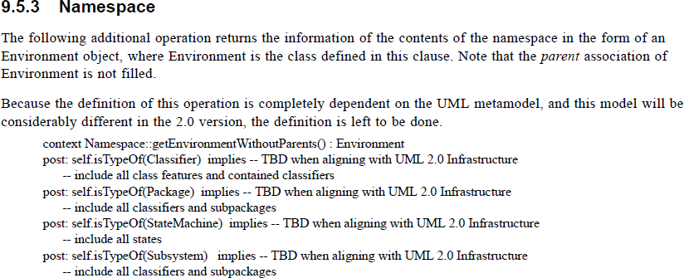
OCL 2.3.1 / ISO/IEC 19507 (2012)

Slide 7

OCL Progress
OCL 2.5 RFP (Feb 2014)
  initial submission deadline Dec 2014 - extended
  extended deadline Aug 2015 - lapsed
    RFP blocks RTF usage of JIRA
OCL 2.5 RTF (chartered Sep 2015)
? OCL 3.0 RFP
  FUML ?
? OCL 2.6 RFP
? RFC

Slide 8
OCL 2.0 ... 2.4 Models
Model
  Abstract Syntax (AS) - inaccurate / unuseable
Text
  Language Grammar - fragmented
  Concrete Syntax (CS) - implied
  CS to AS - semi-formal text
  Name lookup - semi-formal text
  Disambiguation - informal hints
  Standard Library - informal text
  Execution semantics - informal text / annex

Slide 9
Model content
Cannot just model what we 'have'
Must address
  UML alignment
    templates
    stereotypes
    missing EMOF elements
  OCL concepts
    open classes
    synthetic types
    lambda expressions

Slide 10
OCL 'next' Models
Models
  Abstract Syntax (AS) - OCL.uml + UML.uml
Text
  Language Grammar - OCL.xtext (AEBNF)
  Concrete Syntax (CS) - OCLCS.uml
  CS to AS - OCLCS2AS.ocl
  Name lookup - OCLNameResolution.ocl
  Disambiguation - OCLDisambiguation.ocl
  Standard Library - OCLstdlib.oclstdlib
  Execution semantics - informal text / Isabelle

Slide 11
OCL specification
OCL 2.0 ... 2.4
  best / rushed human endeavours
  numerous inconsistencies
OCL next
  auto-generated from the models
  no inconsistencies

Slide 12
Eclipse OCL / QVT Prototyping
Models
  extensible pivot internal AS representation ... XMI
  Extensible OCL Standard Library Model
Omissions
  stereotypes, templates, ... UML
Reified
  lambda expressions
New
  pattern expressions, type 'constructors'

Slide 13
Eclipse OCL Automation
Today:
  QVTo from UML models to internal Ecore/Java
  Xtext from 'AEBNF' grammars to internal Ecore/Java
Imminent:
  OCL CS2AS + name lookup + disambiguation
Close: QVTr to Java
  UML2AS,

Slide 14
Auto-documentation
Currently error prone manual FrameMaker
autogenerate from models
  MOFM2T (Acceleo) to FrameMaker MIF
  Xtend to FrameMaker MIF
  Xtend to Latex
Latex in use for Isabelle academic exposition
  replaces semi-formal Annex

Slide 15
UML / EMOF / OCL / FUML
UML - analysis/design language
  powerful/bloated - redefinitions
EMOF / (UML Basic) - implementation language
  efficient/deficient - no unnavigable opposites
OCL - executable specification language
  powerful/efficient
FUML - ? low level
  incomplete/implementation - no exceptions ....

Slide 16
1 = 1.0 or 1 <> 1.0
Specification language - OCL
  1 = 1.0
Programming Language - C, C++, Java (primitives)
  1 = 1.0
Implementation language - FUML, Java (objects)
  1 <> 1.0
!! UML is no longer a specification language !!
  needs a Real to Integer relationship

Slide 17
OCL and FUML
OCL is a higher abstraction than OCL
?? why didn't FUML use OCL to define FUML ??
  because OCL is a mess
OCL to FUML mapping is an irrelevance
  cf defining UML to Ada is an irrelevance
    useful to some, irrelevant to nearly everyone
  stronger formality for OCL via Isabelle
    widely recognised approach, already cataloged
Whoever wants OCL to FUML must fund it.

Slide 18
Next OMG OCL
OCL 3.0 RFP with FUML - won't happen
  unless 100% funding available
OCL 3.0 RFP without FUML - could happen
OCL 2.6 RFP - can it coexist with OCL 2.5 RTF?
OCL 2.5 RTF - changes too substantial
.... RFC - could happen
... Eclipse OCL

