Slide 1
Safe Navigation in OCL
Edward Willink
Willink Transformations Ltd
Eclipse Foundation
MMT Component co-Lead
OCL Project Lead
QVTd Project Lead
QVTo Committer
OMG (Model Driven Solutions)
OCL 2.3, 2.4, 2.5 RTF Chair
QVT 1.2, 1.3 RTF Chair
OCL 2015 @ MODELS 2015
28th September 2015

Slide 2


Overview
The null navigation problem
Inadequate solution
  "?." and "?->" safe counter parts to "." and "->"
Viable solution
  non-null object declarations
  null-free collection declarations
  ...

Slide 3

null
C.A.R.Hoare 2009
"I call it my billion-dollar mistake. It was the invention of the null reference in 1965. At that time, I was designing the first comprehensive type system for references in an object oriented language (ALGOL W). My goal was to ensure that all use of references should be absolutely safe, with checking performed automatically by the compiler."
  a good goal for OCL
"But I couldn't resist the temptation to put in a null reference, simply because it was so easy to implement. This has led to innumerable errors, vulnerabilities, and system crashes, which have probably caused a billion dollars of pain and damage in the last forty years."
  ignored in OCL for too long
  OCL is broken

Slide 4

null in OCL
null has many, but not all, object characteristics
  use of a missing characteristic crashes
aPerson.father.name.toUpper()
  obviously fails if aPerson is null
  fails if a father is null
    inevitable in a finite model
  fails if a name is null
    quite possible in an incomplete model
DATA DEPENDENT RUN-TIME FAILURE
    and we think OCL is a better language

Slide 5

Cures
Mitigation
Strong declarations
  C++ references: int&
    works
  Java annotations: @NonNull Integer
    fails on unannotated system/library/framework code
Safe navigation operator
  Groovy, Python, Xbase my?.name
    pushes problem sideways

Slide 6
OCL Safe Navigation Operators 1
Safe Object Navigation Operator
  x?.y
shortform for
  if x <> null then x.y else null endif
Safe Collection Navigation Operator
  x?->y
shortform for
  x->excluding(null)->y

Slide 7
OCL Safe Navigation Operators 2
null hazards can be avoided
aPerson.children.name->toUpper()
aPerson?.children?.name?->toUpper()
ugly
4 rather than 2 operators to confuse novices
  need tooling

Slide 8
Safe Navigation Operator WFRs
Error: Safe Navigation Required. a.b
  If the source could be null, a safe navigation operator should be used to avoid a run-time hazard.
Warning: Safe Navigation not Required. a?.b
  If the source cannot be null, a safe navigation operator is unnecessary and may incur overheads.
How do we determine could be null for OCL?

Slide 9
Non-Null Objects
Constants
  4
  Set{42}
Constant Expressions
  if ... then Set{42} else Set{} endif
But objects are rather useful
  if self = x then y else z endif

Slide 10

Non-Null Object Declarations
New syntax - e.g. C++ references
UML syntax
optionalName : String[?]
mandatoryName : String[1]
[?] String value is optional; null value is permitted.
[1] String value is required; null value is prohibited.
[*], [+], [2..5] etc not appropriate for single Object
OCL extension
  let/iterator variable types may have a multiplicity
let name : String[1] = ... in ...
someNames->forAll(name : String[?] | ...)
  OCL legacy default is [?], UML default is [1]

Slide 11
Non-Null collection elements
Collections are a very important part of OCL
OCL: Collections can contain null elements
  in practice very few do
OCL: Any iterator variable may be null
  in practice iterator variables are non-null
Major inconsistency between OCL and practice

Slide 12
Null-Free Collections
New syntax / Extended UML syntax
UML-alignment requires bounded collections
  Sequence(Integer)[1..2]
    one or two element sequence
  Sequence(Sequence(Real)[3])[3]
    3x3 matrix
OCL extension collection | element multiplicity
  Set(String)[+|1]
    collection multiplicity: + => one or more
    element multiplicity: 1 => non-null => null-free collection

Slide 13
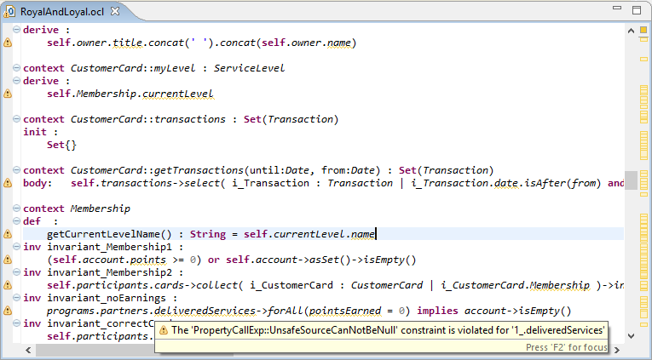
Null-Free Collection Example

Slide 14
Null-Safe Libraries - Simple
OCL Standard Library should be modeled
  planned for OCL 2.5/3.0, prototyped in Eclipse OCL
semi-formal declarations
  String::toBoolean() : Boolean
  post: result = (self = 'true')
pessimistically
  String::toBoolean() : Boolean[?]
after analysis of post-conditon
  String::toBoolean() : Boolean[1]

Slide 15
Null-Safe Libraries - Complex 1
OCL 2.4: Set::including(object : T) : Set(T)
  vague
    is source T same as argument/result T?
    how are derived types resolved?
  Java analogy inappropriate
    Set(E)::add(E) : boolean
    Set is mutable, no creation, no type change
  OCL Set is immutable, new instance/type for result
Clearer: Set(T)::including(object : T) : Set(T)
  All T's exist in library
  Choose the most derived T

Slide 16
Null-Safe Libraries - Complex 2
Set(T)[*|e1]::including(object : T[e2]) : Set(T)[*|e3]
Informally: result is null-free if
  source is null-free and argument object is non-null
Formally:
    null-free = true
    non-null = true
  e3 = e1 and e2
Pessimistic static modeled definitions

Slide 17
Null-Safe Libraries - Complex 3
Set(T)[c1|e1]::including(object : T[e2]) : Set(T)[c3|e3]
Pessimitic, very simple
  multiplicity is always 0 to unlimited.
  c1.lower = 0, c1.upper=*, c3.lower = 0, c3.upper = *
Pessimitic, more accurate
  c3.lower = c1.lower
  c3.upper = if c1.upper = * then * else c1.upper+1 endif
Null-safety requires element multiplicity modeling
  collection multiplicity modeling is comparable

Slide 18
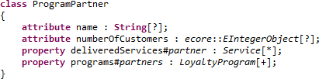
Null-Safe User Models
RoyalAndLoyal.ocl shows numerous errors
RoyalAndLoyal.ecore inaccurate
  Kleppe & Warmer UML diagrams specify [1]
  Ecore has [?] defaults
  Fixing RoyalAndLoyal.ecore fixes Object problems
But all Collection/Iterator problems remain
  add null-free EAnnotations

Slide 19
OCL Collection Stereotypes
UML has no null-free Collection support
  fixable with a MultiplicityElement stereotype
  one fix per stereotyped MultiplicityElement
OCL legacy - null-full collections
OCL practice - null-free collections
  fixable with a Class or Package stereotype
  changed defauly throughout Class / Package

Slide 20
OCLforUML Profile
(MultiplicityElement) Collection::isNullFree
(Class or Package) Collections::isNullFree
(InstanceSpecification) Validation::validate
(Package) Validations::validate
(DataType) Integer::maximum / minimum
  ... BoundedInteger ... Overflow
(DataType) Real::maximum / minimum / epsilon
  ... FixedPoint, FloatingPoint ... Bits ... Rounding

Slide 21
Deep Non-Null Analysis
let anObject : NamedElement[?] = ....
in anObject <> null implies anObject.name <> null
Variable declarations give pessimistic safety
anObject : NamedElement[?] implies anObject.name unsafe
Deeper analysis needed
  total analysis impractical
  simple implies/and/or practical
  TBD: defined in OCL in OCL specification

Slide 22
Experience Report
Available in Eclipse Mars release (June 2015)
  optional error/warning/ignore severity
Two non-trivial Complete OCL documents
  change ignore severity to warning
    numerous diagnostics - depressing
  add safe navigation operators
    hard work - wrong
  correct user model declarations
    stronger design - success

Slide 23
Summary
OCL is seriously unsafe null-wise
Naive safe navigation operators confusing
Intelligent Analysis tooling requires
  non-null object declarations: [?]/[1] multiplicity
  null-free collection declarations: [...|1] multiplicity
  null-safe library collection declarations
Prototype available in Eclipse OCL (June 2015)

