Slide 1
Aligning OCL and UML
Edward Willink
Eclipse OCL Project Lead,
Eclipse QVTd Project Lead,
Thales OMG OCL RTF Representative,
Thales OMG QVT RTF Representative
OCL 2011 @ TOOLS 2011
29th June 2011

Slide 2


Overview
OCL and UML and EMOF
  Problems
Complete OCL
  Problems and Solutions
Values
  Problems and Solutions
Summary

Slide 3
UML and OCL integration
UML
Meta-Model
OCL
Meta-Model
EMOF / Ecore
Meta-Model
conforms to
conforms to
conforms to
conforms to
UML
Model
EMOF / Ecore
Model
UML
Model
UML Edit
Export
OpaqueExpression
???
generalises
ExpressionInOcl
ExpressionInOcl
UML
Model
OCL for EMOF
Model
OCL for UML
Model
OCL Edit
Export

Slide 4
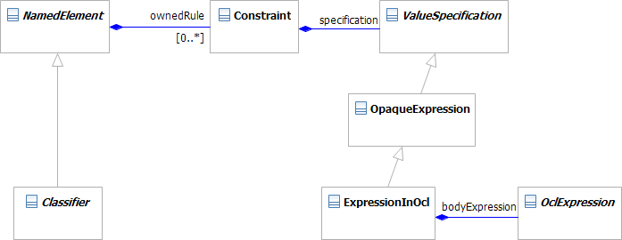
Complete OCL 2.3 Property Definition
context MyClass
def: upperCaseName : String = name.toUpper()
No Property
<def>

Slide 5

XMI Serialization
One of three primary OCL compliance points
In AS
  PropertyCallExp.referredProperty : Property
No problem for UML/EMOF models
  Property exists
Major problem for Complete OCL
  Property does not exist

Slide 6
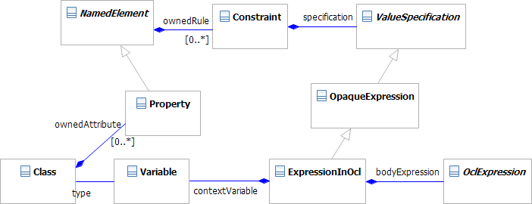
New Complete OCL Property Definition
Property defined (can be referenced)
  Constraint now owned by Property not Classifier

Slide 7
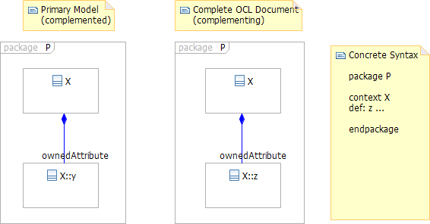
New Multiple Models Problem
  P::X::y defined by a primary UML model
  P::X::z defined by a Complete OCL document
How many P's? How Many X's?
What is the value of P::X.ownedAttribute?

Slide 8

Multiple Models Solution
Simple Model Usage
  How many P's? How Many X's?
    One
  What is the value of P::X.ownedAttribute?
    Set{P::X::y, P::X::z}
Reflective Model Usage, URI Access
  How many P's? How Many X's?
    Two
  What is the value of P::X.ownedAttribute?
    depends on P::X - Set{P::X::y} or Set{P::X::z}

Slide 9
Meta-Model Problems to solve
Library Modeling
    Reflection
    Iteration
UML alignment
    obsolete/inconsistent classes in use
    templates
EMOF (and Ecore and ...) utility
    arbitrary meta-meta-models
Complete OCL realizability
    definition of real Property/Operation
    multiple models, URIs

Slide 10
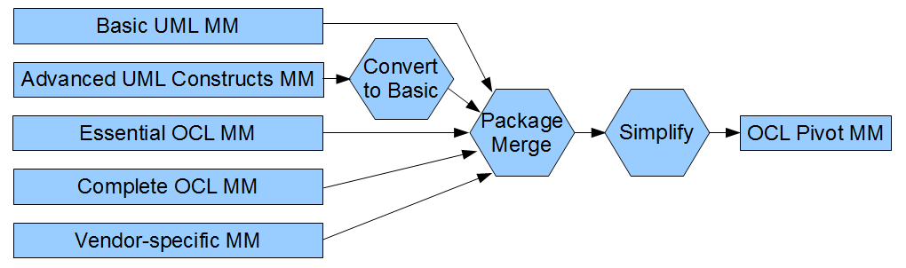
Meta-Model Solution
Selected UML contributions for UML-alignment
Selected OCL contributions for tailored OCL
Vendor contributions support practical tooling
Merge gives single uniform package
  OCL::Class, OCL::OclExpression etc

Slide 11
Overview
OCL and UML and EMOF
  Problems
Complete OCL
  Problems and Solutions
Values
  Problems and Solutions
Summary

Slide 12
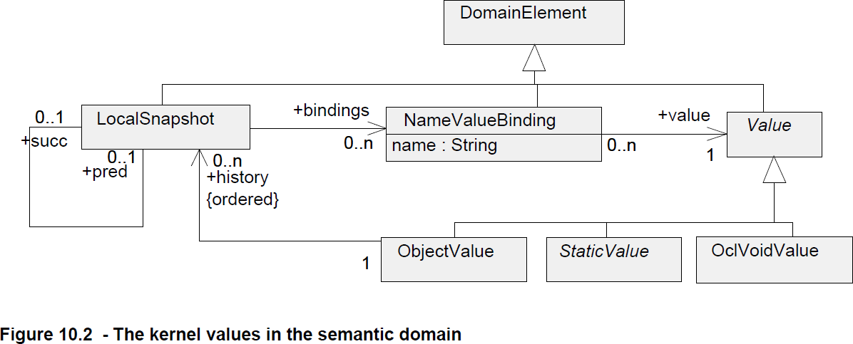
LocalSnapShots
LocalSnapShot: all names and their values
  useful for defining semantics
    N snapshots for OclMessage history
    2 snapshots necessary for @pre, not @pre
  inefficient for practical implementations

Slide 13
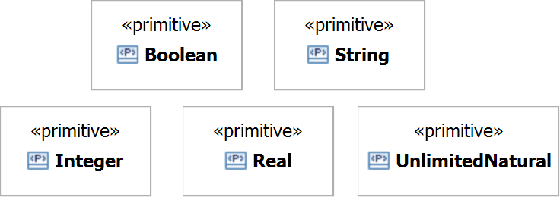
UML Primitives
UML Primitives have no representation
    ensures implementation freedom
UML Primitives have no behaviour
    cannot be used
UML Primitives have no conformance
    cannot be interchanged

Slide 14
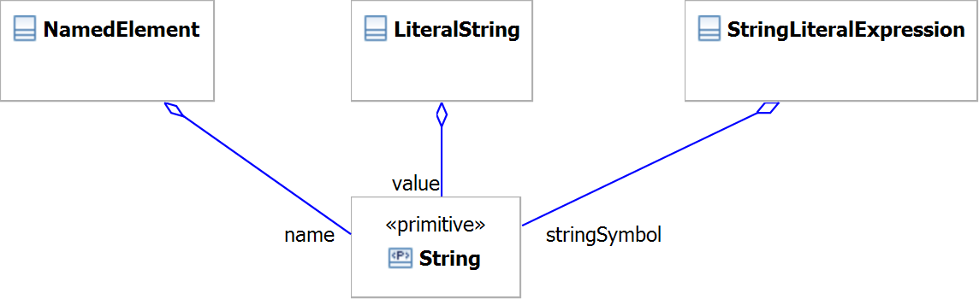
UML Primitive Usage
Representation provided by host Class
Behaviour/Role defined by host Class

Slide 15
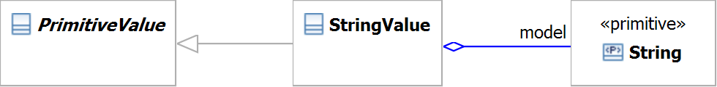
OCL Primitive Usage
StringValue hosts the String primitive
  provides a representation
OCL Standard Library defines behaviour
  operations of StringValue
    not String, not a companion class
OCL specification defines conformance
[IntegerValue/RealValue/BooleanValue ... missing]

Slide 16
OCL Primitives in Java
Ignore *Value classes
  OCL::String implemented by java.lang.String
  OCL::Integer implemented by java.lang.Integer
  OCL::Set implemented by java.util.Set
    oops! number ranges ... java.math.BigInteger
    oops! in OCL: 4 = 4.0 so Set{4} = Set{4.0}
Complete OCL adds operations
    oops! java.lang.String is final

Slide 17
OCL Values in Java
xxxValue provides an indirection
IntegerValue/SetValue provide OCL semantics
  exploit Java for implementation not behaviour
IntegerValue may be polymorphic
  int or long or BigInteger representation
  IntegerValue-for-int similar to java.lang.Integer

Slide 18
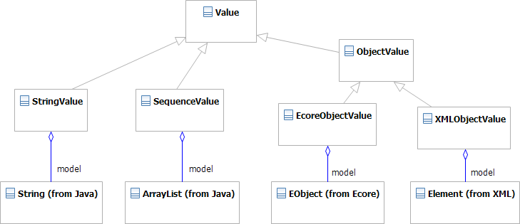
OCL Object Values in Java
ObjectValue can be polymorphic
  an indirection to a real Object representation
Foundation for a Java binding for OCL

Slide 19
Summary
Reviewed Complete OCL and URI issues
  introduced Pivot meta-model
    derived from UML
    reifying missing OCL concepts
Reviewed the Values Package
  provides OCL/Implementation semantic separation
  basis for a Java binding for OCL

Slide 20
UML (and OCL)
UML
MOF
Complete MOF
Complete MOF
Essential MOF (≈ Ecore)
Powerful, Flexible, Big
Small, Effective, Efficient
Analysis
Design
Implementation
Complete OCL
Essential OCL
OCL

Slide 21
Significant Problem Summary
OCL for EMOF lacks essential elements
  OpaqueExpression, Constraint
  Types with features
Complete OCL incomplete
  Property/Operation definition not useable
  Property/Operation definition not persistable
OCL not UML aligned
  AssociationEnd/Property
  AssociationClass

Slide 22
Solution Summary
OCL for EMOF lacks essential elements
  support EMOF only indirectly
Complete OCL incomplete
  complete it
OCL not UML aligned
  define OCL with respect to UML

Slide 23
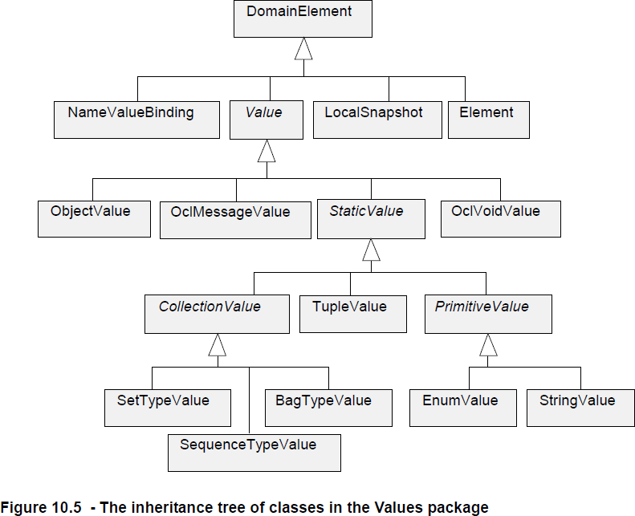
Values
Integer ??
Type ??
OrderedSet ??
*Type* ??

