Slide 1
Reflections on OCL 2
Edward Willink
Willink Transformations Ltd
Eclipse Foundation
MMT Component co-Lead
OCL Project Lead
QVTd Project Lead
QVTo Committer
MoDisco Project Lead
OMG (Model Driven Solutions)
OCL 2.3, 2.4, 2.5 RTF Chair
QVT 1.2, 1.3, 1.4 RTF Chair
ADTF @ OMG 2020-06
24th June 2020

Slide 2


OCL is in a very bad place
Cause for reflection
  where are we?
  why OCL?
OCL 1 reality
OCL 2 aspiration
  process failings
  technical struggles
  OCL 2.5?
?? OCL 3 ??

Slide 3
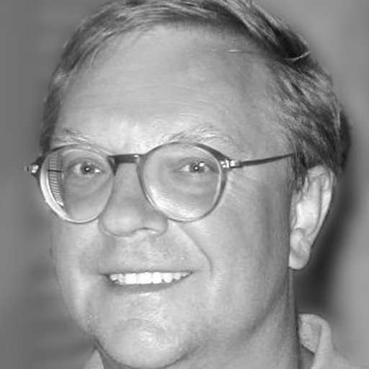
Cause for Reflection
Prof. Dr. Martin Gogolla is retiring
Universität Bremen
Uni Bremen
Faculty 03:
Mathematics/
Computer Science

Slide 4
OCL Tools
Oldest - still active
  IBM/EMF/MDT/Eclipse OCL
  USE
Others - not active
  Dresden OCL
  Kent OCL
  Octopus
  Together
  ...

Slide 5
UML-based Specification Environment
Independent self-contained modeling environment
  variety of UML-related diagrams (integrated)
  supports OCL evaluation history (Filmstrips)
  platform for many research papers
  mainly OCL 1.x, some OCL 2.x (not Ecore)
2002 "Development of UML Descriptions with USE"
2009 USE 2.4.0 on SourceForge
2020-01 USE 5.2.0 on SourceForge
Martin Gogolla's students
  Martin's successor doesn't like UML or OCL

Slide 6
IBM ... EMF ... MDT ... Eclipse OCL
1995 OCL invented at IBM
2002 Earliest copyright in Eclipse OCL sources
2005-09-05 First EMF OCL Bugzilla
2007-06 (1.1.0) (Classic) OCL for UML 2.1
2008-06 (1.2.0) Validation implemented
2010-06 (3.0.0) EMF delegates
2011-06 (3.1.0) Pivot OCL as 'examples'
2012-06 (4.0.0) Java Code Generator
2020-06 (6.12.0) Latest 3-monthly Eclipse release
4 original IBM developers
  => 1 residual ex-IBM developer - Christian Damus
then 1 independent enthusiast - Edward Willink
  one occasional assistant - Adolfo Sanchez

Slide 7
Future
Dresden OCL died through lack of funding
USE may die once Martin's students graduate
  ?? another university might take it over
Eclipse OCL dies as soon as I lose enthusiasm

Slide 8

OCL State of the Art
OCL developer base is probably declining
  no commercial tools - all failed / Open Source
  many tool failures - Dresden OCL most recently
  two 'ok' quality implementations
  OCL has less than ten developers
  OCL specification is poor
  OCL specification progress is pitiful
OCL user base is perhaps steady
  many modeling papers use OCL
    little alternative - OCL is 'right'

Slide 9
Java contrast
Java etc keeps improving (similar good ideas)
  generics, lambdas, streams, ...
  Java has multiple high quality implementations
    some free
  Java has thousands of developers, OCL barely ten
  @Pure is not practical
OCL cannot outdo Java on Java's ground
  find another playing field

Slide 10
Language Progress as Bye-Byes
Assembler
  bye bye 1's and 0's
C
  bye bye stack/condition code corruption
  bye bye self-modifying code
Object Orientation
  nearly bye bye global variable corruption
  nearly bye bye distant variable corruption
Java
  bye bye heap corruption
OCL
  bye bye side effects
  bye bye memory corruption
  hello integrity

Slide 11
Why OCL?
OCL has just one Unique Selling Point left
  side effect free
    analyzeable, predictable, reliable, (fast)
But OCL is useless
  side effect free prohibits mutation - no results
  needs embedding in a model provider
    OCLinEcore helps
    Model Transformation really helps

Slide 12
Incremental (bidirectional) Declarative Transformation
Underlying OCL
  rigorous queries / analyzeable memory accesses
Declarative Transformation
  limited / analyzeable mutations
  global dependency analysis
  reliable computation scheduling
  reliable selective / incremental re-computation
Manual Java cannot sensibly do this
=> OCL / QVTr Killer Application

Slide 13
OCL for proofs
Not my field - just my prejudice
  need to challenge a specification
    is it sensible
    is a behaviour guaranteed / impossible
cf. Declarative Model Transformation
  metamodel type system very restrictive
  eliminates numerous scheduling alternatives
  potentially NP complete but O(1) or O(2) in practice
Contradiction finders
  transform to existing non-metamodel tools
    really really slow for moderate problems
  ?? remain metamodel aware and exploit OCL ??

Slide 14
OCL is in a very bad place
Cause for reflection
  where are we?
  why OCL?
OCL 1 reality
OCL 2 aspiration
  process failings
  technical struggles
  OCL 2.5?
?? OCL 3 ??

Slide 15

OCL 1.x History
Early 1990s, Steve Cook + John Daniels @ IBM
  Syntropy: OMT diagrams + Z formality
1995, Steve Cook + Jos Warmer @ IBM
  OCL - compromise between Z / programming
1997... OCL 1.x bundled as part of UML 1.x
  constraints only
1998 Jos Warmer + Anneke Kleppe
  The Object Constraint Language:
  Precise Modeling with UML

Slide 16
Black Box specification - OCL 1
U
s
e
r
s
Concrete Syntax
OCL
Standard Library
Evaluation
OCL 1.x is UML 1.x chapter 6 (50 pages)
Friendly informal description
  extra operations/attributes ?? => open classes
  nearly yaccable grammar

Slide 17
OCL 2.0 History
2000 ad/2000-09-02 UML 2.0 RfP
2000-2005 UML 2U/U2P competition
2000 ad/2000-09-03 UML 2.0 OCL RfP
  draft OCL 2.0 ejected as generally useful
2003 ad/2003-01-07 response to RFP
  expressions too, let, minor syntax evolution
2003 Jos Warmer + Anneke Kleppe
  The Object Constraint Language: Second Edition
  Getting Your Models Ready for MDA

Slide 18
OCL 2 Aspiration
UML 1 - specification
UML 2 - analysis and implementation
  more formal
OCL 2 - independent specification
  more formal
    metamodel(s) ... XMI
    semantics

Slide 19
White Box specification - OCL 2
U
s
e
r
s
Concrete Syntax
OCL
M
o
d
e
l
s
Loader
Standard Library
Abstract
Syntax
XMI
Evaluation
Saver
Specification totally inadequate
  Missing / Unimplementable
Rewrite / Design

Slide 20
OCL 2.0 History
2004-2006 8-way QVT competition
  7 submissions re-use OCL
2006 OCL 2.0 (still draft) published
  minimal change from response
  no prototype
  were the AB/BoD asleep?
  OMG's crowning disgrace
2007 QVT 1.0 published

Slide 21
OCL 2.x
2010 OCL 2.1 .. 2.2 - minor fixes
2010 OCL 2.3 - minor fixes
  null/invalid clarification
2012 OCL 2.3.1 ISO standard
  complete with TBDs
2014 OCL 2.4 - minor fixes
2015 OCL 2.5 Request For Proposal
  bug list

Slide 22
The Response to Issue problem
Trivial one word/paragraph change
  tedious but ok add/replace instructions
Changes often impact in multiple places
  really tedious but ok add/replace instructions
  often only 95% hit-rate
Non-trivial changes often overlap
  really really tedious edit detail sequencing
  or fix 1 delegates all edits to fix 2
Non-trivial changes are a mega-pain (unpaid)

Slide 23
The OCL Response Problem
OCL 2.0 was actually still a draft
  many TBDs for when UML 2.0 exists
  numerous pervasive overlapping fixes
    e.g. UML 2.0 changed "Attribute" to "Property"
Not enough time/enthusiasm to detail all 'typos'
  replacement chapter-sized fixes not acceptable
OCL specification is referential
  full of references to model concepts
  auto-generate from models plus comments
    cf Eclipse OCL Standard Library help pages
    UML 2.5 is 50% auto-generated

Slide 24
OCL Specification way forward
OCL 2.5 Request for Proposal
  Rewrite rather delta edit
  similar to UML 2.5 rewrite
  from OMG: (unpaid) solutions from interested parties
  expired: OCL 2.5 RTF necessary to exploit JIRA
Need to be coherent with other OMG standards
  fUML introduces stronger semantics for UML
  similar approach needed for OCL
    massive (unpaid) research activity
OCL 2.next Request for Comments
  from interested party to OMG
    take it => OMG OCL 2.next specification
    leave it => Eclipse OCL 2.next specification

Slide 25
OCL specification progress
Many of the problems solved
  prototyped in Eclipse OCL
  extensively modelled for the models
    needs a clean-up pass
    remove Eclipse-isms
  inadequately modelled for the conversions
    e.g. Normalization of UML stereotypes
    needs QVTr
Auto-generation
  currently models + comments to textile using Xtend
  probably models + comments to latex using QVTr

Slide 26
A Problem: The OCL Metamodel
OCL 1 part of UML so re-uses UML Class
OCL 2 evicted from / independent of UML
  'aligned with UML'
  re-uses Basic UML (oops: eliminated in UML 2.5)
  works with EMOF (oops: no Constraint)
  works with your favourite metamodel representation
  needs open classes
  mad to use both Associations and Properties
OCL 2 defines an OCL expression metamodel
  needs a full metamodel with open Classes

Slide 27
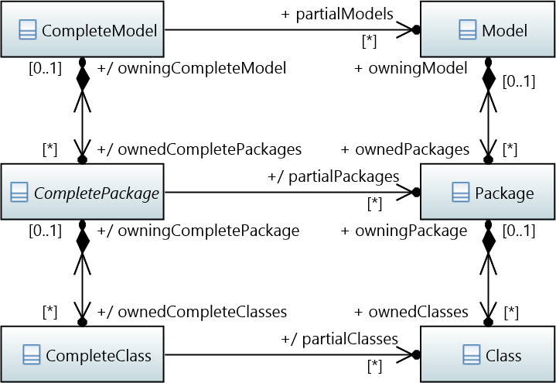
A solution: OCL Complete Model

Slide 28
OCL Specification Interpretation
Eclipse OCL (my predecessors)
  OCL specification is perfect - work of the gods
  Implement precisely
Eclipse OCL (my old view)
  OCL specification is imperfect
  Implement as precisely as possible
    deviate only once plausible OMG issue raised
Eclipse OCL (my new view)
  spirit of OCL specification is good
  letter of OCL specification is often rubbish
    reconsideration needed

Slide 29
OCL Future
Do nothing
  USE dies, maybe limps on - OCL 1++, not Ecore
  Eclipse OCL dies, maybe limps on- ~OCL 2
A better/merged OCL 2
  needs developer enthusiasm / funding
  'my' code is always better than 'your' code
  needs an implementable specification
OCL 3
  yet another OCL variant
  yet another drain on no resources

Slide 30
Language tooling
Mainstream language e.g Java
  ? millions of users
  ? thousands of full-time tool developers
  can tolerate user rather than tool friendly spec
    standard/custom sub-tooling
Domain-specific Language - DSL
  ? tens of users
  ? 1 or two part-time tool developers
    exploit standard sub-tooling e.g. yacc and successors
Object Constraint Language - OCL
  ? thousands of users
  ? ten part-time tool developers
    must suit standard sub-tooling

Slide 31
Implementing OCL 2
Really hard
  specification rubbish / unintelligible
  no re-useable metamodels
  distinct Concrete / Abstract Syntax metamodels
  no yaccable grammar
  I ignore what I don't understand / like
  each tool has a different proprietary solution
  no 'code' interchange / re-use
  really hard to extend
  many My-OCLs e.g. ATL-OCL, EOL, pOCL, ...

Slide 32
OCL 3
KISS
  must be simpler and easy to implement
    ideally from machine readable specification files
Revisit hard to implement specification aspects
  one complete self-standing metamodel
    not UML plus OCL Abstract + OCL Concrete Syntax
  open classes / XMI
    serialize type descriptions not type references
  yaccable grammar
    make declaration / iteration expression distinct
Revisit bad design decisions
  "->" and "." are unnecessarily confusing

Slide 33
Summary
OCL 1 is obsolete but not dead
OCL 2 is dying
  unimplementable inconsistent incomplete specification
OCL could have an important future
  accurate incremental bidirectional execution
  provably consistent code
OCL 3
  ? solve all the problems
  ? further dilution of resources
  ripples to QVT, MOFM2T, ..., UML

