Slide 1
MDT/OCL Architecture
Perspectives
Edward Willink
MDT/OCL Project Lead
Adolfo Sánchez-Barbudo Herrera,
Open Canarias
TU Dresden
5th November 2010

Slide 2
Overview
MDT/OCL Background, Evolution
Pivot Model
  solution to OMG Issues
  solution to Eclipse Problems
Some Pivot Details
Convergent Activity
  OMG specification consumability
  MDT/OCL implementation
API Ideas

Slide 3
MDT/OCL Background
OMG OCL 1.x within IBM
OMG OCL 2.x within Eclipse
Orginally Java API
  OCL AST MM adjusted to extend Ecore MM
    Ed Merks: "Never extend Ecore"
  OCL MM made generic (Christian Damus)
    OCL<.... Ecore .... >, OCL<.... UML ....>
    long parameter lists - 10 types
    wrong (base class) getXxx returns
  Extensibility for QVTd (EDW) and QVTo (ASBH)

Slide 4
MDT/OCL Now
Christian Damus moved on
New team: EDW , ASBH, Alex Igdalov and Laurent Goubert
Initial work migrating editors
    mandatory re-engineering to Xtext
Awareness of the various OMG specification problems
    trivial inconsistencies
    major impossibilities
Pivot solution to all problems

Slide 5
Overview
MDT/OCL Background, Evolution
Pivot Model
  solution to OMG Issues
  solution to Eclipse Problems
Some Pivot Details
Convergent Activity
  OMG specification consumability
  MDT/OCL implementation
API Ideas

Slide 6
Pivot Solutions for OMG
Basic
UML
Basic
Merged
UML
Essential
MOF
Minimal capabilities
for code generation
Basic
UML
Basic
UML
Essential
OCL
Essential
OCL
Essential
OCL
Package
Merge
Export
Complete
OCL
Complete
OCL
Complete
OCL
Advanced
UML
Advanced
UML
Advanced
UML
Advanced
UML
Complete
MOF
Rich capabilities for
meta-modeling
UML <= 2.4 Basic packages
    no subset properties
UML <= 2.4 Advanced Construct packages
    prolific subset properties
UML 2.5 Simplification
    no Basic; model-checking of arbitrary sub-UMLs

Slide 7
The Pivot Solution
Basic
UML
Basic
Merged
UML
Essential
MOF
Minimal capabilities
for code generation
Basic
UML
Basic
UML
Rich capabilities
for run-time
Essential
OCL
Essential
OCL
Essential
OCL
Package
Merge
Export
OCL
Merge
OCL
Pivot
Complete
OCL
Complete
OCL
Complete
OCL
Advanced
UML
Advanced
UML
Advanced
UML
Advanced
UML
Complete
MOF
Rich capabilities for
meta-modeling
OCL '2.4' All model contributions merged
  single coherent OCL Pivot Model
  conforms to UML-aligned OCL Pivot Meta-Model
=> Rich run-time evaluation capabilities

Slide 8
OMG Pivot : Reflection
UML has no reflection
MOF adds reflection
OCL is UML-aligned
  what is the return from of OclAny::oclType() ?
OCL 2.0 : an open Enumeration of all types
OCL 2.2 : a powerset of all types
OCL '2.4' : an OCL::Class(T)
  full reflection
    optional compliance point for partial reflection
My
Class
instance of
Class

Slide 9
OMG Pivot : Unnavigable Opposites
Person
child
Person
parent
OCL allows arbitrary navigation of associations
EMOF models discard unnavigable opposites
    MOF 2.4 adds an org.omg.mof.oppositeRoleName Tag
CMOF OCL has no problem
EMOF OCL needs extra functionality
OCL 2.4 Pivot fully represents associations
    no analysis/evaluation problem
    just a meta-model loading/model access issue

Slide 10
OMG Pivot : OclAny
All types conform to OclAny
  but Classifier does not generalize AnyType
  OclAny is not in any user's meta-model
  OclAny is not in the UML specification
This is a meta-model merge
Pivot Model is derived from User Model
  OclAny is merged as top classifier
    OclVoid, OclInvalid as bottom classifiers
  OclAny is not constrained by UML

Slide 11
OMG Pivot : Standard Library
The Standard Library is not a model
The Standard Library has no URI
  cannot serialize an AST that references e.g. '+'
  XMI AST compliance is impossible
The Standard Library is a Pivot MM instance
The model and its elements have URIs
Variant libraries with distinct URIs for variant semantics
Extended libraries for extended OCL-based languages

Slide 12
OMG Pivot : Iterators
Iterators and Iterate have no UML meta-class
Iterators and Iterate are referred by name
Operations and Properties are referred by URI
Iterators and Iterate are Operations
    owned as Class.ownedOperations
Parameters have an IteratorKind (or extend ParameterKind)
    Parameter, Iterator, Accumulator, Result
IterateExp, IteratorExp and LoopExp are obsolete
    OperationCallExp.referredOperation uniformly

Slide 13
OMG Pivot : Complete OCL
Complete OCL supports
    additional features in user classes
    additional features in the Standard Library
UML does not support addition of features
    no URI if a merge
Standard Library is not a UML model
Standard Library is a Pivot Model
Complete OCL additions reified in the Pivot Model

Slide 14
Eclipse Pivot : Ecore
OCL<Ecore> extends Ecore - not recommended
OCL<UML> extends UML - not recommended
OCL<?> does not work well
Separate Ecore, UML support generally required
Pivot meta-model is UML-aligned
Pivot model is derived (perhaps adapted)
from either Ecore or UML or ...

Slide 15
Eclipse Pivot : Conformance
OCL<?> has trivial spelling mistakes
  e.g. OCLExpression for OclExpression
Pivot meta-model is UML-aligned
  opportunity to correct errors

Slide 16
Eclipse Pivot : Reflection
Ecore, OCL, UML meta-model is Ecore
  *.eClass() is an EClass
EMF 2.6M4 corrected spurious EObject feature visibility
  *.eContainer() no longer readily available in OCL
Pivot meta-model is a Pivot model
  T::oclType() : Class(T)
Full uniform reflection
My
Class
instance of
ecore::
EClass
instance of
ecore::
EClass
adapts
adapts
adapts
My
Class
instance of
OCL::
Class
instance of
OCL::
Class

Slide 17
Eclipse Pivot : Ecore Mutation
Ecore meta-model cannot change dynamically
  if MM changes, model.eClass() reverts to a proxy
Prevents users enhancing OCL constraints
  must close and reopen model editors
Pivot meta-model can change dynamically
  pivot model elements adapt Ecore/UML elements
  Ecore <-> UML conversion via Pivot
  UML merge via Pivot
  (not in first release)

Slide 18
Pivot Model Adoption
May meet resistance
  OMG: ? vendors reluctant to change
  Eclipse: ? projects reluctant to migrate
Demonstrable solution
  OMG - cannot leave problems unsolved
  Eclipse - solve compliance, Ecore/UML problems
  Dresden - compatible, single new variant API
  Users - reduced Open Source supplier confusion

Slide 19
Overview
MDT/OCL Background, Evolution
Pivot Model
  solution to OMG Issues
  solution to Eclipse Problems
Some Pivot Details
Convergent Activity
  OMG specification consumability
  MDT/OCL implementation
API Ideas

Slide 20
The Pivot Meta-Model
Basic UML
'Advanced Basic UML Constructs'
Package
Merge
Essential OCL
Pivot OCL
Complete OCL
MDT/OCL
Basic UML - UML alignment, no subset properties
Advanced Basic UML Constructs - potential UML alignment
  Templates etc adjusted for no subset properties
Essential, Complete OCL - UML alignment debug
MDT/OCL - Implementation conveniences - e.g. Visitors
Pivot OCL - all classes in single OCL:: package

Slide 21
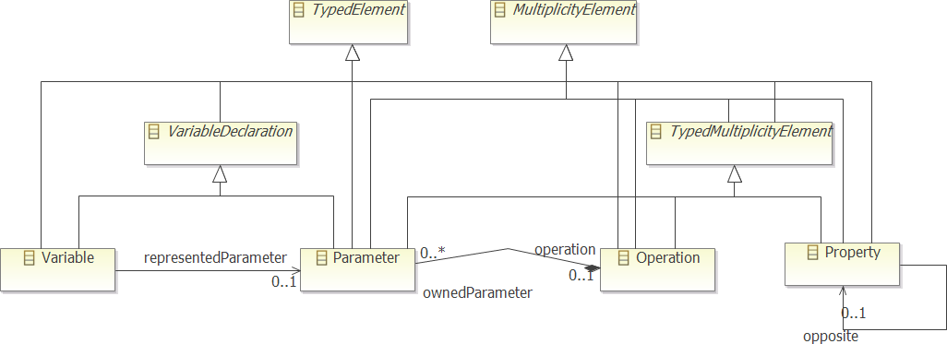
Example Merges
Extend UML meta-model
Variable Declaration
    used but not defined by OCL specification
TypedMultiplicityElement
    an implementation convenience

Slide 22
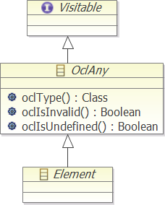
Root Merges
Visitable
  unmodelled interface
<T> T accept(Visitor<T>)
<T> T getAdapter(Class<T>)
OclAny
  UML: * generalises Element
  OCL: * conformsTo OclAny

Slide 23
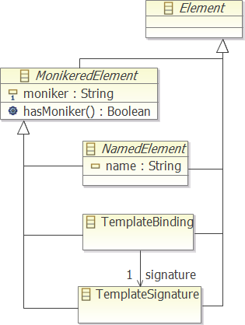
Monikers
  (a signature)
  globally unique
  consistent
    same moniker CST and ASG
      CST/ASG correlation
  hierarchical
  readable name
    debug
    xmi:id
  ?? immutable

Slide 24
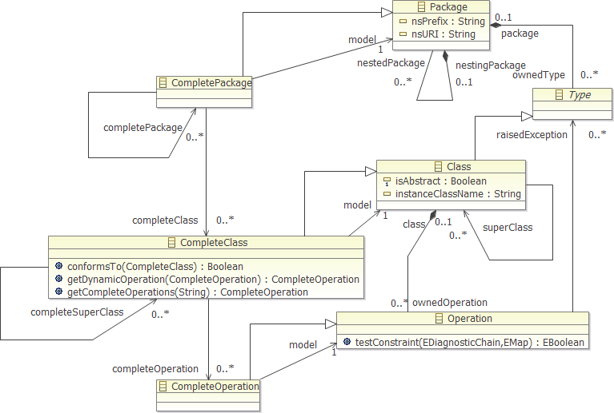
Complete Classes

Slide 25
Complete Types
OCL::Class
    immutable, same for everyone,defined by meta-model load
    e.g. has ownedProperties
OCL::CompleteClass extends OCL::Class
    mutable during load, varies between usages
    model refers to prototype Class
    (inherited) self.ownedProperties for merged properties
    self.model.ownedProperties for prototype properties
referredType is always to the shared OCL::Class
    Environment maps OCL:Class to OCL::CompleteClass

Slide 26
Complete Types At Work
All type references are to an OCL::Class
    unaffected by OCL merges
    can be shared across OCL applications
All type accesses mediated by Environment
    may map lazily to an OCL::CompleteClass
      additional merged features
      allOperations, allSuperClasses etc caches
    may map to the unchanged OCL::Class
      dominant no-change use case
Minimize overheads on trivial OCL queries
    only create Complete Classes on demand
    only populate a cache on demand

Slide 27
Overview
MDT/OCL Background, Evolution
Pivot Model
  solution to OMG Issues
  solution to Eclipse Problems
Some Pivot Details
Convergent Activity
  OMG specification consumability
  MDT/OCL implementation
API Ideas

Slide 28

OCL Specification/Implementation
OCL specification is incomplete
Xtext covers large parts of an implementation

Slide 29
OMG : Define OCL Grammars
OCL specification is incomplete
    LL or LALR exposition to demonstrate completeness
OCL specification is difficult to consume
    LL or LALR grammar could be consumable
    CST weaving is an implementation skill

Slide 30
OMG : Define UML-aligned Pivot
OCL specification is unrealizable
    Pivot model supports merges
OCL specification is not UML-aligned
    Pivot model is derived from UML by UML Package Merge
OCL specification is difficult to consume
    Pivot Model should be provided

Slide 31
OMG : Debug OCL Constraints
OCL are erroneous, never tool checked
    Constraints should be checked for syntax
    Constraints should be checked for semantics
    Constraints should be checked for function
OCL specification is difficult to consume
    Constraints should be provided in a model

Slide 32
MDT/OCL : Auto-validation
EMF 2.6 (Helios) supports OCL for validation
Relatively little needed to use OMG's OCL
    enhanced messages
[OCL to Java code generation for efficiency]

Slide 33
MDT/OCL : Enhanced Pivot
OMG's Pivot defined by UML Package Merge
Merging extra implementation is easy

Slide 34
MDT/OCL : Auto-analysis
OCL specification
    OCL: abstract syntax mapping
    OCL: synthesized/inherited attributes
    ~OCL: disambiguation rules
Potentially automatable
    research task

Slide 35
Overview
MDT/OCL Background, Evolution
Pivot Model
  solution to OMG Issues
  solution to Eclipse Problems
Some Pivot Details
Convergent Activity
  OMG specification consumability
  MDT/OCL implementation
API Ideas

Slide 36
APIs
Eclipse
New
Custom
EMF
OMG
Editor
Interaction
Parser
Interaction
EMF
Validation
EMF
Access
Debug
Debug
Evaluation
Meta-Model
Access
Editor
Lexer
Parser
CST
Analyzer
Validator
Pivot
AST
Evaluator
Syntax
Extension
Semantic
Extension
Pivot
Load
Model
Access
Library
Access
eInvoke
OCL
Grammars
OCL
OCL
Standard
Library
Model
Standard
Library
OCL
Standard
Library
Implementation
OMG potentially defines many of the building blocks
Eclipse platform provides some APIs
EMF provides many more
Remainder could be shared

Slide 37
Meta-Model APIs
Pivot Model defined by OMG specification
    standard Ecore implementation for tool usage
MDT/OCL adds/merges the Visitor/Adaptable API
    pre-Pivot: all OCL classes override accept(Visitor)
    post-Pivot: all (OCL) classes override accept(Visitor)
    post-Pivot: Visitor implements getAdapter
class XxxImpl ... {
<T> T accept(Visitor<T> v) {
return v.visitXxx(this);
}
}
EMF
Access
Pivot
AST

Slide 38
Evaluation APIs
AST Node Evaluation with EvaluationVisitor
    2 function call per node overhead: accept, visitXxx
    cf ~ 9 function call per node with Dresden OCL
      'Ecore'Switch is flexible but really inefficient
Meta-Model Access
    always a Pivot Model
Model Access
    mediated by EvaluationVisitor for simple values
    wrapped by a 'Collection'Adapter for complex values
Model Extent
    always a ResourceSet mediated by Model Access API
Evaluation
Debug
Debug
Meta-Model
Access
Evaluator
Model
Access
Library
Access

Slide 39
Standard Library API
Standard Library is an OMG-defined Pivot Model
    variant libraries are possible
MDT/OCL: one class per library feature
    simple binding/extensibility
    simple API: visitor, sourceValue, astNode
Object evaluate(EvaluationVisitor, Object, CallExp)
    deep inheritance hierarchy of common functionality
    sourceValue pre-determined for dynamic dispatch
Pivot
Load
Library
Access
Standard
Library
Model
Standard
Library
OCL
Standard
Library
Implementation

Slide 40
API Summary
If OMG (RTF representatives) provide
  consumable models
  run-time Pivot model
then many APIs are inherently
  EMF defined
internal APIs migrate to align with
  EMF-generated OMG UML, OCL meta-models
external APIs are small
  non-critical
  easily aligned

Slide 41
Summary
MDT/OCL originally focussed on Java API
Evolving to provide IDE
Exploiting modeling tools
  EMF, Xtext, Acceleo, QVTo, OCL
Pivot Model needed by OMG, Eclipse
  hides Ecore/UML
Opportunities for shared low-level APIs
  advanced tools more useful
[Contributions welcome]

