Slide 1
Enriching Your Models with OCL
Adolfo Sanchez-Herrera Barbudo, Open Canarias
Axel Uhl, SAP
Edward Willink, MDT/OCL Project Lead
Eclipse Summit Europe
3rd November 2010

Slide 2
Overview
Why and When OCL
Introduction to OCL
OCL within Eclipse
OCL Use Cases, coming soon
Serious OCL

Slide 3
How Much OCL?
None
  very simple modeling
  Java augmented modeling
A little
  OCL (and Java) augmented modeling
A lot
  OCL as a powerful formal specification language
    OMG's UML, OCL, QVT, ... specifications
  OCL as the foundation of a transformation language
  OCL as a portable implementation language

Slide 4
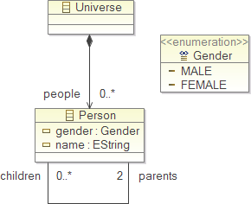
Simple Meta-Modeling
Graphics
  box
    Class, Enumeration
  compartment
    property, operation
  line
    association
  decoration
    composition, navigability
Text
  name, type, stereotype
  multiplicity
Example Family Tree Meta-Model
Ecore Diagram
(similar to UML Class Diagram)

Slide 5
Richer Meta-Modelling
Textual constraints
    exactly 2 parents
    MALE/FEMALE gender
Arbitrary constraints
  lowercase name
  1 MALE, 1 FEMALE parent
  not own parent

Slide 6
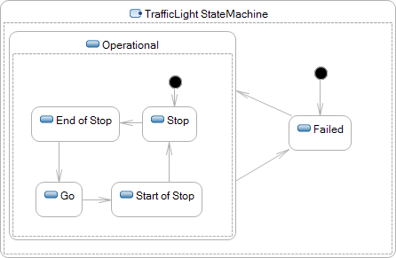

UML State Machines
Need to specify behavior
  amber when End of Stop or Start of Stop
  transition when signal received/time elapsed

Slide 7
UML Solutions
1.x Use your favourite programming language
  Ada/C/...
  magically inserted by proprietary code generator
2.x Use a neutral specification language
  the Object Constraint Language
    class invariants
    operation bodies, pre/post conditions
    property initial/derived values
    state machine guards/actions

Slide 8
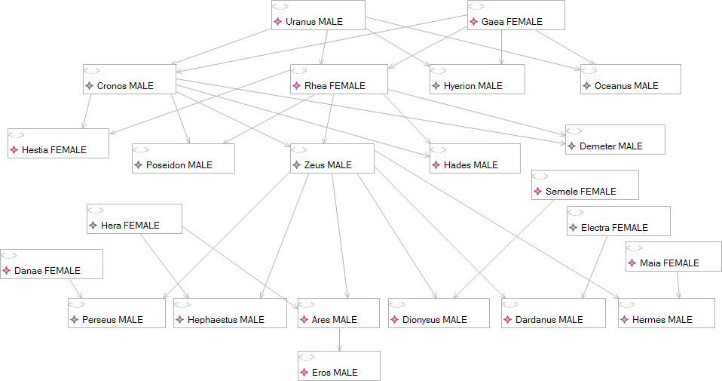
Example Family Tree Model
Simple GMF Diagram Editor

Slide 9
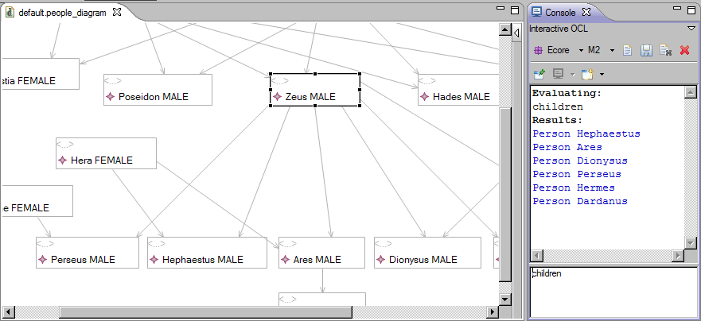
Simple Query
Window->Show View->Other... Console
Console: New: Interactive OCL
Select Zeus as the Model Context self (in any model editor)
Type children then carriage return

Slide 10
Language Principles
Declarative Constraint Language
All queries side-effect free
    no need to re-evaluate for same arguments
    no object/collection modification
    no assignment operation
Assertion of result is equivalent to assignment
result = 4
asserts that the result is equal to four
does not make the result equal four
an implementation may choose to do so

Slide 11

Primitive Types 1
    e.g. 3.14159
    nb unlimited, no float/double distinction
    e.g. -100, 0, 999
    nb unlimited, no byte/short/int/long/long long distinction
    non-negative integers
    for UML multiplicity upper bound
    e.g. 0, 10, 999, *
    nb unlimited with an additional 'infinity'

Slide 12

Primitive Types 2
    false, true
    e.g. 'this is a string'
    nb no defined \ policy in OCL 2.0, 2.2
    nb OCL 2.3 introduces Java-like \ policy (except octal)

Slide 13
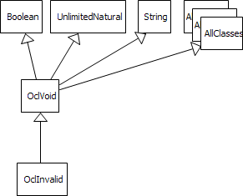
Bottom Types
singleton instance: null
    any value can be undefined
singleton instance: invalid
    any value can be an error

Slide 14
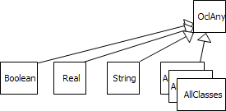
Top Type
Every user and OCL type conforms to OclAny
User-defined Types
    least derived types conform to OclAny
    OclVoid conforms to all most derived types
    self is the current object within an expression

Slide 15
Mathematical Operators
Infix: +, -, *, /
and, or, xor, implies
=, <>, <, >, <=, >= nb =, <>
Prefix: not, -
Operators: mod, div, max, min, ...

Slide 16
if ... then ... else ... endif

Slide 17
let ... in ...

Slide 18
Object Navigation
Properties
  self.name or name
  (cf. this.getName() or getName())
Operations
  self.toString() or toString()
  (cf. this.toString() or toString())

Slide 19
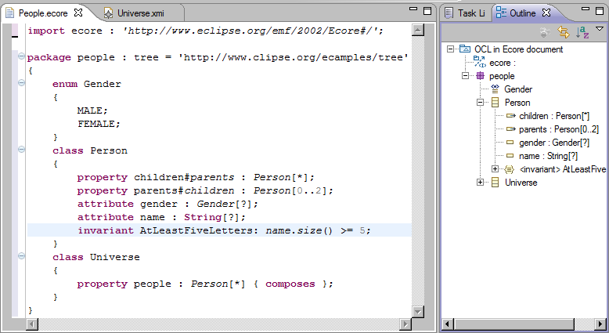
Validation Example
Name must be at least five letters

Slide 20
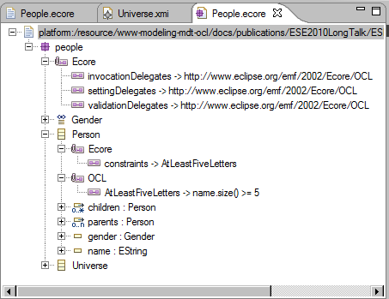
Validation in Sample Ecore Editor
OCLinEcore editor maintains EAnnotations automatically
OCLinEcore editor provides OCL syntax checking
OCLinEcore editor will provides OCL semantic checking

Slide 21
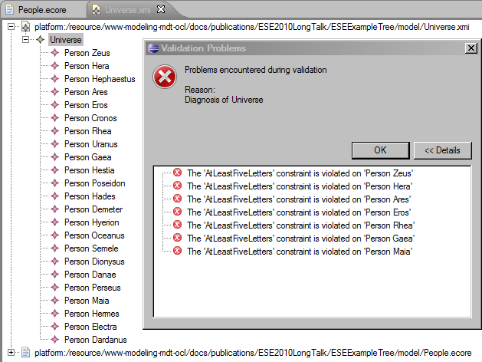
Example Validation Failure

Slide 22
Multiplicities and Collections
UML has multiplicities
    children : Person[*] {ordered,unique}
    parents : Person[2] {unique}
  multiplicities are specification concepts; not objects
Implementations (e.g. Ecore) reify multiplicities
    getChildren() returns a UniqueEList<Person>
  'many' properties have extra 'irregular' objects
    getName() setName(newName)
    getChildren().get(2) getChildren().add(newChild)

Slide 23
OCL 2.0
Collections partially reified as non-objects
[Objects (OclAny) are navigated with .]
Collections are navigated using ->
Collections are not objects.
Collections have useful operations.
Collections have very useful iterations.
 | Unordered | Ordered
Non-Unique | Bag | Sequence
Unique | Set | OrderedSet

Slide 24
Example Collection Operations
Collection::size() self.children->size()
Sequence::at(Integer) self.children->at(1)
    nb 1 is the first index, size() is the last
Collection(T)::including(T) : Collection(T)
    nb returns a new collection with added content
Collection(T)::includes(T) : Boolean
    tests existing content

Slide 25
Collection::select Iteration
children
    self.children
sons
self.children->select(gender = Gender::MALE)
self.children->select(child | child.gender = Gender::MALE)
self.children->select(child : Person | child.gender = Gender::MALE)
select(iterator : type | body)
    filters to select elements for which the body is true
reject(iterator : type | body)
    filters to reject elements for which the body is true
cf multi-line Java loop and anonymous function

Slide 26
Collection::collect iteration
children
    self.children
grandchildren
self.children->collect(children)
self.children->collect(child | child.children)
self.children->collect(child : Person | child.children)
collect(iterator : type | body)
    creates a new collection comprising all the bodies
cf multi-line Java loop (and anonymous function)

Slide 27
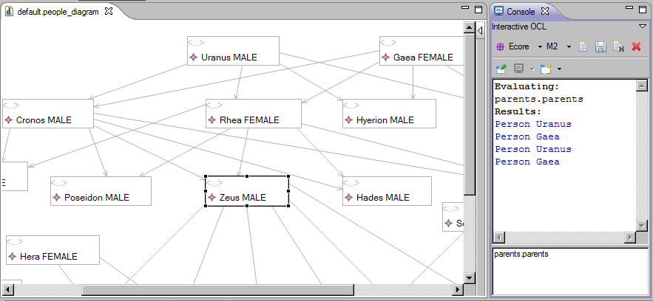
Implicit Collect Query
parents.parents = parents->collect(parents)
3 symbols, compared to 4 lines of Java
4 grandparents, but not all different!

Slide 28
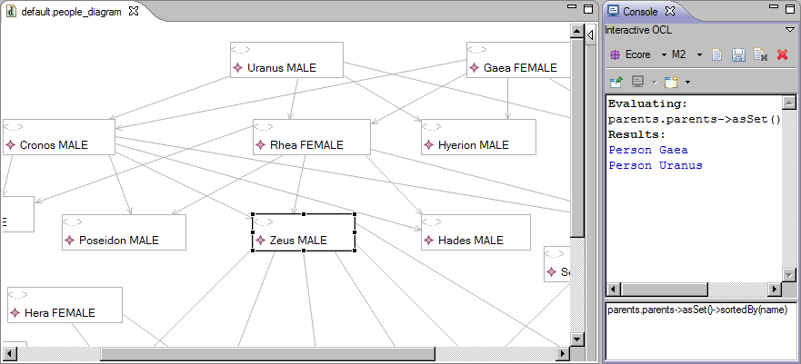
Cleaned up query
parents.parents->asSet()->sortedBy(name)
->asSet() converts Bag to Sequence, removes duplicates
->sortedBy(name) alphabeticizes

Slide 29
Implicit Collection Conversion
 | Object | Collection
. | Navigation | Implicit collect()
-> | Implicit Collection | Navigation
self->notEmpty()
  standard OCL idiom
    converts self (if an object) to a Collection of self
    if self is a defined object
      result is not empty - true
    if self is an undefined object (null)
      result is empty - false
    if self is an error (invalid)
      result is also an error - invalid

Slide 30
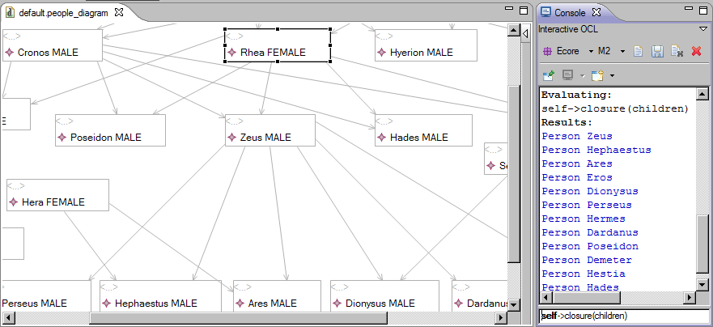
Collection::closure iteration
children, grandchildren, greatgrandchildren etc
self->closure(children)
Implicit collection of self, then closure of all children

Slide 31
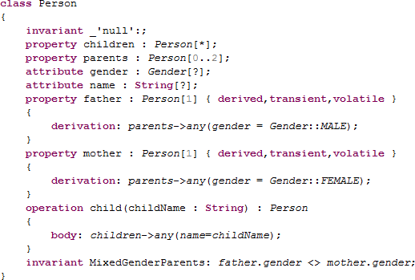
OCL for Implementation
any(x) iteration selects an arbitrary element for which x is true.

Slide 32
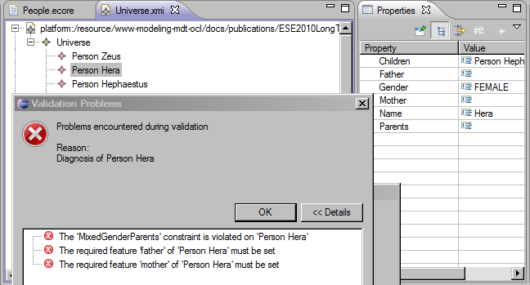
Derived Property Validation
In this case
invariant MixedGenderParents: father.gender <> mother.gender;
fails because father is null and mother is null

Slide 33
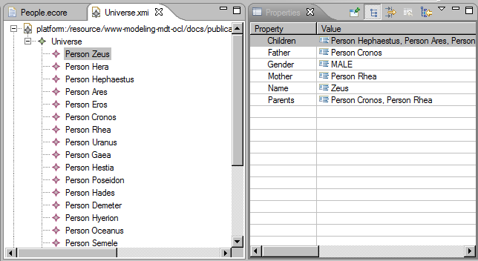
Example Derived Properties
NB. No Java code.

Slide 34
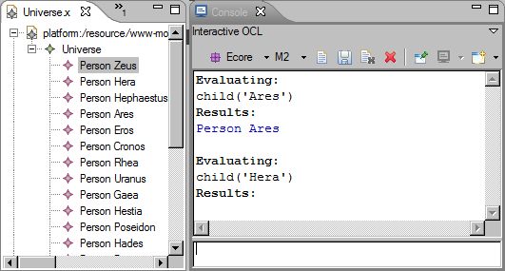
OCL Operation Evaluation
Powerful operation body - no Java code
Need to use Console to practice evaluations

Slide 35
OCL 2.2
Collections are objects!
    Collection conforms to OclAny
    no need for Collection/Object polymorphic operations
    Collections can mix Object/Collection content
    collections can be navigated with .
Oops!
    If collections are objects
    collections can be navigated with .
    But collections use . for implicit collect
    currently unresolved
    recommend do not use . for collection navigation

Slide 36
Other OCL Capabilities
Tuples
Association Classes/Qualifiers
@pre values
Messages

Slide 37
OCL Resources
OCL 2.2 Specification
    (http://www.omg.org/spec/OCL/2.2)
    Clause 7 is quite readable (many typos)
The Object Constraint Language:
Getting Your Models Ready For MDA
Jos B. Warmer, Anneke Kleppe

Slide 38
Eclipse MDT/OCL
Original code contribution by IBM
  Java callable API
    parse/evaluate OCL 1.x against Ecore meta-models
Eclipse evolution: MDT/OCL 1.x
  Ecore or UML meta-models
  OCL 2.0 (in so far as possible)
  example Interactive Console
Eclipse evolution: MDT/OCL 3.x
  example Xtext editors (Ecore only)

Slide 39
OMG OCL 2.x
Manual text entry
    inconsistent with models
    internally inconsistent
    examples never verified by tools
    OCL constraints never berified by tools
  autogenereate with Acceleo
Never really aligned with UML 2.x
    some serious oversights - function overloading
    some serious underspecifications - URIs
    some serious impossibilities - UML model modification
  clarify, introduce pivot evaluation-time meta-model

Slide 40
Validation History
Use of OCL to define model validation
Eclipse 3.2 EMF Validation Framework
    embed OCL in XML CDATA
Eclipse 3.3 EMF, OCL EAnnotations
    embed OCL in EAnnotation
    genmodel to integrate
Eclipse 3.6, EMF 2.6, OCL 3.0 Delegates
    embed OCL in EAnnotation
    EObject.eInvoke() for dynamic invocation
    OCLinEcore editor for semi-validated editing

Slide 41
OCLinEcore Editor
Install MDT/OCL 3.0 Examples
Select *.ecore
Open With->OCLinEcore editor
    Save As *.ecore - loses formatting and comments
    Save As *.oclinecore - text file preserves comments
Useful for plain Ecore too
    printable/reviewable text
    searchable/replaceable text

Slide 42
Complete OCL Editor

Slide 43
Meta-model Update
UML
meta-model
realizes
Ecore
meta-model
conformsTo
Model
My.uml
My.ecore
data.my
Edit UML/Ecore meta-model in UML/Ecore editor
    manual export/save of Ecore to workspace
Create Dynamic Instance/Load Model in editor
    validate/evaluate OCL constraints
EMF does not support meta-model mutation
    Model.eClass() reverts to an unresolved proxy
    must exit and re-enter model editor

Slide 44
Eclipse MDT/OCL Futures
3.1 Core (Indigo)
    minor maintenance
3.1 Examples (Indigo)
    new Ecore/UML blind pivot meta-model
    extensible modelled Standard Library
    Xtext editors
    super-compliant - anticipating OMG OCL resolutions
4.0 Core + Tools + Examples (Indigo+1)
    3.1 Examples promoted to Core or Tools
      preserved external APIs, siugnificant revision of internal APIs
    OCL to Java code generation

Slide 45
OCL Use Cases
 | Validate | Evaluate | Console | Editor
Static Java For Ecore | 1.0 | 1.0 | 1.0 Examples | 3.0 Examples
Static Java For UML | 1.2 | 1.2 | 3.1 Examples | 3.1 Examples
Complete OCL For Ecore | 3.1 Examples | 3.1 Examples | 3.1 Examples | 3.0 Examples
Complete OCL For UML | 3.1 Examples | 3.1 Examples | 3.1 Examples | 3.1 Examples
Embedded OCL in Ecore | 3.0 | 3.0 | 3.0 Examples | 3.0 Examples
Embedded OCL in UML | 3.1 Examples | 3.1 Examples | 3.1 Examples | 3.1 Examples
Released in Helios Example functionality in Helios
Example functionality in Indigo, release in Indigo+1

Slide 46
Beyond OCL
OMG OCL is a powerful expression language
  declarative, First Order Predicate Calculus/Logic
  model-oriented, UML navigation, multiplicites, ...
Why re-invent it?
  OMG QVT (M2M/QVTo, QVTd) uses OCL for M2M
  OMG MOFM2T (M2T/Acceleo) uses OCL for M2T
MDT/OCL used by
    M2T/Acceleo, M2M/QVTo, GMF, M2M/QVTd
MDT/OCL not used by
    M2M/ATL, GMT/Epsilon, GMT/VIATRA, Xtend

Slide 47
Serious OCL
Speed/size not a problem
    for small models, few constraints, single evaluations
Major concern for serious applications
Interpreted Evaluation is slow
    code generation
    efficiency
Re-Evaluation is slow
    impact analysis, selective re-evaluation
    representations, effective re-evaluation

Slide 48
OCL Evaluation
MDT/OCL evaluation is doubly interpreted
  Java interpreted by JVM
  OCL interpreted by Java
  OCL Interpreter uses Visitors
    2 function calls per AST node in MDT/OCL
    cf. 9 function calls for EcoreSwitch in Dresden OCL
  OperationCallExp visit is very inefficient
  Slightly hard to extend for QVTo, Acceleo
  OCL within genmodelled Java is just a String
    non-trivial first time parsing costs

Slide 49
Evaluation Enhancements
Model-defined Standard Library
    easily extensible, OCL configurable
    one class per library feature
    efficient OperationCallExp visit
OCL to Java Code Generation
    eliminate many visit overheads
    inline/flattened evaluation
    OCL parsing to genmodel pure Java in *Impl.java
    .... iteration strategy optimisations
Expect 100-fold speed up

Slide 50
Re-Evaluation
Axel's slides

Slide 51
Summary
MDT/OCL originally focussed on Java API
Interactive Modeling Tools require OCL IDE
  EMF, Xtext, Acceleo, QVTo, OCL enable OCL
Extensibility required by QVTo, Acceleo
Efficiency required for serious use
IDE starting to appear
  Console, Editors
Expect/Demand much more
Contributions welcome

