Slide 1

Fast, Faster and Super-Fast Queries
István Ráth
EMF-IncQuery lead
VIATRA2 committer
Budapest University of Technology and Economics
Edward Willink
Eclipse MMT co-lead
Eclipse OCL lead
Eclipse QVTd lead
Eclipse QVTo committer
OMG OCL 2.4 RTF chair
OMG QVT 1.2 RTF rep
OMG UML 2.5 FTF rep
EclipseCon Europe, Ludwigsburg
23rd October 2012

Slide 2


Overview
Queries and Technologies
Fast OCL queries
  OCL to Java code generation
Faster OCL queries
  OCL Virtual Machine
Super-fast queries
  faster than Java
  optimized re-evaluation
Summary

Slide 3
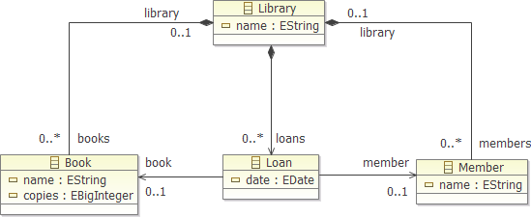

Example
Query
Ecore metamodel
Ecore model
Query
  result derived by computation on model
class Library {
List<Pair<Book, Member>> overdueReport(Date today) {
List<Pair<Book, Member>> results = new ArrayList<Pair<Book, Member>>();
for (Loan loan : library.getLoans()) {
if (loan.getDate() < today) {
results.add(new Pair<Book, Member>(loan.getBook(), loan.getMember()); }
}
return results;
}
}
EMF Java to produce overdue Book+Member report

Slide 4
Query Technologies
Increased abstraction/portability
Technology | Data model | Query language | Expressive power | Execution
SQL | RDBMS | SQL | Tuple relational calculus | Compiler
XML/XPath | XML documents | Xpath expression language | Tree path expressions | Interpreter
SPARQL | RDF | Graph pattern based logical queries (SPARQL) | Tuple relational calculus | Interpreter, compiler
OCL (active) | EMF,... | OCL Expression | Powerful functional language | Interpreter, compiler
EMF Query (mature) | EMF | SQL-like | Simple queries (subset of SQL) | Interpreter
EMF Query2 (incubation) | EMF | SQL-like | Simple queries (subset of SQL) | Interpreter with index
EMF-IncQuery (incubation) | EMF | Graph pattern based logical queries (IQPL) | Tuple relational calculus + extras (comparable to OCL) | Interpreter, compiler
Xtend (active) | EMF | Xbase Expression | Extended Java | Compiler

Slide 5
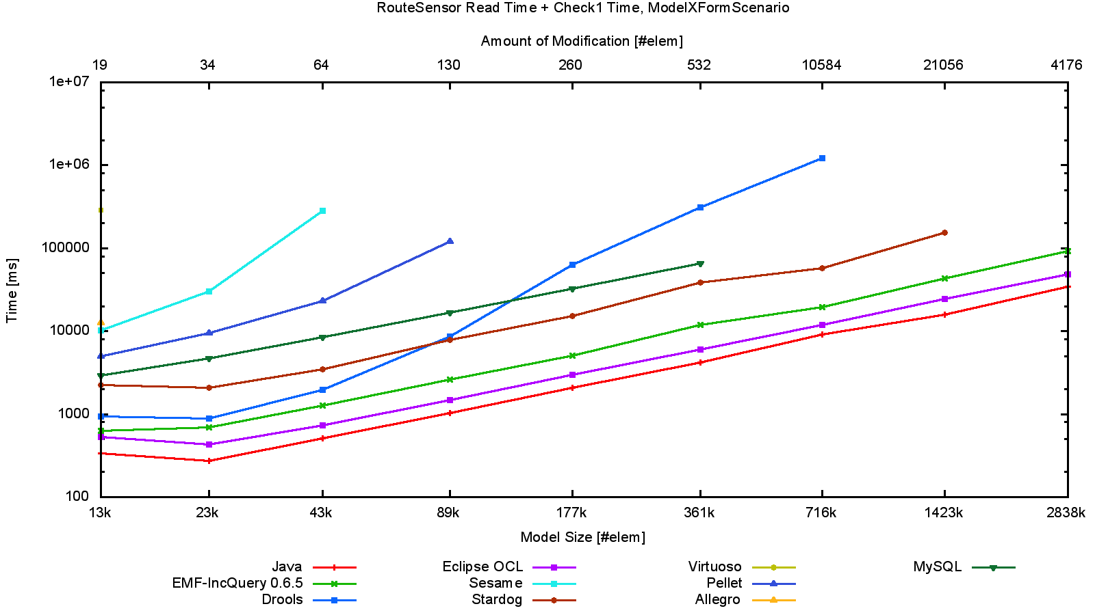
Batch Evaluation Time vs Model Size
Model query performance
evaluation by
model validation
In order of increasing performance:
- SPARQL tools
- MySQL
- top Eclipse tools (OCL, EMF-IncQuery)
- hand-optimized Java
One order of magnitude (10x)

Slide 6
Complete OCL
Complementary document
  extra operations/properties/invariants
  existing meta-model unaware of the complements
Pre-Indigo: no OCL editing support
  Java API for many years
  only useable in custom applications
Indigo: Xtext editor
Juno: Load Complete OCL Resource...
  Xtext/Ecore/UML can be complemented

Slide 7
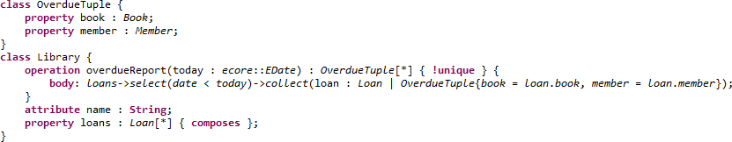

Embedded OCL
Pre-Helios: no OCL editing support
  manual XML editing of CDATA and EAnnotations
Helios: Xtext OCLinEcore editor
  automates EMF Delegate EAnnotations entry
  OCL source embedded in EMF's Java
    automatically executed by OCL interpreter
Juno: OCL to Java code generator
    automatically executed by EMF genmodel

Slide 8
Fast OCL execution
@Generated NOT manual Java (pre-Helios)
EMF Delegates support EAnnotations (Helios)
Direct OCL 2 Java (Juno)
Ecore Model
genmodel
Java File/Class
run
@generated NOT
Ecore Model
Java File/Class
run
parse
interpret
EAnnotation
genmodel
run
some_ocl
some_ocl
Ecore Model
Java File/Class
(Impl)
Java File/Class
(OCL bodies)
EAnnotation
run
genmodel
call
some_ocl

Slide 9
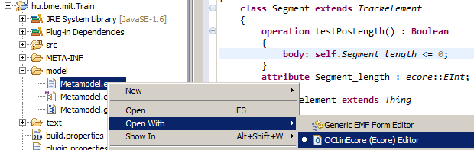
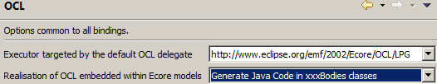

Useable OCL
Step 1, Add OCL to Ecore
Step 2, optionally enable Code Generation
    Window->Preferences->OCL
Step 3, Generate Models

Slide 10
Fast OCL Execution Support
Fast Control
  Acceleo templates tree-walk at compile-time
Fast Values with OCL semantics
    1 is always equal to 1.0 (Java: only sometimes equal)
    unlimited integers (Java: unchecked 32/64 bit wraparound)
  Polymorphic Values
Fast Operations and Properties
  Polymorphic feature implementation API
Fast Reflection, Metamodel access
  auto-generated dispatch table view of metamodel

Slide 11
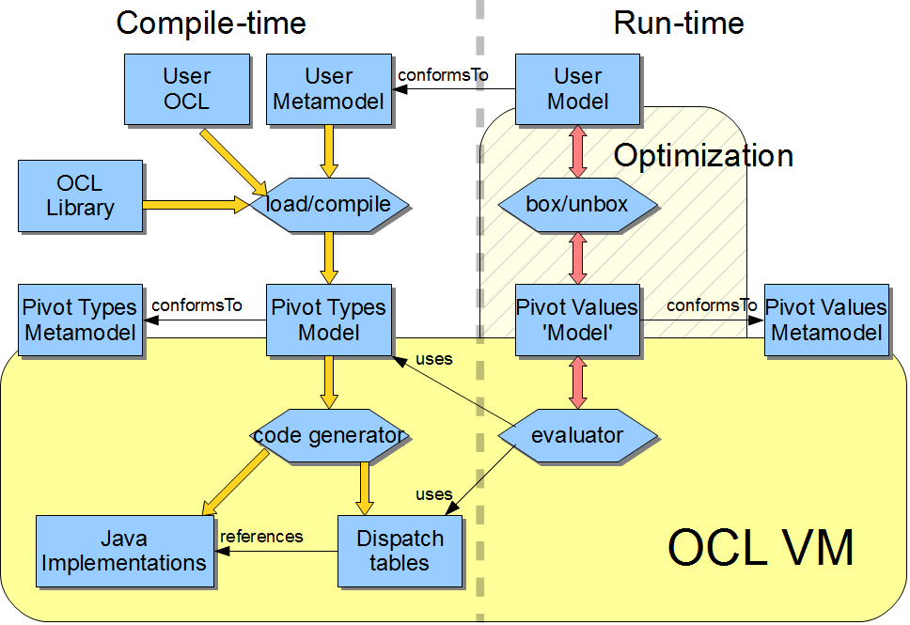
The Eclipse OCL VM

Slide 12
Is the OCL VM Faster?
Fast Control, Values, Operations, Reflection
Juno Code Generator performance
  no run-time parsing costs - good
  subsequent speed similar - really disappointing
Investigation
  eGet("XXX") costly
    code generate as getXXX saves 30%!
  fully polymorphic values are very costly
    every collection is copied
    every collection element is wrapped by a 'box' object

Slide 13
Smart Code Generation => Faster
Partial value polymorphism
    EMF collections used directly
    only Integer, Real and EClass objects wrapped/boxed
  static analysis eliminates instanceof costs
    redundant polymorphic dispatch eliminated
Kepler M3 is 3 to 29 times faster than Juno
Still To Do
    deeper analysis of invalid/null
    operation inlining, CSE, ...

Slide 14
Faster, Extensible OCL Evaluation
OCL evaluation is just a tree walk over the AST
  interpreter visits tree nodes directly at run time
  compiler pre-visits tree nodes at compile time
Extended languages add extra AST classes
  extra visitor methods
  same evaluation process
  same debugging requirements
OMG extended languages
  QVTc, QVTo, QVTr, MOFM2T (Acceleo)

Slide 15
Real systems
Simple systems - full evaluate once
  just need efficient evaluation
Real systems
  evaluate [small-change re-evaluate]*
Naive Java full re-evaluation costly
    e.g. Xtext substantially reconstructs intermediates
    reliable hand-coded incremental update error-prone
Intelligent re-evaluation is selective
    declarative exposition gives reliable incremental update

Slide 16

Imperative Java / Declarative OCL
Java: imperative expressions with side effects
    difficult/impossible to analyze large programs
      many methods may change some field
OCL: declarative side-effect free expressions
    programs can be analyzed
      all changes occur outside the program
Program analysis
  supports correctness proofs
  supports efficient re-evaluation
    only re-evaluate those areas affected by changed input
  OCL Impact Analyzer
    Provides real benefits for Juno users (see later)

Slide 17
EMF-IncQuery: Pattern queries
OCL expressions: Model-based evaluations
    Constraint - returns true/false
    Query - returns one or more values/objects
IncQuery Patterns: Additional Abstraction
    Query - returns a tuple of matching objects
    Constraint – an annotated query
  objects in source model
    constrained by instance type
    constrained by inter-relationships
    constrained by arbitrary subqueries (attribute constraints as Xbase expressions)

Slide 18
Pattern example
pattern OverdueBooks(P: Member, B:Book)
{
Loan(L); // declaration optional due to type inference
Loan.book(L,B);
Loan.member(L,P);
Loan.date(L,D);
check({
var today = new java.util.Date()
return today.after(D)
});
}
Incremental example 2
today becomes tomorrow
  all comparisons previously returning true re-evaluate
  some OverdueBooks matches change
  < full-revaluation
Incremental example
a book is renewed
  one due date changes
  one OverdueBooks match changes
  << full-re-evaluation
B
L
P

Slide 19


Benchmarking
Goal: to assess query performance of EMF-based tools
Methodology
  Use small (<1000 EObjects), medium (10-100k EObjects) and very large instance models (up to 2.8M EObjects)
Benchmarking loop (measure memory usage throughout)
  Load model (measure model initialization time)
  Evaluate queries (measure evaluation time)
  Modify model (measure modification time)
  Re-evaluate queries (measure re-evaluation time)
Technical details
  http://viatra.inf.mit.bme.hu/publications/trainbenchmark
  http://viatra.inf.mit.bme.hu/performance
Batch validation
(Incremental) revalidation

Slide 20
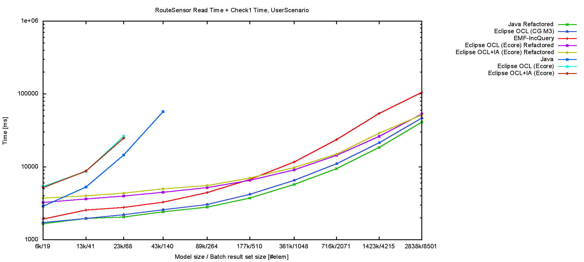
Batch Validation Reprise
OCL(+IA) performance
significantly impacted by
query specification (.allInstances)
Same effect for „naive“ Java code
Top Eclipse tools
(OCL, EMF-IncQuery)
within close range of
hand-optimized Java

Slide 21
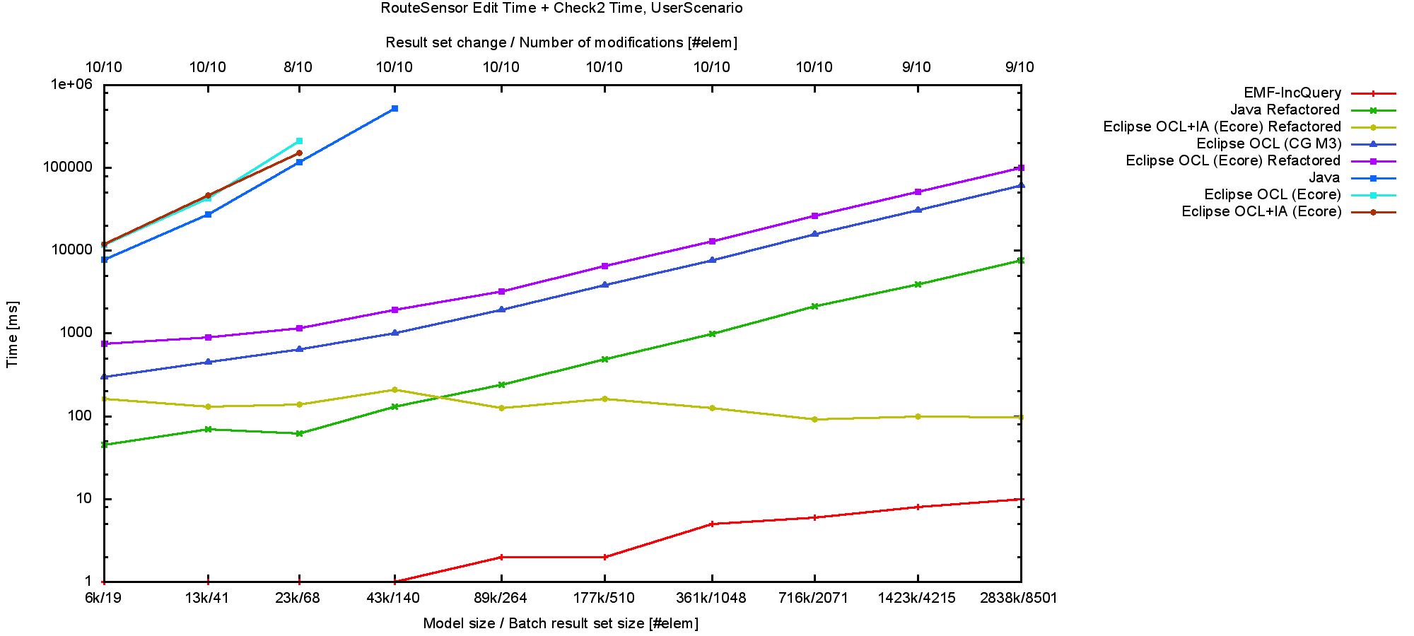
Re-validation
OCL+IA and EMF-IncQuery
are characteristically faster
than hand-optimized Java
Both provide nearly constant
re-evaluation performance
IA can significantly improve
OCL performance for revalidation
EMF-IncQuery 10x-100x
faster than IA
One order of magnitude (10x)

Slide 22
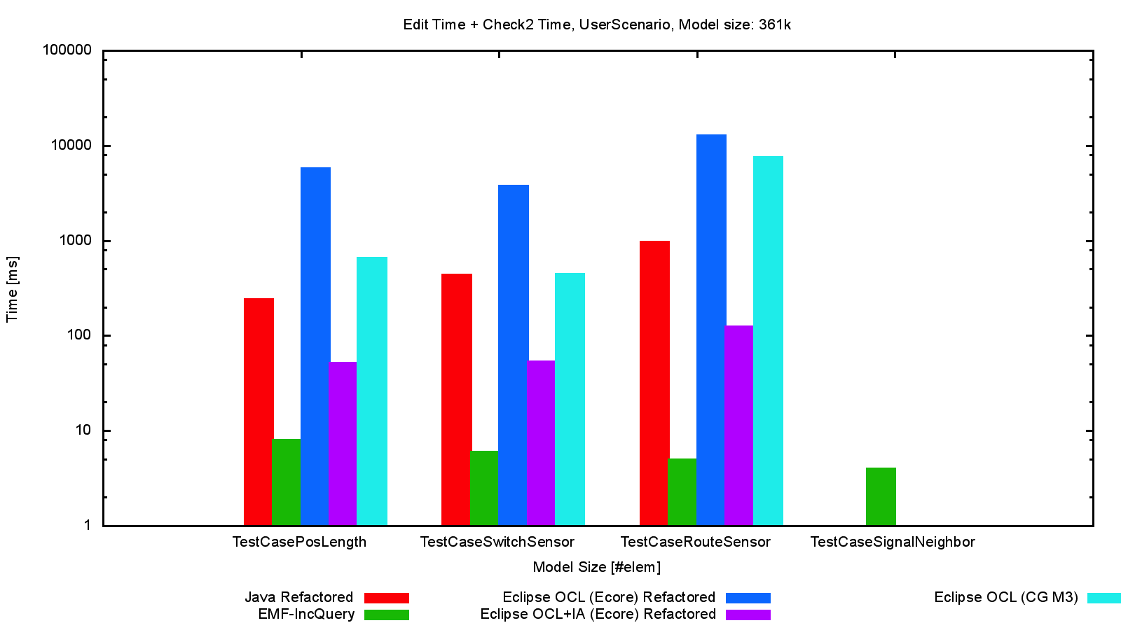
Comparing rule "difficulty"
EMF-IncQuery provides top
performance regardless of
query complexity
OCL(+IA) performance prone
to degradation for complex queries
and/or use of .allInstances()

Slide 23
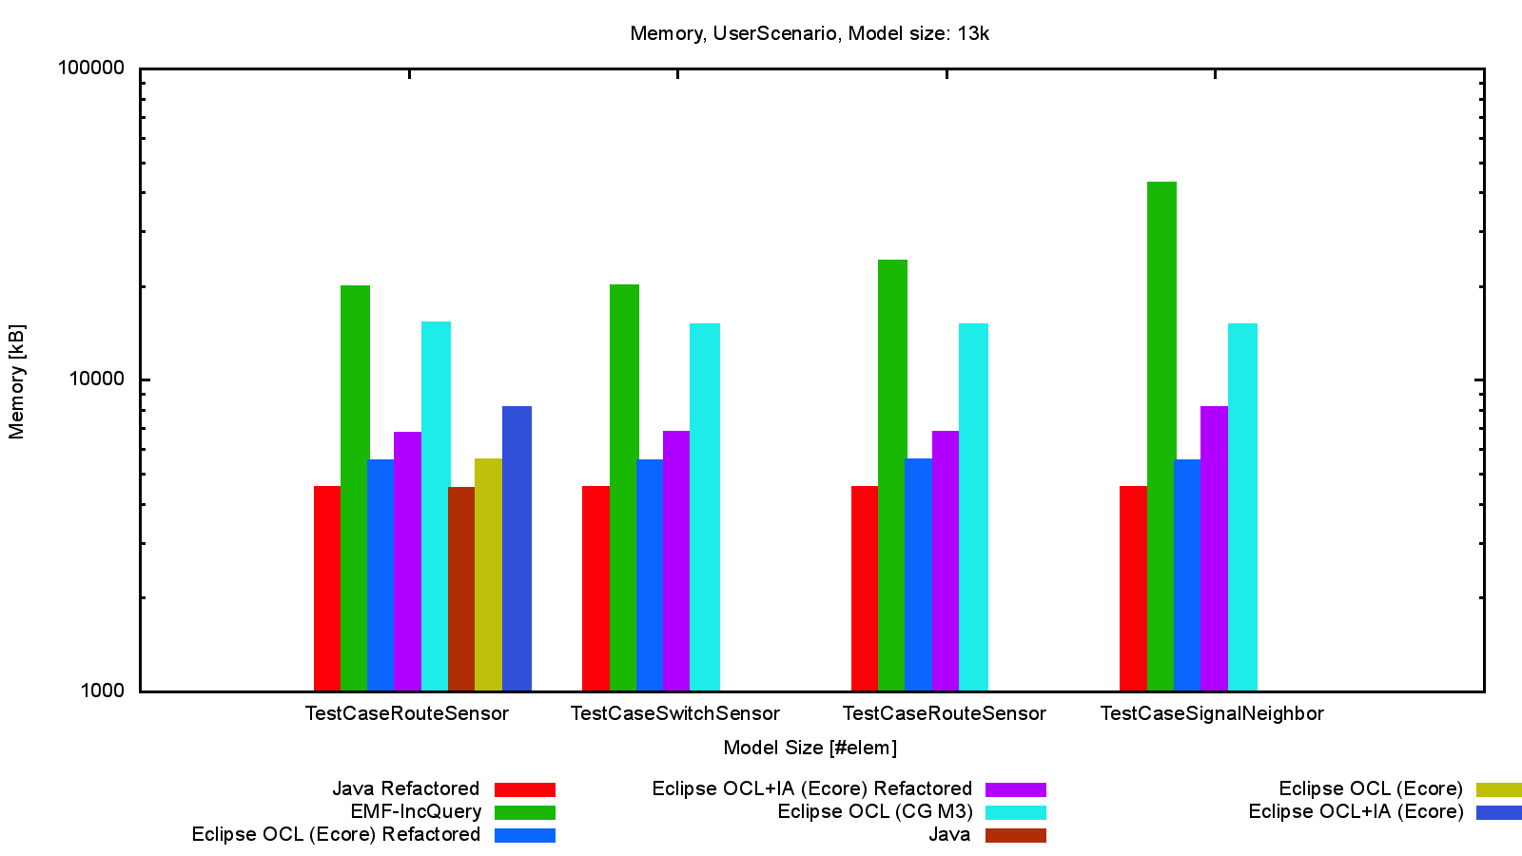
The cost of speed

Slide 24
Super-fast queries
Today in Juno
  OCL+IA can reduce re-evaluation times significantly
  EMF-IncQuery (coming soon to Modeling)
    Provides top performance regardless of model size and query complexity (much faster than OCL+IA and handwritten Java)
    New 0.6.7 release (works with 3.7.x+) available today from http://viatra.inf.mit.bme.hu/incquery and the Marketplace
Future
  Synergies between EMF-IncQuery and OCL(+IA)

Slide 25
Summary
Fast
  direct OCL to Java code generation
Faster
  efficient OCL Virtual Machine dispatch tables
  ongoing optimizations
Super-fast
  declarative (re-)evaluation can be optimized with EMF-IncQuery and OCL+IA
  much faster than naive Java and OCL

Slide 26
Unused slides

Slide 27
Xcore and friends / OCL
If all you want is Java
  use Xcore/Xbase not OCL
OCL is a Specification language -
  platform neutral
Sharper syntax
  much of it adopted by Xbase
Declarative
  side effect free, no assignment
Foundation for MOFM2T(Acceleo), QVT, ...

Slide 28
OCL Code Generator
Acceleo templates
  flexible, extensible
  eliminates run-time parsing costs
Run-time speed not significantly faster
  polymorphic, accurate, UML-aligned
Juno 2012, pivot-based code generator
  Acceleo OCL to Java templates
  eliminates run-time compilation
    not significantly faster

Slide 29
OCL Evaluation Principles
root
AST Tree walk
  root to if to ...
AST node per usage
  IfExp
  VariableExp
  IntegerLiteralExp
Extensible
  Polymorphic AST nodes
  auto-generated Visitor (faster than Ecore Switch)
if
condition
then
else
a
referred
Variable
a
(ref)
1
0
if a then 1 else 0 endif

Slide 30
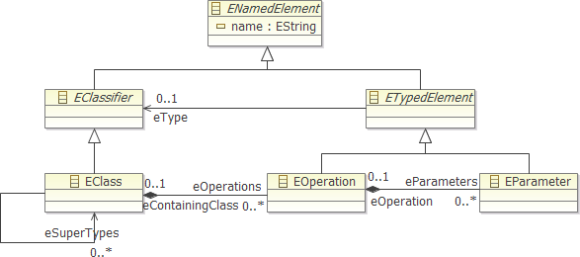
'Ecore' Operation Call : a.b(c,d)
Tree search over type and supertypes --- a
  Linear search for operation name --- b
    Linear search to match argument types --- (c,d)
      Tree search for conformant type/supertype --- c then d
Select best unique match

Slide 31
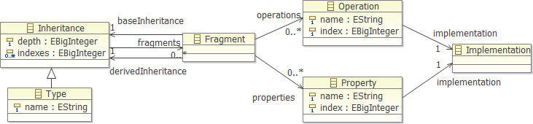
'OCL VM' Operation Call
Fragment provides derived view of base
  may have overloaded entries
Linear search of fragments at required depth
  Direct index to operation

Slide 32
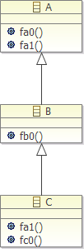
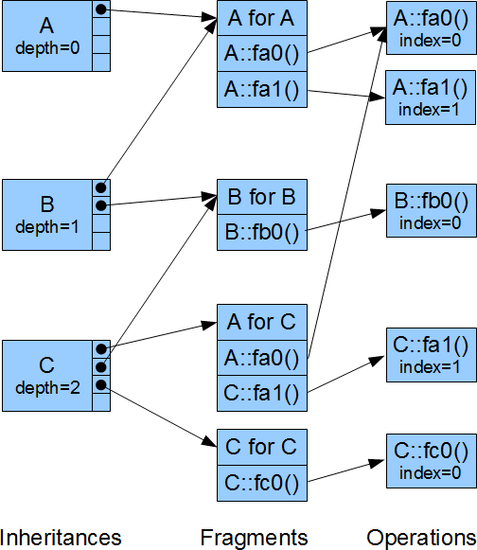



Example OCL VM dispatch
Problem
  fa1() for a C
Compile-time
  A::fa1
  depth 0, index 1
Run-time
  C
  A is depth 0
    A for C
  A::fa1 is index 1
    C::fa1
let c : C in c.fa1()

Slide 33
OCL Virtual Machine => Faster
Non-polymorphic values bad
[org.eclipse.ocl.ecore since at least Europa]
    Boolean, String, Integer ...
    difficult/impossible to have precise OCL semantics
Fully polymorphic values bad
[org.eclipse.ocl.examples.pivot since Indigo]
    BooleanValue, StringValue, IntegerValue ...
  too many boxing/wrapping objects
Partially polymorphic values also bad
    Boolean, String but IntegerValue ...
  too many instanceof tests

Slide 34
Simple Interpreted OCL VM
Program is an Abstract Syntax Graph (AST)
  VariableExp
    references variable to read as a value
  PropertyCallExp
    references object and property to read as a value
  OperationCallExp
    references operation to apply to some values
Run-time Interpretation
  tree-walking evaluation visitor
Extensible with new AST node classes

Slide 35
Code Generated OCL VM
Program is an Abstract Syntax Graph (AST)
Compile-Time Code Generation
  tree-walking code generating visitor
Run-time Execution
  direct Java, direct model accesses
Extensible with new AST node classes
Optimisable
  direct model access getXX() rather than eGet('XX')
  inlining of non-polymorphic (final) operations

Slide 36
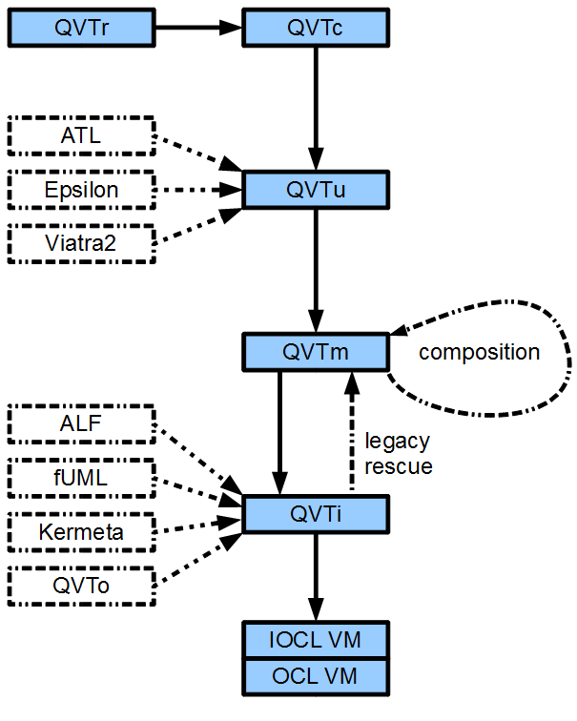
(Imperative) OCL VM for QVT
Simple OCL VM
  AST walker
  QVT richer AST
Code generated VM
  dispatch tables
  flattened code
  inlined operations
Debugging tools

