Slide 1
OCL Integration and Code Generation
Edward Willink
(Eclipse MMT co-lead)
Eclipse OCL lead
Eclipse QVTd lead
Eclipse QVTo committer
OMG OCL 2.4 RTF chair
OMG QVT 1.2 RTF chair
OMG UML 2.5 FTF rep
EclipseCon Europe, Ludwigsburg
29th October 2013

Slide 2


Overview
OCL overview
OCL in Ecore
  code generation
OCL in Xtext
OCL in UML
OCL in Papyrus
OCL in QVT
  code generation
Summary

Slide 3

OCL Overview
Executable specification language
  used for the hard bits of UML, ...
  simple model ops
    if self <> null then self.name else 'no-self' endif
  powerful collection operations
    self.children->isUnique(name)
Side effect free
    contributes to strong analysis and optimisation
Useless
    needs a model providing environment

Slide 4
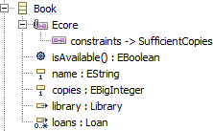
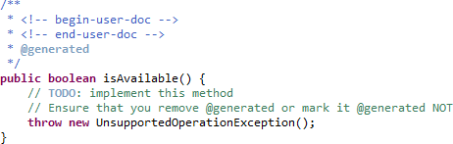
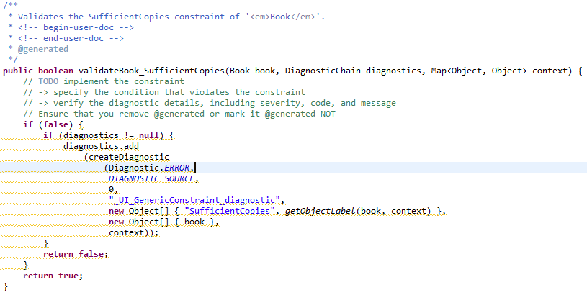
Out Of The Box EMF Code Generation

Slide 5
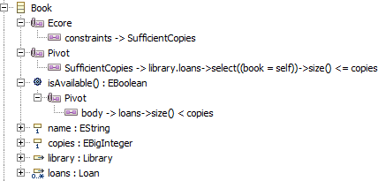
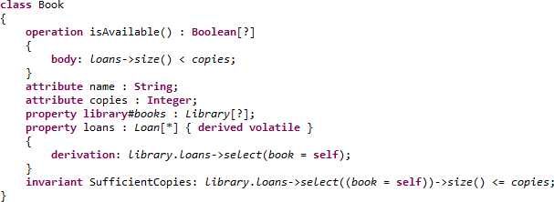
OCLinEcore editor for OCL Delegates

Slide 6
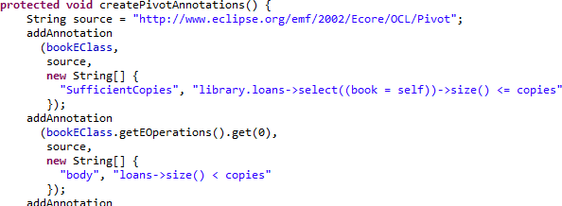
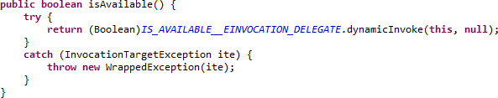
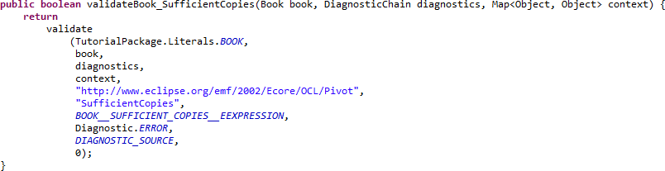
OCL Delegates EMF Code Generation

Slide 7
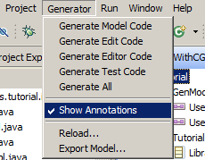
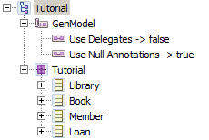
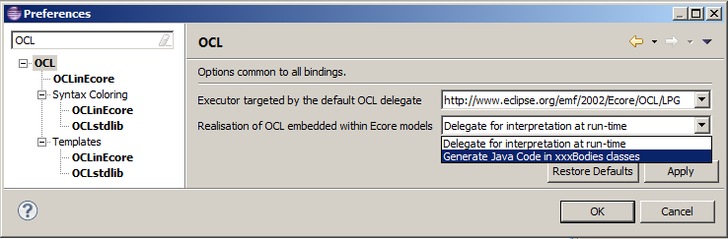
OCL to Java GenModel Options

Slide 8
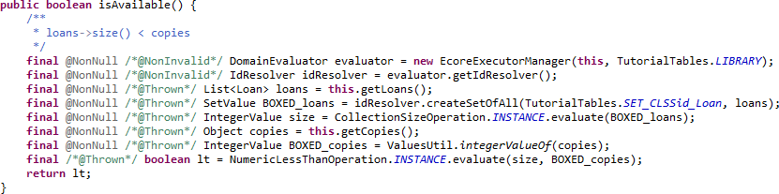
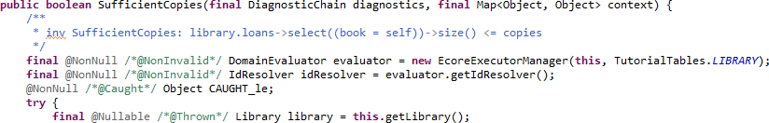
OCL to Java EMF Code Generation

Slide 9
OCL to Java Dispatch Tables
EMF XXXPackageImpl
  hierarchy of EClass objects
    multi-dimensional searches for types/parameters
OCL to Java XXXTables
  flat tables
    constant time lookups

Slide 10
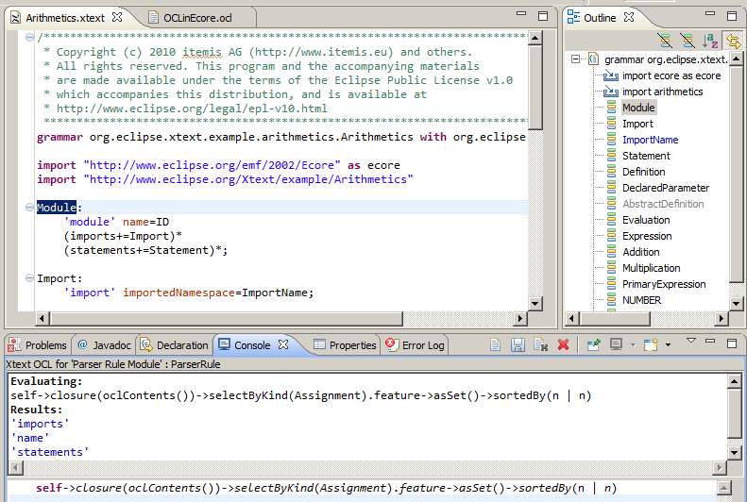
Xtext Integration

Slide 11
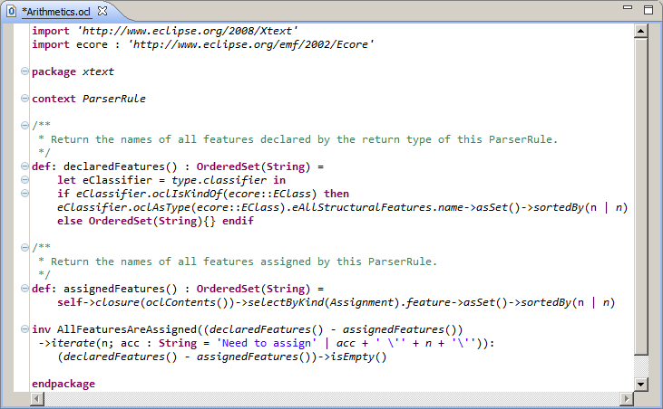
Xtext Integration - OCL Document

Slide 12
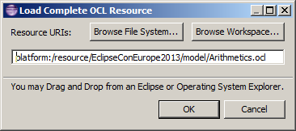
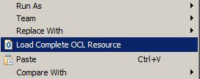
Xtext Integration - OCL Loading
Wherever selection is convertible to EObject
  EObject ==> ResourceSet
    Sample Ecore Editor
    Outlines
    Xtext editors (including Xtext)
    UML editors
  load additional Complete OCL Resource
    ResourceSet-specific EValidator.Registry add-on

Slide 13
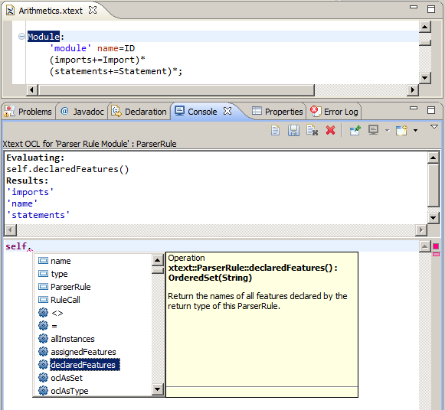
Xtext Integration - OCL Helpers
Auto-Content Assist
Comments from declaration

Slide 14
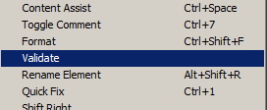
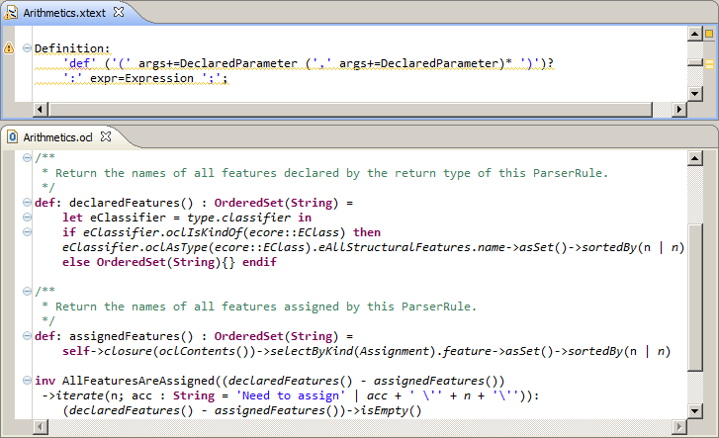
Xtext Integration - OCL Invariants
Invariants support debug/style rules
Extra operations to aid navigation

Slide 15
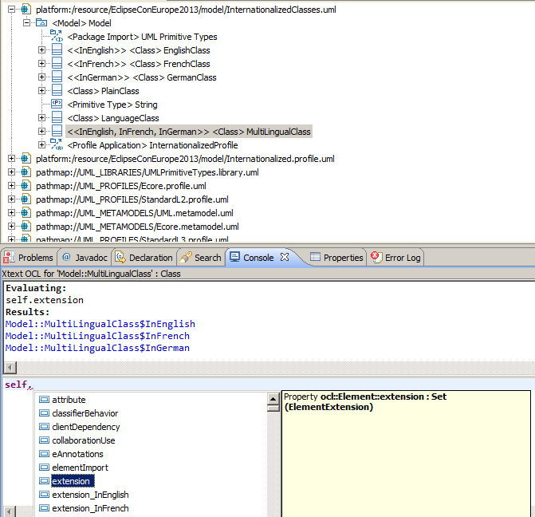
UML Integration

Slide 16
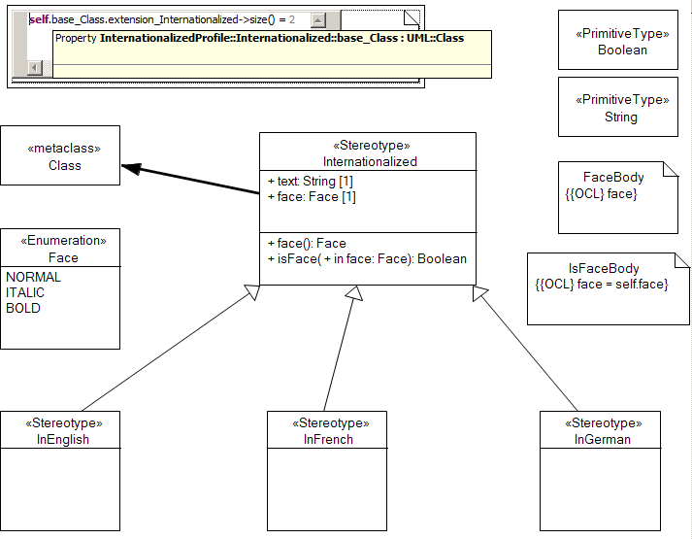
Papyrus Integration

Slide 17
UML+OCL to Java
Helios, Indigo, Juno
  OCL in UML exported with obsolete namespace
Kepler
  namespace fixed (invariants, operations)
    OCL delegates or OCL to Java code generator
  properties in progress
Papyrus
  quite tricky to get right
  needs a UI Wizard

Slide 18
OCL to Java 'for everything'
Currently
  Abstract Syntax validation rules
  QVT declaration code generation
Work In Progress
  UML 2.5 embedded OCL
    avoid need to retranscibe manually
  Name lookups
  Concrete Syntax to Abstract Syntax mappings
Future
  OCL-defined code can be incremental

Slide 19
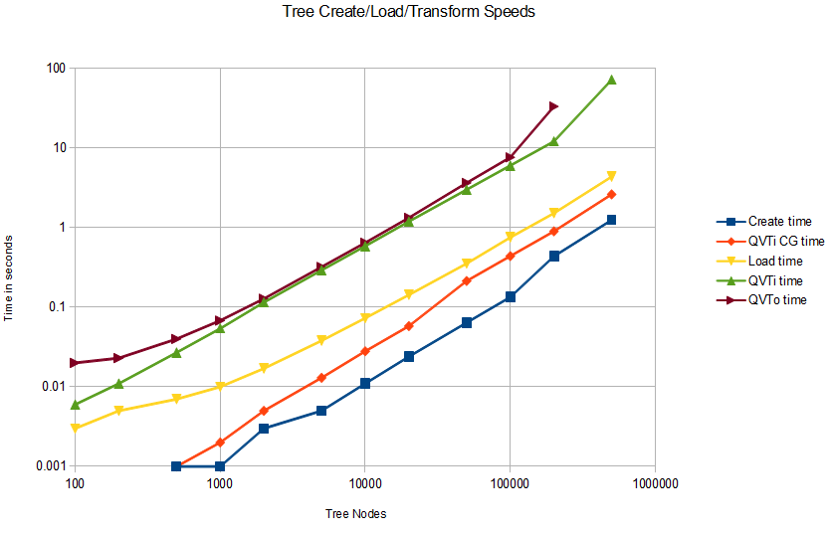
QVTi Preliminary Performance
20x

Slide 20
Summary
OCL useless by itself
Increasingly useful with IDE
  model tools (Xtext), UML, Papyrus
Increasingly acceptable with Code Generation
  ? QVTi is the first Eclipse MtoM CG

