Slide 1
An extensible OCL Virtual Machine and Code Generator
Edward Willink
Eclipse MMT Component co-Lead,
Eclipse OCL Project Lead,
Eclipse QVTd Project Lead,
Eclipse QVTo Committer,
Nomos OMG 2nd OCL 2.4 RTF Chair,
Nomos OMG QVT 1.2 RTF Representative,
Nomos OMG UML 2.5 FTF Representative
OCL 2012 @ MODELS 2012
30th September 2012

Slide 2


Overview
OCL Reality check
OCL Execution Principles
    motivation
    status
OCL Execution Practice
    what's easy
    what's hard
Solutions
    what's slow ...
Summary

Slide 3



UML Today
Currently UML 2.4.1 - should be really good
  But [Wilke/Demuth,OCL2010]
      47% of OCL is missing
      58% of OCL is syntactically/semantically wrong
  Functional utility unknown
    never executed - only manually transcribed
UML 2.5 - major simplification/improvement
      less OCL missing - major new complex additions
      '0'% of OCL is syntactically/semantically wrong
  Functional utility unknown
    must use in real tools

Slide 4
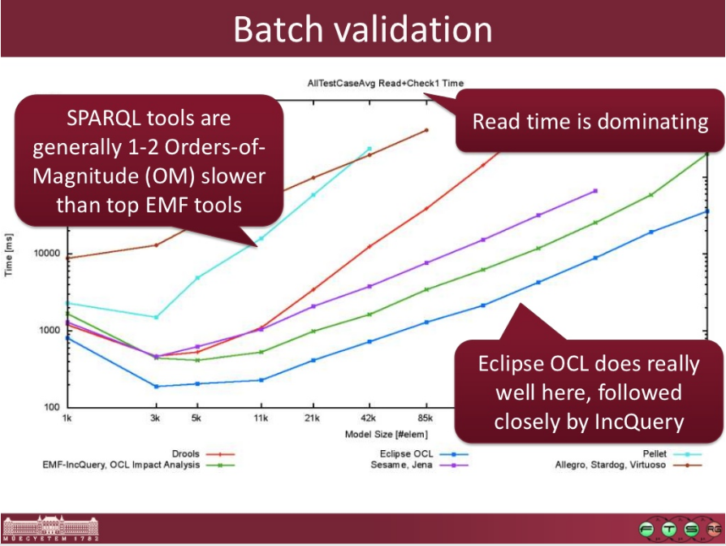
Query Execution
From: High-performance model queries, Benedek Izsó, Zoltán Szatmári, István Ráth

Slide 5
Eclipse OCL execution is interpreted
obviously unsuitable for heavy usage
  surely code generation could be better
OCL:
self.feature >= 0
Java:
this.feature >= 0
Obvious solution: OCL is rather like Java
  use Java for functionality, EMF for models
Potentially 500 times faster using obvious Java
  naive code generator only 3 or 4 times faster
Approach | Time | Availability
Direct Ecore interpreter | 72 ms | ..., Juno
Pivot Value interpreter | 88 ms | Indigo, Juno
Pivot Value code gen | 22 ms | Juno
'Java' code gen | 0.13 ms | <manual>

Slide 6


OCL Execution challenges
Datatype equality by value
    3.0 = 3 Set{3.0, 3}->size() = 1
Unbounded integers and reals
    32 or 64 bits may not be enough
4-valued logic
    null/invalid everywhere
Extensible types
    Any type (including OclAny) may have user-defined features
Model access
    properties, dynamic operation dispatch for extensible types
OCL Type System
    oclIsKindOf, oclType, allInstances ...

Slide 7
Obvious solution's assumptions
OCL: self.feature >= 0 Java: this.feature >= 0
  self not invalid
  self not null
  self.feature not invalid
  self.feature not null
  this.feature numerically compatible with 0
    e.g both Long
  >= not overloaded for self.feature
Simple efficient solution is semantically unsound
    difficult to retrofit all required corrections
Try to make semantically sound efficient

Slide 8

Pivot Values
Java boxes int etc as Integer
    uniform Java Object behaviour
Pivot Values box int etc as IntegerValue
    uniform OCL Value behaviour
Everything is a polymorphic Value
  BooleanValue, StringValue, NullValue, InvalidValue
  IntegerValue supports equality/growth
      IntIntegerValueImpl, LongIntegerValueImpl, BigIntegerValueImpl
  CollectionValue, TupleValue ...
  ObjectValue adapts particular Object
      EObjectValue, XMLObjectValue, ...

Slide 9
Value representation tradeoffs
Direct Java Object values
    no boxing overheads
    incorrect semantics, equality, growth, null, invalid
      careful adjustment of all semantic deviations
Boxed Pivot Values
    significant boxing overheads
      every collection element is individually boxed
    correct semantics
Pivot approach is accurate
  relative speed benchmark-dependent
    good for bulk numerics e.g. Fibonacci series
    bad for bulk objects e.g. collection size/contains

Slide 10
Hybrid Value Approach
Hybrid Object values
    box only when Java semantics is wrong
      unboxed Boolean, String, EObject
      boxed Integer, Real, Collection, Tuple
    non-trivial instanceof if trees
As accurate as Pivot
    relative speed still benchmark-dependent
      semantic correction / boxing / instanceof testing
Static analysis can prune instanceof trees
    only a few instanceof cases possible
      Boolean incompatible with String (unless static type is OclAny)
    invalid often impossible; not persistable; not gettable
    null can be ill-formed with [1..n] multiplicity

Slide 11
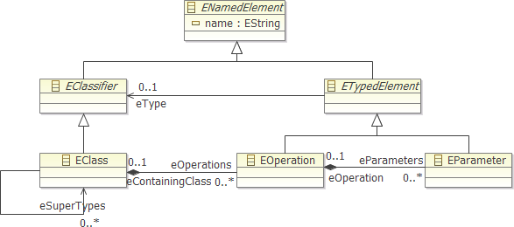
'Ecore' Operation Call : a.b(c,d)
Tree search over type and supertypes --- a
  Linear search for operation name --- b
    Linear search to match argument types --- (c,d)
      Tree search for conformant type/supertype --- c then d
Select best unique match

Slide 12
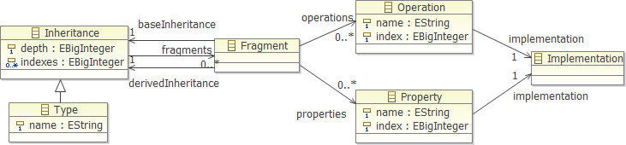
'OCL VM' Operation Call
Fragment provides derived view of base
  may have overloaded entries
Linear search of fragments at required depth
  Direct index to operation

Slide 13
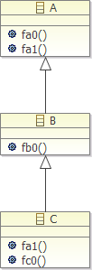
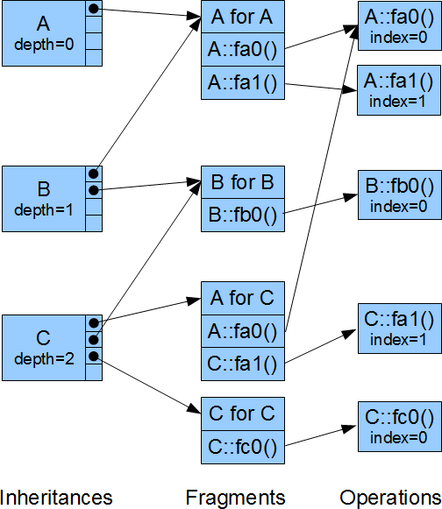



Example OCL VM dispatch
Problem
  fa1() for a C
Compile-time
  A::fa1
  depth 0, index 1
Run-time
  C
  A is depth 0
    A for C
  A::fa1 is index 1
    C::fa1
let c : C in c.fa1()

Slide 14
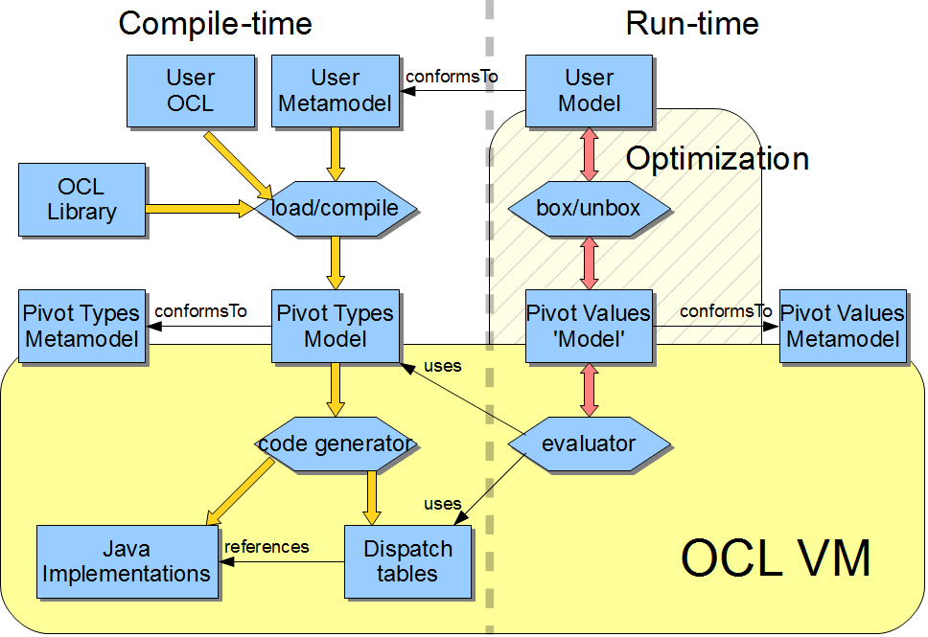
The Eclipse OCL VM

Slide 15
Simple Interpreted OCL VM
Program is an Abstract Syntax Graph (AST)
  VariableExp
    references variable to read as a value
  PropertyCallExp
    references object and property to read as a value
  OperationCallExp
    references operation to apply to some values
Run-time Interpretation
  tree-walking evaluation visitor
Extensible with new AST node classes

Slide 16
Code Generated OCL VM
Program is an Abstract Syntax Graph (AST)
Compile-Time Code Generation
  tree-walking code generating visitor
Run-time Execution
  direct Java, direct model accesses
Extensible with new AST node classes
Optimisable
  direct model access getXX() rather than eGet('XX')
  inlining of non-polymorphic (final) operations

Slide 17
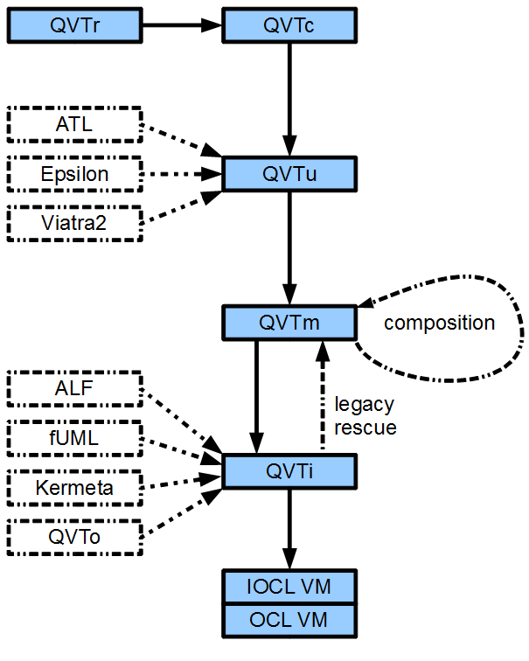
(Imperative) OCL VM for QVT
Simple OCL VM
  AST walker
  QVT richer AST
Code generated VM
  dispatch tables
  flattened code
  inlined operations
Debugging tools

Slide 18
Summary
OCL Evaluation
  necessary to progress UML's OCL development
  Eclipse OCL comparatively fast but dreadfully slow
OCL not quite the same as Java
OCL VM
  polymorphic pivot values give accuracy
  code generator
    efficient dispatch tables - pivot types, operations
    naive execution flow
  ongoing execution flow optimization
  foundation for QVT and other Tx languages

Slide 19
UML 1.0 to UML 2.4.1
UML infrastructure
    re-useable
    many pick and choose re-useable packages
UML superstructure
    graphical detail
    more pick and choose packages
  Massive (ill-specified) package merge
  two large manually produced specifications
  information in many places
  infrastructure has never been re-used

Slide 20
UML 2.5 (UML Simplification)
'No change' to meta-model
  Single specification
    No package merge
      Each class is in just one place
    Includes Diagram Interchange
  Normative models
      approximately 50% of specification auto-generated (XSLT)
      approximately 50% MS Word editorial content
  Intense review
embedded OCL checked with Eclipse OCL
  'no' syntax errors, 'no' semantic errors
  ?? functional errors

Slide 21
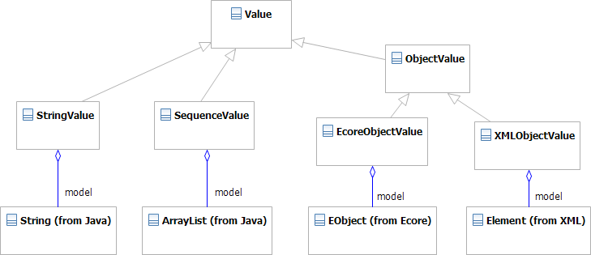
OCL Object Values in Java
ObjectValue can be polymorphic
  an indirection to a real Object representation
Foundation for a Java binding for OCL

Slide 22
Dispatch comparison
Direct Ecore
  potentially 6D search
    all super classes
    all operations
    all parameters
    all super classes again
OCL VM Dispatch tables
  1D search over width of inheritance tree
    usually 1, sometimes 2 or 3 steps

Slide 23
Auto-generated to ...Tables.java
private static final ExecutorOperation[] _Integer__Real = {
OCLstdlibTables.Operations._Integer___mul_ /* _'*'(OclSelf) */,
OCLstdlibTables.Operations._Integer___add_ /* _'+'(OclSelf) */,
OCLstdlibTables.Operations._Integer__0__sub_ /* _'-'() */,
OCLstdlibTables.Operations._Integer__1__sub_ /* _'-'(OclSelf) */,
OCLstdlibTables.Operations._Integer___div_ /* _'/'(OclSelf) */,
OCLstdlibTables.Operations._Real___lt_ /* _'<'(OclSelf) */,
OCLstdlibTables.Operations._Real___lt__eq_ /* _'<='(OclSelf) */,
OCLstdlibTables.Operations._Real___lt__gt_ /* _'<>'(OclSelf) */,
OCLstdlibTables.Operations._Real___eq_ /* _'='(OclSelf) */,
OCLstdlibTables.Operations._Real___gt_ /* _'>'(OclSelf) */,
OCLstdlibTables.Operations._Real___gt__eq_ /* _'>='(OclSelf) */,
OCLstdlibTables.Operations._Integer__abs /* abs() */,
OCLstdlibTables.Operations._Integer__compareTo /* compareTo(OclSelf) */,
OCLstdlibTables.Operations._Real__floor /* floor() */,
OCLstdlibTables.Operations._Integer__max /* max(OclSelf) */,
OCLstdlibTables.Operations._Integer__min /* min(OclSelf) */,
OCLstdlibTables.Operations._Real__round /* round() */,
OCLstdlibTables.Operations._Integer__toString /* toString() */
};
private static final ExecutorFragment[] _Integer =
{
Fragments._Integer__OclAny /* 0 */,
Fragments._Integer__OclComparable /* 1 */,
Fragments._Integer__OclSummable /* 1 */,
Fragments._Integer__Real /* 2 */,
Fragments._Integer__Integer /* 3 */
};
private static final int[] __Integer = { 1,2,1,1 };
static final ExecutorProperty[] _NamedElement = {
PivotTables.Properties._Element__Comment,
PivotTables.Properties._Element__Constraint,
PivotTables.Properties._NamedElement__isStatic,
PivotTables.Properties._NamedElement__name,
PivotTables.Properties._NamedElement__ownedAnnotation,
PivotTables.Properties._Element__ownedComment,
PivotTables.Properties._NamedElement__ownedRule
};

Slide 24

genmodel integration
OCL Examples & Editors Genmodel Adapter
  .../XXXTables.java
  .../bodies/*Body.java
  .../impl/*Impl.java
  MANIFEST.MF needs manual edit
    depends on org.eclipse.ocl.examples.library
Provided
  Global OCL Preference
    "Realisation of OCL embedded in Ecore models" set to "Generate Java code in xxxBodies classes"
  No "http://www.eclipse.org/OCL/GenModel" GenAnnotation
    with"Use Delegates" set true

