Slide 1
Re-engineering Eclipse MDT/OCL for Xtext
Edward D Willink
MDT/OCL Project Lead
Eclipse Modeling Project
MODELS 2010
Workshop on OCL and Textual Modeling
3rd October 2010

Slide 2
Overview
Eclipse MDT/OCL evolution to use Xtext
Xtext impact
Xtext/LPG performance comparison
Xtext-mandated changes of approach
Xtext-motivated revisions

Slide 3
MDT/OCL Evolution
reuse by
QVT, MOFM2T
Custom Standard Library
Pivot Meta-Model
realisability
OCL spec
Missing OCL Meta-Models
Correct OCL Meta-Models
Java API
OCL expressions
compliance
OCL spec
Complete OCL Meta-Models
Standard Library Editor
validation
OCL spec
Essential OCL Editor
Complete OCL Editor
OCL in Ecore Editor
useability
editors/evaluators
Evaluator

Slide 4
Adding Editors to MDT/OCL
First attempt used basic SWT framework
Second attempt used IMP
    re-uses existing LPG LALR parsers
    inherited realisation of editing idioms (highlighting)
Third attempt uses Xtext
    requires migration to LL parser (ANTLR)
    inherited modeled generation of editing idioms
    modeled generation of syntactical constructs
Contrast old LPG+IMP with new Xtext approach

Slide 5
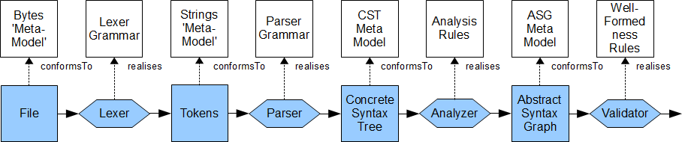
Basic Parser Architecture
Lexer: Text -> Tokens
Parser: Tokens -> CST Nodes
Analyzer: CST Nodes -> ASG Nodes
Validator: ASG Nodes -> Diagnostics
[OCL is complex: CST very different to ASG]

Slide 6
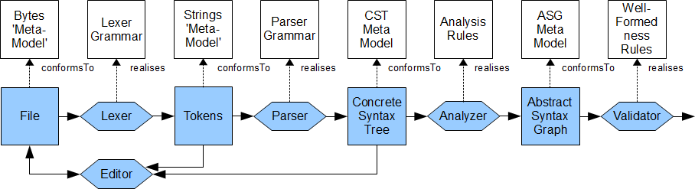
LPG Parser with IMP Editor
Manual provision of
  2 lexer grammars and 1 parser grammar
  parser action code to populate CST
Auto-generation of
  lexer, LALR parser

Slide 7

Xtext Parser and Editor Support
Manual provision of
    combined parser grammar
    optional CST meta-model
Auto-generation of
    lexer, LL parser, and analyzer framework
    editor with rich model-driven features
Validation using CHECKS language or Java

Slide 8
LPG Action Code
CollectionRange: 1..10
CST access woven into code
    not checked till Java compiled/run
Significant and repetitive actions
    fragile policies, casts, magic numbers
CollectionRangeCS ::= OclExpressionCS '..' OclExpressionCS
/.$BeginCode
CollectionRangeCS result = CSTFactory.eINSTANCE.createCollectionRangeCS();
result.setExpressionCS((OCLExpressionCS)getRhsSym(1));
result.setLastExpressionCS((OCLExpressionCS)getRhsSym(3));
setOffsets(result, (CSTNode)getRhsSym(1), (CSTNode)getRhsSym(3));
setResult(result);
$EndCode
./

Slide 9
Xtext 'Action Code'
CollectionRange: 1..10
CST woven into grammar
  declarative: checkable / generateable
No code
In practice, two productions can be merged
CollectionRangeCS ::= expressionCS=OclExpressionCS '..'
lastExpressionCS=OclExpressionCS
CollectionLiteralPartCS ::= expressionCS=OclExpressionCS
('..' lastExpressionCS=OclExpressionCS)?

Slide 10
Cross-references
PathName A::B::c
LPG - cross-reference is an unresolved String
  left recursion
Xtext - cross-reference is a resolved EObject
  No code, CST Declarations woven into grammar
  EObject Reference Declarations woven into grammar
  =, += and ?= CS assignments
  (), *, +, ? BNF operators
pathNameCS ::= Identifier
/* Code not shown */
pathNameCS ::= pathNameCS '::' Identifier
/* Code not shown */
pathNameCS returns PathNameExpCS:
(namespace+=[Namespace|Identifier] '::')*
element=[NamedElement|Identifier];

Slide 11
Cross-reference impact
Cross-reference requires analysis
  to locate the Namespace for an Identifier
Xtext provides a default scope resolution
OCL defines explicit Environment lookup
pathNameCS returns PathNameExpCS:
(namespace+=[Namespace|Identifier] '::')*
element=[NamedElement|Identifier];

Slide 12
Performance : Grammar Size
Simple examples
  Xtext line count is three times smaller
MDT/OCL 3.0.0 implementation comparisons
  Similar real application, similar editorial style
  Xtext at least 5 times smaller
    and it autogenerates an editor too
Line counts | LPG 2.0.17 | Xtext 1.0.0
Lexer grammars | 251 | 395
Parser grammar | 1485
Templates | 1000 | library
Java support | 1040+library | library
Total | ~2800 | ~400

Slide 13
Performance : Parser Size
MDT/OCL 3.0.0 implementation comparisons
Similar grammar
Xtext about 10 times larger
  different grammar generated for editor
    extra completion assist functionality
  another 1MB
class file sizes | LPG 2.0.17 | Xtext 1.0.0
Lexers and Parsers | 221 kB | 2370 kB
Semantic analysis | excluded | excluded
Total | ~220 kB | ~2400 kB

Slide 14
Performance : Speed
350 line Complete OCL example (Royal & Loyal)
MDT/OCL 3.0.0 implementation comparisons
  Similar real application, same example
  Xtext about 11 times slower
Time in milliseconds | LPG 2.0.17 | Xtext 1.0.0
First parse | 1800 | 4800
Files read for first parse | 2 | 6
Average of 100 reparses | 97 | 1114
Files read for reparse | 1 | 1

Slide 15
Performance: Summary
Xtext is 5 times smaller source size
  fundamental technology advance
  massive ergonomic gain
Xtext is 10 times larger classes sizes
Xtext is 11 times slower execution
  Xtext 1.0.0 is not perfect
    maybe better in Xtext 2.0
  use of ANTLR and LL is not fundamental
    maybe a conversion to LALR is appropriate
  size, at least, very sensitive to grammar approach

Slide 16
Left Recursion
LALR uses left recursion extensively
ANTLR can only right recurse, but in Xtext
  recursion replaced by repetition
multiplicativeCS ::= unaryCS
multiplicativeCS ::= multiplicativeCS '*' unaryCS
...
multiplicativeCS ::= multiplicativeCS '/' unaryCS
...
multiplicativeCS: unaryCS (('*'|'/') unaryCS)*;

Slide 17
Lookahead in OCL
a->b(c,d could be
a->b(c,d|e an IteratorExpCS
a->b(c,d,e an OperationCallExpCS
[iterator names (e.g. b) are not reserved/known]
Difficult, inelegant to disambiguate with LALR(1)
    compile time integrity check
Must use backtracking in LL
    Xtext hides any ANTLR checking
    use an LALR copy for checking

Slide 18
Flexible operation parsing 1
Concrete Syntax parsed as a larger language
ID ('.'|'->') ID '('
(expr (':' type)?
(',' expr (':' expr)?)*
(';' expr)*
('|' expr (',' expr)*)?
)?
')'
a.b(c=5:d,e;f|g,h) is parsed successfully
  a semantic rather than syntactic error

Slide 19
Flexible operator parsing 2
OCL 2.0 and 2.2 (and QVT) change precedences
  different grammars
  one larger flexible grammar
infixOp ::= 'and'|'or'|'xor'|'implies'|'+'|'*'....
prefixOp ::= 'not'|'-'
expr ::= unary (infixOp unary)*
unary ::= (prefixOp)* atomic
all operators parsed with equal precedence
    'standard' library defines precedence, associativity
    semantic analysis uses 'standard' library
5 fold reduction in ANTLR class sizes
    solves 65536 byte class size limit

Slide 20
Summary
Xtext facilitates an IDE for Eclipse MDT/OCL
Xtext does many things very well
Xtext cannot emulate all traditional approaches
  Xtext seems to have a better way
Xtext motivates a major rethink

Slide 21
Active OCL Participation
Eclipse/Modeling/MDT/OCL
OMG OCL 2.3 RTF
Mariano Belaunde
(France Telecom)
chair
Edward Willink (Thales part-time)
lead
Adolfo Sánchez-Barbudo Herrera (Open Canarias)
2 others
IBM, NIST, SAP, Fujitsu
Borland, 88Solutions
Open Source
Individual participation
Original code from IBM
maintained by IBM until 2009
(Christian Damus)
Intellectual Property checks
Open Specification
Corporate participation

Slide 22
OCL Specification-driven
Make OCL specification consumable
  useable complete lexer/parser grammar
  useable/accurate analysis/validation constraints
Model-driven analyzer framework
OCL-driven validation

Slide 23
OCL-driven validation
Eclipse Helios adds Validation Delegate support
  OCL can be embedded in Ecore annotations
  OCL is then executed during model validation
    this works in Xtext
Add a validation reason to Complete OCL
Add OCL to Java code generation
  avoid performance penalties
context MyClass
inv UpperCaseName
('\'' + name + '\' is not uppercase in ' + toDiagnostic())
: name.toUpperCase() = name

