Slide 1
Eclipse OCL for Juno
Edward Willink
Eclipse OCL Project Lead
OMG OCL RTF chair
EclipseCon 2012 Modeling Symposium
Reston, VA
26th March 2012

Slide 2


Overview
Background
  why OCL
Embedded OCL
  OCLinEcore editor
  OCL 2 Java code generation
Complementary OCL
  Complete OCL editor
  Load Complete OCL Resource
Summary

Slide 3
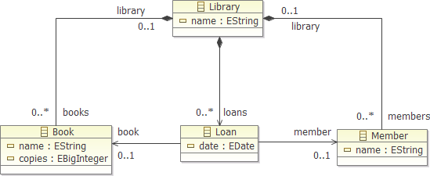

Basic Modeling
Class Diagrams / Entity Relationship Diagrams
  structural modeling
    packages, classes, features/properties, operation names
Easy with EMF / Ecore Diagram / ....

Slide 4
Enriched Modeling in EMF
Richer modeling
  derived features
    constants only in EMF
  operation bodies
    signature only in EMF
  class constraints / invariants
    name only in EMF annotations
manual '@generated not' Java
/**
* <!-- begin-user-doc -->
* <!-- end-user-doc -->
* @generated NOT
*/
@Override
public <R, C> R accept(Visitor<R, C> visitor) {
return visitor.visitClass(this);
}

Slide 5
Enriched Modeling beyond EMF
Manual Java code
OCL in Ecore XML CDATA
OCL in Ecore EAnnotations
OCL in Ecore as EAnnotation delegates [Helios]
  compiled and interpreted at run-time
OCL in Ecore as EAnnotation delegates [Juno]
  compiled to Java by genmodel
  executed by OCL VM at run-time
Java/Xbase in Xcore [Juno]

Slide 6
Xcore and friends / OCL
If all you want is Java
  use Xcore/Xbase not OCL
OCL is a Specification language -
  platform neutral
Sharper syntax
  much of it adopted by Xbase
Declarative
  side effect free, no assignment
Foundation for MOFM2T(Acceleo), QVT, ...

Slide 7
OCLinEcore
Available since Helios
Very like Xcore
Tutorial.ecore Outline/Hovertext/loans->select
  Member.loans
Tutorial.xmi Validate/Property m3
Eval m3 loans, loans.book
Tutorial.genmodel, Global OCL preference

Slide 8
Complete OCL
Available since Helios
Loadable since Juno M6
  Semanticed UML.ocl @ non_final_parents
    syntax complete on is|Final ... coments
  xtext.ocl, Arithmetics.xtext Validate
    add xtext.ocl, Validate, INTa, AbstractDefinition9, no ecore
  Tutorial.ecore as Ecore, select package,
    load Tutorial.ocl, Validate

Slide 9
Summary
Eclipse OCL
  originally targetted at Java API
OCL in Ecore editor
  now compilable to Java
Complete OCL editor
  now loadable into Xtext or Ecore or ... editors/...

Slide 10
Less is more
C compared to assembler
  no stack, no condition codes => no stack/flow bugs
C++ compared to C
  no malloc... => no memory anomalies
Java compared to C++
  no delete, Object => 'no' memory leaks, polymorphic
OCL compared to Java
  no assignment => no side effects
  => OCL is analyzable, fast incremental evaluation

Slide 11
Pre-Demo
Close OCL Xtext Console
Delete Tutorial src, MANIFEST, plugin.xml
1 Open Tutorial.ecore with OCLinEcore
2 Open Tutorial.xmi
3 Open Tutorial.genmodel
Open OCL Xtext Console
4 Open Semanticed UML.ocl
5 Open xtext.ocl
6 Open Arithmetics.xtext

