Slide 1
The Importance of Opposites
Edward D. Willink
Willink Transformations Ltd
Eclipse Foundation
MMT Component co-Lead
OCL Project Lead
QVTd Project Lead
QVTo Committer
OMG (Model Driven Solutions)
OCL 2.3, 2.4, 2.5 RTF Chair
QVT 1.2, 1.3, 1.4 RTF Chair
OCL 2016 @ MODELS 2016
2nd October 2016

Slide 2


Bidirectional Navigation Relationships
Arbitary navigation
context Parent
inv: children->forAll(parent = self)
context Child
inv: parent.children->includes(self)

Slide 3


Unidirectional Navigation Relationships
No opposite
let aParent:Parent = ... in aParent.children->size()
run-time optimization
  no wasted memory supporting the opposite
  analysis inconvenience
evolution necessity
  Child is part of a pre-existing immutable metamodel
  Parent is part of a new metamodel

Slide 4
Implicit Navigation Relationships
Implicit opposite - use the target class name
  let aChild:Child = ... in aChild.Parent <> null implies ...
  may be ambiguous - multiple roles
Disambiguated Implicit opposite
- use the target class name qualified by property
  let aChild:Child = ... in aChild.Parent[children] <> null implies ...
Every Class-typed Property has an opposite

Slide 5
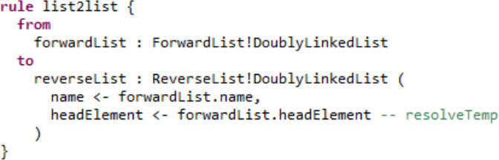
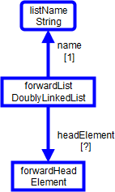
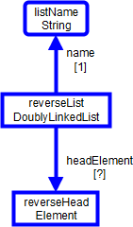
Modeling an ATL Rule
resolveTemp

Slide 6
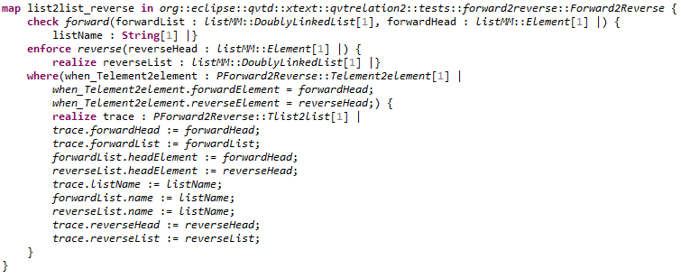
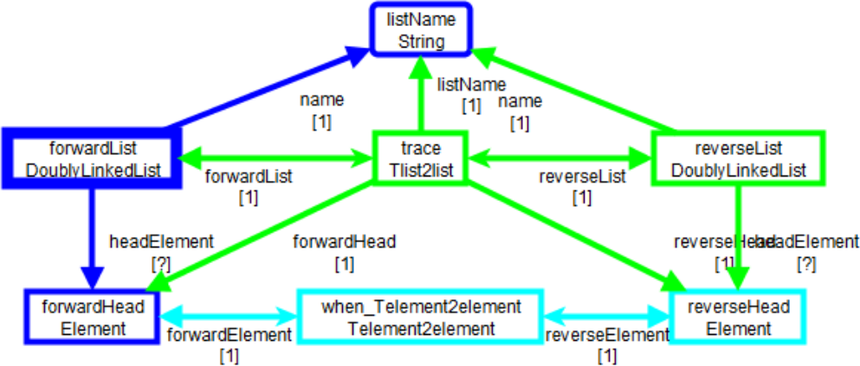
Modeling the
QVTc mapping for a QVTr relation

Slide 7


Full opposites
OCL defines an opposite role name
  MOF supports it via a Tag
  Ecore supports it via an EAnnotation
Is the opposite a Set?
  inference:
    container is 0..1
    non-container can be anything => Bag
      QVTc trace is nearly always 1..1
  need opposite upper/lower/unique/ordered
    Eclipse QVTd uses further EAnnotations
    UML 2.5's embedded OCL needs further Tags

Slide 8
Summary
Every Class-typed Property has an opposite in OCL
Supports efficient transformation modeling
EXE 2016 paper :
  Thirty fold speed-up of Eclipse QVTr wrt ATL
  Linear performance for Eclipse QVTr wrt quadratic ATL

