Slide 1
Disciplined Engineering and the Open Systems Engineering Environment
Ryan D. Brooks
OSEE Eclipse Open Source Project Lead
21 April 2021

Slide 2
Agenda
What is OSEE? Who is using it?
Overview of Capabilities
Product Line Engineering Topics
OSEE Architecture
Deep Dive

Slide 3
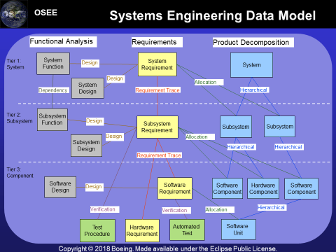
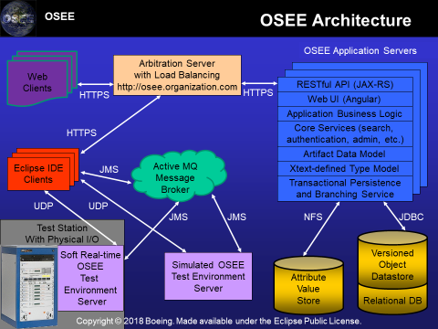
What Is OSEE?
The Open System Engineering Environment is a tightly integrated, extensible environment providing full lifecycle traceability and Product Line Engineering in the context of an overall systems engineering approach. OSEE complements and integrates existing tools via its shared, extensible data model and integration platform.
Key OSEE Users
Army
Boeing
Bosch
Navy
Proven on fielded avionics and automotive platforms

Slide 4
Overview of OSEE Capabilities
Tool Integration Platform
Product Line Engineering provides strategic, systematic reuse
Automated Verification Testing with Continuous Integration
Integrated Workflow Management and Peer Reviews
Release Management
Code Coverage Disposition
Requirements Management
Automatic CDRL Generation and Publishing
Data Rights Management
Systems Safety Analysis
Mission System Message Management
Full Lifecycle Traceability
Easy access to all lifecycle data

Slide 5
Product Line Engineering Topics
What is Product Line Engineering?
Product Line Benefits

Slide 6
What is Product Line Engineering?
A Product Line is a family of products sharing a common, managed set of features that satisfy the specific needs of a particular customers and that are developed from a common set of core assets in a prescribed way.
A Feature models a characteristic of a product that varies across the family of products. Each feature is assigned a value for each Product Line configuration.
A Product Line Configuration is a deliverable product generated from the product line to satisfy specific customer needs.
Applicability is metadata on the engineering artifacts that denotes its contribution to base, features, and configuration-specific aspects of the Product Line.

Slide 7
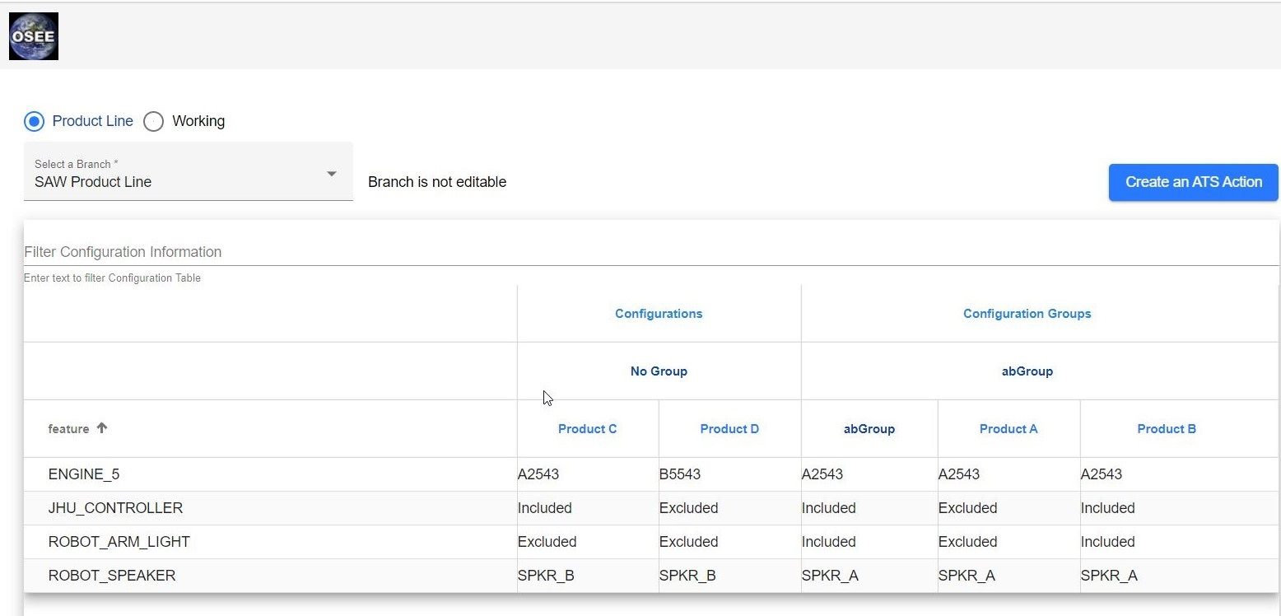
Web UI for PLE Management

Slide 8
Product Line Engineering Benefits
Provide for strategic, systematic reuse
Maximize commonality while retaining flexibility for satisfying customer specific needs
Enable reuse across multiple configurations and platforms
Eliminate time and expense of traditional sanitization
Leverage investment of personnel & funding across configurations
Field capabilities faster across configurations
Reduce life cycle maintenance costs
Fixes made once and available for inclusion in all future builds
Product Line architecture promotes modular design
Makes product more maintainable
Helps keep configurations specific capabilities relevant as product architecture and shared capabilities evolve
Notes:
Demo db example of PL configuration:
http://localhost:8089/orcs/branch/8/applic/table

Slide 9
OSEE Architecture and Deep Dive
OSEE Architecture
Extensible Data Model
OSEE Open Source Project
Built Upon Open Standards and Open Source
System Safety and Structural Coverage
OSEE clients
OSEE Deployment
OSGi Declarative Services
REST API
Automated Verification Testing with Continuous Integration
Object Revision Control System (ORCS)

Slide 10
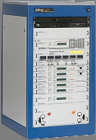
OSEE Architecture
OSEE Application Servers
Web Clients
Arbitration Server
with Load Balancing
http://osee.organization.com
RESTful API (JAX-RS)
HTTPS
HTTPS
Web UI (Angular)
Application Business Logic
HTTPS
Core Services (search,
authentication, admin, etc.)
Active MQ
Message Broker
Artifact Data Model
Eclipse IDE
Clients
JMS
Xtext-defined Type Model
Transactional Persistence
and Branching Service
UDP
UDP
JMS
JMS
NFS
JDBC
Test Station
With Physical I/O
Versioned
Object
Datastore
Soft Real-time
OSEE
Test
Environment
Server
Relational DB
Simulated OSEE
Test Environment
Server
Attribute
Value
Store

Slide 11
Extensible Data Model
Conceptual clarity and semantic completeness of the model
OSEE model elements
Elements always manipulated in a transaction on a branch
Artifact
Attribute
Relation
Tuples
Relations are between two objects on the same branch
Tuples allow relating objects across branches
Computed characteristics

Slide 12
Systems Engineering Data Model
Functional Analysis
Requirements
Product Decomposition
Tier 1:
System
System
Function
System
Requirement
System
Design
System
Design
Design
Allocation
Dependency
Requirement Trace
Hierarchical
Subsystem
Function
Tier 2:
Subsystem
Design
Subsystem
Requirement
Subsystem
Subsystem
Subsystem
Design
Design
Allocation
Hierarchical
Hierarchical
Requirement Trace
Tier 3:
Component
Software
Design
Software
Requirement
Software
Component
Hardware
Component
Software
Component
Design
Verification
Verification
Allocation
Hierarchical
Test
Procedure
Hardware
Requirement
Automated
Test
Software
Unit

Slide 13
OSEE Open Source Project
OSEE Eclipse Project
http://eclipse.org/osee
https://github.com/eclipse/osee
Eclipse IP due diligence
OSEE is an Eclipse project hosted by the Eclipse Foundation
318 member organizations
over 1,600 Eclipse committers
Eclipse Foundation’s governance and disciplined development approach promotes the high quality that Eclipse projects have a reputation for
Mature continuous integration infrastructure including integrated review, build, test, and delivery
Strong commercial ecosystem with significant influence in the software industry

Slide 14
Policy-based Reasons for Open Source
Transparency - open and public development process
Flexibility
Perpetuity
Availability – source always, freely, easily, universally available
Predictability – roadmap, releases, known development status
Quality – diversity of ideas and more use cases explored (robust)
Affordability – lower total cost of ownership
Rigorous Intellectual Property Management
Promotes use of open standards
Promotes wide-spread adoption and contributions

Slide 15
Eclipse Intellectual Property (IP) Due Diligence
Carefully defined contribution and committer agreements
Legal Team review of IP Provenance
who wrote the code and how they agreed to the license
Static code analysis detects IP issues
Orbit - Repository of third party open source libraries that are approved for use in one or more Eclipse projects.

Slide 16
Built Upon Open Standards and Open Source
OSGi Service Platform Core Specification Release 4, Version 4.3
SQL 2003
The Java Language Specification, Java SE 8 Edition
Angular
Java API for RESTful Web Services (JAX-RS)

Slide 17
System Safety and Structural Coverage
System safety report leverages full life cycle traceability
Trace Hazard analysis > functions > requirements > code and test
Uses MIL-STD-882E
IDAL
Software Control Category
Severity Category
Software Criticality Index
Structural Coverage Analysis
Aggregates coverage data across multiple runs and versions
Disposition mechanism with integrated PRCs

Slide 18
OSEE Clients
Web Client
Angular is an open-source web application framework for creating single-page apps
OSGi Services provide extensibility
Desktop Client
Built on Eclipse open source tool integration platform
Deployed as a set of Eclipse features. Features contain Eclipse bundles (plug-ins)
OSGi Services and Eclipse extension points provide extensibility
Both Desktop and Web clients use the same OSEE REST API

Slide 19
OSEE Deployment
OSEE client and server runs on any OS with Java VM
Previously demonstrated OSEE on Amazon Government Cloud
OSEE Server Container Hardening with Platform One
OSEE Docker container on Platform One CI/CD pipeline
Using existing PostgreSQL 12.x container from Iron Bank
Locally Tested the two containers working together using Docker compose
Added OSEE container to Iron Bank
OSEE server container added to Iron Bank for DOD-wide availability
Addressed all findings from OpenSCAP, Twistlock, and Anchore
Continuous ATO approval
Created Helm Chart based on the Docker compose file
references Kubernetes Secrets file with database connect information
Load Balancer and server farm

Slide 20
OSGi Declarative Services
OSGi is the dynamic module system for Java.
OSGi services use a publish-find-bind mechanism.
A bundle can provide/publish a service implementation of a given interface (type) for other bundles to consume.
With declarative services, services are not registered or consumed programmatically.
Instead, a Service Component is declared via a Component Description in an XML file in the OSGI-INF folder.
The Component Description is processed by a Service Component Runtime (SCR), e.g. Equinox DS or Felix SCR) when a bundle is activated.
https://wiki.eclipse.org/OSEE/Architecture#OSGi_Declarative_Services

Slide 21
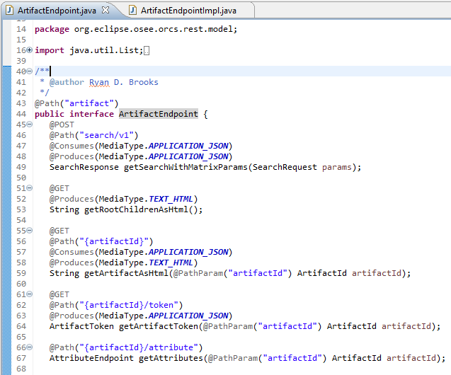
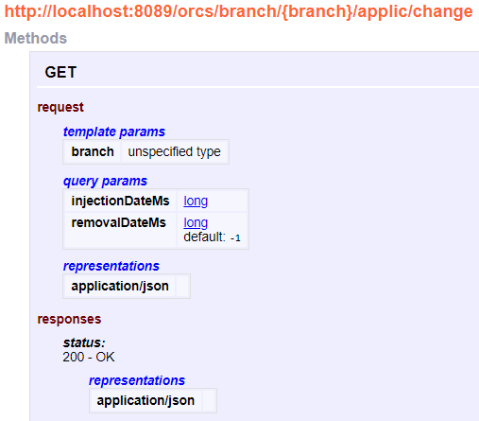
REST API
Java API for RESTful Web Services (JAX-RS)
Let’s dive into the code

Slide 22
Automated Verification Testing with Continuous Integration
Fully integrated test development, debugging, execution, and result analysis
Choreographed execution control (lockstep or real-time) of mission software, tests, and models (simulation components)
Advanced Messaging tools
Built-in debugger
Tests (without modification of any kind) can be run in both soft real-time and simulated environments (simultaneously, if desired)
Real-time messaging system that supports MIL-STD-1553 MUX, serial, wire, analog and digital discretes, and publish/subscribe Data Distribution Service (DDS)
Automated test point tally and rollup of pass/fail determination
Continuous integration with hardware-in-the-loop

Slide 23
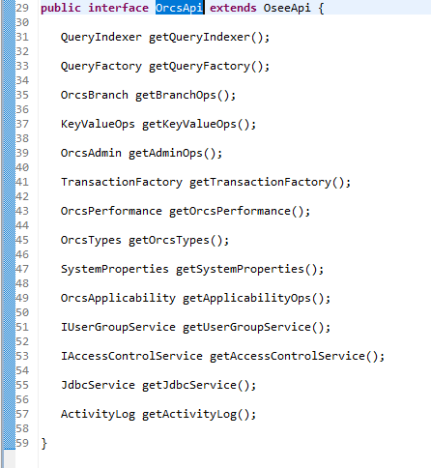
Object Revision Control System (ORCS)
Let’s dive into the code

