Slide 1
PHP Development Tools 2.1
Release Review
Planned Review Date: 10 June
Communication Channel: eclipse.tools.pdt
[Names of submitters]

Slide 2
Introduction
The PDT project provides a PHP Development Tools framework for the Eclipse platform. This project encompasses all development components necessary to develop PHP and facilitate extensibility. It leverages the existing Web Tools Project (WTP) and Dynamic Languages Toolkit (DLTK) in providing developers with PHP capabilities.
Principles:
  Intuitive and easy to learn
  Seamless integration with other Eclipse projects
  Adherence to Eclipse standards
  Extensibility
  Continuous support of PHP development

Slide 3
Features
Based on Galileo release
Support PHP 5.3 new language features (Namespaces, Lambda functions)
  Outline
  Code Assist
  PHP Explorer
Improved code assist
281 bugs fixed

Slide 4
Non-Code Aspects
User documentation
  Dedicated technical writer for the project
  New features docs are updated
Conferences
  EclipseCon 2009 - http://www.eclipsecon.org/2009/sessions?id=240
  EclipseCon 2008 - http://www.eclipsecon.org/2008/?page=sub/&id=17
Tutorials - http://wiki.eclipse.org/PDT/TUTORIALS
Articles - http://www.eclipse.org/pdt/articles/articles.php

Slide 5
APIs
org.eclipse.php.core
  goalEvaluatorFactories- PHP Evaluator Factory
  phpMixinBuildVisitors - PHP Mixin Build Visitor
  PhpSourceElementRequestors PHP Mixin Build Visitor
org.eclipse.php.ui
  ActionFilterContributors – PHP Action Filter Contributor
  FoldingStructureProviders - PHP Folding Structure Provider
  PhpActionDelegator - PHP Action Delegator
  PhpEditorTextHovers - PHP Editor Text Hover
  PhpElementFilters - PHP Element Filter
  PhpFormatterPrefBlock - PHP Formatter Preferences Block
  PhpFormatterProcessor - PHP Formatter Processor

Slide 6
APIs (cont. 1)
org.eclipse.php.ui
  PhpHyperlinkDetector - PHP Hyperlink Detector
  PhpManualSites - PHP Manual URL
  PhpPreferencePageBlocks - PHP Preferences Page Block
  PhpTreeContentProviders - PHP Tree Content Provider
  PhpTreeElementComparers - PHP Tree Element Comparer
  PhpWizardPages - PHP Wizard Page
  WizardAndCompositeFragments - Wizard and Composite Fragments
  QuickAssistProcessors - Quick Assist Processor
  QuickFixProcessors - Quick Fix Processor
org.eclipse.php.debug.core
  fileMapper
  pathEntryFilters

Slide 7
APIs (cont. 2)
org.eclipse.php.debug.core
  phpDebuggers
  phpDebugHandlers
  phpDebugMessages
  phpDebugParametersInitializer
  phpDebugStepFilters
  PhpExe
org.eclipse.php.debug.ui
  debugServerConnectionTest
  launchConfigurationTabs
  phpConsoleListeners
  phpDebugModelPresentations

Slide 8
Architectural Issues

Slide 9
Tool Usability
Aligned with Eclipse (Java/DLTK) standards
Build Path mechanism to improve modularity
PHP specific features

Slide 10
End-of-Life
PHPCodeData API (PDT 1.0) was removed
Include path variable feature was removed, but we are considering implementing it for the 2.2 release.

Slide 11
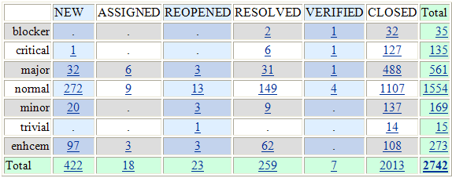
Bugzilla - Summary
PDT 2.1 Status
PDT 2.0 Status

Slide 12
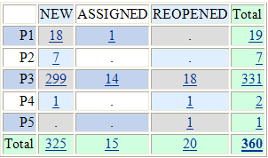
Bugzilla - Status
281 issues were closed during PDT 2.1 development
PDT 2.1 Status
PDT 2.0 Status

Slide 13
Standards
Based on DLTK's standards, which are relatively similar to JDT's standards
Code standards remain the same as those for the previous PDT 1.0 version

Slide 14
UI Usability
The original DLTK UI usability was maintained
A language pack is not currently available

Slide 15
Schedule
2.1 M4 – January 6
2.1 M5 – February 6
2.1 M6 – March 6
2.1 M7 – May 6
2.1 RC1 – May 20
2.1 RC2 – May 28
2.1 RC3 – June 02
2.1 RC4 – June 10
2.1 RC5 – June 16
2.1 Release – June 25

Slide 16
Communities
Webinar:
  http://www.eclipse.org/galileo/galileoinaction.php
Blogs (and more...):
  http://spektom.blogspot.com/
  http://ganoro.blogspot.com/

Slide 17
IP Log - 3rd Party Contributions
http://www.eclipse.org/pdt/documents/iplog.xls

Slide 18
IP Log - Contributors
Active Non Active

Slide 19
IP Log - Contributions
Boldt (gmail.com) (1)
Toshihiro Izumi (yahoo.co.jp) (14)
Pavel Petrochenko (onpositive.com) (2)
Vadim Punski (zend.com) (11)
Q.S. Wang (zend.com) (18)
David M Williams (us.ibm.com) (1)
zhaozhongwei (eclipseworld.org) (1)
More details: http://www.eclipse.org/projects/ip_log.php?projectid=tools.pdt

Slide 20
IP Issues
The EMO explicitly asks during the Release Review if any Member would like to assert that this release infringes their IP rights.
If so, the EMO and the project will follow the Eclipse IP Policy in discussions with that Member.

Slide 21
Credits and Kudos
Eclipse PDT community
Our contributors – Dave K., Michael S., Nick B., and Roy G. (and other people who helped us with this release and contributed code)
Cross Project thank yous – DLTK and WTP
The Eclipse Foundation team – from IT to Management.

Slide 22
Credits and Kudos
List individuals/organizations who have contributed here
(optional)

