Slide 1
Changing the look and feel of Eclipse applications
Stefan Xenos and Jean-Michel Lemieux
IBM Rational Software
Ottawa, Ontario
Eclipse Platform Committers

Slide 2
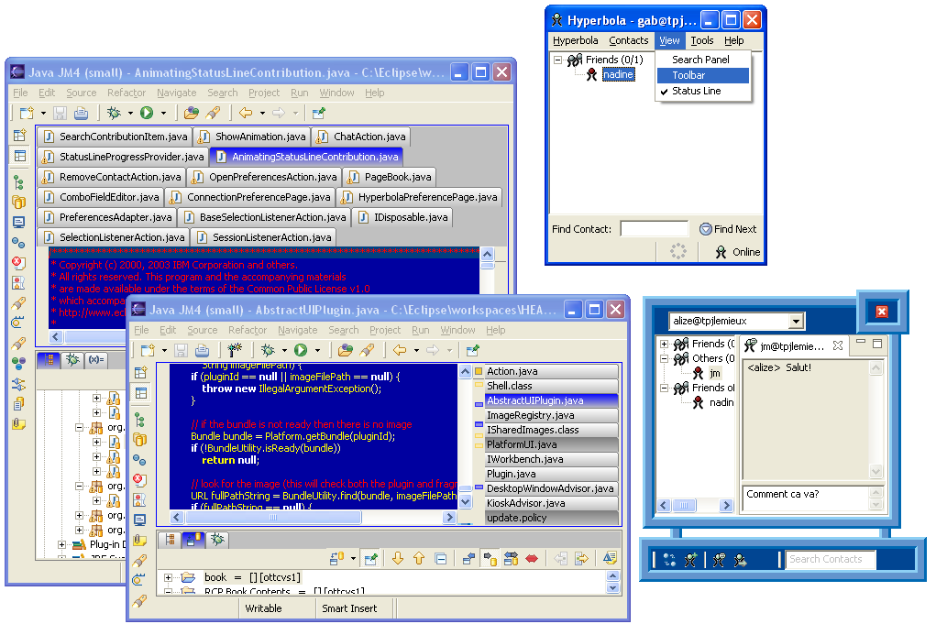
Examples
Multiple editor rows and customized editor management
Hiding the toolbar and status line
Additional Controls that aren’t part of a perspective
_{Non-rectangular window}
Views that only show icon and toolbar is optional
_{Custom tab management}

Slide 3
Why the fuss
“An open letter to the Eclipse Board of Directors - …very strong distaste for the new look and feel [in eclipse 3.0], as it looks incredibly out of place on any platform. We feel strongly that one of the biggest advantages of Eclipse is how clean and professional it looks, and how well it fits in with other native applications on each platform.[…]”
– On the eclipse.platform newsgroup
“I showed an RCP application to my boss the other day
and he said that it was nice but it still looked like Eclipse.”
– over heard in a meeting

Slide 4
What is the Eclipse look?
But what exactly makes an application look like Eclipse?
The Eclipse community has had lengthy debates regarding the "look
and feel" of Eclipse and much of this revolved around the way in which
editor and view tabs are shown. While most of Eclipse uses native
widgets for toolbars, dialogs, and menus, there are some components
in the workbench where this was not possible because the native
widgets did not support the functionality that was needed. For
example, native tab widgets don't support drag and drop, focus
highlighting, and close buttons. For this reason the default tabs in
Eclipse uses a custom folder widget.

Slide 5
Our response
If you don’t like it – change it!
-
And it’s easy to do! We will show you how.
Part I: Presentations API
  Controls the look and feel of views and editors – the presentations API is responsible for managing and displaying editors and views. Provides much of the look and feel of Eclipse applications.
Part II: WorkbenchWindowAdvisor customizations (RCP applications only)
  Customize a window’s content area – the content area is usually created by the Workbench with a predefined layout including a menu, toolbar, page area, and status
  Customize a window’s shape – it’s possible to customize how a Workbench window is displayed and shaped.

Slide 6
Part I: Presentations API
Presentation = A look and feel extension for Workbench parts.
Part = a view or editor.
Presentations manage the trim and layout of areas that contain one or more parts – called part stacks.
Widget factories, not skinning
  Don’t just paint widgets. Supply the widgets themselves.
  Don’t lose that native feelin’
Benefits
  Maximum flexibility
  No custom widgets needed

Slide 7
Presentation Responsibilities
Create the trim for part stacks
  Tabs
  Title
  System menu
  Close/Minimize/Maximize buttons
  Borders
Control layout and visibility
  Parts
  Toolbars
  View menus
  Drag/drop regions

Slide 8
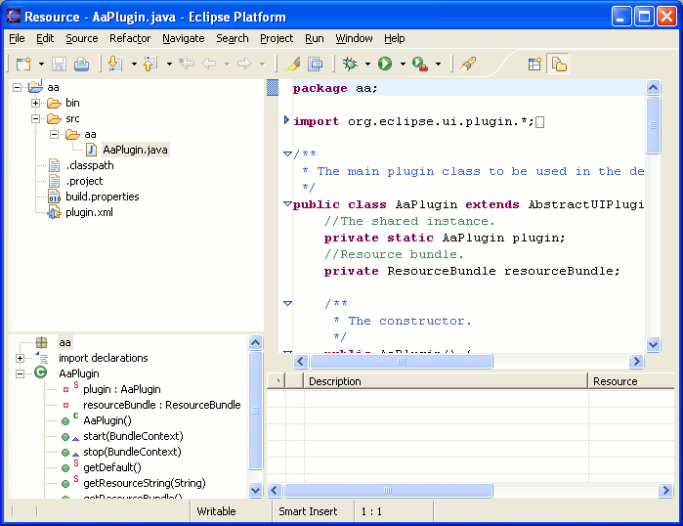
What happens when you remove the Presentation?
_{Tabs are gone!}
The border and focus highlight are gone!
You only get to see one part in the stack!

Slide 9
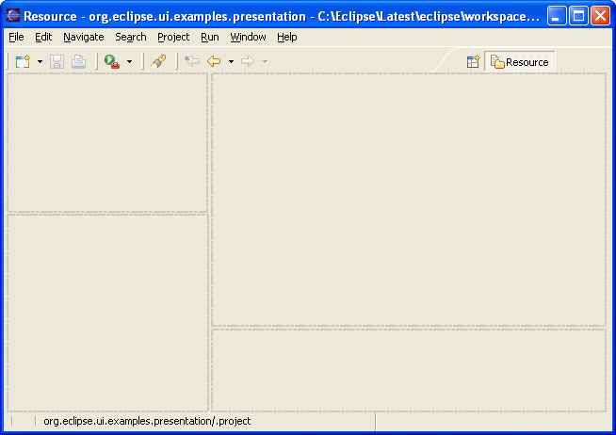
Presentation and Perspectives
A Perspective contains a groups or stacks of views and editors.
There is one presentation instance for each group or stack of parts in a perspective.
_{Presentation Instance}
_{Presentation Instance}
_{Presentation Instance}
_{Presentation Instance}

Slide 10
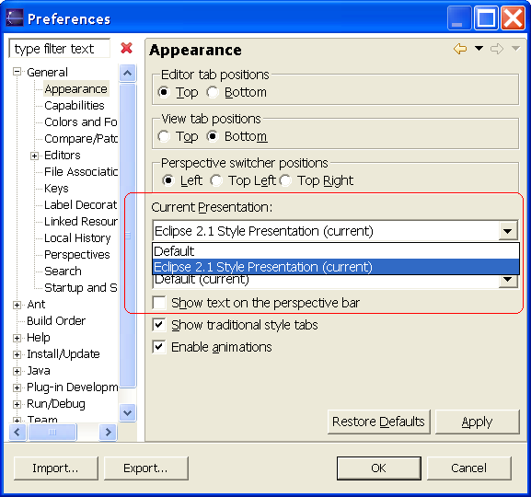
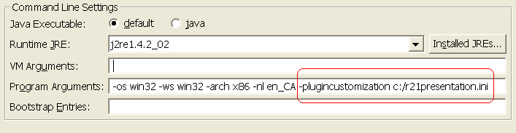
Activating a presentation
From the IDE preference page
Using a preference
Preference customization file
# R21 presentation settings: copy these values to your product's
# plugin_customization.ini file before starting eclipse
# use the R2.1 style
org.eclipse.ui/presentationFactoryId=org.eclipse.ui.internal.r21presentationFactory
You need to restart the Workbench – kind of ☺
When you change the presentation in the preference dialog, you will be asked to restart the Workbench. Instead, open a new window. The new presentation will be used for all new windows.

Slide 11
Example: Creating a bare presentation
A barebones presentation doesn’t actually do anything expect show the current part.
Gives an idea of the classes you will have to learn about.
First thing, create a presentation factory. And
register it with the presentation extension point.
The factory creates the stacks that will contain
presentation parts.
AbstractPresentationFactory
createEditorPresentation()
createViewPresentation()
createStandaloneViewPresentation()
getStatusLineControl()
getStatusLineManager()
<extension
point="org.eclipse.ui.presentationFactories">
<factory
class="org.eclipse.ui.examples.presentatition.
BarePresentationFactory"
name="Bare-bones presentation"
id="org.eclipse.ui.examples.presentation.barebones"/>
</extension>
WorkbenchPresentationFactory
BarePresentationFactory

Slide 12
Example: BarePresentationFactory
The Presentation Factory creates the presentations for the different
stack areas (views, fixed views, and editors). The real work will be
implementing the StackPresentation.
public class BareBonesPresentationFactory extend
AbstractPresentationFactory {
public StackPresentation createEditorPresentation(
Composite parent,
IStackPresentationSite site) {
return new BarePartPresentation(parent, site);
}
public StackPresentation createViewPresentation(
Composite parent,
IStackPresentationSite site) {
return new BarePartPresentation(parent, site);
}
public StackPresentation
createStandaloneViewPresentation(
Composite parent,
IStackPresentationSite site, boolean showTitle) {
return new BarePartPresentation(parent, site);
}
}

Slide 13
Example: BareStackPresentation
StackPresentation displays a stack of views or editors.
From the presentation’s point of view, there is no difference between a view and an editor. It sees both as instances of IPresentablePart.
An IPresentablePart is a rectangular region
of the screen that provides a name, tooltip,
title, description, etc.
IStackPresentationSite provides stack related
Behavior and access to stack layout settings.
StackPresentation
addPart(IPresentablePart)
setBounds(Rectangle)
setVisible(boolean)
selectPart(IPresentablePart)
Control getControl()
Control[] getTabList(IPresentablePart)
…
IStackPresentationSite
isStackMoveable()
isPartMoveable(IPresentationPart)
isCloseable(IPresentationPart)
selectPart(IPresentationPart)
close(IPresentationPart)
…
BareStackPresentation
TabbedStackPresentation

Slide 14
Example: BareStackPresentation (cont…)
Let’s walk through it’s implementation… first, the constructor:
private Composite presentationControl;
private IPresentablePart current;
public BareBonesPartPresentation(Composite parent,
IStackPresentationSite stackSite) {
super(stackSite);
// Create a top-level control for the presentation.
presentationControl = new Composite(parent, SWT.NONE);
// Add a dispose listener. Important because dispose() may
// not always be called.
presentationControl.addDisposeListener(new DisposeListener() {
public void widgetDisposed(DisposeEvent e) {
presentationDisposed();
}
});
}

Slide 15
Example: Widget Hierarchy
There is a subtle implementation detail that must be understood when implementing a presentation. The runtime widget hierarchy of the workbench doesn't reflect the class hierarchy.
The presentation doesn't actually parent the widget created by the presentable part. Instead, the part's control and toolbar are parented by the workbench window.
This is to allow re-parenting and moving of parts between stacks.
A presentation should never reference a presentable part's control. Instead, it should call IPresentablePart.setBounds() and IPresentablePart.setVisible() to control the placement of the part's controls.
A presentable part can actually be shown simultaneously in several stacks. This is one of the reasons why its control cannot be parented with a particular stack.

Slide 16
Example: BareStackPresentation (cont…)
The setBounds method is called to provide the stack with it’s size. In
this example the current part will take up the entire stack area.
public void setBounds(Rectangle bounds) {
// Set the bounds of the presentation widget
presentationControl.setBounds(bounds);
if (current != null) {
current.setBounds(presentationControl.getBounds());
}
}

Slide 17
Example: BareStackPresentation (cont…)
SelectPart is called when a part should be made visible. This is called
when a part is added to a stack.
public void selectPart(IPresentablePart toSelect) {
// Ignore redundant selections
if (toSelect == current) {
return;
}
// If there was an existing part selected, make it invisible
if (current != null) {
current.setVisible(false);
}
// Select the new part
current = toSelect;
// Make the part visible before setBounds, or the call to setBounds
// may be ignored.
if (current != null) {
current.setVisible(true);
}
current.setBounds(presentationControl.getBounds());
}

Slide 18
Example: BareStackPresentation (cont…)
setVisible is called when the stack’s visibility should be
changed? Will be called after the constructor or when a
perspective is switched.
public void setVisible(boolean isVisible) {
// Make the presentation widget visible
presentationControl.setVisible(isVisible);
// Make the currently visible part visible
if (current != null) {
current.setVisible(isVisible);
}
if (isVisible) {
// Restore the bounds of the currently visible part.
// IPartPresentations can be used by multiple StackPresentations,
// although only one such presentation is ever visible at a time.
// It is possible that some other presentation has changed the
// bounds of the part since it was last visible, so we need to
// update the part's bounds when the presentation becomes visible.
updatePartBounds();
}
}

Slide 19
Example: BareStackPresentation (cont…)
The last two methods are trivial…
// This is the only time you should call IPresentablePart.getControl().
// Provides the tab order for the stack.
public Control[] getTabList(IPresentablePart part) {
return new Control[] {part.getControl()};
}
public Control getControl() {
return presentationControl;
}

Slide 20
Example: Demo of using the presentation
Export and self-host with the new presentation then
Create an RCP application that uses the presentation.

Slide 21
Making a real presentation
Let’s upgrade the bare bones example and make it more useable
We will add the following features to it:
  Draw a border that reflects the stack’s focus state,
  Show more than one part at a time,
  Allow closing parts
  Show the system menu
Note: At this point you should ensure that you have a good
understanding of SWT, in particular how to write your own layouts and
how to use GC drawing APIs.

Slide 22
Part II: WorkbenchWindowAdvisor Customizations
The second method of customizing the look and feel of Eclipse
applications if to change the window layout.
A WorkbenchWindowAdvisor can participate in window creation
Ability to control things in the Workbench that regular plug-ins can’t
Can complement the Presentations API to allow other Workbench customizations
Workbench provides a default layout = fixed and not very customizable

Slide 23
WorkbenchWindowAdvisor
A WorkbenchWindowAdvisor can participate in the creation and configuration of WorkbenchWindows.
WorkbenchWindow
WorkbenchAdvisor
WorkbenchWindowAdvisor
ActionBarAdvisor
createWorkbenchWindowAdvisor()
_{Shell hasn’t been created yet.}
preWindowOpen()
createActionBarAdvisor()
_{Actions get created.}
fillActionBars()
createWindowContents()
.
.
.
Shell is created and controls are added to the window.
postWindowClose()

Slide 24
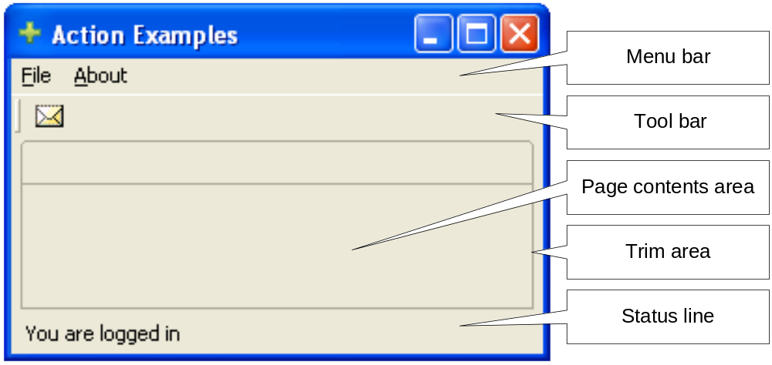
WorkbenchWindowAdvisor – custom layout
The Workbench opens and configures workbench windows based on the
configuration information provided by the WorkbenchWindowAdvisor. By
default a workbench window is created with the following controls:

Slide 25
WorkbenchWindowAdvisor – custom layout
If you want to change how the Workbench creates these controls you
have two choices:
You can change the visibility of some of the controls by using the IWorkbenchWindowConfigurer.setShow*() methods. These methods control the initial visibility only and won’t hide/show the controls once the window is opened.
Visibility and layout of the entire workbench window by overriding WorkbenchAdvisor.createWindowContents(). This is basically moving responsibility to the advisor for creating all of the window’s controls.

Slide 26
WorkbenchWindowAdvisor – custom layout
The IWorkbenchWindowConfigurer provides methods to create the common workbench
controls and can be called from within the createWindowContents() method.
The controls returned from the control creation methods are un-typed and are provided
uniquely for placement within the layout defined by the advisor. They are not meant to be
configured or downcasted.
public void createWindowContents(IWorkbenchWindowConfigurer
configurer, final Shell shell) {
Menu menu = configurer.createMenuBar();
shell.setMenuBar(menu);
FormLayout layout = new FormLayout();
layout.marginWidth = 0;
layout.marginHeight = 0;
shell.setLayout(layout);
toolbar = configurer.createCoolBarControl(shell);
page = configurer. createPageComposite(shell);
statusline = configurer.createStatusLine(shell);
}
Using a FormLayout to allow toggling the visibility of controls in the workbench window.

Slide 27
WorkbenchWindowAdvisor – custom layout
Simple example is to use a different layout for a workbench window
that allows removing showing/hiding of control. You can add new
controls to the layout as needed.
public void setShowSearchPanel(boolean visible) {
if (visible) {
if (searchPanel != null) return;
searchPanel = new QuickSearchPanel(
getWindowConfigurer().getWindow().getShell(), null);
FormData data = (FormData) page.getLayoutData();
data.bottom = new FormAttachment(searchPanel, 0);
page.setLayoutData(data);
data = new FormData();
data.left = new FormAttachment(0, 0);
data.right = new FormAttachment(100, 0);
if (statusline.isVisible())
data.bottom = new FormAttachment(statusline, 0);
else
data.bottom = new FormAttachment(100, 0);
searchPanel.setLayoutData(data);
} else {
…
Using a FormLayout to allow toggling the visibility of controls in the workbench window.
Re-wiring the control in the window’s layout.

Slide 28
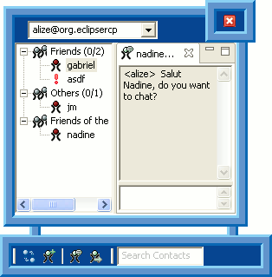
WorkbenchWindowAdvisor – window shape
Another common technique for making an application stand out is to
forfeit the platform’s standard window look and provide your own
custom shaped window with curves, see through areas, and a funky
design.
Hire a graphic designer.
Use image mask to create SWT Regions that can be used to define the shape of a Shell.
In the WorkbenchWindowAdvisor ensure that the SWT.NO_TRIM style is configured on the Shell before the Shell is created. This is done in preWindowCreate().
Once the window is created in postWindowCreate(), add a paint listener to the Shell to draw the border for the shaped window and set the region of the Shell.
In createWindowContents() you will create the controls to be shown in the window.
public void preWindowOpen() {
getWindowConfigurer().setShellStyle(
SWT.NO_TRIM | SWT.ON_TOP | SWT.NO_BACKGROUND);
}
shell.setRegion(currentRegion);

Slide 29
Conclusion
Now that you are armed with this knowledge there are two possible
outcomes:
When your boss complains that your application looks like Eclipse you can simply change it and keep your job.
When your boss complains that he can’t read the text on the editor tabs in Eclipse, you can simply change it and get a bonus!

