Slide 1
Integrating Team Tools into Eclipse
Michael Valenta
IBM Canada
Eclipse Platform Team

Slide 2
Overview
Introduction
History of VCM/Team
Current Team Related (2.0/2.1) Support
  Both Team and other components
What’s new in 3.0
What does the future hold

Slide 3
What are Team Tools
Working with a repository
  CVS, ClearCase, etc.
  This has been the main focus of Eclipse Platform Team
Bug reporting
  Bugzilla, ClearQuest, etc.
Deploying
  FTP, WebDAV, etc.
  Experimental support in Eclipse
Collaborating
  Chat, SameTime, Jazz, etc
Configuration Management
Release Engineering

Slide 4
History: Eclipse 1.0
A single comprehensive VCM API
  All repository venders must implement the API to integrate
UI provided on top of API
  Did allow some tailoring by individual repositories
Advantages
  Compelling since repository vendors would get UI for free
  API can be used by 3rd party tools
Disadvantages
  API was lowest common denominator
  Impractical because repository systems differ in form and function
  Repository vendors had to bend to conform to API and could not surface unique functionality

Slide 5
History: Eclipse 2.0
Minimalist approach to Team API
  Provide integration points where repository functionality could be accessed
  After that, just get out of the way
Advantages
  Provides the possibility of rich integration into Eclipse
Disadvantages
  Cost of rich integration is high
  No 3rd party access to repository functionality

Slide 6
What Team/Core Provided in Eclipse 2.0/2.1
Associate a project with a repository
  RepositoryProvider and IConfigurationWizard
Enhanced local resource API
  IResource: local history, session and persistent properties, etc.
Cache state of corresponding remote resource
  ISynchronizer: can cache for non-existent local resources
Control access to resources in local file system
  IMoveDeleteHook and IFileModificationValidator
Share workspace setup
  IProjectSetSerializer
Resource management
  Ignore and file type lists

Slide 7
Team Core Architecture
_{IProjectSetSerializer}
_{- share workspace setup}
_{- associate a project with a}
_{repository}
_{RepositoryProvider}
_{- sync state}
_{management}
_{ISynchronizer}
_{Team}
_{- ignores}
_{- file types}
_{IResource}
_{- access to local file system}
_{- addition capabilities}
_{MoveDeleteHook}
_{IFileModificationValidator}
- control over access to local file system
_{Tools}

Slide 8
Relevant UI Support in Eclipse 2.0/2.1
SWT/JFace/Workbench
Presence in workspace views
  Context menu object contributions
  Decorations
Compare framework
  2-way and 3-way file content comparison
  Structure compare
  Tools provide support for their file types (e.g. JDT)

Slide 9
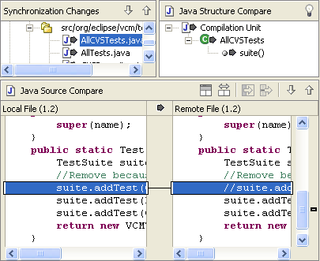
Compare Archritecture
_{CompareEditorInput}
_{is-a}
_{DiffTreeViewer}
_{StructuredDiffViewer}
_{ContentMergeViewer}
_{Tools}
_{IDiffElement}
_{IStructureComparator}
_{IRangeComparator}

Slide 10
How to be a Team Friendly Tool
For operations that modify one or more files
  Call IWorkspace#validateEdit(IFile[], Object)
  This gives pessimistic repository provides a chance to ensure that the modification will succeed ahead of time.
Include workbench menu and decorations in your resource views
  Use a DecoratingLabelProvider
  Use IWorkbenchPartSite#registerContextMenu()
Provide ignore and file type entries for your file types
  contributions in plugin.xml
Provide compare viewers for your file types
  If you provide an editor for a file type, you should consider providing a compare viewer

Slide 11
Motivation for 3.0
Focus in Eclipse has been Repository tool integration
CVS reference implementation has been a success
  And have had lots of feedback on how to improve it
  Want to allow others to gain from that work
Want to encourage rich integration of team tools in developers daily workflows.
  maintaining synchronization between workspace and remote location
  Provide developer with responsive UI during remote synchronization

Slide 12
What is Being Done in 3.0
Provide infrastructure to aid in local workspace management
  Optional but helpful infrastructure
  Pieces are as independent as possible
    can be used by RepositoryProvider, deployment or other
Synchronization framework
  Complements compare framework
  Single view that contains synchronization pages for each subscriber
  Ability to embed synchronization page in other views/dialogs
UI Responsiveness
  Remote communications done in a background thread
QuickDiff
  In-editor display of differences

Slide 13
Team Core Synchronization Support
Access to synchronization state between workspace and remote
  Team Subscriber
    SyncInfo for local resources
      in-sync
      incoming, outgoing or conflict
      addition, deletion or change
    Refresh of remote state
    Change events for changed sync state
      Due to refresh or local delta
Additional helper API
  Remote contents caching (IResourceVariant)
  Sync state management (IResourceVariantTree)

Slide 14
Team Subscriber Architecture
_{- set of root resources}
_{- local traversal under roots}
- access to sync state of resources
_{- refresh of remote state}
_{Subscriber}
_{- local IResource}
- remote and base IResourceVariant
_{- sync kind}
_{SyncInfo}
_{IResourceVariant}
- access to labeling information
- access to contents through IStorage
_{IStorage}
- contents of remote resource cached locally
- can use CachedResourceVariant

Slide 15
Team UI Synchronization Related API
Multi-page synchronize view
  ISynchronizeParticipant:
    Contributed via extension point
    General integration into synchronize view
  SubscriberParticipant for Subscriber specific support
    model
    actions
    label decoration, etc.
Embeddable in Compare framework
  SyncInfoSetCompareInput
  Diff tree viewer and diff tree nodes

Slide 16
Synchronize View Architecture
_{ISynchronizeView}
- view can contain multiple pages
_{ISynchronizeParticipant}
_{SubscriberParticipant}
_{- CVS, FTP, etc.}
_{IPageBookViewPage}
_{SubscriberParticipantPage}
_{SynchronizeModelAction}
- can be contributed programmatically
_{or through plugin.xml}

Slide 17
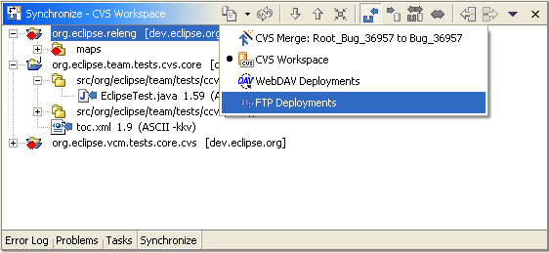
Synchronize View with Multiple Participants

Slide 18
Additional Team Core Facilities
Dynamic maintenance of sets of out-of-sync resources
  SyncInfoSet
    Set of out-of-sync resources
    Change notification
  SyncInfoSet Collectors
    Dynamically updates a sync set in response to input changes from a subscriber or another set
    Filters by working set and sync kind
    Support for background event processing

Slide 19
Dynamic Synchronization Views
_{- Access to sync state}
_{- Refresh remote state}
- Notification of sync state changes
_{Subscriber}
_{Resource deltas}
- maintains set of out-of-sync resources
- listens to subscriber changes and deltas
- Filters by resource or sync state
_{Collector}
_{Collector}
_{SyncInfoSet}
_{SyncInfoSet}
- the set of resources the user cares about
_{- dynamically updated}
_{SyncInfoSetCompareInput}
_{SubscriberParticpantPage}

Slide 20
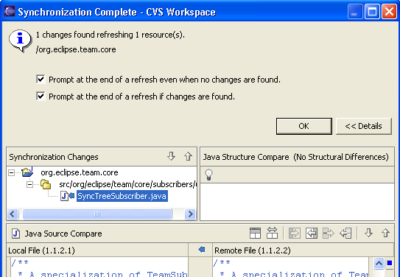
Synchronization Viewer in a Dialog

Slide 21
What do Team Tools need to provide
Implement a Subscriber
  this is where most of the work is required
Subclass team subscriber participant classes as needed
  Must override SubscriberParticipant
    To configure page
    To save and restore state
    To add other custom actions
Implement SynchronizeModelActions
  which modify sync state accordingly
  Inherently tool specific
  Can make use of SyncInfoSetCompareInput in dialogs to improve usability

Slide 22
Concurrency Considerations
Issues covered in talk on Responsive UIs
Background operation built into some synchronization components
  TeamSubscriber refresh
  SyncInfoSet state maintenance
  Subscriber actions
Requirements for TeamSubscriber implementors
  must be thread safe
  should use an appropriate level of locking granularity
    Project level is good enough in most cases

Slide 23
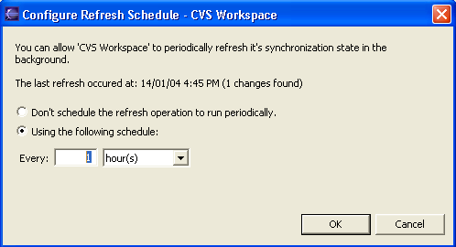
Scheduling a Background Refresh

Slide 24
Conclusion: Levels of Tool Integration
Coexistence of multiple tools
  Views from multiple tools exist in the same application window
  Menu items of one tool available in context menus on another
  Decorations of one tool in views of another
Common look and feel of similar tools
  Compare framework
  Synchronization framework
  Are there other areas where integration effort can be eased
    Remote browsing?
Integrated Workflows of multiple tools
  Something to shoot for

Slide 25
Towards Integrated Workflows
Specific combinations
  Requires each component to have an API
    May be proprietary
  ClearCase and ClearQuest
  CVS, and Bugzilla
  Possible today but not ideal
General interoperability
  Requires standard APIs to the various components
  Repositories: JSR 147 (WVCM)
  Bug tracking: ?
  Work in this area is in its early stages

Slide 26
References
The Team component webpage is:
http://dev.eclipse.org/viewcvs/index.cgi/%7Echeckout%7E/
platform-vcm-home/main.html
The Team 3.0 component plan can be found at:
http://dev.eclipse.org/viewcvs/index.cgi/%7Echeckout%7E/
platform-vcm-home/docs/online/team3.0/milestone-plan.html
The latest version of the slides can be found at:
http://dev.eclipse.org/viewcvs/index.cgi/%7Echeckout%7E/
platform-vcm-home/docs/online/team3.0/EclipseCon2004TeamTalk.ppt

