Slide 1

Eclipse Project 3.6 Release Review
Eclipse Project PMC

Slide 2
Highlights
3.6 new features:
  New platforms: PPC-64, Ubuntu LTS, Windows 7
  Flexible resources, open file from command line, WebKitGTK+ browser, help extensibility, new accessibility API, O/S task bar integration, Java formatter improvements, import plugin from CVS, API usage reporting, Junit 4 support in test framework
API quality:
  High. 11 entries in porting guides.
  Binary compatible for compliant plug-ins
  New API: 181 types, 218 methods
  Deprecated API: 13 types, 9 methods, 17 fields
  10 breaking changes: Platform (10), JDT (0), PDE (0)
End-of-life issues:
  Bundles org.eclipse.team.cvs.ssh and org.eclipse.core.resources.compatibility removed (no API)
IP Clearance and Licenses:
  All licenses and about files are in place as per the Eclipse Development Process, the Due Diligence Process was followed for all contributions
Community and Committer Diversity:
  108 committers, 55 active in past 9 months
  Organizations: IBM, Anywhere Technologies, BestSolution, EclipseSource, Freescale, Intel, Red Hat, Sonatype, Tasktop
  Geographies: Canada, USA, India, Switzerland, Poland, Germany, Austria, Japan, France
  Commits: IBM (94%), Individuals (2%), Freescale (2%), others <1% each
  Over 275 patches accepted from the community this release
  Consumed by many other Eclipse projects
Notes:
Committer info:
http://dash.eclipse.org/dash/commits/web-app/commit-count-loc.php?top=eclipse&range=1yr

Slide 3
Themes and Plan Items
Platforms
  Windows 7
  Ubuntu
  Focus on accessibility
Robustness
  Help system extensibility
  Asynchronous debug commands
  Flexible resources
  API tools usage scan improvements
  Focus on compatibility
Consumability
  Build anywhere
  Test framework support for JUnit 4
  Patch enhancements
  Debug and launch enhancements
http://www.eclipse.org/projects/project-plan.php?projectid=eclipse

Slide 4
Themes and Plan Items
Deferred plan items:
  Java SE 7 support (due to delayed Java 7 release, and lack of public specifications)
  BIDI improvements
http://www.eclipse.org/projects/project-plan.php?projectid=eclipse

Slide 5
New and Noteworthy - Platform
Open file from command line
Resource filters
Dynamic path variables
Support for 64-bit PPC
Virtual folders
Create links on import
WebKitGTK+ Browser widget
Path patterns and relatative paths in open resource dialog
Keybindings in quick access popup
Search keywords in wizards
Canceling long-running operations in wizards
Progress integrated in native task bar
Print dialog remembers user settings
UNIX file permissions
Editable linked resource locations
New options when dragging and dropping resources
Grouping by license in install wizard
NTLMv2 proxy support
Compare configurations in local history
Handling unmappable characters on save
Fix multiple problems in problem hover
Improved content assist for getter/setter proposals
Folded annotations visible in editor ruler
Working sets when applying patches
Improved CVS configure branches and versions
Link with editor in Synchronize view
Logical models in commit wizard
Sorted diffs in patches
Apply patch in Synchronize view
Ignore leading path segments in patch wizard
Enhanced Open With actions in compare editor
Columns in Expressions view
Breakpoint detail panes

Slide 6
New and Noteworthy - Platform
Customizable help footer
Customized sorting of help topics
Reusable intro news reader
Extensible help UI
Extension point for help search
Scoping by criteria in help system
Headless external tool builders
Platform test framework support for JUnit 4
Icon support for GTK text widgets
Mozilla browser support on Solaris SPARC
Browser closing API
Key events for F16-F20
DnD insertion feedback for tables
Horizontal mouse wheel support
Variable tab stops in StyledText
Customize tab stops by line in StyledText
Get/set margins in Clabel
Key location
New API in Scrollbar
State mask for selection events
Orientation event
Browser#setURL can specify post data and headers
Wrap indent in StyledText
Improved bidi segments support
Right-to-left text support on Cocoa
Widget skin engine support
New layout API
Browser#setText can restrict permissions
New SWT accessibility API
SWT#OpenDoc event
Program working directory support
XULRunner 1.9.2 support
TaskItem overlay images and text
TaskItem progress overlay
TaskItem menu support
CTabFolder custom renderer support
Custom traversals
Draw background at offset

Slide 7
New and Noteworthy - JDT
Export java code style preferences
New code formatter options
  Insert new line after label
  Align element-value pairs in annotations
  Align method declaration
  Control formatting in code sections
  New strategy for wrapping nested method calls
New comment formatter options
Javadoc hovers include annotations
Javadoc hovers render @value
Extract Method improvements
Move type to new file refactoring
Report missing @Override for method implementations
New “rawtypes” token for @SuppressWarnings
@SuppressWarnings for optional errors
Compiler detects unused object allocation
Type hierarchy computed in background
Remove nodes from call hierarchy
New Open Implementation command
Import/export formatter preferences
New headless JDT JUnit plugin
JUnit imports test results with <skipped> nodes
Two versions of JUnit plugin
Edit test method in Junit launch configuration
New categories for JDT preference import/export
Improved refresh in Call Hierarchy
Junit view opens test result URL
Opening attached Javadoc now uses preferred web browser
Find broken externalized strings improvements
Instance counts in debugger
Java breakpoint detail pane
Source attachment for referenced JARs
New build path error decorator
Package name abbreviations

Slide 8
New and Noteworthy - PDE
XML error reporting in context help editor
Spelling checking in TOC editor
Headless launching support
Console log on by default
Configurable problem severities for build.properties
Synchronize Java search with target platform
Support software installation while running and debugging
Plug-in specific compiler arguments
Custom compiler arguments
Import plug-ins from CVS
Export target content
Compare with baseline new reports deprecations
Add to target platform dialog
Search repositories quick fix
API use reports
Customize API use scan reports
Enhanced build.properties validation
API use report filters and details
OSGi console in Console view
Enhanced compiler options for PDE build
Synchronize project settings with PDE build
API for plug-in project creation
Feature-based launches
Feature-based targets

Slide 9
3.6 Plug-in Changes from 3.5
Added Plug-ins (4)
org.eclipse.ant.launching
org.eclipse.core.externaltools
org.eclipse.jdt.junit.core
org.eclipse.pde.launching
Added 3rd Party Plug-ins (4)
org.junit version 4.8.1
org.eclipse.equinox.event
org.eclipse.equinox.p2.operations
org.eclipse.equinox.p2.ql
Removed Plug-ins (2)
org.eclipse.core.resources.compatibility
org.eclipse.team.cvs.ssh
Removed 3rd Party Plug-ins (1)
org.eclipse.equinox.p2.exemplarysetup
Note: 3rd party plug-ins are plug-ins consumed in the Eclipse SDK but not produced by the Eclipse Project

Slide 10
Non-Code Aspects
The 3.6 release will contain updated User and ISV documentation
Community is very active
  Mailing lists, newsgroups, and forums have steady activity
  Blogs dedicated to Eclipse are active e.g.
    http://planeteclipse.org
  Wiki content is growing
    http://wiki.eclipse.org/index.php/Eclipse_Project
    E4 wiki: http://wiki.eclipse.org/E4

Slide 11
Non-Code Aspects
Internationalization
  Latin1 and Latin2 locales are supported in all operating environments
  DBCS locales are supported on all platforms
  BIDI locales (with mirroring) supported on Windows and Linux GTK, BIDI text supported on Mac.
  GB18030-1 Chinese codepage standard is supported on Windows, Linux GTK and Mac.
Localization
  Tested for Localization and participating in Babel Project
Accessibility
  Tested for accessibility
  Open accessibility bugs: 9 major, 0 critical, 0 blocker
  Major new accessibility API in 3.6; better integration with screen readers

Slide 12
Non-Code Aspects
Articles, examples, and tutorials
  New and updated articles and tutorials on eclipse.org
  Numerous Webinars and Podcasts
  Some of the new/updated articles and tutorials were provided by the Eclipse community
  Older articles need to be reviewed and updated for 3.6, if applicable

Slide 13
Platform Quality API
API quality is a collaborative effort that involves the experience of the developers working on the Eclipse project, and feedback from consumers.
API changes and proposed API additions are often broadcast to mailing lists to raise awareness of the changes and encourage discussion and feedback.
API changes between 3.5 and 3.6 are checked automatically by API tooling integrated into integration build process.
The 3.6 migration guide identifies 11 changes:
  http://dev.eclipse.org/viewcvs/index.cgi/org.eclipse.platform.doc.isv/porting/3.6/incompatibilities.html?view=co
  http://dev.eclipse.org/viewcvs/index.cgi/org.eclipse.jdt.doc.isv/porting/3.6/incompatibilities.html?view=co
  For each, a description of the change, what code is affected, and the action that needs to be taken is described.
  We are not aware of any API compliant plug-ins breaking as a result of these changes.
  The 3.6 migration guide also describes changes required to adopt mechanisms and APIs that are new in 3.6.
The PMC is comfortable supporting the API that is in the Eclipse project 3.6

Slide 14
Tool Usability
Eclipse is a superior IDE for Java tooling and plug-in development
Many usability enhancements made in 3.6 to continue this tradition
  Open file in editor from command line
  Flexible resource model: resource filters, virtual folders, patch variables
  Improved target platform support in PDE
  Support to import a running plug-in as source from repositories
  Many new code and comment formatter options
  Several patch wizard improvements
  Breakpoint detail panes
  And many more tooling improvements!

Slide 15
Architectural Issues
Primary runtime is still a 1.4 JRE. Complementary functionalities on Java SE 5 (junit4, APT 5) and Java SE 6 (APT 6, compiler API)
Reference JREs for development and testing updated to most recent releases
8 new plug-ins, 3 removed plug-ins
  4 new plug-ins in platform
  2 removed plug-ins in platform (org.eclipse.team.cvs.ssh, org.eclipse.core.resources.compatibility)
  4 new plug-ins due to external dependencies (Equinox, Orbit)
  1 plug-in removed due to external dependency (org.eclipse.equinox.p2.exemplarysetup)
All new platform plug-ins due to refactoring existing capabilities into “headless” bundles with no UI dependencies

Slide 16
End of Life Issues
When evolving API the Eclipse Platform will, whenever possible, deprecate the affected API methods and continue to keep them operational.
Exceptions to this rule are in the 3.6 migration guide.
Introduced a process for removing invalid/outdated API
  Balance need for API stability with API simplicity for clients and maintainability for platform developers
  Process includes announcing through various channels and waiting two years for community feedback prior to removal
  A small set of candidates identified for removal in 2012
  http://wiki.eclipse.org/Eclipse/API_Central/API_Removal_Process

Slide 17
Bugzilla
Between June 25, 2009 and May 28, 2010 (RC3)
  More than 8,200 reports were created
  Over 6,600 were resolved
  331 were backported to 3.5.x maintenance
Current state (RC3) is
  7 blockers, 40 critical
  0 P1, 47 P2
3.5 final state was
  18 blockers, 41 critical
  0 P1, 49 P2

Slide 18
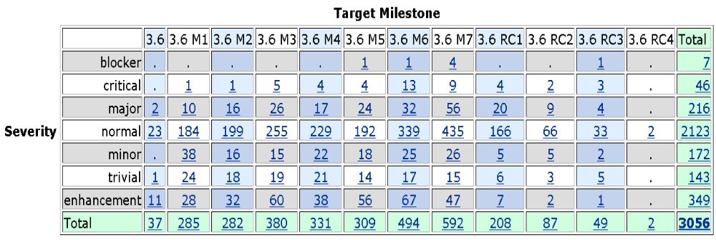
Bugs fixed during 3.6

Slide 19
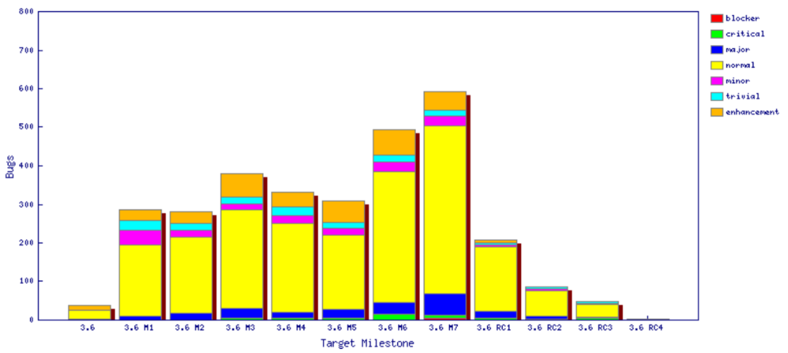
Fixed bugs

Slide 20
Standards
Annotation Processing APIs
  com.sun.mirror 1.5
  javax.annotation.processing 1.6
Java compiler API
  javax.tools 1.6
User Assistance consumes (parses) a small subset of RSS 1.0 to get news from eclipse.org
JUnit 3.8.2 and JUnit 4.8.1
J2SE
  Tools are built against J2SE 1.4
  Compiler can generate 1.3, 1.4, 1.5, and 1.6 code
  Clients can run 1.4, 1.5 or 1.6.
SWT
  Win32, GDI, GDI+, OLE, IE, Carbon, Cocoa, Core Graphics, Quick Draw, Safari, ATSUI, X Windows, X/t, Motif, GTK, GDK, Pango, cairo, ATK, Mozilla, Uniscribe, WPF, OpenGL

Slide 21
UI Usability
Strings are externalized to support translation into other languages.
Extensive use of mnemonics and shortcut keys in the user interface enhances usability.
Full Bidirectional support (mirroring) on Windows and Linux GTK, bidirectional text on Mac OS X
Accessibility support for Windows, Linux GTK and Mac OS X
Eclipse User Interface Guidelines followed

Slide 22
Schedule
Milestones every 6 weeks, 6 cycle duration
  API frozen on March 12 (M6), Feature freeze April 20 (M7)
  http://www.eclipse.org/projects/project-plan.php?projectid=eclipse#release_milestones
Tracked schedule
  All milestones delivered as planned
End game (release candidate) milestones for 4 cycles
  Duration reduced from 2-week to 1-week cycles at RC2 milestone
  No new features or API allowed without proper approvals
  Development to end on June 3, 2010
  Increasingly stringent approval, checking, and change notification requirements in this stage
  http://www.eclipse.org/eclipse/development/plans/freeze_plan_3.6.php

Slide 23
Process
The Eclipse project is developed using an open, transparent, and inclusive process
Teams rely on Bugzilla, mailing lists and newsgroups for input
Weekly planning calls conducted with the PMC and component leads
  Meeting minutes posted to the eclipse-dev mailing list
  Public PMC minutes: http://wiki.eclipse.org/Eclipse/PMC
Component teams have publicly available milestone plans
  Use project’s web space on eclipse.org to broadcast component milestone plan items and provide status on each item, per milestone

Slide 24
Community
Eclipse team members are active in Bugzilla, newsgroups, and mailing lists
Blogs started by Eclipse committers are evolving
  Use blogging infrastructure at Eclipse.org
  http://planeteclipse.org
  Some teams are using the eclipse-dev IRC channel
  irc.freenode.net#eclipse-dev
  irc://irc.freenode.net/#eclipse-e4
  also see: http://wiki.eclipse.org/index.php/IRC
The Eclipse team participates in code camps, conference presentations, and tutorials, including
  EclipseCon, JavaOne, JavaWorld, JAOO, Eclipse Summit Europe, Eclipse Forum Europe, JAX, JAX Asia, Eclipse Day India
The Eclipse team interacts with other open source projects, standards bodies, and other projects on eclipse.org, including
  OSGi, Apache Ant, JLS, WTP, Apache Harmony, GCJ, GTK

Slide 25
IP Issues
All significant and third party contributions have been reviewed and approved by Eclipse legal.
Eclipse Software User Agreement updated to April 14, 2010 version for all delivered features
About files and license files are complete and correct.
Draft project logs:
  http://www.eclipse.org/projects/ip_log.php?projectid=eclipse.platform
  http://www.eclipse.org/projects/ip_log.php?projectid=eclipse.pde
  http://www.eclipse.org/projects/ip_log.php?projectid=eclipse.jdt

Slide 26
Project Plan for Eclipse 3.7/4.x
4.0 early adopter release scheduled for July 2010
  Similar functionality to 3.6, but with new technology from e4
  New look and feel
  Widget styling with CSS
  New programming model using injection and services
  http://wiki.eclipse.org/Eclipse/Eclipse_SDK_4.0_FAQ
3.7 release planned for June 2011
  Java 7 support
  Accessibility improvements
  Focus on stability
4.1 release planned for June 2011
  Exploit new capabilities made available by e4 technology
  Focus on innovation and improved platform API
  Will include all features added in 3.7 release

