Slide 1
[________________________]
Eclipse project briefing materials.
Copyright (c) 2002, 2003 IBM Corporation and others. All rights reserved. This content is made available to you by Eclipse.org under the terms and conditions of the Common Public License Version 1.0 ("CPL"), a copy of which is available at
http://www.eclipse.org/legal/cpl-v10.html
The most up-to-date briefing materials on the Eclipse project are found on the eclipse.org website at
http://eclipse.org/eclipse/
Notes:
Note: Dummy separator slide. This slide is hidden during presentations.

Slide 2
[________________________]
Revision history:
Mar. 31, 2003 – Updated for 2.1; new board members
Sept. 4, 2002 – Initial version by Jim des Rivières (OTI)
Notes:
Note: Dummy separator slide. This slide is hidden during presentations.

Slide 3
Eclipse Project

Slide 4
Eclipse Project Aims
Provide open platform for application development tools
  Run on a wide range of operating systems
  GUI and non-GUI
Language-neutral
  Permit unrestricted content types
  HTML, Java, C, JSP, EJB, XML, GIF, …
Facilitate seamless tool integration
  At UI and deeper
  Add new tools to existing installed products
Attract community of tool developers
  Including independent software vendors (ISVs)
  Capitalize on popularity of Java for writing tools

Slide 5
Eclipse Overview
Eclipse Platform
Another
Tool
Java
Development
Tools
(JDT)
Workbench
Help
JFace
SWT
Team
Your
Tool
Plug-in
Development
Environment
(PDE)
Workspace
Debug
Platform Runtime
Their
Tool
Eclipse Project
Notes:
If you only get to show one slide, this is the one that best captures “The Big Picture”.

Slide 6
[________________________]
Slides that provide non-technical background info on Eclipse.
Notes:
Note: Dummy separator slide. This slide is hidden during presentations.

Slide 7
Eclipse Origins
Eclipse created by OTI and IBM teams responsible for IDE products
  IBM VisualAge/Smalltalk (Smalltalk IDE)
  IBM VisualAge/Java (Java IDE)
  IBM VisualAge/Micro Edition (Java IDE)
Initially staffed with 40 full-time developers
Geographically dispersed development teams
  OTI Ottawa, OTI Minneapolis, OTI Zurich, IBM Toronto, OTI Raleigh, IBM RTP, IBM St. Nazaire (France)
Effort transitioned into open source project
  IBM donated initial Eclipse code base
    Platform, JDT, PDE
Notes:
Tidbit: In the early days of the project, the internal name for the Eclipse Platform was “VA/Base”.

Slide 8
Brief History of Eclipse
1999
April - Work begins on Eclipse inside OTI/IBM
2000
June - Eclipse Tech Preview ships
2001
March - http://www.eclipsecorner.org/ opens
June - Eclipse 0.9 ships
October - Eclipse 1.0 ships
November - IBM donates Eclipse source base
- eclipse.org board announced
- http://www.eclipse.org/ opens
2002
June - Eclipse 2.0 ships
September - Eclipse 2.0.1 ships
November - Eclipse 2.0.2 ships
2003
March - Eclipse 2.1 ships

Slide 9
[________________________]
Slides that provide technical background info on Eclipse Platform’s plug-in architecture.
Notes:
Note: Dummy separator slide. This slide is hidden during presentations.

Slide 10
What is Eclipse?
Eclipse is a universal platform
for integrating development tools
Open, extensible architecture based on plug-ins
Plug-in development
environment
PDE
Java development
tools
JDT
Eclipse Platform
Platform
Standard Java2
Virtual Machine
Java VM
Notes:
[Contains animated elements]

Slide 11
Eclipse Plug-in Architecture
Plug-in - smallest unit of Eclipse function
  Big example: HTML editor
  Small example: Action to create zip files
Extension point - named entity for collecting “contributions”
  Example: extension point for workbench preference UI
Extension - a contribution
  Example: specific HTML editor preferences

Slide 12
Eclipse Plug-in Architecture
Each plug-in
  Contributes to 1 or more extension points
  Optionally declares new extension points
  Depends on a set of other plug-ins
  Contains Java code libraries and other files
  May export Java-based APIs for downstream plug-ins
  Lives in its own plug-in subdirectory
Details spelled out in the plug-in manifest
  Manifest declares contributions
  Code implements contributions and provides API
  plugin.xml file in root of plug-in subdirectory

Slide 13
Plug-in Manifest
plugin.xml
<plugin
id = “com.example.tool"
name = “Example Plug-in Tool"
class = "com.example.tool.ToolPlugin">
<requires>
<import plugin = "org.eclipse.core.resources"/>
<import plugin = "org.eclipse.ui"/>
</requires>
<runtime>
<library name = “tool.jar"/>
</runtime>
<extension
point = "org.eclipse.ui.preferencepages">
<page id = "com.example.tool.preferences"
icon = "icons/knob.gif"
title = “Tool Knobs"
class = "com.example.tool.ToolPreferenceWizard“/>
</extension>
<extension-point
name = “Frob Providers“
id = "com.example.tool.frobProvider"/>
</plugin>
Plug-in identification
Other plug-ins needed
Location of plug-in’s code
Declare contribution
this plug-in makes
Declare new extension point open to contributions from other plug-ins
Notes:
[Contains animated elements]

Slide 14
Eclipse Plug-in Architecture
Typical arrangement
plug-in A
plug-in B
extension
point P
contributes
extension
interface I
implements
class C
creates, calls
Plug-in A
  Declares extension point P
  Declares interface I to go with P
Plug-in B
  Implements interface I with its own class C
  Contributes class C to extension point P
Plug-in A instantiates C and calls its I methods

Slide 15
Eclipse Platform Architecture
Eclipse Platform Runtime is micro-kernel
  All functionality supplied by plug-ins
Eclipse Platform Runtime handles start up
  Discovers plug-ins installed on disk
  Matches up extensions with extension points
  Builds global plug-in registry
  Caches registry on disk for next time

Slide 16
Plug-in Activation
Each plug-in gets its own Java class loader
  Delegates to required plug-ins
  Restricts class visibility to exported APIs
Contributions processed without plug-in activation
  Example: Menu constructed from manifest info for contributed items
Plug-ins are activated only as needed
  Example: Plug-in activated only when user selects its menu item
  Scalable for large base of installed plug-ins
  Helps avoid long start up times

Slide 17
Plug-in Fragments
Plug-in fragments holds some of plug-in’s files
  Separately installable
Each fragment has separate subdirectory
  Separate manifest file
Logical plug-in = Base plug-in + fragments
Plug-in fragments used for
  Isolation of OS dependencies
  Internalization – fragments hold translations

Slide 18
Plug-in Install
Features group plug-ins into installable chunks
  Feature manifest file
Plug-ins and features bear version identifiers
  major . minor . service
  Multiple versions may co-exist on disk
Features downloadable from web site
  Using Eclipse Platform update manager
  Obtain and install new plug-ins
  Obtain and install updates to existing plug-ins

Slide 19
Plug-in Architecture - Summary
All functionality provided by plug-ins
  Includes all aspects of Eclipse Platform itself
Communication via extension points
  Contributing does not require plug-in activation
Packaged into separately installable features
  Downloadable
Eclipse has open, extensible architecture based on plug-ins
Notes:
[Contains animated elements]

Slide 20
[________________________]
  Slides that provide technical background info on various Eclipse Platform components.
Notes:
Note: Dummy separator slide. This slide is hidden during presentations.

Slide 21
Eclipse Platform
Eclipse Platform is the common base
Consists of several key components
Eclipse Platform
Workbench
Team
Help
Debug
“UI”
JFace
SWT
“Core”
Workspace
Ant
Platform Runtime
Notes:
[Contains animated elements]

Slide 22
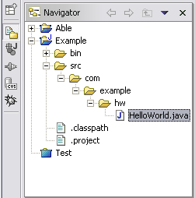
Workspace Component
Tools operate on files in user’s workspace
Workspace holds 1 or more top-level projects
Projects map to directories in file system
Tree of folders and files
{Files, Folders, Projects} termed resources
Tools read, create, modify, and delete resources in workspace
Plug-ins access via workspace and resource APIs

Slide 23
Workspace and Resource API
Allows fast navigation of workspace resource tree
Resource change listener for monitoring activity
  Resource deltas describe batches of changes
Maintains limited history of changed/deleted files
Several kinds of extensible resource metadata
  Persistent resource properties
  Session resource properties
  Markers
  Project natures
Workspace session lifecycle
  Workspace save, exit, restore
Incremental project builders

Slide 24
Incremental Project Builders
Problem: coordinated analysis and transformation of thousands of files
  Compiling all source code files in project
  Checking for broken links in HTML files
Scalable solution requires incremental reanalysis
Incremental project builder API/framework
  Builders are passed resource delta
  Delta describes all changes since previous build
  Basis for incremental tools
Extensible – plug-ins define new types of builders
  JDT defines Java builder
Configurable – any number of builders per project

Slide 25
Workbench Component
Workbench
JFace
SWT
SWT – generic low-level graphics and widget set
JFace – UI frameworks for common UI tasks
Workbench – UI personality of Eclipse Platform

Slide 26
SWT
SWT = Standard Widget Toolkit
Generic graphics and GUI widget set
  buttons, lists, text, menus, trees, styled text...
Simple
Small
Fast
OS-independent API
Uses native widgets where available
Emulates widgets where unavailable
Notes:
How small? SWT is about 200 classes, with a 200 KB native library.
By comparison, AWT/Swing is about 1000 classes, with a 1 MB native library.

Slide 27
Why SWT?
Consensus: hard to produce professional looking shrink-wrapped products using Swing and AWT
SWT provides
  Tight integration with native window system
  Authentic native look and feel
  Good performance
  Good portability
  Good base for robust GUIs
The proof of the pudding is in the eating…
Notes:
Controversial decision to use SWT over Swing/AWT.

Slide 28
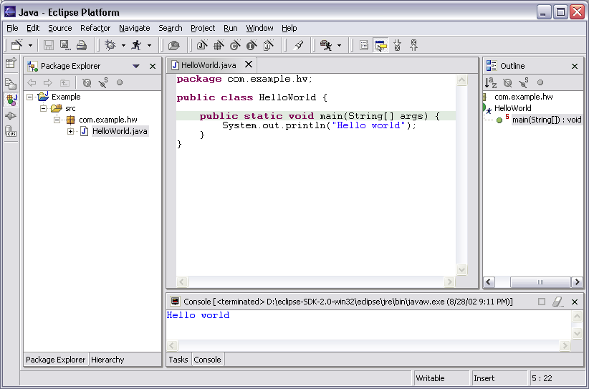
Why SWT?
Eclipse Platform on Windows XP

Slide 29
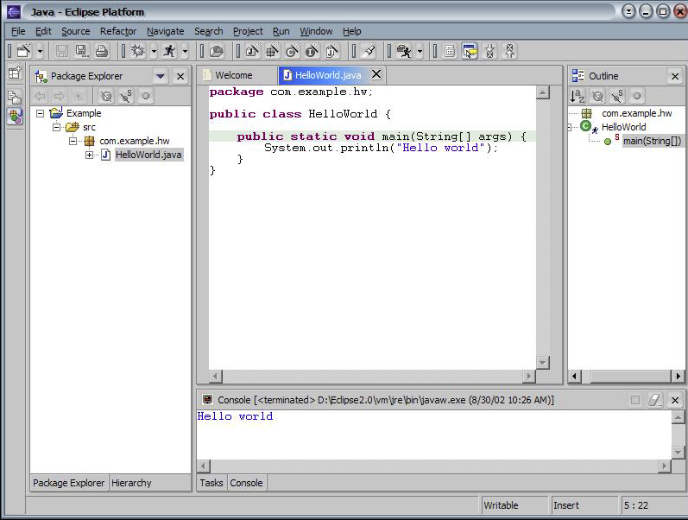
Why SWT?
Eclipse Platform on Windows XP (skinned)
Notes:
Windows XP allows customs skins to be applies to widgets to alter overall appearance.

Slide 30
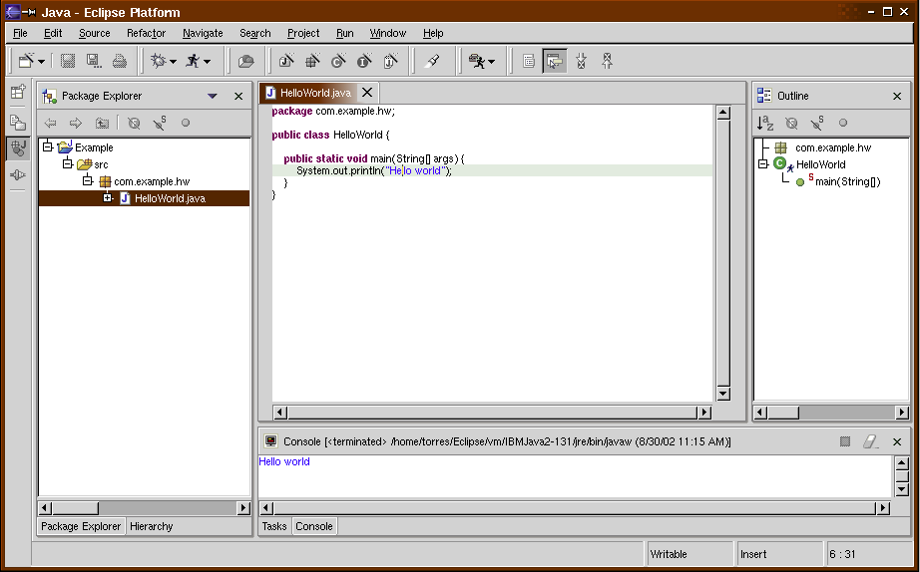
Why SWT?
Eclipse Platform on Linux - GTK 2.0

Slide 31
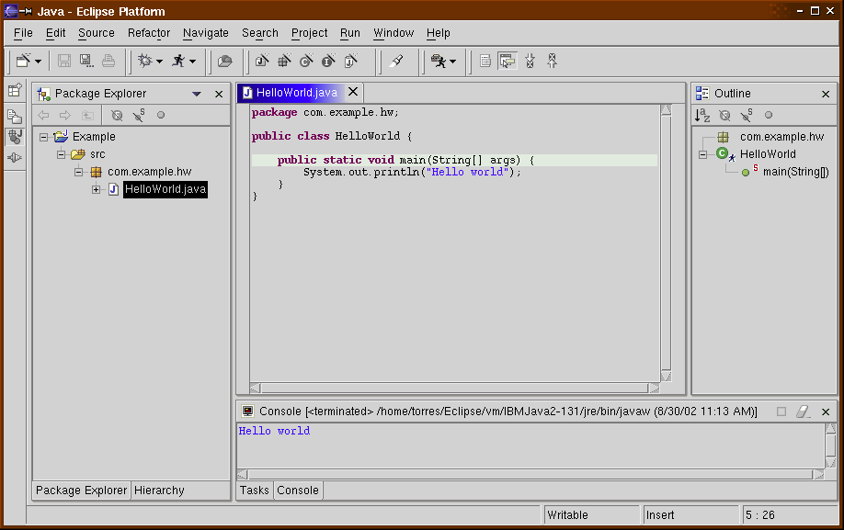
Why SWT?
Eclipse Platform on Linux - Motif
Notes:
Motif on HP-UX, Solaris, and AIX look pretty much the same – ugly.

Slide 32
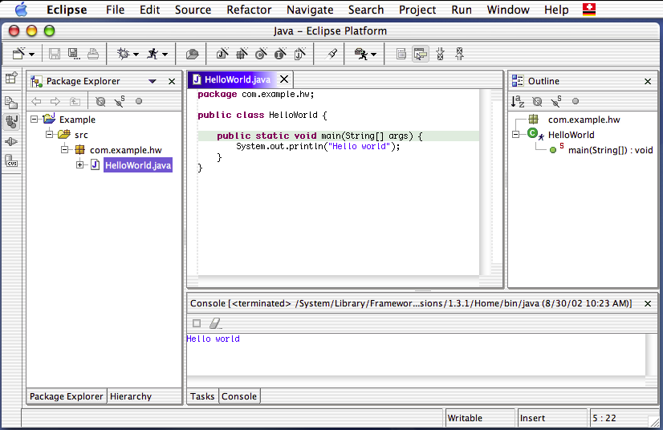
Why SWT?
Eclipse Platform on Mac OS X - Carbon

Slide 33
JFace
JFace is set of UI frameworks for common UI tasks
Designed to be used in conjunction with SWT
Classes for handling common UI tasks
API and implementation are window-system independent

Slide 34
JFace APIs
Image and font registries
Dialog, preference, and wizard frameworks
Structured viewers
  Model-aware adapters for SWT tree, table, list widgets
Text infrastructure
  Document model for SWT styled text widget
  Coloring, formatting, partitioning, completion
Actions
  Location-independent user commands
  Contribute action to menu, tool bar, or button

Slide 35
Workbench Component
Workbench is UI personality of Eclipse Platform
UI paradigm centered around
  Editors
  Views
  Perspectives

Slide 36
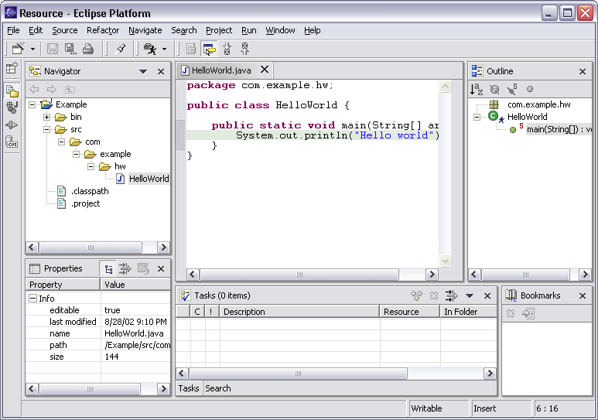
Workbench Terminology
Menu bar
Text
editor
Tool bar
Perspective
and
Fast View
bar
Outline
view
Resource
Navigator
view
Bookmarks
view
Properties
view
Message
area
Editor
Status
area
Stacked
views
Tasks
view
Notes:
[Contains animated elements]

Slide 37
Editors
Editors appear in workbench editor area
Contribute actions to workbench menu and tool bars
Open, edit, save, close lifecycle
Open editors are stacked
Extension point for contributing new types of editors
Example: JDT provides Java source file editor
Eclipse Platform includes simple text file editor
Windows only: embed any OLE document as editor
Extensive text editor API and framework

Slide 38
Views
Views provide information on some object
Views augment editors
  Example: Outline view summarizes content
Views augment other views
  Example: Properties view describes selection
Extension point for new types of views
Eclipse Platform includes many standard views
  Resource Navigator, Outline, Properties, Tasks, Bookmarks, Search, …
View API and framework
  Views can be implemented with JFace viewers

Slide 39
Perspectives
Perspectives are arrangements of views and editors
Different perspectives suited for different user tasks
Users can quickly switch between perspectives
Task orientation limits visible views, actions
  Scales to large numbers of installed tools
Perspectives control
  View visibility
  View and editor layout
  Action visibility
Extension point for new perspectives
Eclipse Platform includes standard perspectives
  Resource, Debug, …
Perspective API

Slide 40
Other Workbench Features
Tools may also
  Add global actions
  Add actions to existing views and editors
  Add views, action sets to existing perspectives
Eclipse Platform is accessible (Section 508)
Accessibility mechanisms available to all plug-ins

Slide 41
Workbench Responsibilities
Eclipse Platform manages windows and perspectives
Eclipse Platform creates menu and tool bars
  Labels and icons listed in plug-in manifest
  Contributing plug-ins not activated
Eclipse Platform creates views and editors
  Instantiated only as needed
Scalable to large numbers of installed tools

Slide 42
Team Component
Version and configuration management (VCM)
Share resources with team via a repository
Repository associated at project level
Extension point for new types of repositories
Repository provider API and framework
Eclipse Platform includes CVS repository provider
Available repository providers*
  ChangeMan (Serena) - AllFusion Harvest (CA)
  ClearCase (Rational) - Perforce
  CM Synergy (Telelogic) - Source Integrity (MKS)
  PVCS (Merant) - TeamCode (Interwoven)
  Microsoft Visual Source Safe
* March 2003

Slide 43
Team Component
Repository providers have wide latitude
  Provide actions suited to repository
  No built-in process model
Integrate into workbench UI via
  Share project configuration wizard
  Actions on Team menu
  Resource decorators
  Repository-specific preferences
  Specialized views for repository browsing, …

Slide 44
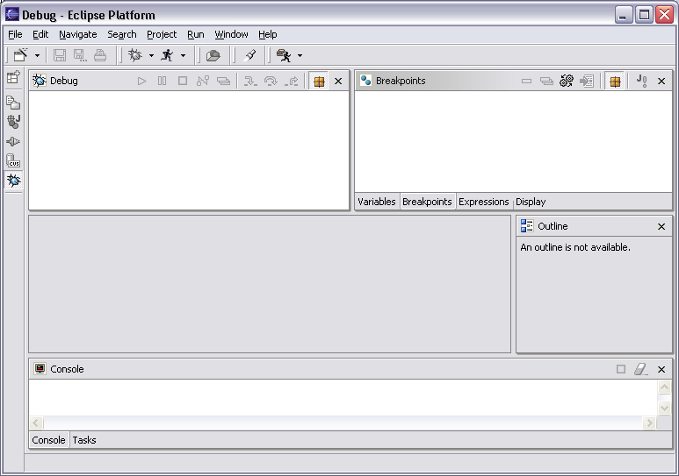
Debug Component
Common debug UI and underlying debug model

Slide 45
Debug Component
Launch configurations
  How to run a program (debug mode option)
Generic debug model
  Standard debug events: suspended, exit, …
  Standard debug actions: resume, terminate, step, …
  Breakpoints
  Expressions
  Source code locator
Generic debug UI
  Debug perspective
  Debug views: stack frames, breakpoints, …
Example: JDT supplies Java launcher and debugger
  Java debugger based on JPDA
Debug mechanisms available to other plug-ins

Slide 46
Ant Component
Eclipse incorporates Apache Ant
Ant is Java-based build tool
  “Kind of like Make…without Make's wrinkles”
XML-based build files instead of makefiles
Available from workbench External Tools menu
Run Ant targets in build files inside or outside workspace
PDE uses Ant for building deployed form of plug-in

Slide 47
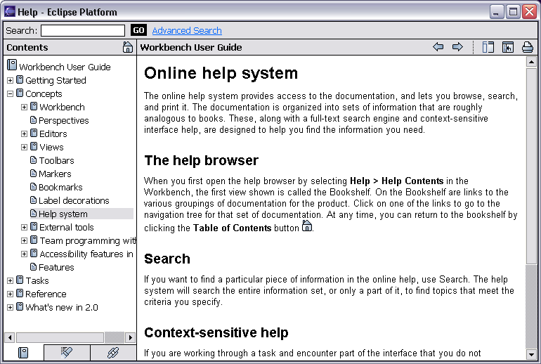
Help Component
Help is presented in a standard web browser

Slide 48
Help Component
Help books are HTML webs
Extension points for contributing
  entire books
  sections to existing books
  F1-help pop ups
Eclipse Platform contributes
  “Workbench User Guide”
  “Platform Plug-in Developer Guide” (APIs)
  F1-help for views, editors, dialogs, …
JDT and PDE contribute their own help
Help mechanisms available to all plug-ins
Help search engine based on Apache Lucene
Headless help server based on Apache Tomcat

Slide 49
Internationalization
Eclipse Platform is internationalized
2.0 translations available for following languages
  English German
  Spanish Italian
  French Portugese (Brazil)
  Japanese Korean
  Chinese (Traditional) Chinese (Simplified)
Translations live in plug-in fragments
  Separately shippable
Internalization mechanisms available to all plug-ins

Slide 50
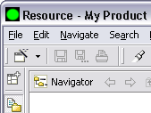

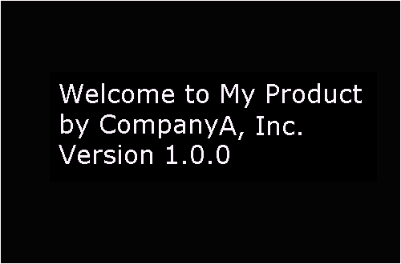
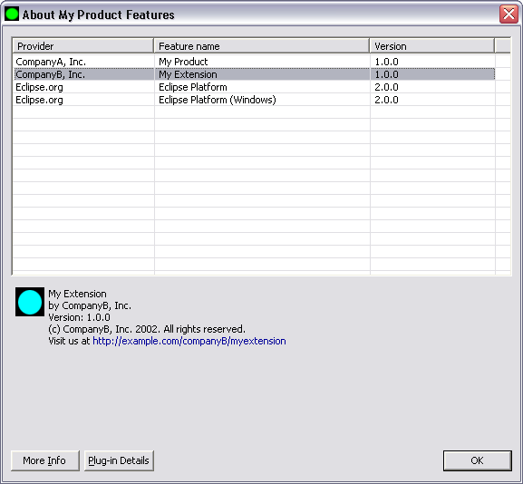
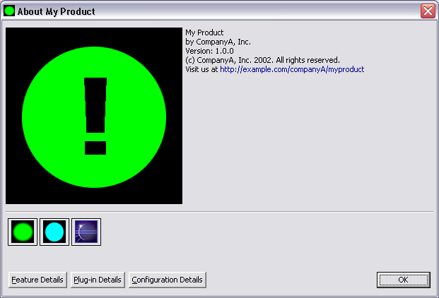
Product Information
Window
image
Welcome
pages
Splash
screen
About
product
info
About
feature
info
Notes:
[Contains animated elements]

Slide 51
Product Information
Primary feature controls product information
  Splash screen
  Window image
  About product info
  Initial welcome page
  Default perspective
  Preference default overrides
All features can provide
  Welcome page
  About feature info

Slide 52
Eclipse Platform - Summary
Eclipse Platform is the nucleus of IDE products
Plug-ins, extension points, extensions
  Open, extensible architecture
Workspace, projects, files, folders
  Common place to organize & store development artifacts
Workbench, editors, views, perspectives
  Common user presentation and UI paradigm
Key building blocks and facilities
  Help, team support, internationalization, …
Eclipse is a universal platform for
integrating development tools
Notes:
[Contains animated elements]

Slide 53
[________________________]
  Slides that provide technical background info on JDT.
Notes:
Note: Dummy separator slide. This slide is hidden during presentations.

Slide 54
Java Development Tools
JDT = Java development tools
State of the art Java development environment
Built atop Eclipse Platform
  Implemented as Eclipse plug-ins
  Using Eclipse Platform APIs and extension points
Included in Eclipse Project releases
  Available as separately installable feature
  Part of Eclipse SDK drops

Slide 55
JDT Goals
Goal: To be #1 Java IDE
Goal: To make Java programmers smile

Slide 56
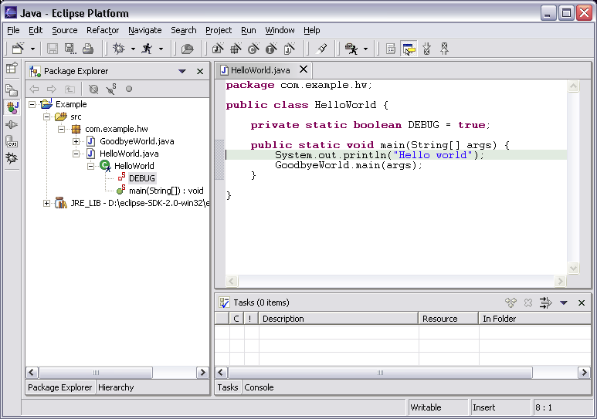
Java Perspective
Java-centric view of files in Java projects
  Java elements meaningful for Java programmers
Java
project
package
class
field
method
Java
editor

Slide 57
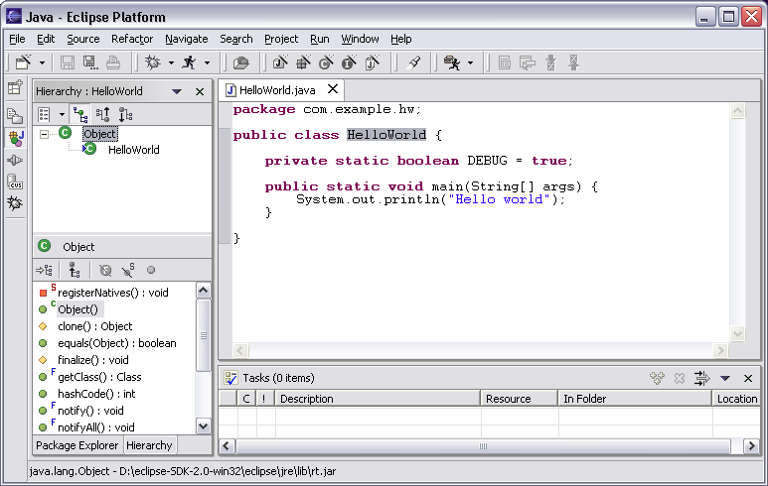
Java Perspective
Browse type hierarchies
  “Up” hierarchy to supertypes
  “Down” hierarchy to subtypes
Type
hierarchy
Selected
type’s
members

Slide 58
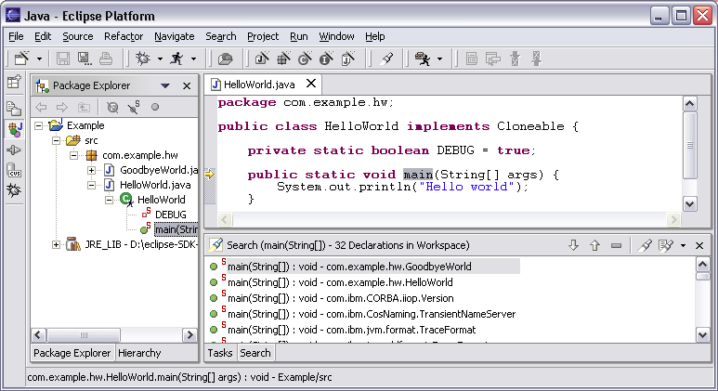
Java Perspective
Search for Java elements
  Declarations or references
  Including libraries and other projects
Hits
flagged
in margin
of editor
All search results

Slide 59
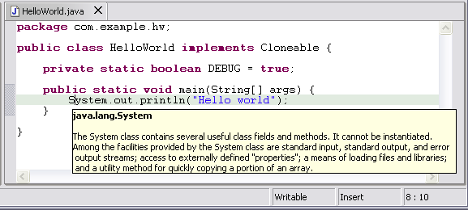
Java Editor
Hovering over identifier shows Javadoc spec
Notes:
[Contains animated elements]

Slide 60
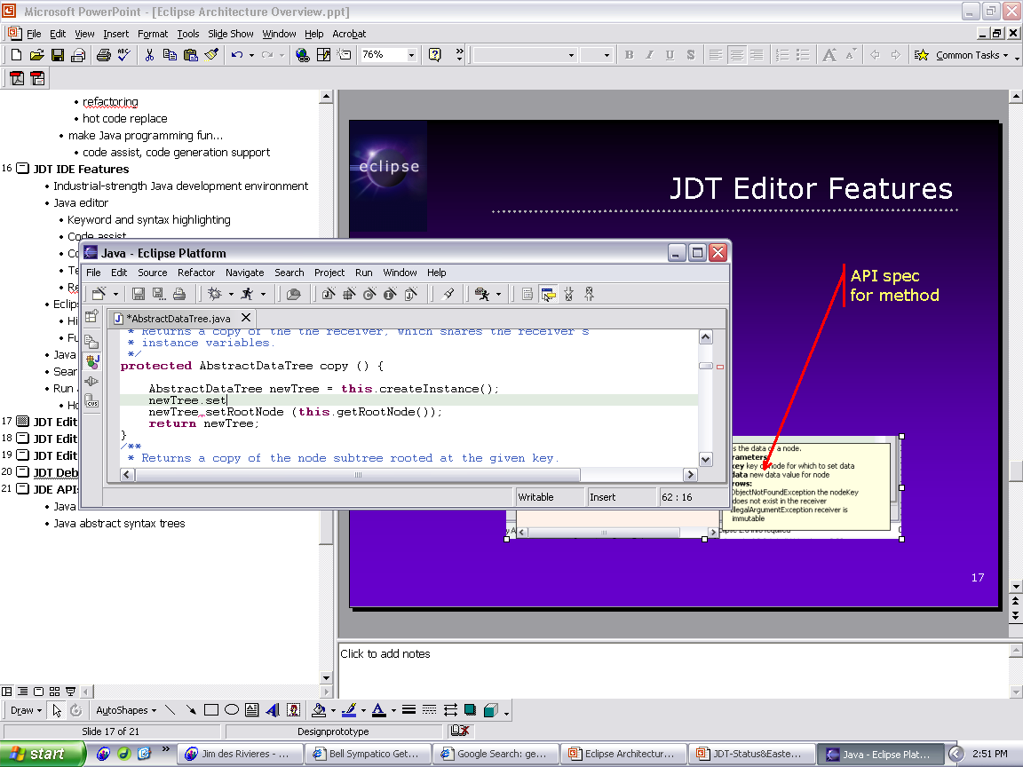
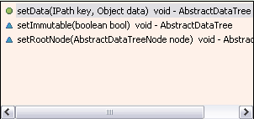
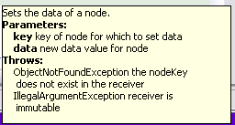
Java Editor
Method completion in Java editor
List of plausible methods
Doc for method
Notes:
[Contains animated elements]

Slide 61
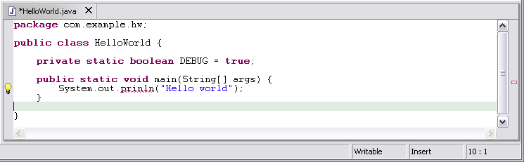
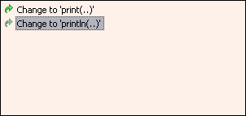
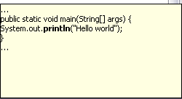
Java Editor
On-the-fly spell check catches errors early
Click
to see
fixes
Problem
Preview
Quick
fixes
Notes:
[Contains animated elements]
Syntax and spell checking are done on-the-fly.
Calls Java compiler to parse source code and resolve names in context.
Developers refer to those wavy red lines as “the red sea” :-).
Problem markers are appear in the left margin of editor.
“Red X” instead of “light bulb” if no proposed corrections.

Slide 62
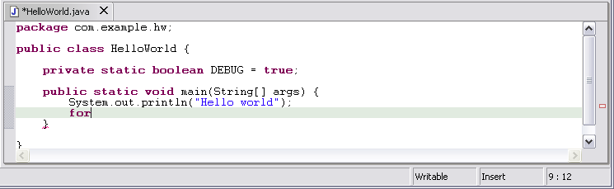
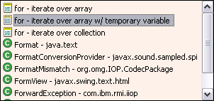
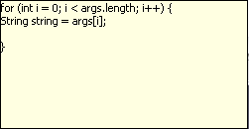
Java Editor
Code templates help with drudgery
Statement
template
Preview
Notes:
[Contains animated elements]

Slide 63

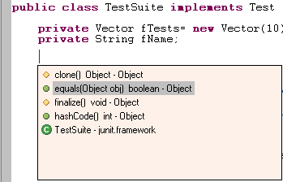
Java Editor
Java editor creates stub methods
Method stub insertion for anonymous inner types
Method stub insertion
for inherited methods
Notes:
[Contains animated elements]

Slide 64
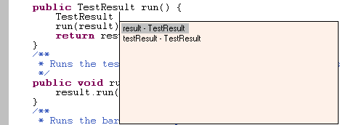
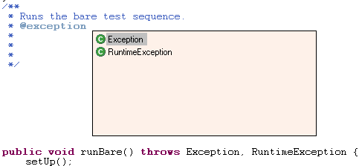

Java Editor
Java editor helps programmers write good Java code
Variable name
suggestion
JavaDoc
code assist
Argument hints and
proposed argument
names
Notes:
[Contains animated elements]

Slide 65
Java Editor
Other features of Java editor include
  Local method history
  Code formatter
  Source code for binary libraries
  Built-in refactoring

Slide 66
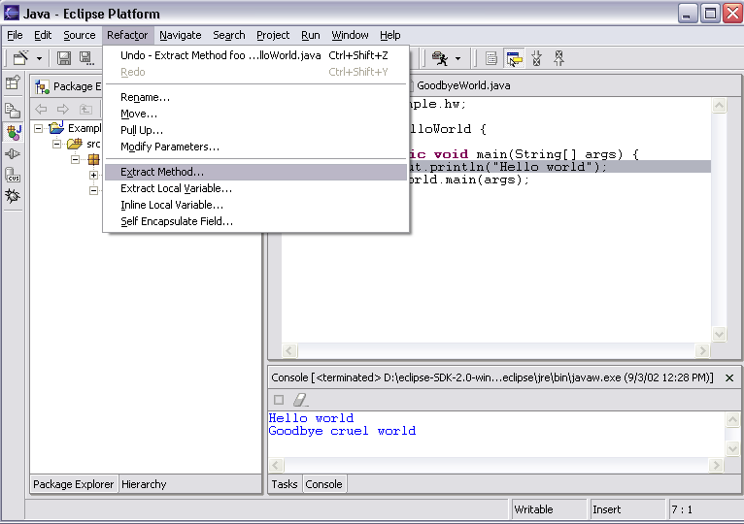
Refactoring
JDT has actions for refactoring Java code

Slide 67
Refactoring
Refactoring actions rewrite source code
  Within a single Java source file
  Across multiple interrelated Java source files
Refactoring actions preserve program semantics
  Does not alter what program does
  Just affects the way it does it
Encourages exploratory programming
Encourages higher code quality
  Makes it easier to rewrite poor code

Slide 68
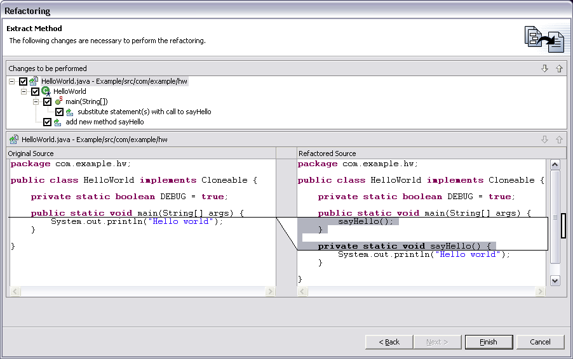
Refactoring
Full preview of all ensuing code changes
  Programmer can veto individual changes
List of changes
“before” vs. “after”
Notes:
Screen shot shows Extract Method applied to the print statement in HelloWorld.main method.

Slide 69
Refactoring
Growing catalog of refactoring actions
  Organize imports
  Rename {field, method, class, package}
  Move {field, method, class}
  Extract {method, local variable, interface}
  Inline {method, local variable}
  Reorder method parameters
  Push members down
  …

Slide 70
Eclipse Java Compiler
Eclipse Java compiler
  JCK-compliant Java compiler (selectable 1.3 and 1.4)
  Helpful error messages
  Generates runnable code even in presence of errors
  Fully-automatic incremental recompilation
  High performance
  Scales to large projects
Multiple other uses besides the obvious
  Syntax and spell checking
  Analyze structure inside Java source file
  Name resolution
  Content assist
  Refactoring
  Searches
Notes:
Scales to large projects, like Eclipse itself.

Slide 71
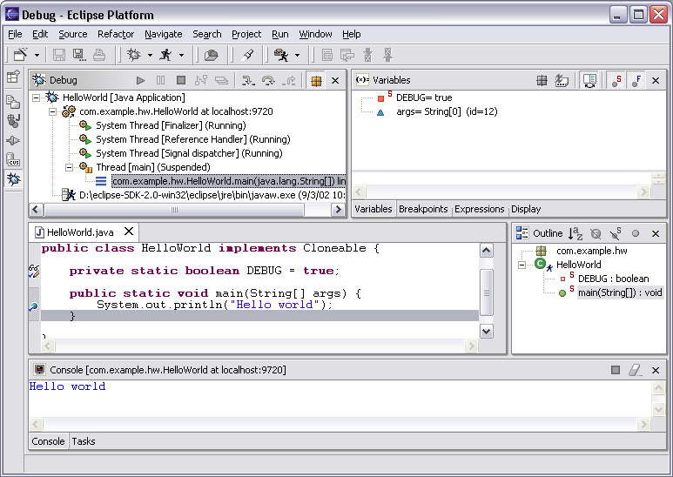
Eclipse Java Debugger
Run or debug Java programs
Local variables
Threads and stack frames
Editor with breakpoint marks
Console I/O

Slide 72
Eclipse Java Debugger
Run Java programs
  In separate target JVM (user selectable)
  Console provides stdout, stdin, stderr
  Scrapbook pages for executing Java code snippets
Debug Java programs
  Full source code debugging
  Any JPDA-compliant JVM
Debugger features include
  Method and exception breakpoints
  Conditional breakpoints
  Watchpoints
  Step over, into, return; run to line
  Inspect and modify fields and local variables
  Evaluate snippets in context of method
  Hot swap (if target JVM supports)

Slide 73
JDT APIs
JDT APIs export functionality to other plug-ins
Java model
  Java-centric analog of workspace
  Tree of Java elements (down to individual methods)
  Java element deltas
  Type hierarchies
  Model accurate independent of builds
Building blocks
  Java scanner
  Java class file reader
  Java abstract syntax trees (down to expressions)
Many others…

Slide 74






Eclipse JDT - Summary
JDT is a state of the art Java IDE
Java views, editor, refactoring
  Helps programmer write and maintain Java code
Java compiler
  Takes care of translating Java sources to binaries
Java debugger
  Allows programmer to get inside the running program
Eclipse Java
programmmers

Slide 75
[________________________]
  Slides that provide technical background info on PDE.
Notes:
Note: Dummy separator slide. This slide is hidden during presentations.

Slide 76
Plug-in Development Environment
PDE = Plug-in development environment
Specialized tools for developing Eclipse plug-ins
Built atop Eclipse Platform and JDT
  Implemented as Eclipse plug-ins
  Using Eclipse Platform and JDT APIs and extension points
Included in Eclipse Project releases
  Separately installable feature
  Part of Eclipse SDK drops

Slide 77
PDE Goals
Goal: To make it easier to develop Eclipse plug-ins
Goal: Support self-hosted Eclipse development

Slide 78
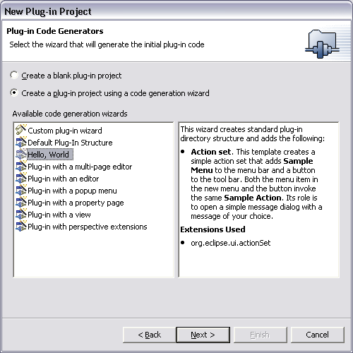
PDE
PDE templates for creating simple plug-in projects

Slide 79
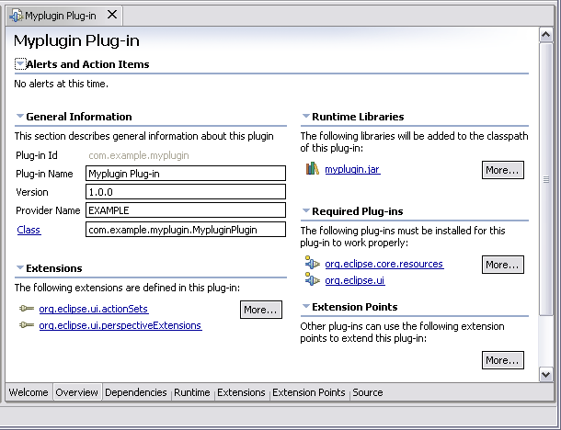
PDE
Specialized PDE editor for plug-in manifest files

Slide 80
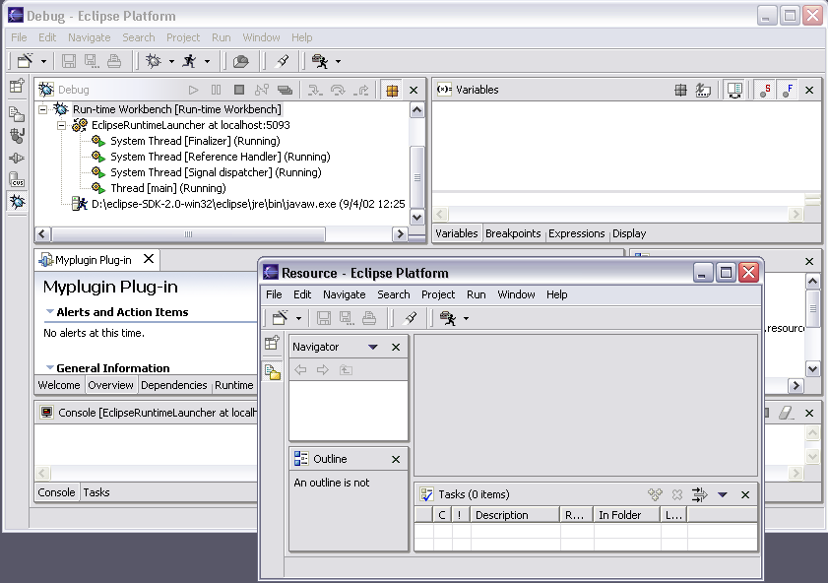
PDE
PDE runs and debugs another Eclipse workbench
1. Workbench
running PDE
(host)
2. Run-time
workbench
(target)

Slide 81
PDE - Summary
PDE makes it easier to develop Eclipse plug-ins
PDE also generates Ant build scripts
  Compile and create deployed form of plug-in
PDE is basis for self-hosted
Eclipse development

Slide 82
[________________________]
  Slides about what operating environments Eclipse runs in.
Notes:
Note: Dummy separator slide. This slide is hidden during presentations.

Slide 83
Eclipse Operating Environments
Eclipse Platform currently* runs on
  Microsoft® Windows® XP, 2000, NT, ME, 98SE
  Linux® on Intel x86 - Motif, GTK
    RedHat Linux 8.0 x86
    SuSE Linux 8.1 x86
  Sun Solaris 8 SPARC – Motif
  HP-UX 11i hp9000 – Motif
  IBM® AIX 5.1 on PowerPC – Motif
  Apple Mac OS® X 10.2 on PowerPC – Carbon
  QNX® Neutrino® RTOS 6.2.1 - Photon®
* Eclipse 2.1 - March 2003

Slide 84
Other Operating Environments
Most Eclipse plug-ins are 100% pure Java
  Freely port to new operating environment
  Java2 and Eclipse APIs insulate plug-in from OS and window system
Gating factor: porting SWT to native window system
Just added in 2.1*
  Mac OS X PowerPC – Carbon window system
  QNX Neutrino RTOS Intel x86 - Photon window system
Eclipse Platform also runs “headless”
  Example: help engine running on server
* March 2003
Notes:
Gating factor for “headless” is availability of production quality Java 2 Runtime Environment.

Slide 85
[________________________]
  Slides about who are involved with and committed to Eclipse.
Notes:
Note: Dummy separator slide. This slide is hidden during presentations.

Slide 86

















Who’s on Board?
Wide range of software vendors on Eclipse board
Represent various development tool markets
*As of August 2002

Slide 87








Who’s on Board?
New members joined Sept.-Dec. 2002

Slide 88
Who’s Shipping on Eclipse?
Commercial products*
10 Technology – Visual PAD
Assisi – V4ALL Assisi GUI-Builder
Bocaloco – XMLBuddy
Borland – Together Edition for WebSphere Studio
Catalyst Systems – Openmake
Computer Associates – AllFusion Harvest Change Manager VCM
Ensemble Systems – Glider for Eclipse
Fujitsu – Interstage
Genuitec – EASIE Plug-ins
HP – OpenCall Media Platform OClet Development Environment
James Holmes – Struts Console
Instantiations – CodePro Studio
* As of March 2003

Slide 89
Who’s Shipping on Eclipse?
IBM uses Eclipse for
  WebSphere^{® Studio Family}
    WebSphere Studio Homepage Builder
    WebSphere Studio Site Developer (WSSD)
    WebSphere Studio Application Developer (WSAD)
    WebSphere Studio Application Developer Integration Edition (WSADIE)
    WebSphere Studio Enterprise Developer (WSED)
    WebSphere Studio Device Developer (WSDD)
    WebSphere Development Studio for iSeries
  Rational® XDE Professional: Java Platform Edition
  Tivoli Monitoring Workbench
* As of March 2003

Slide 90
Who’s Shipping on Eclipse?
Commercial products*
Interwoven – TeamSite repository
Intland – CodeBeamer
LegacyJ – PERCobol
Merant – PVCS Version Manager
MKS – Source Integrity Enterprise plug-in
Mobile Media – Grand-Rapid Browser
mvmsoft – Slime UML
No Magic Inc. – MagicDraw UML
Object Edge – Weblogic Plug-in
ObjectLearn – Lomboz
Omondo – EclipseUML
Ontogenics – hyperModel
* As of March 2003

Slide 91
Who’s Shipping on Eclipse?
Commercial products*
Parasoft – Jtest
ProSyst – Eclipse OSGi Plug-in
QNX – QNX Momentics
Quest Software – JProbe integration
Serena Software – ChangeMan DS
SlickEdit – Visual SlickEdit Plug-in
Systinet – WASP Developer
THOUGHT – CocoBase Enterprise O/R
TimeSys – TimeStorm 2.0
xored – WebStudio IDE for PHP
* As of March 2003

Slide 92
Who’s Building on Eclipse?
Plus more than 40* other open source projects based on Eclipse
See http://eclipse.org/community/plugins.html
* As of March 2003

