Slide 1

Eclipse Project Indigo Release Review
Eclipse Project PMC

Slide 2
Highlights
Shipping two platform releases simultaneously with Indigo: 3.7 and 4.1
3.7 new features:
  New platforms: HP-UX GTK, 64-bit AIX, Red Hat Enterprise Linux 6
  Touch screen API, Lightweight workspace refresh, Native task tray integration, Install from file, Help system customization, PDE shared license build support
4.1 new features:
  Detached editors, improved drag support, major styling changes, NLS support
API quality:
  Both releases binary compatible for compliant plug-ins
  New API: 175 types, 123 methods
  Deprecated API: 5 types, 5 methods, 2 fields
  18 breaking changes (all caused by move to new version of Apache Lucene)
End-of-life issues:
  One bundle removed: org.eclipse.equinox.p2.metadata.generator
IP Clearance and Licenses:
  All licenses and about files are in place as per the Eclipse Development Process, the Due Diligence Process was followed for all contributions
Community and Committer Diversity:
  67 active committers in past 9 months
  Active organizations: Adobe, BestSolution, Eclipse Source, Freescale, IBM, Intel, SAP, Siemens, Sierra Wireless, Sonatype, Soyatec
  Geographies: Canada, India, Poland, U.K., USA, Switzerland, Germany, Austria, Japan, France
  Over 135 patches accepted from the community this release
Notes:
Committer info:
http://dash.eclipse.org/dash/commits/web-app/commit-count-loc.php?top=eclipse&range=1yr

Slide 3
Themes and Plan Items
Platforms
  BIDI enhancements
  Webkit on Windows
  Transition from Motif to GTK
  Adopt accessibility API
  Support for Java 7
Robustness
  Build at eclipse.org
  Help servlet API
  Resource filter improvements
Ease of Use
  Multi-touch support
  Problems view enhancements
  Help enhancements
http://www.eclipse.org/projects/project-plan.php?projectid=eclipse

Slide 4
Themes and Plan Items
Deferred plan items:
  Java SE 7 support (due to delayed Java 7 release, and lack of public specifications)
  Resource filter improvements
http://www.eclipse.org/projects/project-plan.php?projectid=eclipse

Slide 5
New and Noteworthy - Platform
Lightweight refresh on access
Showing state in problem view icon
Support for back/forward mouse buttons
Job image overlay in task item
Mac standard window menu items
Document proxy icons in Cocoa
GTK on HP-UX
GTK on AIX + 64-bit AIX
Derived resource encoding support
Install software from file
Install software from another product
Filtered install history
Open With context menu in editors
Shift reverses direction in Find dialog
New whitespace rendering options
New 'Open Hyperlink' command
Branch column in history view
Author information in compare editor
Changed SSH home directory on Windows
Undo support for breakpoints
Edit with keyboard in Expressions view
Builder framework enhancements
Help search refinement
Extension point for changing help main page
Remote help styling
Variables in launch shortcuts
Support SCM URL format in project sets
Test framework timeout diagnostics
Support for changing widget orientation
Accessible editable text support
Duplex printing
Tool shell support on Cocoa
Default linux browser moved to WebKitGTK
Wrappable text in buttons
Cocoa app menu bar support
Improved date/time widget on Cocoa and GTK
Cocoa system menu support

Slide 6
New and Noteworthy – Platform 4.1
Support for detached editors
Improved stack dragging
Editor area styling
Multi-drag sashes
NLS support in workbench model

Slide 7
New and Noteworthy - JDT
Open Java element from clipboard
More hyperlinks in Java editor
New quick assists:
  Introduce new local with cast
  Join variable declaration
  Exchange operands
  Wrap in parentheses
  Add missing case statements
Semantic coloring for abstract classes
Ctrl+drag to Call Hierarchy view
Navigate to @inheritDoc target
Navigate to break and continue targets
Format Java elements in Outline view
Disable smart indentation on 'Enter'
New quick assists in properties file editor
Escaped character hover in properties files
JUnit Test Suite wizard supports JUnit 4
Show latest JUnit test in all windows
Paste URL in JUnit view
New formatter options:
  New line after annotation
  Preserve whitespace before line comment
New option to include 'assert' in null analysis
Missing javadoc tags for method type parameters no longer reported by default
Improved detection of unused variables
Filtering in Java compiler preferences
Suppress unavoidable generic type problems
Compiler detects methods that can be static
JRE change detection
New “javadoc” token for @SuppressWarnings
Open type hierarchy on multiple type containers
Pinning the Call Hierarchy view
Configure 'Search In' in Call Hierarchy
History for breakpoint conditions
Prompt before deleting breakpoints
Quick outline shows inherited members for nested types

Slide 8
New and Noteworthy - PDE
PDE build model API
Launch configuration changes:
  Set default workspace location
  Headless application launching
Editable source attachments
Import plug-ins from repository
Target definition changes:
  Caching of remote targets
  Offline p2 target support
  Target update support
  Software site collaboration
  Automatic find source for target
  Improved target export wizard
Support for configuration properties in product editor
Share licenses between features
Include lists in API Ant tasks
Consumer usage reports
API use scan builder
Consumer reports in launch configurations
Ant task to report missing use scan references
Summaries for API tool Ant tasks

Slide 9
3.7 Plug-in Changes from 3.6
Added 3rd Party Plug-ins (4)
org.apache.lucene.core
org.eclipse.equinox.p2.publisher.eclipse
org.eclipse.equinox.p2.transport.ecf
org.eclipse.equinox.p2.ui.importexport
Removed 3rd Party Plug-ins (1)
org.eclipse.equinox.p2.metadata.generator
Note: 3rd party plug-ins are plug-ins consumed in the Eclipse SDK but not produced by the Eclipse Project

Slide 10
Non-Code Aspects
The 3.7 and 4.1 releases will contain updated User and ISV documentation
Community is very active
  Mailing lists, newsgroups, and forums have steady activity
  Blogs dedicated to Eclipse are active e.g.
    http://planeteclipse.org
  Wiki content is growing
    http://wiki.eclipse.org/index.php/Eclipse_Project
    E4 wiki: http://wiki.eclipse.org/E4

Slide 11
Non-Code Aspects
Internationalization
  Latin1 and Latin2 locales are supported in all operating environments
  DBCS locales are supported on all platforms
  BIDI locales supported on all platforms
  GB18030-1 Chinese codepage standard is supported on Windows, Linux GTK and Mac.
  Significant BIDI work in 3.7: widget mirroring
Localization
  Tested for Localization and participating in Babel Project
  Localization of modeled UI strings in 4.1
Accessibility
  Tested for accessibility
  Open accessibility bugs: 9 major, 0 critical, 0 blocker
  New accessibility API in 3.7: accessible text widget

Slide 12
Non-Code Aspects
Articles, examples, and tutorials
  New and updated articles and tutorials on eclipse.org
  Numerous Webinars and Podcasts
  Some of the new/updated articles and tutorials were provided by the Eclipse community

Slide 13
Platform Quality API
API quality is a collaborative effort that involves the experience of the developers working on the Eclipse project, and feedback from consumers.
API changes and proposed API additions are often broadcast to mailing lists to raise awareness of the changes and encourage discussion and feedback.
API changes between 3.6 and 3.7 are checked automatically by API tooling integrated into integration build process.
The 3.7 migration guide identifies 3 changes:
  http://dev.eclipse.org/viewcvs/index.cgi/org.eclipse.platform.doc.isv/porting/3.7/incompatibilities.html?view=co
  http://dev.eclipse.org/viewcvs/index.cgi/org.eclipse.jdt.doc.isv/porting/3.7/incompatibilities.html?view=co
  For each, a description of the change, what code is affected, and the action that needs to be taken is described.
  We are not aware of any API compliant plug-ins breaking as a result of these changes.
  The 3.7 migration guide also describes changes required to adopt mechanisms and APIs that are new in 3.7.
The PMC is comfortable supporting the API that is in the Eclipse project 3.7
All new API in 4.1 release is 'x-internal' provisional API

Slide 14
Tool Usability
Eclipse is a superior IDE for Java tooling and plug-in development
Many usability enhancements made in 3.7 to continue this tradition
  Lightweight resource refresh
  Improved target platform support in PDE
  Improved quick fix support in Problems view
  More unused Java code detection
  Undo support for breakpoint changes
  Many new quick assists and Java editing shortcuts
  And many more tooling improvements!

Slide 15
Architectural Issues
Primary runtime has moved to Java SE 5. Complementary functionality available on Java SE 6 (APT 6, compiler API)
Reference JREs for development and testing updated to most recent releases
Completed transition away from Motif – All *nix platforms now on GTK
4 new plug-ins, 1 removed plug-in
  1 new plug-in due to refactored Lucene bundles
  3 new p2 bundles supporting new p2 functionality
  1 plug-in removed due to external dependency (org.eclipse.equinox.p2.metadata.generator)
All breaking changes in Platform due to “leakage” of Lucene API into the Help system API. All such API was deprecated with replacements introduced in 3.6 release to prepare for this change

Slide 16
End of Life Issues
Dropped Mac Carbon and Motif reference platforms. Continuing to build Carbon this year to smooth transition
When evolving API the Eclipse Platform will, whenever possible, deprecate the affected API methods and continue to keep them operational.
Exceptions to this rule are in the 3.7 migration guide.
A process in place for removing invalid/outdated API
  Balance need for API stability with API simplicity for clients and maintainability for platform developers
  Process includes announcing through various channels and waiting two years for community feedback prior to removal
  A small set of candidates identified for removal in 2012
  http://wiki.eclipse.org/Eclipse/API_Central/API_Removal_Process

Slide 17
Bugzilla
Between June 25, 2010 and May 30, 2011 (RC3)
  More than 6,800 reports were created
  Over 4,600 were resolved
  Over 280 were backported to 3.6.x maintenance
Current state (RC3) is
  7 blockers, 98 critical
  1 P1, 50 P2
3.6 final state was
  7 blockers, 40 critical
  0 P1, 47 P2

Slide 18
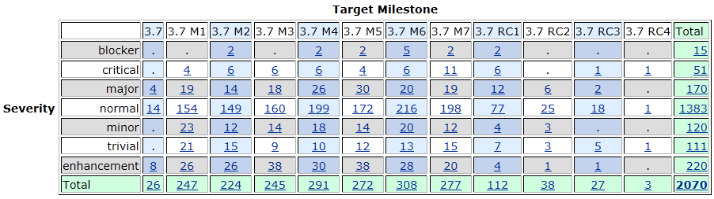
Bugs fixed during 3.7

Slide 19
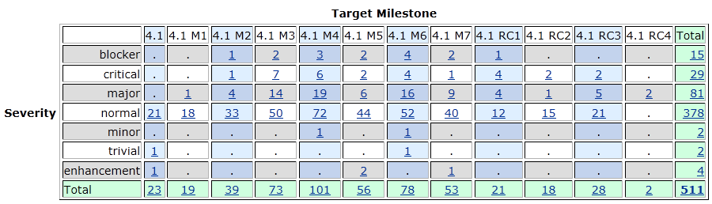
Bugs fixed during 4.1

Slide 20
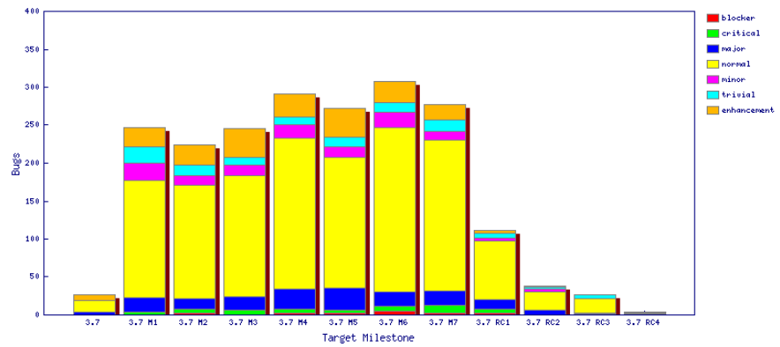
Fixed bugs – 3.7

Slide 21
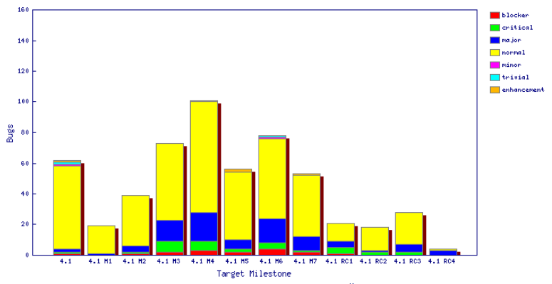
Fixed bugs – 4.1

Slide 22
Standards
Annotation Processing APIs
  com.sun.mirror 1.5
  javax.annotation.processing 1.6
Java compiler API
  javax.tools 1.6
User Assistance consumes (parses) a small subset of RSS 1.0 to get news from eclipse.org
JUnit 3.8.2 and JUnit 4.8.2
J2SE
  Tools are built against Java SE 5
  Compiler can generate 1.3, 1.4, 1.5, and 1.6 code
  Clients can run Java SE 5 or 6
SWT
  Win32, GDI, GDI+, OLE, IE, Carbon, Cocoa, Core Graphics, Quick Draw, Safari, ATSUI, X Windows, X/t, GTK, GDK, Pango, cairo, ATK, Mozilla, Uniscribe, OpenGL

Slide 23
UI Usability
Strings are externalized to support translation into other languages.
Extensive use of mnemonics and shortcut keys in the user interface enhances usability.
Full Bidirectional support (mirroring) on Windows and Linux GTK, bidirectional text on Mac OS X
Accessibility support for Windows, Linux GTK and Mac OS X
Eclipse User Interface Guidelines followed

Slide 24
Schedule
Milestones every 6 weeks, 6 cycle duration
  API frozen on March 11 (M6), Feature freeze April 29 (M7)
  http://www.eclipse.org/projects/project-plan.php?projectid=eclipse#release_milestones
Tracked schedule
  All milestones delivered as planned
  Additional M2a due to compiler bug discovered after M2
End game (release candidate) milestones for 4 cycles
  Duration reduced from 2-week to 1-week cycles at RC2
  No new features or API allowed without proper approvals
  Development to end on June 3, 2011
  Increasingly stringent approval, checking, and change notification requirements in this stage
  http://www.eclipse.org/eclipse/development/plans/freeze_plan_3_7.php

Slide 25
Process
The Eclipse project is developed using an open, transparent, and inclusive process
Teams rely on Bugzilla, mailing lists and newsgroups for input
Weekly planning calls conducted with the PMC and component leads
  Meeting minutes posted to the eclipse-dev mailing list
  Public PMC minutes: http://wiki.eclipse.org/Eclipse/PMC
Component teams have publicly available milestone plans: http://wiki.eclipse.org/Eclipse/Indigo_Plan
  Use project’s web space on eclipse.org to broadcast component milestone plan items and provide status on each item, per milestone

Slide 26
Community
Eclipse team members are active in Bugzilla, newsgroups, and mailing lists
Blogs started by Eclipse committers are evolving
  http://planeteclipse.org
  Some teams are using the eclipse-dev IRC channel
  irc.freenode.net#eclipse-dev
  irc://irc.freenode.net/#eclipse-e4
  also see: http://wiki.eclipse.org/index.php/IRC
The Eclipse team participates in code camps, conference presentations, and tutorials, including
  EclipseCon, JavaOne, JavaWorld, JAOO, Eclipse Summit Europe, Eclipse Forum Europe, JAX, JAX Asia, JSConf
The Eclipse team interacts with other open source projects, standards bodies, and other projects on eclipse.org, including
  OSGi, Apache Ant, JCP, WTP, Apache Harmony, GCJ, GTK

Slide 27
IP Issues
All significant and third party contributions have been reviewed and approved by Eclipse legal.
Eclipse Software User Agreement updated to February 1, 2011 version for all delivered features
About files and license files are complete and correct.
Draft project logs:
  http://www.eclipse.org/projects/ip_log.php?projectid=eclipse.platform
  http://www.eclipse.org/projects/ip_log.php?projectid=eclipse.pde
  http://www.eclipse.org/projects/ip_log.php?projectid=eclipse.jdt

Slide 28
Future Plans
Transition to Git source control: summer 2011
Full Java SE 7 support scheduled for September 2011
  Either separate download or part of Indigo SR1
4.2 release planned for June 2012
  Further Java 7 support and progress on Java 8 support (depending on available specifications)
  Focus on making new generation platform fully enterprise ready
  Documentation and API for 4.x generation features
  Investigate port to GTK+ 3.0
3.8 release also planned for June 2012
  Focus on stability
  Some feature work depending on contributor interest

