Slide 1

Ant and Eclipse
Darin Swanson
IBM Rational
Portland, Oregon

Slide 2
Why Ant and Eclipse?
Two powerful, extendable tools integrated to help the user solve problems

Slide 3
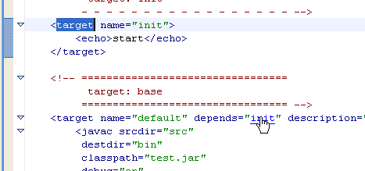
Writing Ant Buildfiles: Ant Editor
Content assist
Text hovering
Problem annotations
Navigation
Synchronized outline
Formatting
Open external documentation

Slide 4
Writing Ant Buildfiles: Ant Preferences
Editor Preferences
  Error Annotations
Runtime Preferences
  Tasks, Type and Properties
    Limit buildfile portability
  Runtime classpath

Slide 5
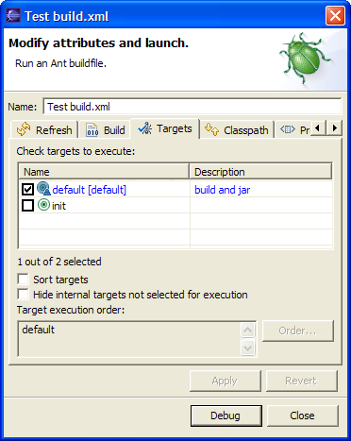
Ant builds in Eclipse:
Launch configurations
Ant launch configurations
Mechanism for configuration of a specific Ant build

Slide 6
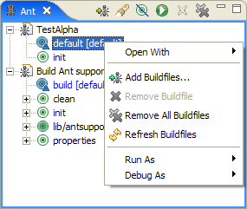
Running Ant Builds in Eclipse: Ant View
Consolidates buildfiles in one location
Simplifies running a single Ant target
Searching

Slide 7
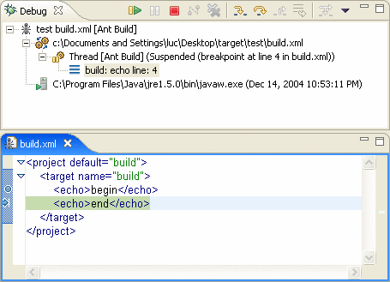
Debugging Ant Builds
Controlled execution of an Ant build
  Breakpoints
  Stepping
  Termination
  Properties displayed in the Variables View
    System
    User
    Runtime
  Run to line

Slide 8
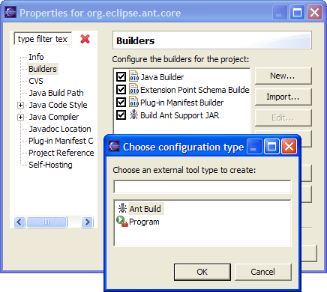
Running Ant Builds in Eclipse: Builders
Shareable
Configurable
  Refresh
  Triggers

Slide 9
Customize Eclipse: Ant Integration Extension Points
Tasks, types, properties and extra classpath entries
  Plugin customization of Ant runtime
All provided by the Ant Core plug-in
<extension point="org.eclipse.ant.core.extraClasspathEntries">
<extraClasspathEntry
library="lib/antsupportlib.jar">
</extraClasspathEntry>
</extension>

Slide 10
Questions?
Contact with the Eclipse Ant Component
Log bugs against the Platform Ant component for both feature requests and defects (patches welcome ☺)
eclipse.platform newsgroup on news.eclipse.org
Contributor or extender
  Platform Ant dev mailing list
Darin_Swanson@us.ibm.com

