Slide 1
Orion Project 0.4 Release Review

Slide 2
New Features
More advanced client side file system integration:
  Binary file support
  WebDAV file system plugin
  Copy and move across file systems
New editor features:
  Search and replace
  Code folding
  Hyperlinks in editor can be navigated
Git improvements:
  Delete remote branches
  Git rebase
  Edit committer/author details on commit
  Push to multiple remotes
Notes:
Committer info:
http://dash.eclipse.org/dash/commits/web-app/commit-count-loc.php?top=eclipse&range=1yr

Slide 3
Non-Code Aspects
Orion User Guide and Orion Developer Guide included with release. Documentation developed using Mylyn WikiText
Developer Guide includes server administration guide that describes how to setup and manage the server
Public beta server hosted by Eclipse Foundation: orionhub.org
Blog for New and Noteworthy updates: planetorion.org
Community is very active
  Mailing list has steady activity
  Firefox 8 builds include Orion editor
  Firebug plugin for integrating with Orion
  Wiki content is growing
    http://wiki.eclipse.org/Orion
  Orion webinar: http://live.eclipse.org/node/1006

Slide 4
Non-Code Aspects
Internationalization
  No internationalization or localization of messages has been done in this release
  Editor is capable of displaying non-latin characters and supporting bidirectional text
Accessibility
  Some accessibility testing done
  Screen readers handle Orion editor fairly well
  Some known accessibility bugs: many commands and components are not keyboard accessible

Slide 5
API
Orion has initial JavaScript API for client side services and components
HTTP API for accessing server functionality
No Java API on the server to allow for alternate server implementation languages and technologies
Client API documented using jsdoc
No APIs are final while Orion is incubating

Slide 6
Tool Usability
Filled in some major usability gaps such as editor search & replace
Syntax validators now distinguish warnings from errors
Much improved JavaScript outliners are now available as plugins
Added detection of unused variables in JavaScript

Slide 7
Architectural Issues
Strong architecture and modularity of Orion client
CommonJS module format used to facilitate client side reuse
JavaScript plugin architecture allows for integration via linking rather than a monolithic application: architecture designed for the web
Editor and “text view” components factored out with no external dependencies to enable reuse by other applications
Modular server using OSGi, Jetty, Servlets, Java SE 6
Worked on separating images from JavaScript to enable CSS skinning
Added ability to select from multiple implementations of some services, but with many services still just pick the first one found
Targeting modern HTML5-compliant browsers: Chrome 14/15, Firefox 6/7, Internet Explorer 9

Slide 8
End of Life Issues
None.

Slide 9
Bugzilla
Between July 1, 2011 and Oct 11, 2011 (RC1)
  326 reports were created
  282 were resolved/closed
Current state (M2) is:
  0 blockers, 1 critical
  0 P1, 6 P2

Slide 10
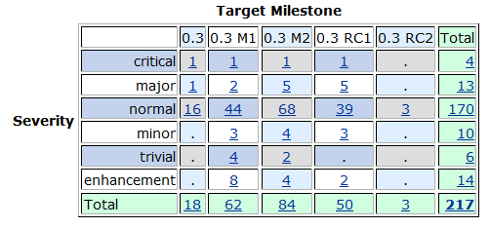
Bugs fixed during 0.3

Slide 11
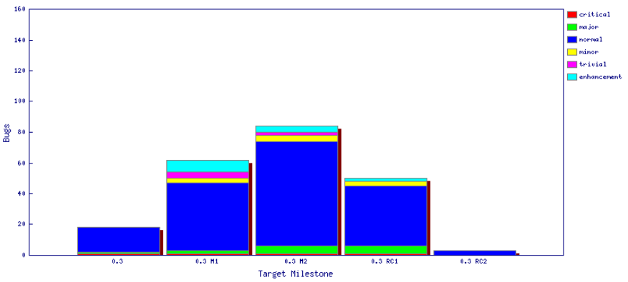
Fixed bugs – 0.3

Slide 12
Standards
Client components conforming to CommonJS Asynchronous Module Definition (AMD) format
HTML5 standard source code
Participating in specification of CrossFire browser debug protocol
  http://getfirebug.com/doc/crossfire/crossfire-splash-2011.pdf

Slide 13
UI Usability
Eclipse User Interface Guidelines followed where applicable to a web UI
Emphasis on allowing browser functionality to show through: using normal links, not hijacking the browser context menu, letting browser manage tabs
Assessed usability on tablet and mobile platforms – some improvements in 0.3 so far.
Significant usability improvements in presentation of global search results

Slide 14
Schedule
Moving towards web-scale release cycle
  Four month release cycle
  13 weeks development, 3 weeks end-game
Daily build and deployment to self-hosting server
Tracked schedule
  All milestones delivered as planned

Slide 15
Process
Orion is developed using an open, transparent, and inclusive process
Team relies on Bugzilla, mailing lists, forums, social media for input
Weekly planning calls conducted with all contributors welcome
Self-hosted development on http://orion.eclipse.org
  Meeting minutes posted to the orion-dev mailing list
Publicly available plan: http://wiki.eclipse.org/Orion/Plan

Slide 16
Community
Orion team members are active in Bugzilla, newsgroups, and mailing lists
Held an Orion Planning Summit in Palo Alto, CA (March 2011)
Blogs started by Orion committers are active:
  http://planetorion.org
  http://planeteclipse.org
  Team is using the eclipse-orion IRC channel
  irc.freenode.net#eclipse-orion
  also see: http://wiki.eclipse.org/index.php/IRC
The Orion team participates in code camps, conference presentations, and tutorials, including
  EclipseCon, What's Next Conference, jsconf, Eclipse Demo Camps
The Orion team interacts with other open source projects, standards bodies, and other projects on eclipse.org, including
  Mozilla, Dojo Foundation (Dojo framework, Maqetta), JGit, Mylyn, jsdoc, Firebug

Slide 17
IP Issues
All significant and third party contributions have been reviewed and approved by Eclipse legal.
About files and license files are complete and correct.
Client code (JavaScript) is dual-licensed with EPL and EDL
Approved 0.3 release log:
  http://www.eclipse.org/eclipse/development/project-log-files/eclipse-orion-0-3-log.pdf

Slide 18

Future Plans
Continue with 4 month release cycle to keep up with pace of development in the web community. For example with new browsers shipping every 3 months we can't ship Orion once a year and expect to be current
Aiming for a 0.4 incubating release in February 2012
Focus on enabling richer cross-domain integration, filling in gaps in self-hosting usability

