Slide 1

Eclipse 4.0 Release Review
July 28, 2010
Review communication channel: e4-dev@eclipse.org

Slide 2
Highlights
4.0 is an early adopter release of work graduating from the e4 incubator combined with plug-ins from the Helios (2010) release
The goal is to provide a stable platform for adopters to begin testing and migrating their applications to a major new generation of the platform user interface
This release is not suitable for commercial products: all new API is provisional, no maintenance releases planned, incomplete localization support
Includes implementations of significant new technology:
  Model-based user interface: highly configurable
  Highly decoupled service-based programming model
  Declarative user interface styling
  New user interface look and feel
  Completely new, binary-compatible implementation of the 3.x generation workbench API
Also releasing components remaining in the e4 incubator:
  New version of the XWT declarative UI design tool
  Tooling support for model-based UI
  Semantic file system: a mechanism for connecting the platform resource model to remote resources exposed via REST-style APIs
  Support for integrating JavaScript and OpenSocial-based views in a rich client
JDT and PDE sub-projects not participating in the release (releasing identical content as Helios 3.6 release)
Notes:
Committer info:
http://dash.eclipse.org/dash/commits/web-app/commit-count-loc.php?top=eclipse&range=1yr

Slide 3
Highlights
Committer and community diversity (for e4 and new code in 4.0):
  64 committers, 19 active in past 9 months
  Organizations: IBM (10), Individuals (3), BestSolution.at, Soyatec, SAP, Siemens, Anyware Technologies, Instantiations (1 each)
  Geographies: Canada, Germany, Austria, Poland, France, USA
  Commits: IBM (51%), BestSolution.at (32%), Soyatec (9%), SAP (3%), Individuals (3%), Anyware, Instantiations, Siemens (<1% each)
Seven new committers on platform project components as a result of technology graduating from the e4 incubator
Notes:
Committer info:
http://dash.eclipse.org/dash/commits/web-app/commit-count-loc.php?top=eclipse&range=1yr

Slide 4
Themes and Plan Items
Easier to Develop
  API compatibility
  Eclipse application services
Easier to Assemble
  Model-based workbench
  Skinnable UI
  Service-oriented programming model
http://www.eclipse.org/projects/project-plan.php?projectid=eclipse

Slide 5
Themes and Plan Items
Deferred plan items (remaining in incubation):
  OpenSocial gadget container
  Web UI components
http://www.eclipse.org/projects/project-plan.php?projectid=eclipse

Slide 6
New and Noteworthy
Platform
Model-based UI
Pluggable widget renderer
Full API binary compatibility
Dependency injection
Annotations for injection
Hierarchical context service binding system
Common event bus
Pluggable add-ons mechanism for customizing UI behavior
Declarative Styling
Styling SWT widgets with CSS
Declarative styling with gradients
Margins for spacing between widgets
Extensive styling support for CTabFolder
Modeled UI informs of active state
Styling support for CTabItem
Setting button and label alignment with CSS
New Look and Feel
New tab folder look
Use of spacing rather than extra lines for a cleaner, less cluttered look
Global search bar

Slide 7
New and Noteworthy
XWT
Support for JFace ComboViewer
Simplified JFace viewers
Support for viewer filters
Master/detail support
More operators in conditions
Eclipse forms support
UI profile support
Data binding change notification
Workbench state management
Data binding aggregation
Animation support
Data binding validation and error handling
Support for null layout
Resource pre-processing
Tooling
XWT visual designer
4.0 workbench visual design tool
E4 project wizard
Model integrity control
Form-based workbench model editor
Category display in hierarchical outline view
Other incubating content
OpenSocial gadget container
Semantic file system: integration of resource model with REST-style APIs
Semantic file system team integration
Sample e4 IDE

Slide 8
Non-Code Aspects
The 4.0 release contains no new documentation, but there is extensive documentation on the e4 wiki
Webcasts and presentations planned to spread the word about the new release
Community is very active
  Mailing lists and newsgroups have steady activity
    E4 mailing list: e4-dev@eclipse.org
  Lots of e4 blog activity:
    http://www.planeteclipse.org
  Wiki content is extensive and growing
    http://wiki.eclipse.org/E4

Slide 9
Non-Code Aspects
Internationalization
  The 4.0 release has not undergone Internationalization testing
Localization
  Most message strings are localized
  No localization of strings in user interface model
Accessibility
  The 4.0 release has not been tested for accessibility

Slide 10
Non-Code Aspects
Articles, examples, and tutorials
  e4 whitepaper provides overview of e4 technology:
    http://eclipse.org/e4/resources/e4-whitepaper.php
  e4 presentations/symposia/tutorials at:
    EclipseCon 2008, 2009, 2010
    Eclipse Summit Europe 2008, 2009
    Eclipse Application Developer Day 2009
    Several Eclipse Helios DemoCamps
  e4 presentation material available on e4 wiki
  Two complete e4 example applications: Photo viewer and Contacts application

Slide 11
Platform Quality API
The 4.0 release includes some new provisional API, but is subject to change in the future
Binary compatible with the platform 3.x generation API
Some old API incompatible with new technology will no longer work as expected:
  Old workbench styling and presentation APIs

Slide 12
Tool Usability
Mostly relying on Eclipse platform tooling support and EMF tools for models
Some new tooling available in e4 incubator:
  XWT graphical design editor
  Form-based model editor and model tooling

Slide 13
Architectural Issues
Primary runtime is Java SE 5
User interface can now be configured in multiple ways:
  Plug-ins can contribute either traditional extensions via plugin.xml, or model extensions
  Applications can fully control the user interface model to achieve greater customization of layout
Pluggable UI renderer converts the UI model into widgets
  SWT-based renderer using CSS styling is provided but alternate renderers can be used
EMF runtime is now included in platform and RCP features

Slide 14
End of Life Issues
Some e4 bundles reaching end of life due to lack of active development:
  SWT Browser Edition
  Toolkit Model: EMF-based tool for writing views and editors
E4 JavaScript debugging support moved to new JavaScript Development Tools (JSDT) project

Slide 15
Bugzilla
Since July 31, 2009
  Over 1589 bugs were created
  Over 1057 were resolved
  126 were resolved without changing code
    invalid, duplicate, worksforme, etc...
  289 resolved with no specific milestone set
Current state (RC3) is
  0 blockers, 5 critical
  0 P1, 1 P2

Slide 16
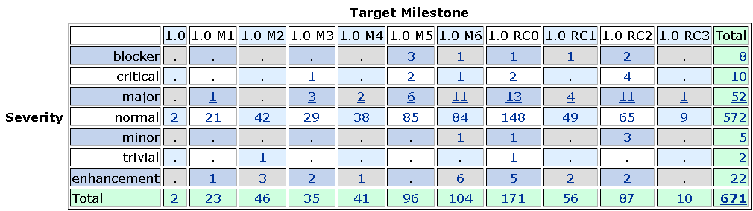
Bug resolution during 4.0

Slide 17
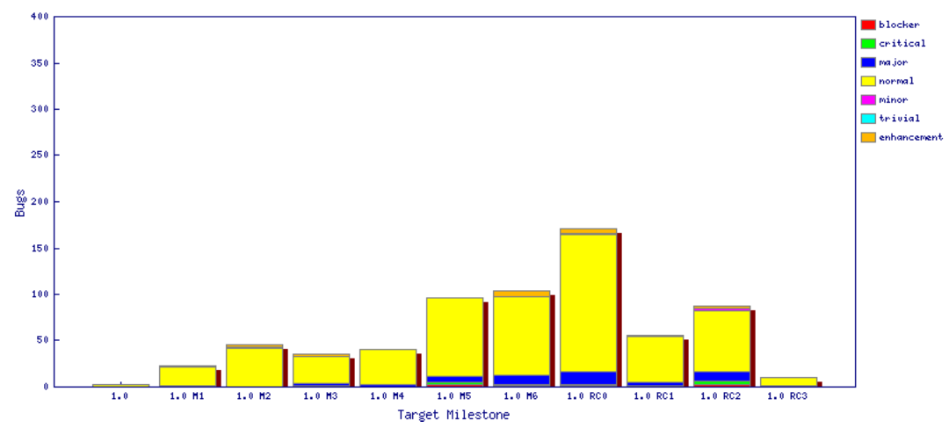
Fixed bugs

Slide 18
Schedule
Milestones every 6 weeks, 6 cycle duration
  Final milestone May 21 (M6)
  Long end-game (four release candidates over nine weeks)
  http://www.eclipse.org/projects/project-plan.php?projectid=eclipse.e4#release_milestones
Tracked schedule
  All milestones delivered, some minor delays
  End-game used to stabilize for release
  Final release date: July 28, 2009

Slide 19
Process
The Eclipse project is developed using an open, transparent, and inclusive process
Teams rely on Bugzilla, mailing lists and newsgroups for input
Bi-weekly planning calls conducted with all e4 contributors welcome
  http://wiki.eclipse.org/E4/Meeting_Minutes
Extensive use of e4 wiki for brainstorming, planning, and development notes

Slide 20
Community
Eclipse team members are active in Bugzilla, newsgroups, and mailing lists
Blogs started by Eclipse committers are evolving
  Use blogging infrastructure at Eclipse.org
  http://www.planeteclipse.org
Some teams are using the eclipse-dev IRC channel
  irc.freenode.net#eclipse-dev
  irc://irc.freenode.net/#eclipse-e4
  also see: http://wiki.eclipse.org/index.php/IRC
The Eclipse team participates in code camps, conference presentations, and tutorials, including
  EclipseCon, JavaOne, JavaWorld, JAOO, Eclipse Summit Europe, Eclipse Forum Europe, JAX, JAX Asia
The Eclipse team interacts with other open source projects, standards bodies, and other projects on eclipse.org, including
  OSGi, Apache Ant, JLS, WTP, Apache Harmony, GCJ, GTK

Slide 21
IP Issues
All significant and third party contributions have been reviewed and approved by Eclipse legal.
About files and license files are complete and correct.
Draft project log:
  http://www.eclipse.org/projects/ip_log.php?projectid=eclipse.platform

Slide 22
Project Plan for Eclipse 4.1
Still in planning stage
Main focus will be on achieving full commercial quality:
  High quality API
  Full localization support
  Documentation
Developing 3.7 and 4.1 in parallel on common release train schedule

