Slide 1
Making the Most of the Eclipse Compare Framework
Michael Valenta
IBM Rational Software
Ottawa Lab

Slide 2
Overview
An analogy
High level architecture
FAQ style presentation
  Compare viewers
  Compare containers
  Sub-file element history
  Multi-file element support
Summary

Slide 3
How are Software Tools like a Passport Office
Inevitably at some point you are going to have to wait!

Slide 4
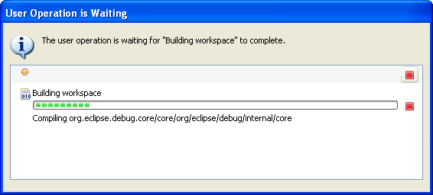
How are Software Tools like a Passport Office
Inevitably at some point you are going to have to wait!

Slide 5
Users don’t like to wait
Passport lines in some countries have been very long lately
  Initial uncertainty was evident
  Personnel gave an indication of what to expect
    3 hours to get in, 1 or 2 hour after that
      10 minutes if you filled in the form on-line
  Line made visible progress
  Could walk away at any time
Analogous to progress monitoring
  Provide indication of length of operation and show progress
  Provide responsive cancellation

Slide 6
Progress Monitoring
Provide indication of length of operation and show progress
Provide responsive cancellation

Slide 7
When they must wait, they like to do other things
Things to do is a passport line
  Read a book
  Have a coffee
  Watch videos on an iPod
  Talk to other’s in the line
Things to do while waiting for your operation to complete
  Any of the above
  Or perhaps you’d like to continue working

Slide 8
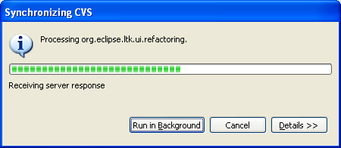
Background Jobs
Can do most things while operations run in the background
Inevitably, there will be interference at some point

Slide 9
What if more information is needed to proceed
For example, your photos may not be adequate
  Do I have to wait for 3 hours in another passport line?
  No, they are not that cruel
    You get to bypass the first line
For software tools
  If the operation is modal, your starting over
    Unless the dialog provides modal access to any contingencies you need
  Using views and editors is much more conducive to this

Slide 10
What’s all this have to do with Compare
Over the last few releases, there has been a progress away from dialogs and towards views and editors.
  Synchronize View
  History view
    Local, Remote and Element History
In 3.3, we have improved the responsiveness of Compare
  Compare container supports asynchronous tasks
    Compare editors can be opened asynchronously
  New differencing algorithm
    Significant improvement in speed and memory usage

Slide 11
The Compare Framework
What is the purpose of the Compare framework
  Support comparison of alternate states of a file system or data store
What does the Compare framework provide?
  API to define the input to a comparison
  Extensions for associating viewers with input types
  Containers to host comparisons in the UI
What parties are involved
  Clients
    e.g. repository providers
    Build the input
  Providers
    e.g. models
    Provide the viewers
  Users

Slide 12
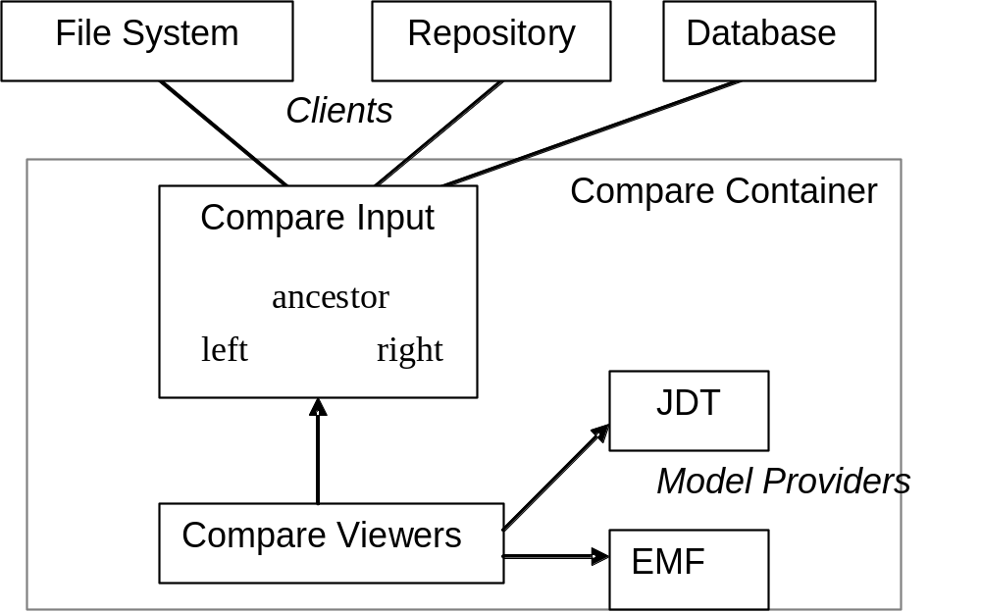
Overview of Compare Architecture

Slide 13
What does the Compare Framework Provide?
API defining the input to the Comparison
  Supports single node or a tree
  Defines interfaces for accessing contributor state
    Content is generally stream based (but not necessarily)
API and infrastructure for defining viewers for various data types
  Content, structure and merge viewers
  Implementations for text, image and zips
Various containers for hosting comparisons
  In editors, views or dialogs
A differencing engine
  For tree or range based differences
API and actions related to file system resources
  Compare with Each Other, Local History, Apply Patch

Slide 14
How do I provide a Compare experience similar to JDT?
JDT plugs into the following Compare features
  Content merge viewer that extends TextMergeViewer
    2 or 3 way content merging
  Structure merge viewer and Structure Creature
    Hierarchical representation of structure changes
  Content viewer
    Simple viewer for use by Restore actions
  Viewers are associated with “java” extension and content type
JDT also makes use of some Team features related to Compare
  API to show element history in the History View
  API to participate in repository operations

Slide 15
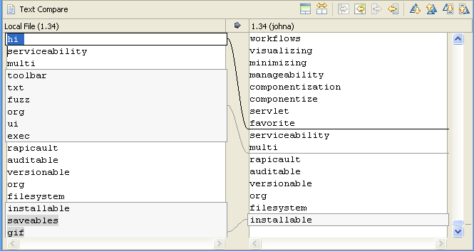
A look at a simple text merge viewer

Slide 16
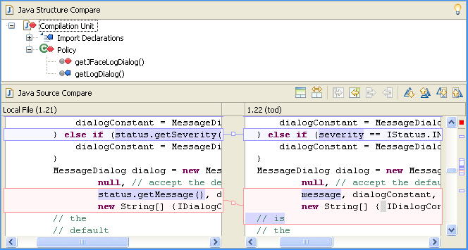
A look at the JDT merge viewer

Slide 17
What do I need to do to enhance my text merger?
Add extension for contentMergeViewer
  Register an IViewerCreator factory
  Association is through content type or file extension
Implement a subclass of TextMergeViewer
  To provide syntax highlighting
    getDocumentPartitioner/getDocumentPartitioning
    configureTextViewer to provide a source viewer configuration
    JDT reuses these components from the JavaTM Editor
  Provide custom toolbar items
    createToolItems/updateToolItems
    JDT doesn’t provide custom actions
  Provide token comparator for breaking a line into tokens
    createTokenComparator
    JDT provides a custom comparator

Slide 18
But I want a full featured editor in my Compare editor
Technically possible but a lot of work
  Because most editor functionality is tied to an editor part
  Compare editors host up to 3 content viewers
Next best things?
  In 3.3, we have implemented support for file buffers
  This means
    You can have both a regular and compare editor open on the same file
    Changes you make in one will appear in another
  This require existing text viewers to provide a specific partitioning
    i.e. viewers don’t get it for free
  Also requires client to provide an appropriate input
    Elements adapt to ISharedDocumentAdapter

Slide 19
How do I provide a structure merge viewer?
Add an extension of structureMergeViewer
  Provide instance or subclass of StructureDiffViewer
Add an extension of structureCreator
  Provide a instance of IStructureCreator
    Provides the structure of a single element (e.g. file)
      i.e. a tree representation of the element
      Nodes are subclasses of DocumentRangeNode
      Need a unique type (“java2” for java)
    Also provides API to write changes back to the element
    Subclass StructureCreator to be file buffer aware
  Viewer uses the differencing engine to create a tree representation of the differences

Slide 20
Example snippet from the Java merge viewer
  <!-- © Copyright 2007 IBM Corp. All rights reserved. This source code is made
  available under the terms of the Eclipse Public License, v1.0. -->
  <extension
point="org.eclipse.compare.contentMergeViewers">
<viewer
extensions="java,java2"
class="org.eclipse.jdt.internal.ui.compare.JavaContentViewerCreator"
id="org.eclipse.jdt.internal.ui.compare.JavaContentViewerCreator">
</viewer>
<contentTypeBinding contentTypeId="org.eclipse.jdt.core.javaSource"
contentMergeViewerId=
"org.eclipse.jdt.internal.ui.compare.JavaContentViewerCreator">
</contentTypeBinding>
</extension>

Slide 21
What do I need to do for non-text artifacts?
Add extension for contentMergeViewer
Subclass ContentMergeViewer
  Manages the arrangement of ancestor, left and right panes
  Provides copy operations for complete contents
  Simple example
    org.eclipse.compare.internal.ImageMergeViewer
Or subclass Viewer
  If you want something totally different

Slide 22
How is the combination of content and structure managed?
CompareEditorInput
  Manages the panes of a comparison
    Input
    Structure (1 or 2 panes)
    Content
  Is hosted in a container that could be an editor, dialog or view.
    CompareUI#openIn<Editor|Dialog>
  Client provides the compare input
    Used to feed input and content panes
    Selection in input pane also feeds structure and content panes
  Input pane is optional
    i.e. the input pane is not used if the input has no children
    Allows tree to be shown in a separate view
      e.g. Synchronize or History view

Slide 23
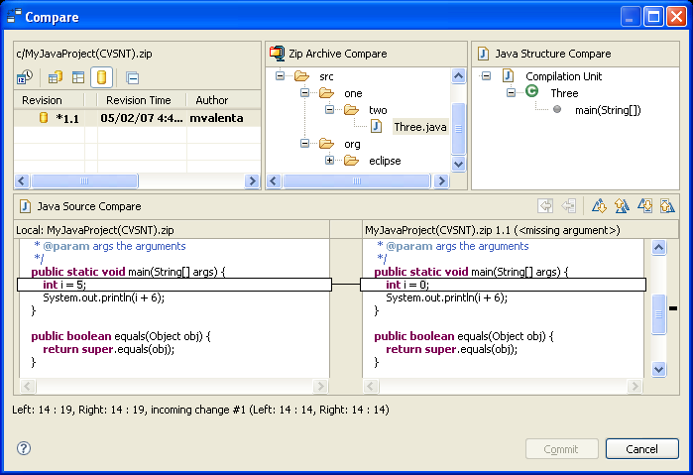
The Panes of a Compare Editor Input

Slide 24
How do I show a single file comparison in an editor?
For example, as used from the Synchronize or History views
A CompareEditorInput subclass is provided by Team
  org.eclipse.team.ui.synchronize.SaveableCompareEditorInput
Implementation tailored to comparison of a single element
Additional support for single file comparison
  SaveableCompareEditorInput.createFileElement(IFile)
    Left side of input
    Right side and ancestor could be remote contents, for example
  Provides file buffer (shared document) support
Has other features as well
  Support Workbench Saveable API
  Auto-close when changes are resolved
  Asynchronous initialization

Slide 25
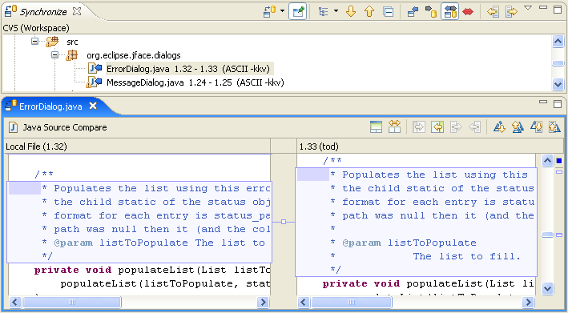
Single file comparison

Slide 26
How do I show the local history for an element?
Team API for IHistoryPage provides embeddable history
  Can be placed in the History view or in a CompareEditorInput
  Pages are obtained from an IHistoryPageSource through adaptable mechanism
Team API provides ElementLocalHistoryPageSource
  Provides a history page for elements
  Uses a structure creator to extract the element from each local history entry
HistoryPageCompareEditorInput
  Hosts an IHistoryPage in a dialog
Supports compare or replace

Slide 27
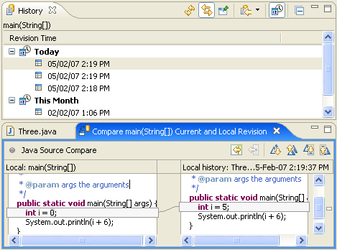
An Element Comparison in the History view

Slide 28
Showing a Comparison in the History View
/* © Copyright 2007 IBM Corp. All rights reserved. This source code is made
available under the terms of the Eclipse Public License, v1.0. */
IMember input= getEditionElement(selection);
JavaElementHistoryPageSource pageSource =
JavaElementHistoryPageSource.getInstance();
IFile file= pageSource.getFile(input);
if (file == null) {
….
return;
}
TeamUI.showHistoryFor(
PlatformUI.getWorkbench().getActiveWorkbenchWindow().getActivePage(),
input,
pageSource);

Slide 29
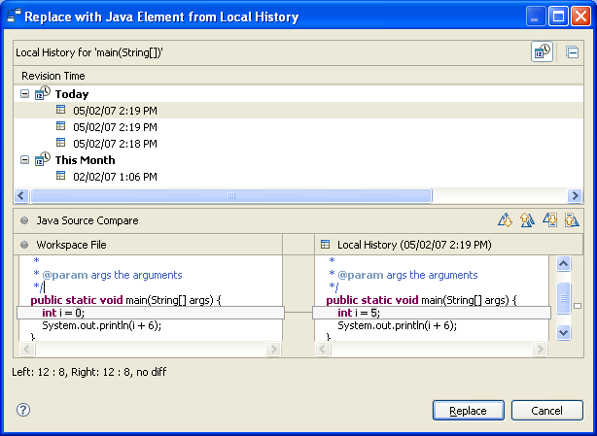
Element Replace in a Dialog

Slide 30
Replace using Dialog Example
/* © Copyright 2007 IBM Corp. All rights reserved. This source code is made
available under the terms of the Eclipse Public License, v1.0. */
JavaElementHistoryPageSource pageSource =
JavaElementHistoryPageSource.getInstance();
CompareConfiguration cc = new CompareConfiguration();
cc.setLeftEditable(false);cc.setRightEditable(false);
HistoryPageCompareEditorInput ci = new HistoryPageCompareEditorInput(
cc, pageSource, input) {
protected void performReplace(Object selectedElement) {
if (selectedElement instanceof ITypedElement) {
JavaReplaceWithEditionActionImpl.this.replace(
input, file, (ITypedElement)selectedElement);
}}};
ci.setReplace(true);
ci.setTitle(CompareMessages.JavaReplaceWithEditionActionImpl_0);
ci.setHelpContextId(IJavaHelpContextIds.REPLACE_ELEMENT_WITH_HISTORY_DIALOG);
CompareUI.openCompareDialog(ci);

Slide 31
Why can’t I get a remote history for elements?
Local History has good characteristics for this
  Local
  Bounded
  Single time line
Remote histories do not
  Remote
  Unbounded
  Can have multiple time lines that cross

Slide 32
What if I don’t need the input or structure panes
In some cases, only content viewing is required
API is provided on CompareUI to access the viewers
  findStructureViewer
  findContentViewer
Clients can use these as they see fit to show comparisons in their operations
  e.g. Refactorings
For best results, compare provides a pane wrapper
  CompareViewerSwitchingPane

Slide 33
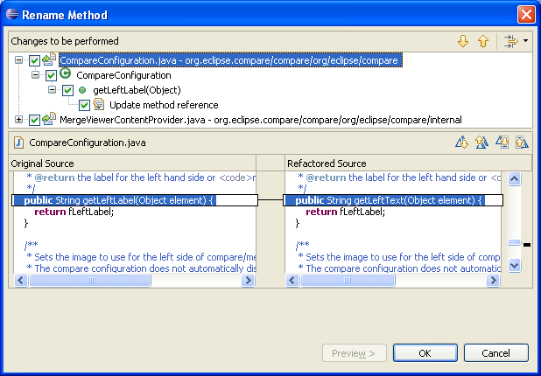
JDT Refactoring uses Merge Viewer only

Slide 34
What if I have model elements that span files?
The Compare framework works in the following way:
  The client provides the compare input
    ICompareInput (left, right, ancestor)
  The client decides the hierarchical structure of that input
    IDiffContainer
  The leaves of the structure typically provide content
    IStreamContentAccessor
  Merge viewers can be applied to the content
In the general case, the structure represents a file system where the leaves are files
  E.g. that is the common currency of repository providers

Slide 35
Need to allow models to participate in structure
Need API for client to describe the file level comparison
  Basically a set of file differences
Need a mechanism to allow models to provide content structure
  Makes use of the Common Navigator framework
    Models are given the set of differences
    Models render a tree that displays these differences in model terms
    Models contribute actions to merge model elements
    Repository provides callbacks to perform the file level merge
Both repository and model must provide support
  CVS and JDT have support for this
  http://help.eclipse.org/help32/index.jsp?topic=/org.eclipse.platform.doc.isv/guide/team_model.htm

Slide 36
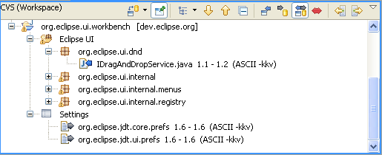
JDT Content in the Synchronize view

Slide 37
Summary
Providing Text merge support leverages existing editor support
  Structure creator is additional work
Providing non-text merge support requires more work
  Model Comparison panel
Model Element (sub-file) support improved in 3.3
  Fairly straightforward given a structure creator
Support exists for handling elements that span files
  A topic unto itself
What about client support?
  As opposed to a model provider
  Another topic unto itself
We didn’t go into a lot of detail
  If you want more detail on a particular aspect and you don’t find it in the doc, ask on the eclipse-platform newsgroup

Slide 38
ICompareContainer
API for exposing part independent facilities
Can be an editor or dialog
  CompareUI#openIn…
Much like a workbench site
  Service locator and action bars
Provides ability to run tasks that require progress
  Synchronous or asynchronous

Slide 39
Compare Input API
ICompareInput
  input to a comparison
  name and image
  two or three contributors
  kind
    2 or 3 way: add, delete or change
    3 way: right, left or conflict
  change notification
Additional API for hierarchies
  IDiffElement, IDiffContainer – define hierarchy
  DiffNode and others – implementations of hierarchy

Slide 40
Contributor (left, right, ancestor) API
ITypedElement – main contributor interface
  name, image, type
IStreamContentAccessor – stream of bytes
IEditableContent – change bytes
IContentChangeNotifier- notification of change
ISharedDocumentAdapter – access to underlying file buffer
IResourceProvider – access to underlying IResource
IModificationData – access to modification date

Slide 41
Input and Content Change Notification
Both happen in the UI thread
Content changes
  happen at the contributor level
  are fired when modified content is flushed from a compare viewer back into the contributor
Input changes
  affect all contributors of the input
  are fired when the input state changes
    a content change from an external source
    A change in the kind or some other input property

Slide 42
Differencing Engines
Differencer
  Calculates the differences between 2 or 3 hierarchies
  Default output is a hierarchy of DiffNodes
RangeDifferencer
  Calculates the differences between 2 or 3 files
  Output is a set of RangeDifferences
  Used by TextMergeViewer to calculate both line and token diffs

Slide 43
Legal Notices
Java and all Java-based trademarks are trademarks of Sun Microsystems, Inc. in the United States, other countries, or both
Other company, product, or service names may be trademarks or service marks of others

