Slide 1
Orion Project 0.2 Release Review

Slide 2
Features
First incubating release of new web-based tool integration platform
Tooling user interface written in HTML, JavaScript, and CSS
  Navigator providing standard file/folder manipulations: create, delete, rename, copy, move, etc
  High performance editor component supporting many of the same text manipulation commands as the Eclipse desktop editor
  Basic Git client, sufficient for self-hosted development
  Search, help system, bookmarks, compare editor
  Site launching feature for testing and debugging apps
JavaScript plugin architecture, allowing integration of tools and functionality across domains
Initial Java-based server, using Jetty and Equinox. Search implementation provided by Apache Solr/Lucene
Notes:
Committer info:
http://dash.eclipse.org/dash/commits/web-app/commit-count-loc.php?top=eclipse&range=1yr

Slide 3
Non-Code Aspects
Orion User Guide and Orion Developer Guide included with release. Documentation developed using Mylyn WikiText
Developer Guide includes server administration guide that describes how to setup and manage the server
Public beta server hosted by Eclipse Foundation: orionhub.org
Blog for New and Noteworthy updates: planetorion.org
Community is very active
  Mailing list has steady activity
  Firefox and Firebug investigating Orion adoption and integration
  Wiki content is growing
    http://wiki.eclipse.org/Orion
  Orion webinar: http://live.eclipse.org/node/1006

Slide 4
Non-Code Aspects
Internationalization
  No internationalization or localization of messages has been done in this release
  Editor is capable of displaying non-latin characters and supporting bidirectional text
Accessibility
  Some accessibility testing done
  Screen readers handle Orion editor fairly well
  Some known accessibility bugs: many commands and components are not keyboard accessible

Slide 5
API
Orion has initial JavaScript API for client side services and components
HTTP API for accessing server functionality
No Java API on the server to allow for alternate server implementation languages and technologies
Client API documented using jsdoc
No APIs are final while Orion is incubating

Slide 6
Tool Usability
Major focus on tool usability in this release to support self-hosting
Task-focused UI design puts different developer tasks on different pages
Page load and refresh times are critical for web applications: extensive work done on caching and build-time page optimization
JavaScript tooling support is rudimentary at this point. Lacking strong content assist and refactoring support
Capable search infrastructure, but missing search & replace functionality is a major drawback at this time

Slide 7
Architectural Issues
Strong architecture and modularity of Orion client
CommonJS module format used to facilitate client side reuse
JavaScript plugin architecture allows for integration via linking rather than a monolithic application: architecture designed for the web
Editor and “text view” components factored out with minimal external dependencies to enable reuse by other applications
Modular server using OSGi, Jetty, Servlets, Java SE 6
HTTP Server API provides maximum flexibility in server implementations
Need to find ways to leverage/work with JavaScript Development Tools from WTP, such as server side JS analysis
Targeting modern HTML5-compliant browsers: Opera 11/12, Firefox 4/5, Internet Explorer 9

Slide 8
End of Life Issues
None.

Slide 9
Bugzilla
Between January 1, 2011 and June 24, 2011 (RC3)
  1,250 reports were created
  865 were resolved
Current state (RC3) is:
  0 blockers, 1 critical
  0 P1, 6 P2

Slide 10
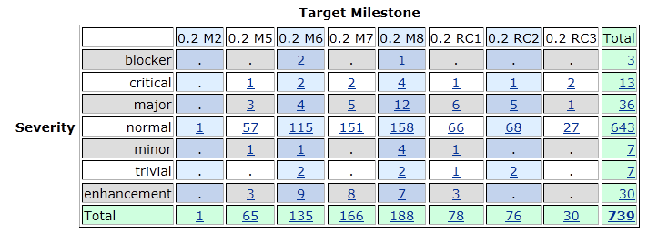
Bugs fixed during 0.2

Slide 11
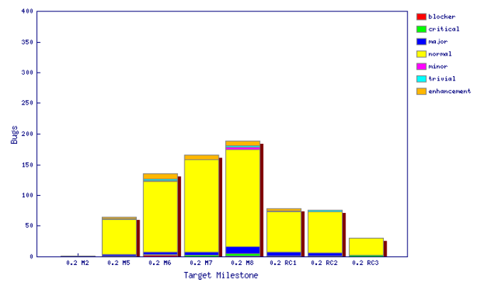
Fixed bugs – 0.2

Slide 12
Standards
Client components conforming to CommonJS Asynchronous Module Definition (AMD) format
HTML5 standard source code
Participating in specification of CrossFire browser debug protocol
  http://getfirebug.com/doc/crossfire/crossfire-splash-2011.pdf

Slide 13
UI Usability
Eclipse User Interface Guidelines followed where applicable to a web UI
Orion has a completely new icon set with consistent color themes
Went through several design iterations with graphic designer to come up with Orion 0.2 look
Emphasis on allowing browser functionality to show through: using normal links, not hijacking the browser context menu, letting browser manage tabs

Slide 14
Schedule
Milestones every 6 weeks, 8 cycle duration
  Became open source shortly after M3
Tracked schedule
  All milestones delivered as planned
End game (release candidate) milestones for 3 cycles
  Duration reduced from 2-week to 1-week cycles at RC2
  Relatively short end-game due to Orion being a very new project

Slide 15
Process
Orion is developed using an open, transparent, and inclusive process
Teams rely on Bugzilla, mailing lists and newsgroups for input
Weekly planning calls conducted with all contributors welcome
Self-hosted development on http://orion.eclipse.org
  Meeting minutes posted to the orion-dev mailing list
Publicly available milestone plans: http://wiki.eclipse.org/Eclipse/Indigo_Plan
  http://wiki.eclipse.org/Orion/Milestone_Plan

Slide 16
Community
Orion team members are active in Bugzilla, newsgroups, and mailing lists
Held an Orion Planning Summit in Palo Alto, CA (March 2011)
Blogs started by Orion committers are active:
  http://planetorion.org
  http://planeteclipse.org
  Teamis using the eclipse-orion IRC channel
  irc.freenode.net#eclipse-orion
  also see: http://wiki.eclipse.org/index.php/IRC
The Orion team participates in code camps, conference presentations, and tutorials, including
  EclipseCon 2011, What's Next Conference, jsconf, Eclipse Indigo Demo Camps
The Orion team interacts with other open source projects, standards bodies, and other projects on eclipse.org, including
  Mozilla, Dojo Foundation (Dojo framework, Maqetta), jGit, Mylyn, jsdoc, Firebug

Slide 17
IP Issues
All significant and third party contributions have been reviewed and approved by Eclipse legal.
About files and license files are complete and correct.
Client code (JavaScript) is dual-licensed with EPL and EDL
Approved 0.2 release log:
  http://www.eclipse.org/eclipse/development/project-log-files/eclipse-orion-creation-release-0-2-log.pdf

Slide 18

Future Plans
Shift to 3 or 4 month release cycle to keep up with pace of development in the web community. For example with new browsers shipping every 3 months we can't ship Orion once a year and expect to be current
Aiming for a 0.3 incubating release in October 2011
Focus on enabling richer integration, filling in gaps in self-hosting usability

