Slide 1

E4 to Platform Move Review
July 2010
Review date: unknown
Eclipse Project PMC

Slide 2
Rationale
The e4 incubator is an ongoing effort to experiment with and develop new technology for the Eclipse platform
Periodically we transition technology to the platform or other projects as it matures
There is a set of 17 bundles we would like to move into the platform at this time

Slide 3
Highlights
Core APIs to support the e4 programming model of contextualized service lookup and dependency injection
Modeled user interface:
  Formalized model of the platform user interface represented as an EMF model
  Pluggable renderer generates widgets from this model
User interface skinning:
  Mechanism to specifying user interface styling and layout using Cascading Style Sheets (CSS)
  Allows for easier and more powerful customization of the user interface, and styling changes on the fly without code change
A binary-compatible implementation of the Eclipse Platform API from Helios, implemented using the above technologies

Slide 4
Affected Bundles
The following e4 bundles are being proposed to move to the platform:
org.eclipse.e4.core.commands
org.eclipse.e4.core.contexts
org.eclipse.e4.core.di
org.eclipse.e4.core.di.extensions
org.eclipse.e4.core.services
org.eclipse.e4.ui.bindings
org.eclipse.e4.ui.css.core
org.eclipse.e4.ui.css.swt
org.eclipse.e4.ui.css.swt.theme
org.eclipse.e4.ui.di
org.eclipse.e4.ui.model.workbench
org.eclipse.e4.ui.services
org.eclipse.e4.ui.workbench
org.eclipse.e4.ui.workbench3
org.eclipse.e4.ui.workbench.addons.swt
org.eclipse.e4.ui.workbench.renderers.swt
org.eclipse.e4.ui.workbench.swt
org.eclipse.ui.workbench (1)

Slide 5
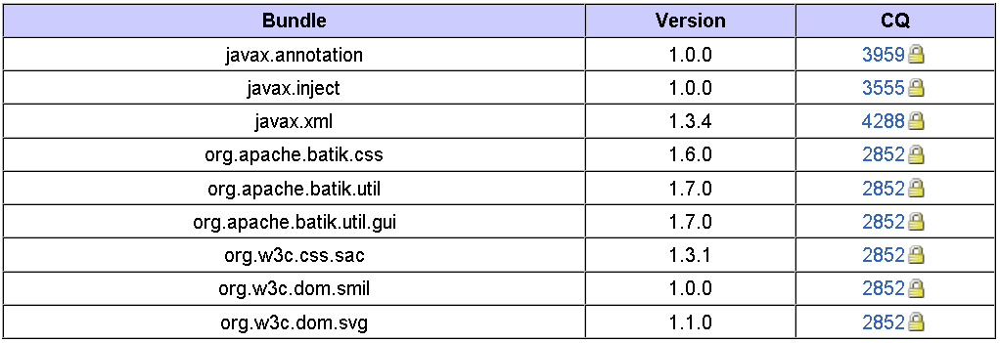
Legal
The following contribution questionaires (CQs) need to be moved :

Slide 6
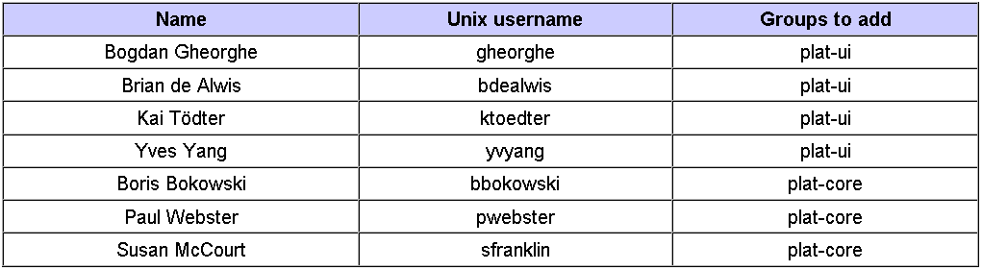
Committers
No committer removals as a result of the move
The following e4 committers require nomination on the move destination component areas

Slide 7
Infrastructure Changes: CVS
Change group ownership of moved bundles. All bundles remain in the Eclipse top-level project repository and do not require moving at this time
We may perform further repository reorganization after the July release

Slide 8
Other Infrastructure Changes
No changes to web pages, newsgroups, or mailing lists, as e4 project will continue to exist after the move
We may create new bugzilla components but this can be handled independently by the PMC

Slide 9
Links
Project plan: http://www.eclipse.org/eclipse/development/plans/eclipse_project_plan_4_0.xml
Move plan: http://wiki.eclipse.org/E4/4.0_Release_Process
Approved IP log for move: http://www.eclipse.org/eclipse/development/project-log-files/eclipse_e4_move_review_20100630.pdf
Communication channel: http://dev.eclipse.org/mhonarc/lists/e4-dev/

