Slide 1
Eclipse Project Juno Release Review
Eclipse Project PMC

Slide 2
Highlights
Shipping two platform releases simultaneously with Juno: 3.8 and 4.2
3.8 new features:
  Cairo graphics on Linux, global debug toolbar, tracing preference page, custom PDE target API, new OSGi console, updated to Jetty 8 and Servlet 3.0, OSGi Core R5 spec implementation, SWT TreeCursor, custom colors in ColorDialog
  Java tooling features: camel-case filtering in quick outline, improved bracket matching, better switch statement diagnostics, more quick fixes, smarter resource leak detection, Annotation-based null reference analysis
4.2 new features:
  All 3.8 new features plus: improved drag support, styling refinements, animated part transitions, robustness
API quality:
  Both releases binary compatible for compliant plug-ins
  Deprecated API: 10 types, 17 methods, 2 fields
  No breaking changes
End-of-life issues:
  Several bundles related to very old deprecated functionality removed
IP Clearance and Licenses:
  All licenses and about files are in place as per the Eclipse Development Process, the Due Diligence Process was followed for all contributions
Community and Committer Diversity:
  50 active committers in past 9 months
  Active organizations: BestSolution, Eclipse Source, Freescale, IBM, Intel, Manumitting Technologies, Red Hat
  Geographies: Canada, India, Poland, U.K., USA, Switzerland, Germany, Austria, Japan, France
  Many community patch contributions
Notes:
Committer info:
http://dash.eclipse.org/dash/commits/web-app/commit-count-loc.php?top=eclipse&range=1yr

Slide 3
Themes and Plan Items
Platforms
  Support for Java 7
  BIDI enhancements
  Migrate SWT graphics to Cairo
Robustness
  Transition to Git
  Make Eclipse 4 enterprise ready
  Build system consolidation
Ease of Use
  Annotations for null checking
http://www.eclipse.org/projects/project-plan.php?projectid=eclipse

Slide 4
Themes and Plan Items
Deferred plan items:
  Start work on Java SE 8 features
  Adopt new Windows 7 APIs
  Support different target platforms per project
http://www.eclipse.org/projects/project-plan.php?projectid=eclipse

Slide 5
New and Noteworthy - Platform
Editor area styling
Multi-drag sash
Fade transition on maximize
Delete project dialog shows location
VoiceOver context menu
Short for context menu on Mac
Editor area tab navigation
New high resolution icon and splash
Lightweight refresh on by default
Full screen support on Mac
Ant updated to 1.8.3
Enhanced Ant editor support
Add all known buildfile types to Ant view
Saturated colors in overview ruler
Filters in CVS sync view
Global debug toolbar
Improved editing of environment vars
Improved launch config name validation
Debug tracing
Breakpoint view sorting
Eclipse code migrated to Git
Flexible viewer refactored
Refactored Eclipse 4 event API
Trim styling
CSS-based theme change events
Changes to CSS extension points
New RelaunchLastAction API
New breakpoint API
Custom find in Variables view
Help updated to run on Jetty 8
Highlight TrayItem image
New StyledText scroll and event API
Configurable default SWT browser
FontDialog effects
New Combo API
New TreeCursor API
Upgraded to XULRunner 10
Provide context menu trigger
Custom colors in ColorDialog
SWT browser function access
SWT runtime introspection
Overlay scrollbars

Slide 6
New and Noteworthy - JDT
CameCase in Quick Outline
Quick assist for enhanced for loop
Improved editor bracket matching
Javadoc hover shows parameter annotations
Pluggable class file viewer
Quick assists in properties editor
Default implementations for corrections
Content assist in package-info.java
Selectively ignore errors from source folders
Incomplete switch over enum warning
Better incomplete switch diagnostics
Smarter resource leak detection
New options to detect resource leaks
Quick fix for using try-with-resources
New batch compiler warning options
New build path option for overlapping folders
Annotation-based null analysis
Batch compiler support for null annotations
Improved messages for null analysis
Detection of missing default null annotations
Assert support in null analysis
Faster java search with pre-built indexes
Encoding for source attachments
Highlighting on errors/warnings pref page
Export detail formatters
Show monitors by default
Toggle breakpoint modifier keys
Now shipping Junit 4.10

Slide 7
New and Noteworthy - PDE
Plug-in vendor history
Tracing preference page
Import from repo in Package Explorer
Add required in feature-based product
Improved extension editor
Cancelable workspace deletion
Custom target locations
Bundle classpath resolution API
Non *.jar plug-ins in target platform
Target definition configure phase
API tools tracing
EE descriptions updated

Slide 8
Added bundles since 4.1
com.sun.el
javax.el
org.apache.felix.gogo.command
org.apache.felix.gogo.runtime
org.apache.felix.gogo.shell
org.apache.jasper.glassfish
org.eclipse.equinox.bidi
org.eclipse.equinox.console
org.eclipse.jdt.annotation
org.eclipse.ui.trace
org.slf4j.api
org.eclipse.jetty.continuation
org.eclipse.jetty.http
org.eclipse.jetty.io
org.eclipse.jetty.security
org.eclipse.jetty.server
org.eclipse.jetty.servlet
org.eclipse.jetty.util
Note: 3rd party plug-ins are plug-ins consumed in the Eclipse SDK but not produced by the Eclipse Project

Slide 9
Removed bundles in 4.2
Removed since 4.1
org.apache.commons.el
org.apache.commons.jxpath
org.apache.jasper
org.eclipse.core.runtime.compatibility.auth
org.eclipse.e4.core.contexts.debug
org.eclipse.e4.emf.xpath
org.mortbay.jetty.server
org.mortbay.jetty.util
Removed since 3.8
org.eclipse.core.boot
org.eclipse.help.appserver
org.eclipse.ui.presentations.r21
org.eclipse.ui.workbench.compatibility
org.eclipse.update.core
org.eclipse.update.scheduler
org.eclipse.update.ui
Note: 3rd party plug-ins are plug-ins consumed in the Eclipse SDK but not produced by the Eclipse Project

Slide 10
Non-Code Aspects
The 3.8 and 4.2 releases will contain updated User and ISV documentation
First major documentation update for 4.x stream
Community is very active
  Mailing lists, newsgroups, and forums have steady activity
  Blogs dedicated to Eclipse are active e.g.
    http://planeteclipse.org
  Lots of wiki content
    http://wiki.eclipse.org/index.php/Eclipse_Project
    E4 wiki: http://wiki.eclipse.org/E4

Slide 11
Non-Code Aspects
Internationalization
  Latin1 and Latin2 locales are supported in all operating environments
  DBCS locales are supported on all platforms
  BIDI locales supported on all platforms
  GB18030-1 Chinese codepage standard is supported on Windows, Linux GTK and Mac.
  Significant BIDI work in 3.8: new Equinox text processor and text input widgets
Localization
  Tested for Localization and participating in Babel Project
Accessibility
  Tested for accessibility
  Open accessibility bugs: 9 major, 0 critical, 0 blocker

Slide 12
Non-Code Aspects
Articles, examples, and tutorials
  Several new and updated tutorials for Eclipse 4:http://wiki.eclipse.org/Eclipse4/Tutorials
  Numerous Webinars and Podcasts
  Some of the new/updated articles and tutorials were provided by the Eclipse community

Slide 13
Platform Quality API
API quality is a collaborative effort that involves the experience of the developers working on the Eclipse project, and feedback from consumers.
API changes and proposed API additions are often broadcast to mailing lists to raise awareness of the changes and encourage discussion and feedback.
API changes between 3.7 and 4.2 are checked automatically by API tooling integrated into integration build process.
The 4.2 migration guide identifies 3 changes:
  http://dev.eclipse.org/viewcvs/index.cgi/org.eclipse.platform.doc.isv/porting/3.7/incompatibilities.html?view=co
  http://dev.eclipse.org/viewcvs/index.cgi/org.eclipse.jdt.doc.isv/porting/3.7/incompatibilities.html?view=co
  For each, a description of the change, what code is affected, and the action that needs to be taken is described.
  Biggest impact is old theme API which is incompatible with CSS theme engine
  The 4.2 migration guide also describes changes required to adopt mechanisms and APIs that are new in 4.2.
The PMC is comfortable supporting the API that is in the Eclipse project 4.2
All new 4.x stream API is still x-internal provisional API

Slide 14
Tool Usability
Eclipse is a superior IDE for Java tooling and plug-in development
Many usability enhancements made in 3.7 to continue this tradition
  Lightweight resource refresh
  Improved target platform support in PDE
  Improved quick fix support in Problems view
  More unused Java code detection
  Undo support for breakpoint changes
  Many new quick assists and Java editing shortcuts
  And many more tooling improvements!

Slide 15
Architectural Issues
Primary runtime has moved to Java SE 5. Complementary functionality available on Java SE 6 (APT 6, compiler API)
Reference JREs for development and testing updated to most recent releases
Completed transition away from Motif – All *nix platforms now on GTK
4 new plug-ins, 1 removed plug-in
  1 new plug-in due to refactored Lucene bundles
  3 new p2 bundles supporting new p2 functionality
  1 plug-in removed due to external dependency (org.eclipse.equinox.p2.metadata.generator)
All breaking changes in Platform due to “leakage” of Lucene API into the Help system API. All such API was deprecated with replacements introduced in 3.6 release to prepare for this change

Slide 16
End of Life Issues
Dropped Mac Carbon and Motif reference platforms. Continuing to build Carbon this year to smooth transition
When evolving API the Eclipse Platform will, whenever possible, deprecate the affected API methods and continue to keep them operational.
Exceptions to this rule are in the 3.7 migration guide.
A process in place for removing invalid/outdated API
  Balance need for API stability with API simplicity for clients and maintainability for platform developers
  Process includes announcing through various channels and waiting two years for community feedback prior to removal
  A small set of candidates identified for removal in 2012
  http://wiki.eclipse.org/Eclipse/API_Central/API_Removal_Process

Slide 17
Bugzilla
Between June 25, 2010 and May 30, 2011 (RC3)
  More than 6,800 reports were created
  Over 4,600 were resolved
  Over 280 were backported to 3.6.x maintenance
Current state (RC3) is
  7 blockers, 98 critical
  1 P1, 50 P2
3.6 final state was
  7 blockers, 40 critical
  0 P1, 47 P2

Slide 18
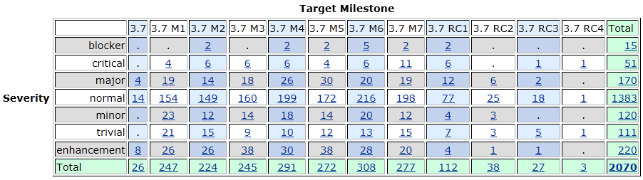
Bugs fixed during 3.7

Slide 19
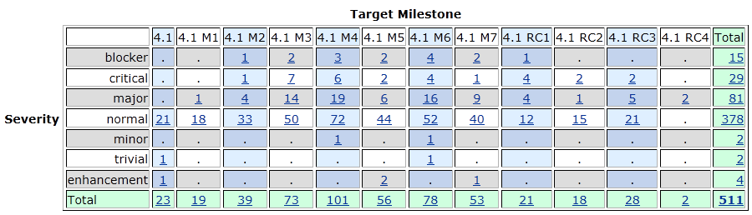
Bugs fixed during 4.1

Slide 20
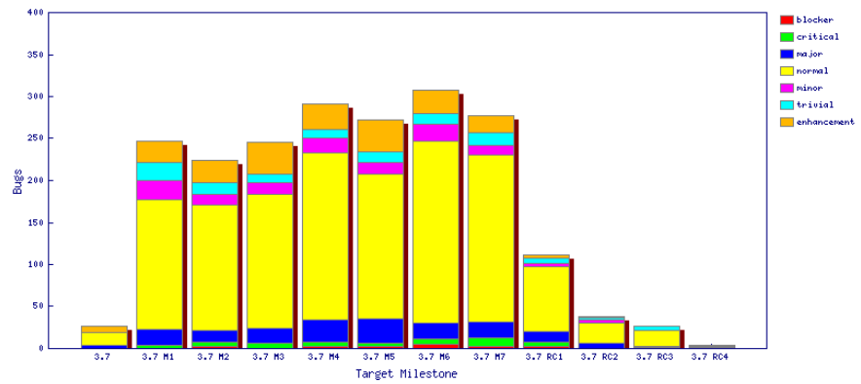
Fixed bugs – 3.7

Slide 21
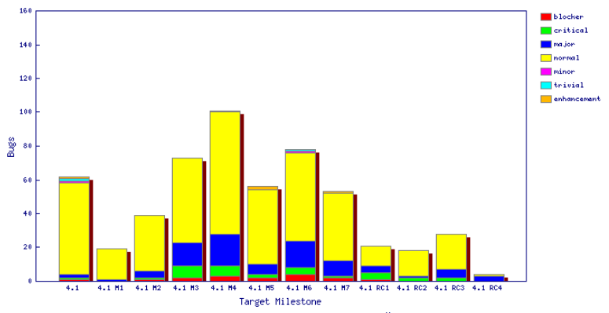
Fixed bugs – 4.1

Slide 22
Standards
Annotation Processing APIs
  com.sun.mirror 1.5
  javax.annotation.processing 1.6
Java compiler API
  javax.tools 1.6
User Assistance consumes (parses) a small subset of RSS 1.0 to get news from eclipse.org
JUnit 3.8.2 and JUnit 4.8.2
J2SE
  Tools are built against Java SE 5
  Compiler can generate 1.3, 1.4, 1.5, and 1.6 code
  Clients can run Java SE 5 or 6
SWT
  Win32, GDI, GDI+, OLE, IE, Carbon, Cocoa, Core Graphics, Quick Draw, Safari, ATSUI, X Windows, X/t, GTK, GDK, Pango, cairo, ATK, Mozilla, Uniscribe, OpenGL

Slide 23
UI Usability
Strings are externalized to support translation into other languages.
Extensive use of mnemonics and shortcut keys in the user interface enhances usability.
Full Bidirectional support (mirroring) on Windows and Linux GTK, bidirectional text on Mac OS X
Accessibility support for Windows, Linux GTK and Mac OS X
Eclipse User Interface Guidelines followed

Slide 24
Schedule
Milestones every 6 weeks, 6 cycle duration
  API frozen on March 11 (M6), Feature freeze April 29 (M7)
  http://www.eclipse.org/projects/project-plan.php?projectid=eclipse#release_milestones
Tracked schedule
  All milestones delivered as planned
  Additional M2a due to compiler bug discovered after M2
End game (release candidate) milestones for 4 cycles
  Duration reduced from 2-week to 1-week cycles at RC2
  No new features or API allowed without proper approvals
  Development to end on June 3, 2011
  Increasingly stringent approval, checking, and change notification requirements in this stage
  http://www.eclipse.org/eclipse/development/plans/freeze_plan_3_7.php

Slide 25
Process
The Eclipse project is developed using an open, transparent, and inclusive process
Teams rely on Bugzilla, mailing lists and newsgroups for input
Weekly planning calls conducted with the PMC and component leads
  Meeting minutes posted to the eclipse-dev mailing list
  Public PMC minutes: http://wiki.eclipse.org/Eclipse/PMC
Component teams have publicly available milestone plans: http://wiki.eclipse.org/Eclipse/Indigo_Plan
  Use project’s web space on eclipse.org to broadcast component milestone plan items and provide status on each item, per milestone

Slide 26
Community
Eclipse team members are active in Bugzilla, newsgroups, and mailing lists
Blogs started by Eclipse committers are evolving
  http://planeteclipse.org
  Some teams are using the eclipse-dev IRC channel
  irc.freenode.net#eclipse-dev
  irc://irc.freenode.net/#eclipse-e4
  also see: http://wiki.eclipse.org/index.php/IRC
The Eclipse team participates in code camps, conference presentations, and tutorials, including
  EclipseCon, JavaOne, JavaWorld, JAOO, Eclipse Summit Europe, Eclipse Forum Europe, JAX, JAX Asia, JSConf
The Eclipse team interacts with other open source projects, standards bodies, and other projects on eclipse.org, including
  OSGi, Apache Ant, JCP, WTP, Apache Harmony, GCJ, GTK

Slide 27
IP Issues
All significant and third party contributions have been reviewed and approved by Eclipse legal.
Eclipse Software User Agreement updated to February 1, 2011 version for all delivered features
About files and license files are complete and correct.
Draft project logs:
  http://www.eclipse.org/projects/ip_log.php?projectid=eclipse.platform
  http://www.eclipse.org/projects/ip_log.php?projectid=eclipse.pde
  http://www.eclipse.org/projects/ip_log.php?projectid=eclipse.jdt

Slide 28
Future Plans
Transition to Git source control: summer 2011
Full Java SE 7 support scheduled for September 2011
  Either separate download or part of Indigo SR1
4.2 release planned for June 2012
  Further Java 7 support and progress on Java 8 support (depending on available specifications)
  Focus on making new generation platform fully enterprise ready
  Documentation and API for 4.x generation features
  Investigate port to GTK+ 3.0
3.8 release also planned for June 2012
  Focus on stability
  Some feature work depending on contributor interest

