Slide 1
Eclipse Project Kepler Release Review
Eclipse Project PMC

Slide 2
Highlights
4.3 is the only development stream this year; 3.x stream has stopped development
4.3 release is primarily a maintenance release with focus on performance and bug fixing
Several major work areas ongoing this year that will target the 4.4 release:
  Compiler and tooling support for Java 8
  Tooling for Eclipse Platform 4 applications: model and style editors
  Major restructuring of OSGi framework
  Full support for GTK+ 3.0
New features in 4.3:
  Blah
  Java tooling features: Blah
API quality:
  Binary compatible for compliant plug-ins
  Some documented breaking changes
  Declared initial API for Eclipse Platform 4, more to come in next release
End-of-life issues:
  Several non-API bundles removed in 4.2 – see End of Life Issues slide for details
IP Clearance and Licenses:
  All licenses and about files are in place as per the Eclipse Development Process, the Due Diligence Process was followed for all contributions
Community and Committer Diversity:
  42 active committers in past 9 months
  Active organizations: BestSolution, Eclipse Source, IBM, Intel, Red Hat, Tasktop
  112 total contributors committed changes in this release (this includes committers)
Notes:
Committer info:
http://dash.eclipse.org/dash/commits/web-app/commit-count-loc.php?top=eclipse&range=1yr

Slide 3
Themes and Plan Items
Platforms
  Start work on Java SE 8 features
  Support Windows 8
  Migrate to GTK+ 3
  SWT browser currency
  Add support for Microsoft UI automation
Robustness
  Performance and stability of Platform user interface
  Finalize initial Eclipse Platform 4 APIs
  Common build infrastructure
  Recruit and train new contributors
http://www.eclipse.org/projects/project-plan.php?projectid=eclipse

Slide 4
Themes and Plan Items
Deferred plan items:
  SWT browser currency
    Progress on supporting XULRunner 17 but not complete
    Aborted work on CEF3 after the project announced it was moving from WebKit to Blink
  Add support for Microsoft UI automation
    Still support IAccessible 2 for Windows
http://www.eclipse.org/projects/project-plan.php?projectid=eclipse

Slide 5
New and Noteworthy - Platform
Detached windows with sash
Trim dragging
Import nested projects
SWT for GTK3
Performance enhancements
Detection of shared install changes
Option to omit -XstartOnFirstThread
Global preference to include exported entries during launching
Launch configuration dialog can show warnings
Support for the Ant augment task
Whole word option on File Search page
Open Search dialog on last used page
Open Resource dialog enhancements
Installation remediation
Initial Eclipse 4 API released
Migrated to Lucene 3.5
Platform updated to Ant 1.8.4
XULRunner on 64-bit Windows
New SWT color constant for hyperlinks
BIDI Text widget direction

Slide 6
New and Noteworthy - JDT
New 'Convert if-else to switch' Quick Assist
'Convert to if-!-return' Quick Assist
Quick Fix to create 'for' loop variable
Quick Assist to combine Strings
Quick Assist for unused type parameters
Template and keyword proposals without prefix
Remove type arguments after content assist
Content assist appends ';' to void methods
Use ';' key to insert method invocation
New API to indicate content assist requested on the start of a constructor
Force Eclipse to compile (illegal) ambiguous varargs code
New batch compiler options
Option to omit @Override for interface methods
Detection of unused type parameters
Option to inherit null annotations
Null annotations for fields
Leak analysis respects well-known utilities
Pre-filling package name in creation wizards
Content assist shows Javadoc in Display, Expressions and Variables view
Javadoc view resolves enclosing method call and keeps last target
Support for package Javadoc in Javadoc hover and view
Package names are linked in Javadoc hover and view
Javadoc and Declaration view indicate when out of sync
Improved evaluation of generics while debugging
API to contribute location information for non-standard JRE / JDK libraries
XML DOM logical structures
Only one JUnit (4.11)
JUnit test templates
JUnit view shows assumption failures

Slide 7
New and Noteworthy - PDE
New API Tools EE descriptions feature
Improved feature selection dialog
Javadoc hover available in plug-in manifest editor
Plug-in image browser view
Launch configurations choose default execution environment
PDE UI requires a 1.5 EE
New import package quick fixes
Bundles in the category editor
New API to contribute to the classpath of plug-in projects
Updating the classpath requires a workspace lock
Problem filters apply to API Tools use scans
API Tools tasks warn about missing include or exclude files
API Tools Analysis and Freeze tasks can run with unresolved bundles
Default start level settings apply to all plug-ins
Running from PDE editors remembers previous launch
JUnit plug-in tests can run on Eclipse platform 4 workbench
API Tools has limited support for pre-OSGi Eclipse plug-ins
API Tools allows @noreference Javadoc tag on types
API Tools Javadoc tags check visibility

Slide 8
New bundles in 4.3
org.apache.httpcomponents.httpclient
org.apache.httpcomponents.httpcore
org.eclipse.ecf.provider.filetransfer.httpclient4
org.eclipse.ecf.provider.filetransfer.httpclient4.ssl

Slide 9
Removed bundles in 4.3
org.apache.commons.httpclient
org.apache.lucene
org.eclipse.ecf.provider.filetransfer.httpclient
org.eclipse.ecf.provider.filetransfer.httpclient.ssl
org.junit4

Slide 10
Non-Code Aspects
Major restructuring of build system
  Migrated to use Tycho
  Anyone can now build the platform in a few steps
Running Juno maintenance builds after 4.2.2 in Long Term Support (LTS) forge
Conscious effort to engage contributors and accept contributions:
  Attended code camps and hack days
  Held dedicated patch days where contributions were reviewed

Slide 11
Non-Code Aspects
Internationalization
  Latin1 and Latin2 locales are supported in all operating environments
  DBCS locales are supported on all platforms
  BIDI locales supported on all platforms
  GB18030-1 Chinese codepage standard is supported on Windows, Linux GTK and Mac.
  Significant BIDI work in 4.3: control text direction independent of widget direction
Localization
  Tested for Localization and participating in Babel Project
Accessibility
  Tested for accessibility
  Open accessibility bugs: 9 major, 0 critical, 0 blocker

Slide 12
Non-Code Aspects
The 4.3 release contains updated User and ISV documentation
Articles, examples, and tutorials
  Several new and updated tutorials for Eclipse 4:http://wiki.eclipse.org/Eclipse4/Tutorials
  Numerous Webinars and Podcasts
  Some of the new/updated articles and tutorials were provided by the Eclipse community

Slide 13
Platform Quality API
API quality is a collaborative effort that involves the experience of the developers working on the Eclipse project, and feedback from consumers.
API changes and proposed API additions are often broadcast to mailing lists to raise awareness of the changes and encourage discussion and feedback.
API changes between 3.7 and 4.2 are checked automatically by API tooling integrated into integration build process.
The 4.2 migration guide identifies 7 incompatible changes:
  http://www.eclipse.org/eclipse/development/porting/eclipse_4_2_porting_guide.html
  For each, a description of the change, what code is affected, and the action that needs to be taken is described.
  Biggest impact is old presentation API which is incompatible with CSS theme engine
  The 4.2 migration guide also describes changes required to adopt mechanisms and APIs that are new in 4.2.
The PMC is comfortable supporting the API that is in the Eclipse project 4.2
All new 4.x stream API is still x-internal and subject to change

Slide 14
Tool Usability
Eclipse SDK is a superior IDE for Java tooling and plug-in development
Many usability enhancements made in 3.8/4.2 to continue this tradition
  Clean and skinnable new Eclipse 4 presentation
  Detached editors and stacking views with editors
  Mac full screen support
  Numerous debugger improvements
  Annotation-based null reference analysis
  New quick fixes and assists for Java 7 features such as try-with-resources, enum switch, multi-catch

Slide 15
Architectural Issues
First fully mature release of new Eclipse 4 user interface architecture: modeled user interface, pluggable rendering and skinning, dependency injection service design
Primary runtime has moved to Java SE 6. Added Java 7 as reference platform
Reference JREs for development and testing updated to most recent releases
Windows (86%) still dominant download, above Linux (8%), Mac (6%)
Starting transition towards GTK+ 3 with switch to Cairo graphics
18 new bundles, 15 removed bundles
  5 removed bundles and 11 added for move to Jetty 8 / Servlet 3.0
  8 removed bundles, related to functionality obsolete 6 or more years ago
  2 removed e4 bundles containing experimental or debugging function
  4 added bundles for new OSGi console
  3 added bundles for new BIDI API, JDT annotations, and dynamic tracing

Slide 16
End of Life Issues
Removed legacy keyring encryption implementation. This was long ago replaced with Equinox secure storage API
Removed some code that allowed plugins compiled against Eclipse 1.0-2.1 to run in Eclipse 3.0 without recompilation
Removed Update Manager from Eclipse 4.2 SDK. It is unusable because it cannot read p2 repositories or metadata
org.eclipse.equinox.concurrent no longer in Eclipse Platform: it was never part of the platform feature but included by an optional ECF dependency in the past
When evolving API the Eclipse Platform will, whenever possible, deprecate API methods and continue to keep them operational
Exceptions to this rule are in the 4.2 migration guide.
A process in place for removing invalid/outdated API
  http://wiki.eclipse.org/Eclipse/API_Central/API_Removal_Process

Slide 17
Bugzilla
Between June 26, 2011 and June 5, 2012 (RC3)
  More than 5,254 reports were created
  Over 3,098 were resolved
  Over 370 back-ported to 3.7.x and 4.1.x maintenance
Current state (RC3) is
  5 blockers, 145 critical
  0 P1, 69 P2
3.7 final state was
  7 blockers, 98 critical
  1 P1, 50 P2

Slide 18
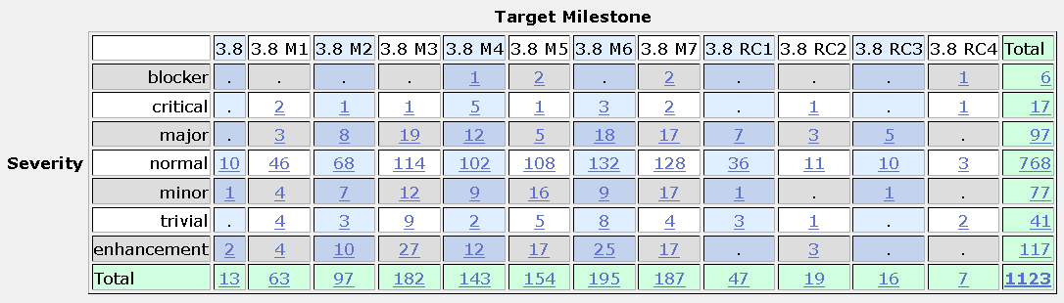
Bugs fixed during 3.8

Slide 19
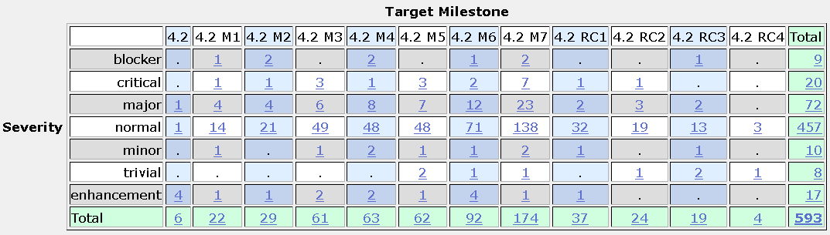
Bugs fixed during 4.2
ff
Note: 1071 bugs fixed in 3.8 were also fixed in 4.2 but not included in the above table. A total of 1664 bugs were fixed in the 4.2 stream.

Slide 20
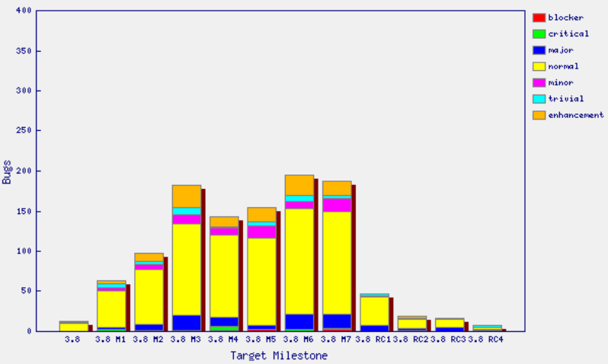
Fixed bugs – 3.8

Slide 21
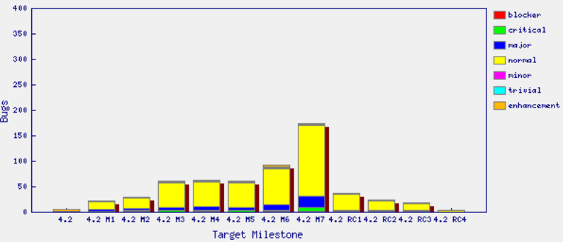
Fixed bugs – 4.2

Slide 22
Standards
Annotation Processing APIs
  com.sun.mirror 1.5
  javax.annotation.processing 1.6
Java compiler API
  javax.tools 1.6
User Assistance consumes (parses) a small subset of RSS 1.0 to get news from eclipse.org
JUnit 3.8.2 and JUnit 4.10
Java SE
  Tools are built against Java SE 6
  Compiler can generate Java 1.1 through Java 1.7 code
  Eclipse Platform can run on Java SE 6 or 7
SWT
  Win32, GDI, GDI+, OLE, IE, Cocoa, Core Graphics, Quick Draw, Safari, ATSUI, X Windows, X/t, GTK+, GDK, Pango, Cairo, ATK, Mozilla, Uniscribe, OpenGL

Slide 23
UI Usability
Strings are externalized to support translation into other languages.
Extensive use of mnemonics and shortcut keys in the user interface enhances usability.
Full Bidirectional support (mirroring) on Windows and Linux GTK, bidirectional text on Mac OS X
Accessibility support for Windows, Linux GTK and Mac OS X
Eclipse User Interface Guidelines followed

Slide 24
Schedule
Milestones every 6 weeks, 6 cycle duration
  API frozen on March 15 (M6), Feature freeze May 3 (M7)
  http://www.eclipse.org/projects/project-plan.php?projectid=eclipse#release_milestones
Tracked schedule
  All milestones delivered as planned
End game (release candidate) milestones for 4 cycles
  Duration reduced from 2-week to 1-week cycles at RC2
  No new features or API allowed without proper approvals
  Development to end on June 5, 2013
  Increasingly stringent approval, checking, and change notification requirements in this stage
  http://www.eclipse.org/eclipse/development/plans/freeze_plan_4_3.php

Slide 25
Process
The Eclipse project is developed using an open, transparent, and inclusive process
Teams rely on Bugzilla, mailing lists and newsgroups for input
Weekly planning calls conducted with the PMC and component leads
  Public PMC minutes: http://wiki.eclipse.org/Eclipse/PMC
Component teams have publicly available milestone plans: http://wiki.eclipse.org/Eclipse/Kepler_Plan
  Use project’s web space on eclipse.org to broadcast component milestone plan items and provide status on each item, per milestone

Slide 26
Community
Eclipse team active in Bugzilla, forums, and mailing lists
Many Eclipse blogs on http://planeteclipse.org
Some teams are using IRC to communicate
  irc://irc.freenode.net#eclipse-dev
  irc://irc.freenode.net/#eclipse-e4
  also see: http://wiki.eclipse.org/index.php/IRC
Major Eclipse presence on http://stackoverflow.com
The Eclipse team participates in code camps, conference presentations, and tutorials, including
  EclipseCon, EclipseCon Europe, Eclipse Demo Camps, JavaOne, JavaWorld, JAOO, JAX, JAX Asia, JSConf
The Eclipse team interacts with other open source projects, standards bodies, and other projects on eclipse.org, including
  OSGi, Apache Ant, JCP, WTP, GCJ, GTK

Slide 27
IP Issues
All significant and third party contributions have been reviewed and approved by Eclipse legal.
Using most recent Eclipse Software User Agreement
About files and license files are complete and correct.
Final approved IP log:
  http://www.eclipse.org/eclipse/development/project-log-files/eclipse-project-4.2-log.html

Slide 28
Future Plans
4.4 release planned for June 2014
  Support for Java SE 8
  Eclipse platform 4 tooling support
  Full support for GTK+ 3
  Migrate to refactored Equinox kernel
4.3.1 and 4.3.2 maintenance releases
  Bug fixes only
Ongoing long term support to Juno stream within LTS forge

