Slide 1
Extending the Standard Widget Toolkit
How to create your own widgets
Veronika Irvine and Steve Northover
Notes:
Veronika Irvine, Eclipse Committer for IBM Canada: Veronika Irvine is one of the original members of the Eclipse SWT team, which she joined in 1998. Her primary areas of responsibility are layouts, drag-and-drop, Active X integration and custom widgets. She has written several articles for eclipse.org, including "ActiveX Support in SWT" and "Adding Drag and Drop to an SWT Application". Veronika works at the IBM OTI Lab in Ottawa.
Steve Northover, Eclipse Committer for IBM Canada: Steve Northover is the principal architect of SWT. He is the SWT team lead for the Eclipse project, and works at the IBM OTI Lab in Ottawa. His areas of expertise include performance, operating system programming and native user interface toolkits. He is the lead author of the book "SWT: The Standard Widget Toolkit, Volume 1".

Slide 2
Latest version of these slides
www.eclipse.org/swt/tutorials/oopsla2005/

Slide 3
Agenda
Intro
Widget Basics
Break 10:00 until 10:30
Advanced Topics
Resources
Q&A

Slide 4
Survey says …
Written your own custom widget?
Using a custom widget developed by somebody else?
http://eclipse.org/swt/community.php
http://www.eclipse.org/proposals/mascara/
Notes:
VI

Slide 5
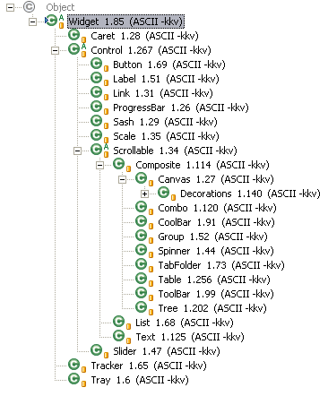
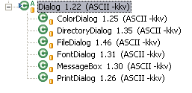
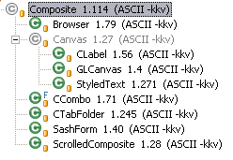
Widgets in SWT
Notes:
SN

Slide 6
New widgets in SWT 3.1
Link
Spinner
Advanced Graphics
Tree with columns
Table – reorderable columns
StyledText – strike through and underlined font
Notes:
SN

Slide 7
Widgets Planned for 3.2*
Expandable Group
Date/Time Picker
Tree and Table improvements
  SWT.VIRTUAL, sort indicator, reorderable columns
GLCanvas - OpenGL
StyledText improvements
  multiple height fonts, bullets, indentation, images
Theme drawing
*under construction
Notes:
SN

Slide 8
Widget Basics
Subclassing
Painting
Size and Position
Mouse
Keyboard and Focus
Traversal

Slide 9
Widget Categories
Static (e.g. Label)
  No input (display only)
Dynamic (e.g. List)
  Simple input (selection, scrolling)
Complex (e.g. TextEditor)
  Sophisticated input (caret, BIDI selection, IME)
Notes:
SN

Slide 10
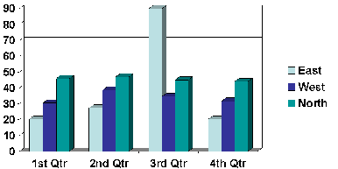
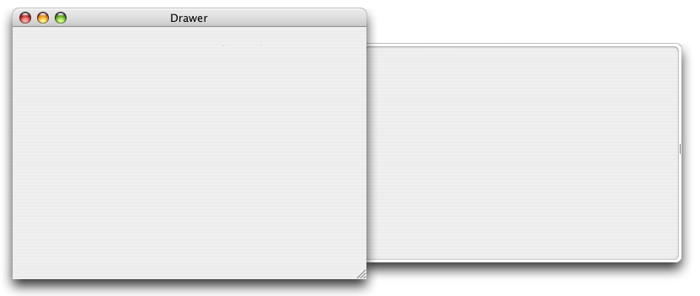
Where to start?
Combine existing widgets
  e.g. combo box
Draw your own
  e.g. graph chart
Wrap native widget
  e.g. drawer (Mac OS X)
  JNI library
Notes:
VI
There are three things …

Slide 11
Is it really a Widget?
Reuse a collection of widgets - Yes
MVC - No
Preset some values – No
Why does it matter?
  API hiding
  events, drag and drop
  the lie
Notes:
VI
Why does it matter?
API hiding – new API added to encapsulated widget, your API is out of date
Extra Composite in the way – issue for listening to events, adding as a drag source or drop target
e.g. hook mouse down but never get it because the event goes to the hidden inner guy
the lie

Slide 12
What to subclass?
Composite / Canvas
Can it have children?
No
Yes
Is it made from a
collection of widgets?
Composite
e.g. Group
No
Yes
Canvas
e.g. label, text
Composite
e.g. combo box
Notes:
VI

Slide 13
Do not subclass Button!
“Inheritance versus composition: Which one should you choose?” http://www.javaworld.com/javaworld/jw-11-1998/jw-11-techniques.html
“Fragile Base Class Problem” by Leonid Mikhajlov. http://www.abo.fi/~lmikhajl/
Notes:
SN + VI

Slide 14
Inheritance and SWT
Use event handlers rather than overriding methods
  Paint, Dispose, Focus
Exceptions
  computeSize, getClientArea, …
Notes:
SN

Slide 15
Life cycle
Constructor
  Parent
  Style bits
Get and Set attributes
Events
Dispose
Notes:
SN

Slide 16
Adding API
Call checkWidget()
  UI thread
  Disposed
Naming conventions
  look for similar API in other widgets
Notes:
SN

Slide 17
Keep it clean!
Use SWT.Dispose event
  DO NOT override dispose()
  DO NOT use finalize()
Free all resources allocated by widget
  DO NOT free resources provided by application
Notes:
VI

Slide 18
"Finalizers are unpredictable, often dangerous, and generally unnecessary. Their use can cause erratic behavior, poor performance, and portability problems." [JB, 2.6].
"The Java programming language does not specify how soon a finalizer will be invoked, except to say that it will happen before the storage for the object is reused. ... If an uncaught exception is thrown during the finalization, the exception is ignored and finalization of that object terminates." [JLS, 12.6].
"The Java programming language imposes no ordering on finalize method calls. Finalizers may be called in any order, or even concurrently." [JLS 12.6.2]
"... the language does not specify which thread will invoke the finalizer for any given object." [JLS 12.6]
[JB] Bloch, Joshua. Effective Java - Programming Language Guide. Addison-Wesley, Boston, 2001.
ISBN: 0-201-31005-8.
[JLS] Gosling James, Bill Joy, Guy Steele, Gilad Bracha. The Java Language Specification, Second Edition
http://java.sun.com/docs/books/jls/second_edition/html/j.title.doc.html
Notes:
VI

Slide 19
Don’t clean up too soon!
Listener listener = new Listener() {
public void handleEvent(Event event) {
removeListener(SWT.Dispose, listener);
notifyListeners(SWT.Dispose, event);
event.type = SWT.None;
// clean up resources and items
font.dispose();
}
};
addListener(SWT.Dispose, listener);
Notes:
VI
Problem – display.addFilter() sees this twice
Alternatives:
– negative event id to put you at end of list
asyncExec

Slide 20
Threading
Apartment threaded
Display.syncExec(Runnable)
  waits until completed
Display.asyncExec(Runnable)
  doesn’t wait for completion
  runs when event loop idle
Notes:
SN

Slide 21
Events
Low level events
  SWT.MouseUp, SWT.KeyUp
High level events
  SWT.Selection, SWT.DragDetect
Notes:
VI

Slide 22
Untyped Events
predefined fixed set in SWT
  Listener l = new Listener() {
  public void handleEvent(Event e) {
  switch (e.type) {
  case SWT.Selection: …
  case SWT.DefaultSelection: …
  }
  }};
  addListener(SWT.Selection, l);
  addListener(SWT.DefaultSelection, l);
Notes:
VI

Slide 23
Sending an SWT Event
notifyListener(SWT.Selection, event)
Calls each listener (typed and untyped)
Does not cause OS event to occur
Notes:
VI

Slide 24
addSelectionListener()
public void
addSelectionListener(SelectionListener l) {
checkWidget();
if (l == null) {
SWT.error(SWT.ERROR_NULL_ARGUMENT);
}
TypedListener tl = new TypedListener(l);
addListener(SWT.Selection, tl);
addListener(SWT.DefaultSelection, tl);
}
Notes:
VI

Slide 25
Typed Events
Anyone can define
Follow JavaBeans listener pattern
addFolderListener(new FolderListener() {
public void itemClosed(FolderEvent e){
}
});
Notes:
VI

Slide 26
Sending typed events
Maintain a list of listeners, loop over list and call each one
FolderEvent extends TypedEvent
FolderListener extends SWTEventListener
Notes:
VI

Slide 27
Map typed to untyped events
Typed Event | Listener | InterfaceMethods | Untyped event
ArmEvent | ArmListener | widgetArmed(ArmEvent) | SWT.Arm
ControlEvent | ControlListener | controlMoved(ControlEvent) controlResized(ControlEvent) | SWT.Move SWT.Resize
DisposeEvent | DisposeListener | widgetDisposed(DisposeEvent) | SWT.Dispose
FocusEvent | FocusListener | focusGained(FocusEvent) focusLost(FocusEvent) | SWT.FocusIn SWT.FocusOut
HelpEvent | HelpListener | helpRequested(HelpEvent) | SWT.Help
KeyEvent | KeyListener | keyPressed(KeyEvent) keyReleased(KeyEvent) | SWT.KeyPressed SWT.KeyReleased
MenuEvent | MenuListener | menuHidden(MenuEvent) menuShown(MenuEvent) | SWT.Hide SWT.Show
ModifyEvent | ModifyListener | modifyText(ModifyEvent) | SWT.Modify
MouseEvent | MouseListener | mouseDoubleClick(MouseEvent) mouseDown(MouseEvent) mouseUp(MouseEvent) | SWT.MouseDoubleClick SWT.MouseDown SWT.MouseUp
Notes:
VI

Slide 28
Typed Event | Listener | InterfaceMethods | Untyped event
MouseEvent | MouseMoveListener | mouseMove(MouseEvent) | SWT.MouseMove
MouseEvent | MouseTrackListener | mouseEnter(MouseEvent) mouseExit(MouseEvent) mouseHover(MouseEvent) | SWT.MouseEnter SWT.MouseExit SWT.MouseHover
PaintEvent | PaintListener | paintControl(PaintEvent) | SWT.Paint
SelectionEvent | SelectionListener | widgetDefaultSeleted(SelectionEvent) widgetSeleted(SelectionEvent) | SWT.DefaultSelection SWT.Selection
ShellEvent | ShellListener | shellActivated(ShellEvent) shellClosed(ShellEvent) shellDeactivated(ShellEvent) shellDeiconified(ShellEvent) shellIconified(ShellEvent) | SWT.Activate SWT.Close SWT.Deactivate SWT.Deiconify SWT.Iconify
TraverseEvent | TraverseListener | keyTraversed(TraverseEvent) | SWT.Traverse
TreeEvent | TreeListener | treeCollapsed(TreeEvent) treeExpanded(TreeEvent) | SWT.Collapse SWT.Expand
VerifyEvent | VerifyListener | verifyText(VerifyEvent) | SWT.Verify

Slide 29
Paint event
Type
  SWT.Paint
Fields
  gc
    font, foreground and background colors
    clipped to damaged region
  x, y, width, height
    smallest rectangle surrounding damage
AVOID drawing outside of the SWT.Paint event
Notes:
SN
deferred update strategy – damage and redraw in event loop – merged by OS
composing versus clipping Mac OS X and Vista
transparency

Slide 30
GC (Graphics Context)
Draw line, shape, text, and image
Set color, font, line style, etc
Control, Device (Display and Printer), or Image
OS resource
  if you create one, you must dispose it
Notes:
SN

Slide 31
Region
translate()
add(), remove()
contains(), intersects()
Array of points, rectangles, other regions
OS resource
  if you create one, you must dispose it

Slide 32
Causing paints to occur
Control.redraw(…)
  damage an area
Control.update()
  force all outstanding paints to be processed
Canvas.scroll(…)
  copy bits on screen
Notes:
SN

Slide 33
SWT Speak
Cheese == pixel corruption
Flash == unnecessary redraws
Pinhead == very, very small
Notes:
SN

Slide 34
Painting Strategies
SWT.NO_REDRAW_RESIZE
  redraw backwards L on resize
SWT.DOUBLE_BUFFERED
  native double-buffering
SWT.NO_BACKGROUND
  background not drawn by control
Notes:
SN

Slide 35
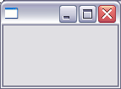
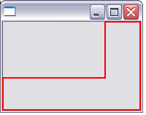

Backwards ‘L’
Area damaged when widget is resized
FlashDemo
CheeseDemo
Notes:
SN
VI - demo
example demo
- draw oval and show cheese, get rid of cheese with NO_REDRAW_RESIZE

Slide 36
Merging Paints
OS will automatically merge paints unless you override with:
SWT.NO_MERGE_PAINTS
PaintDemo
Notes:
SN
**** not normally used
Picture showing damage – like backwards L

Slide 37
Cheese Test
First line in Paint event:
Point pt = getSize();
gc.setBackground(green);
gc.fillRectangle(0,0,pt.x,pt.y);
Notes:
VI

Slide 38
Double Buffering - Pros
Reduce flash
Use when you don’t know every pixel (e.g. rotated text, anti-aliasing)
Do complicated drawing only once (redraw offscreen image)
Notes:
SN

Slide 39
Double Buffering - Cons
Hides the fact you are doing too much work
Can be slow –every pixel is drawn, depends on OS, graphics card
Notes:
SN

Slide 40
SWT.DOUBLE_BUFFERED
Native double buffering support
Some platforms are always double buffered (GTK, Mac OS X)
Not supported everywhere (QNX)
Check style after creating widget
Notes:
SN

Slide 41
Paint Performance
Use Clipping Region
  GC.getClipping()
Cache in SWT.Resize, setters
String operations are expensive
  GC.drawString(), GC.stringExtent()
Notes:
SN

Slide 42
System Resources
display.getSystemColor(…)
display.getSystemImage(…)
display.getSystemCursor(…)
display.getSystemFont()
COLOR_WIDGET_DARK_SHADOW
COLOR_WIDGET_FOREGROUND
COLOR_WIDGET_BACKGROUND
COLOR_WIDGET_BORDER
COLOR_LIST_FOREGROUND
COLOR_LIST_BACKGROUND
COLOR_LIST_SELECTION
COLOR_LIST_SELECTION_TEXT
COLOR_INFO_FOREGROUND
COLOR_INFO_BACKGROUND
ICON_ERROR
ICON_INFORMATION
CURSOR_ARROW
CURSOR_WAIT
etc
Notes:
VI

Slide 43
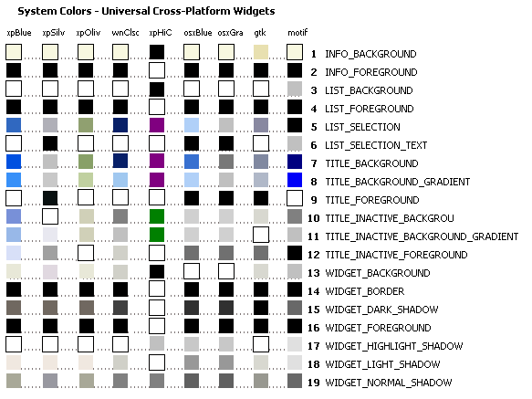
Notes:
VI

Slide 44
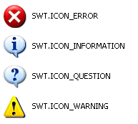
System Images

Slide 45
Text drawing
GC.drawText(…)vs GC.drawString(…)
GC.textExtent(…) vs GC.stringExtent(…)
SWT.DRAW_DELIMITER
SWT.DRAW_TAB
SWT.DRAW_MNEMONIC
SWT.DRAW_TRANSPARENT
Notes:
SN

Slide 46
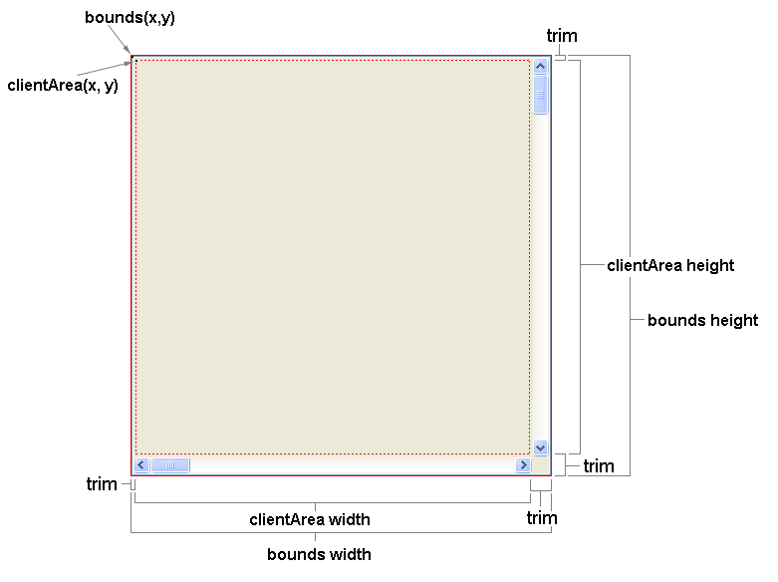
Anatomy of a widget
Notes:
VI

Slide 47
Move & Resize events
SWT.Move
  control’s location has changed relative to its parent
  setLocation(), setBounds(), or user interaction
SWT.Resize
  size of a control’s client area has changed
  setSize(), setBounds(), user interaction, show/hide scrollbars ...
Notes:
VI

Slide 48
Layouts
Layout – abstract superclass
FillLayout – single row or column
RowLayout – multiple rows or columns
GridLayout – grid
FormLayout – attach the edges of each child
StackLayout – children are stacked and topmost is drawn
may use layout data - Control.setLayoutData(Object)
See “Understanding Layouts” on eclipse.org
Notes:
VI

Slide 49
Preferred Size
Control.computeSize(…)
Composite.computeTrim(…)
  SWT.DEFAULT, changed
Composite.getClientArea(…)
Does it wrap? height = ƒ(width)
SizeDemo
Notes:
VI

Slide 50
Mouse events
Types
  MouseDown, MouseUp, MouseMove
  MouseEnter, MouseExit, MouseHover
  MouseDoubleClick
  MenuDetect, DragDetect
Fields
  button - 1, 2, 3
  x, y - mouse pointer in widget-relative coordinates
  stateMask – bit mask of CONTROL, SHIFT, ALT, COMMAND, MOD1, MOD2, MOD3, MOD4
Notes:
SN

Slide 51
Keyboard events
Types
  KeyDown, KeyUp
  Traverse, Verify, Modify
Fields
  character – “character” after applying modifier keys
  keyCode – raw “key code”
  stateMask – bit mask of CONTROL, SHIFT, ALT, COMMAND, MOD1, MOD2, MOD3, MOD4
  doit (Traverse and Verify events) – false cancels the operation
Notes:
SN

Slide 52
Focus events
Types
  FocusIn, FocusOut
Focus control receives all keyboard events until focus is assigned to another control
Draw in a different manner to give visual cue
  i.e. Flashing I-beam caret in Text, dotted rectangle in List
Control.setFocus()
Control.forceFocus()
Control.isFocusControl()
Display.getFocusControl()
Notes:
VI
Display.getFocusControl does not work for composited widgets
Force versus Set
Set with only give focus to something that should take focus – will look through child hierarchy to find someone
Set will not give to parent
Force results is focus being set to a guy who does not accept keyboard input – almost always bad
Occasionally forceFocus() is good – implement a tab widget that has children and force focus to tab

Slide 53
Keyboard Focus
DO NOT override setFocus() or forceFocus()
SWT.NO_FOCUS style bit
  disable mouse focus
SWT.KeyUp, SWT.KeyDown events
  enable keyboard traversal into widget
SWT.Traverse event
  enable keyboard traversal out of widget
Notes:
VI

Slide 54
Traverse Event
Default OS behavior?
YES
NO
doit = true
Implement my own traversal?
YES
NO
doit = true
detail = SWT.TRAVERSE_NONE
doit = false
Notes:
VI
**** confusing topic

Slide 55
 | OS Traversal | Key Event
event.doit = true | Maybe (Tab vs Esc) | Maybe (Tab vs Esc)
event.doit = false | No | Yes
event.doit = true event.detail = SWT.TRAVERSE_NONE | No | No
TraversalDemo
Notes:
VI

Slide 56
Advanced Topics
Scrolling
Advanced Graphics
Text Editors
Shells
Mirroring
Accessibility

Slide 57
Scrolling
SWT.H_SCROLL, SWT.V_SCROLL
getHorizontalBar()
getVerticalBar()
scroll()
min, max, thumb, page increment
selection
ScrollingDemo
Notes:
SN
Flushing outstanding graphics
VI - demo

Slide 58
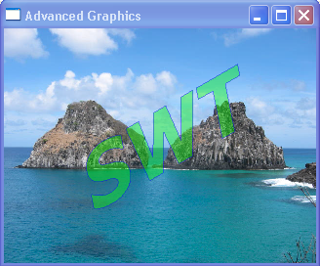
Advanced Graphics
Notes:
VI

Slide 59
Minimum Requirements
SWT 3.1
GDI+ on Windows, Cairo on Linux
GC gc = new GC(control);
gc.setAdvanced(true);
boolean advanced = gc.getAdvanced();
gc.dispose();
Notes:
VI

Slide 60
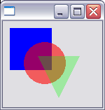
Alpha Transparency
gc.setBackground(blue);
gc.fillRectangle(10, 10, 60, 60);
gc.setBackground(red);
gc.setAlpha(150);
gc.fillOval(30, 30, 60, 60);
gc.setAlpha(75);
gc.setBackground(green);
int[] triangle = new int[]{…};
gc.fillPolygon(triangle);
Notes:
VI

Slide 61
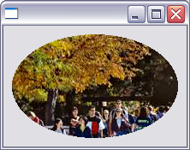
Patterns
Pattern pattern
= new Pattern(display, image);
gc.setBackgroundPattern(pattern);
gc.fillOval(5, 5, 200, 200);
pattern.dispose();
Notes:
VI

Slide 62
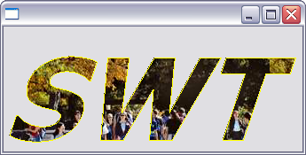
Paths
Path path = new Path(display);
path.addString("SWT", 0, 0, font);
gc.setBackgroundPattern(pattern);
gc.fillPath(path);
gc.setForeground(yellow);
gc.drawPath(path);
path.dispose();
Notes:
VI

Slide 63
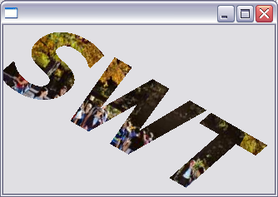
Transformations
Transform tr = new Transform(display);
tr.translate(50, -50);
tr.rotate(30);
gc.setTransform(tr);
gc.setBackgroundPattern(pattern);
gc.fillPath(path);
tr.dispose();
Notes:
VI

Slide 64
Writing a Text Editor
Canvas.setCaret(…)
  I-Beam for insertion
TextLayout
  BIDI locales
  support for drawing, cursor navigation, hit testing, text wrapping, alignment, tab expansion line breaking, etc
Notes:
SN

Slide 65

Internationalized text
TextLayout
TextStyle(font, foreground, background)
layout.setStyle(style1, 0, 6)
layout.draw(event.gc, 10, 10)
TextDemo
Notes:
VI

Slide 66
Wrapped Text
TextLayout.setWidth(width)
TextLayout.getBounds()
TextDemo
Notes:
VI

Slide 67
Shell – tooltips, popups
SWT.NO_TRIM
SWT.TOOL
SWT.ON_TOP
Shell.open(), Shell.setVisible(true)
Non-rectangular shells
GratuitousDemo
Notes:
SN

Slide 68
Coordinate Systems
Relative to parent composite
  Control.set/getBounds(…)
Convert to/from display coordinates
  Display.map(…)
Notes:
VI

Slide 69
Mirroring (BIDI)
SWT.RIGHT_TO_LEFT, SWT.LEFT_TO_RIGHT
SWT.LEAD, SWT.TRAIL versus SWT.LEFT, SWT.RIGHT
MirroringDemo
Notes:
SN
VI - demo

Slide 70
Arrow keys
boolean mirrored =
(getStyle() & SWT.RIGHT_TO_LEFT) != 0;
int leadKey = mirrored ? SWT.ARROW_RIGHT : SWT.ARROW_LEFT;
Notes:
SN
Keys not inverted automatically because it depends on the widget
Tab folder – left arrow should still go to left tab – same as left to right
Tree – expand collapse – reverse of left to right

Slide 71
Multiple Monitors
Control.getMonitor()
Display.getPrimaryMonitor()
Display.getMonitors(),
Monitor.getBounds()
Notes:
VI

Slide 72
Accessibility
comply with platform defined keyboard shortcuts
  SWT.MenuDetect, SWT.DefaultSelection etc
support mnemonics
give visible indication of focus
test with large fonts and high contrast
Notes:
VI
setMenu – free internationalization

Slide 73
Mnemonics
SWT.TRAVERSE_MNEMONIC
SWT.DRAW_MNEMONIC
MnemonicDemo

Slide 74
Assistive Technology Clients
programs like screen readers
AccessibleControlListener
  hit test, role, state
AccessibleTextListener
  caret offset, selection range
AccessibleListener
  name, help, keyboard shortcut, description
Notes:
VI

Slide 75
Accessible accessible = getAccessible();
accessible.addAccessibleListener(new AccessibleListener() {
});

Slide 76

JNI access to native widget
- Spinner

Slide 77
public class MySpinner extends Composite {
int handleSpinner;
static Hashtable table = new Hashtable ();
static {
System.loadLibrary ("spinner");
}

Slide 78
public MySpinner (Composite parent, int style) {
super (parent, style);
int handleParent = handle;
handleSpinner = createControl (handleParent);
if (handleSpinner == 0) SWT.error (SWT.ERROR_NO_HANDLES);
table.put (new Integer (handleSpinner), this);
Listener listener = new Listener() {
public void handleEvent(Event e) {
switch (e.type) {
case SWT.Dispose: widgetDisposed(e); break;
case SWT.FocusIn: focusGained(e); break;
case SWT.Resize: controlResized(e); break;
}
}
};
int[] events = new int[]{SWT.Dispose, SWT.FocusIn, SWT.Resize};
for (int i = 0; i < events.length; i++) {
addListener(events[i], listener);
}
Font font = getFont ();
setFont (handleSpinner, font.handle);
}

Slide 79
public void setFont (Font font) {
super.setFont (font);
int hFont = 0;
if (font != null) hFont = font.handle;
setFont (handleSpinner, hFont);
}
public void controlResized (Event e) {
Rectangle rect = getClientArea ();
resizeControl (handleSpinner, rect.x, rect.y, rect.width, rect.height);
}
public void focusGained (Event e) {
setFocus (handleSpinner);
}

Slide 80
/*********** JAVA NATIVES ************/
static final native int createControl (int handle);
static final native void computeSize (int handle, int [] result);
static final native void resizeControl (int handle, int x, int y, int width, int height);
static final native void setPosition (int handle, int position);
static final native int getPosition (int handle);
static final native void setMaximum (int handle, int max);
static final native int getMaximum (int handle);
static final native void setMinimum (int handle, int min);
static final native int getMinimum (int handle);
static final native void setFont (int handle, int hFont);
static final native void setFocus (int handle);

Slide 81
/*
* Class: org_eclipse_swt_tutorial_MySpinner
* Method: resizeControl
* Signature: (IIIII)V
*/
JNIEXPORT void JNICALL Java_org_eclipse_swt_tutorial_MySpinner_resizeControl
(JNIEnv *env, jclass that, jint hwndUpDown, jint x, jint y, jint width, jint height)
{
HWND hwndText = (HWND) SendMessage((HWND) hwndUpDown, UDM_GETBUDDY, 0, 0);
UINT flags = SWP_NOZORDER | SWP_DRAWFRAME | SWP_NOACTIVATE;
int upDownWidth = GetSystemMetrics(SM_CXVSCROLL);
SetWindowPos(hwndText, (HWND) 0, x, y, width - upDownWidth + 2, height, flags);
SetWindowPos((HWND) hwndUpDown, (HWND) 0, x + width - upDownWidth, y, upDownWidth, height, flags);
}

Slide 82
More Info
org.eclipse.swt.custom.*
  CLabel, CTabFolder, StyledText
SWT Article “Creating Your Own Widgets using SWT”
  www.eclipse.org/articles/

Slide 83
www.eclipse.org/swt
Example code snippets, organized by SWT class
SWT FAQ, downloads, list of documents

Slide 84
www.eclipse.org
Online documentation and articles
Bugzilla (product: platform, component: SWT)
SWT newsgroup (eclipse.platform.swt)
SWT developer mailing list (platform-swt-dev@eclipse.org)
org.eclipse.swt.examples from CVS

Slide 85
Books
“SWT: The Standard Widget Toolkit, Volume 1”
  by Steve Northover and Mike Wilson
“The Definitive Guide to SWT and JFace”
  by Rob Warner and Robert Harris
“SWT/JFace in Action : GUI Design with Eclipse 3.0”
  by Matthew Scarpino
“Professional Java Native Interfaces with SWT/JFace”
  by Jackwind Li Guojie

Slide 86
Q&A
Veronika Irvine
Steve Northover

Slide 87
Latest version of these slides
www.eclipse.org/swt/tutorials/oopsla2005/

