Slide 1
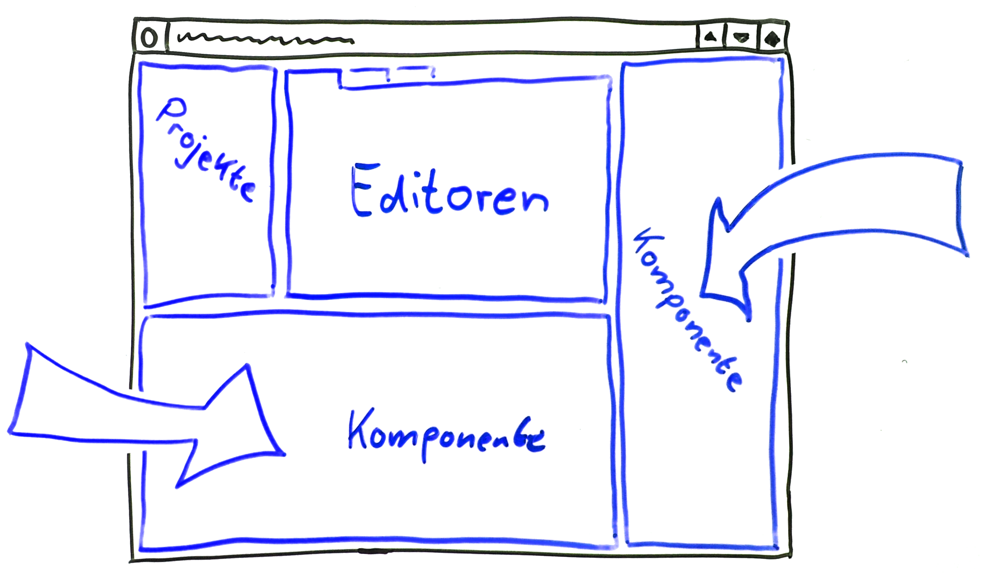





Projects
Editors
Component
Component
additional Eclipse-Components

