Slide 1



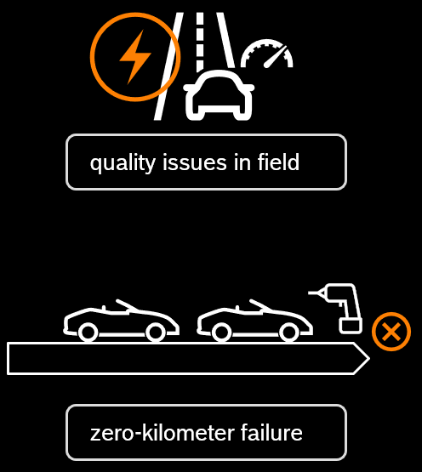






KIT Traceability Adoption View Grafik DT qualityTask
Catena-X Next, UAP3.3 Traceability
Tier 2
Tier 1
OEM
1a
DT transport unit
2
quality issues in field
new DT! UUID…
3
DT
unique ID push (notification)
UUID 123…
or
qualityTask
1b
7
4
5
VIN 1
request
request
VIN 2
DT
…
VIN 3
8
UUID 8n1…
6
zero-kilometer failure
…
IoT Sensor
qualityTask
fleet veh.
fleet diag.
data pull
part 1
data pull
part 2
…
part 3
9
holistic analysis

