Slide 1
ECF 2.1 Release Review
  ECF Team
  Project Lead: Scott Lewis
  <slewis@eclipsesource.com>
  December 23, 2008
  IP Log: http://www.eclipse.org/ecf/ip_log.html
  ECF Mailing List: ecf-dev@eclipse.org

Slide 2
New and Noteworthy
Move to RT Project
2 Videos Available on live.eclipse.org
Sync API – Abstracted from popular Real-Time Shared Editing
  Opens up ability for other applications to use real-time document synchronization (Cola)
Storage API – Uses Equinox secure storage (IsecurePreferences) to store and retrieve ECF Ids securely/persistently, along with any associated properties (e.g. Passwords). Will enable secure storage of user login and credentials info for ECF accounts
Many improvements to Real-time shared editing
Inclusion of RT Shared Editing in WTP point release (for several text editors)

Slide 3
New and Noteworthy (cont)
JSLP (Discovery API provider) additions and bug fixes
XMPP provider critical bug fixes
Remote Services provider bug fixes (generic and r-OSGi)
OSGi Community Event Presentation
113 bugs fixed
  https://bugs.eclipse.org/bugs/buglist.cgi?query_format=advanced&short_desc_type=allwordssubstr&short_desc=&classification=RT&product=ECF&long_desc_type=allwordssubstr&long_desc=&bug_file_loc_type=allwordssubstr&bug_file_loc=&status_whiteboard_type=allwordssubstr&status_whiteboard=&keywords_type=allwords&keywords=&bug_status=RESOLVED&bug_status=VERIFIED&bug_status=CLOSED&emailtype1=substring&email1=&emailtype2=substring&email2=&bugidtype=include&bug_id=&votes=&chfieldfrom=2008-06-20&chfieldto=Now&chfieldvalue=&cmdtype=doit&order=Reuse+same+sort+as+last+time&field0-0-0=noop&type0-0-0=noop&value0-0-0=
Galileo Project Plan
  http://www.eclipse.org/projects/project-plan.php?projectid=rt.ecf

Slide 4
Future Plans: Galileo and Beyond
Galileo Project Plan
  http://www.eclipse.org/projects/project-plan.php?projectid=rt.ecf
Continuing to Support Equinox/P2 with File transfer
ECF Book
Plans to Include Discovery API and Providers in Platform/P2
Plans to Implement OSGi EE RFC 119 for Galileo
Much Greater Emphasis on Remote OSGi Services, Discovery, and other APIs
Work with Riena Project to get Riena provider for ECF remote services API
Notes:
moved from Technology to Runtime project...still will be doing comm/collab for IDE, but also supporting RCP and Runtime inter-process communication

Slide 5
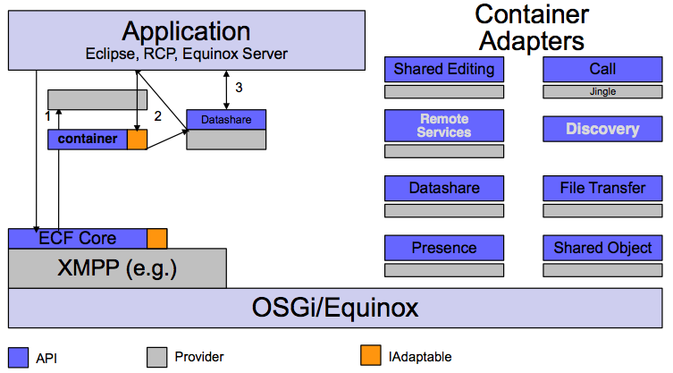
ECF Architecture

Slide 6
Existing ECF Providers
Protocol Container Type Name
XMPP (jabber) ecf.xmpp.smack
Yahoo ecf.yahoo.jymsg
ECF 'generic' client ecf.generic.client
ECF 'generic' server ecf.generic.server
IRC ecf.irc.irclib
Java Messaging Service ecf.jms.tcp.client
Zeroconf /Bonjour ecf.discovery.jmdns
Skype ecf.namespace.skype.user
datashare ecf.generic.channel
fileshare ecf.generic.fileshare
......

Slide 7
ECF Project Resources
Project Website
  http://www.eclipse.org/ecf
Mailing list
  http://dev.eclipse.org/newslists/news.eclipse.technology.ecf/maillist.html
Newsgroup
  news://news.eclipse.org/eclipse.technology.ecf
Project Plan For ECF - version 3.0
  http://www.eclipse.org/projects/project-plan.php?projectid=rt.ecf
Wiki
  http://wiki.eclipse.org/Eclipse_Communication_Framework_Project
Other ECF repository
  http://ecf1.osuosl.org/

