Slide 1
ECF Inside and Out
  Marcelo Mayworm <mayworm@ieee.org>
  Scott Lewis <slewis@composent.com>
  November 19th, 2008

Slide 2
Agenda
ECF Overview
ECF Providers
Docshare and Real Time Shared Editing
Sync API
Datashare API
Demo
Conclusion
Q&A

Slide 3
ECF: What it is
APIs for messaging
  Very Small Core
    core API
      two bundles:
        org.eclipse.ecf – 79kb
        org.eclipse.ecf.identity - 49kb
    Async messaging 'container' == Connection Framework
    extensibility mechanism
Extensibility with Adapters
  data channels, object/model replication, service discovery, file transfer,presence/im/chat, voip call setup, remote services, others/your own...

Slide 4
ECF
Minimalism: Only use messaging APIs you need
  API Consistency: Consistent way of doing same thing (e.g. Filetransfer) over multiple protocols (e.g. Http, bittorrent)
Interoperability, Integration
Open protocols via Open source
Moved from Technology to Runtime project
Notes:
moved from Technology to Runtime project...still will be doing comm/collab for IDE, but also supporting RCP and Runtime inter-process communication

Slide 5
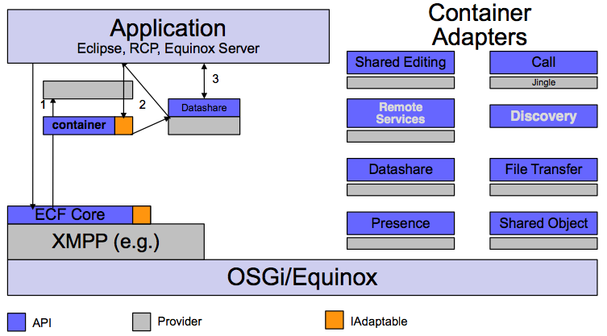
ECF Architecture

Slide 6
ECF Providers
Implement ECF core Extension Points
  Namespace
    unique identifiers to do addressing of remote processes
Implemented so far: ECF Generic, XMPP/Jabber, Skype, JMDNS, JSLP, MSN, r-OSGI, YAHOO, JGroups, ActiveMQ
Can support both open and proprietary network protocols (legacy and new)
Consider implementing your favorite

Slide 7
Existing ECF Providers
Protocol Container Type Name
XMPP (jabber) ecf.xmpp.smack
Yahoo ecf.yahoo.jymsg
ECF 'generic' client ecf.generic.client
ECF 'generic' server ecf.generic.server
IRC ecf.irc.irclib
Java Messaging Service ecf.jms.tcp.client
Zeroconf /Bonjour ecf.discovery.jmdns
Skype ecf.namespace.skype.user
datashare ecf.generic.channel
fileshare ecf.generic.fileshare
......

Slide 8
Creating a simple ECF Provider – Twitter example
Step 1
  Create an identity type
    Create a class, TwitterID that extends org.eclipse.ecf.core.identity.BaseID
Step 2
  Define and register a namespace
    Create a class, TwitterNamespace that extends org.eclipse.ecf.core.identity.Namespace
    Register with the org.eclipse.ecf.namespace extension point
    Twitter namespace constructs TwitterIDs

Slide 9
Creating a simple ECF Provider – Twitter example
Step 3
  Create a container instantiator
    Create a class, TwitterInstantiator that extends org.eclipse.ecf.core.provider.BaseContainerInstantiator
Step 4
  Create an account manager
    Create a class, TwitterAccountManager that implements org.eclipse.ecf.presence.IAccountManager
    TwitterInstantiator creates TwitterContainer which exposes TwitterAccountManager adapter

Slide 10
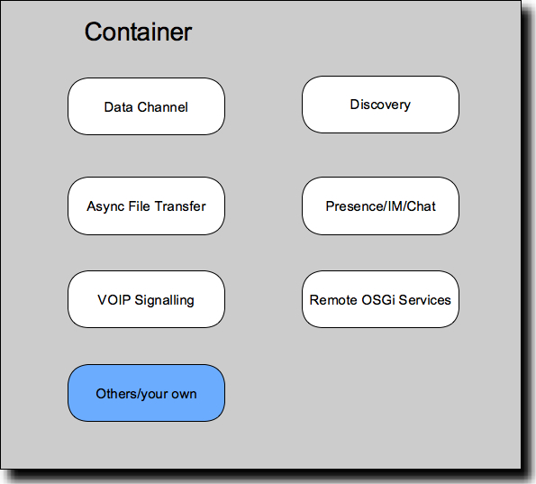
ECF: Extensibility with Adapters
IContainer extends IAdaptable: IContainer.getAdapter(<interface>);

Slide 11
Docshare and Real Time Shared Editing
Demo

Slide 12
Docshare and Real Time Shared Editing
Implements real-time shared editing
Connect via ECF Datashare API
Supported provider: XMPP/Google Talk, Skype, ECF generic, JMS, Javagroups
Generalization / Sync API

Slide 13
Sync API
Synchronization service for document model
Synchronization factory can provide different types of synchronization
Document synchronization implemented with Cola – default implementation
IDocumentChange is applied to local document change and to a replicated document
ECF DocShare for share editing
  Uses Sync API
  Over Datashare API

Slide 14
Sync API
Extensible for other Eclipse Editors
Accessible through OSGI service
ECF 2.1
Beyond document model
More information about Cola algorithm
  http://wiki.eclipse.org/index.php/RT_Shared_Editing

Slide 15
Datashare
Provides messaging channels for asynchronously sending messages to remote processes
  XMPP
    Clients
    Groups
This API also runs on XMPP as well as other transports
Sender Ordering (FIFO). Receivers guaranteed to get messages in same order they were sent
  No stronger ordering guarantees

Slide 16
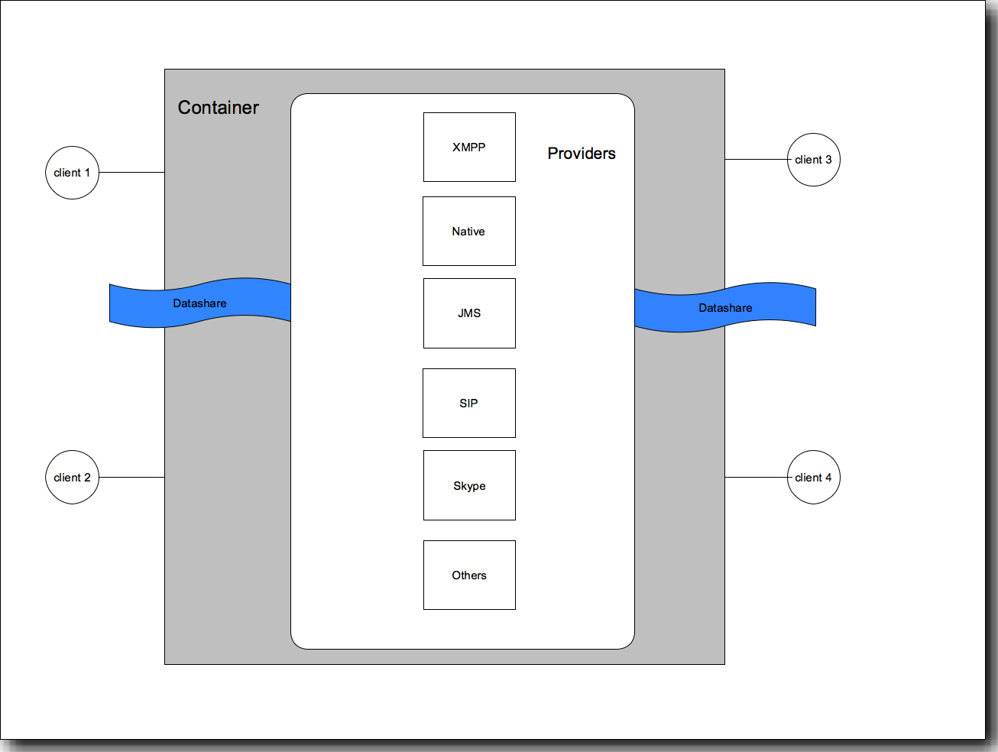

Slide 17
DataShare: Example Code
// Create container instance via named provider
IChannelContainerAdapter channelContainer = getChannelContainer.....
//Create a channel linked to a listener
channelContainer.createChannel(<ChannelStringID>, <ChannelListener>, null);
//Get the channel
IChannel sender = channelContainer.getChannel(<ChannelStringID>);
//Channel used to asynchronously send arbitrary data (byte arrays)
sender.sendMessage(new String("hello").getBytes());

Slide 18
Demo
Collab
  Chat
  URL Sharing
  Remote view opening
IPhone discovery services – Take two? :-)

Slide 19
Ongoing Efforts
Model Synchronization
Real-Time Collaboration for IDE
ECF for Runtimes
Remote OSGi Services – RFC 119
IM/Chat Features
Application Integration
Packaging and Deployment

Slide 20
Conclusion
Support from the community welcomed and appreciated!
  Ways to help
    Improve / Extend existing applications
    Build provider implementations
    Contribute to API Design (we need feedback!)
    Join ECF Community! (commercial or not!)

Slide 21

Q&A

Slide 22
Resources
Website
  http://www.eclipse.org/ecf
Mailing list
  http://dev.eclipse.org/newslists/news.eclipse.technology.ecf/maillist.html
Newsgroup
  news://news.eclipse.org/eclipse.technology.ecf
Project Plan For ECF - version 3.0
  http://www.eclipse.org/projects/project-plan.php?projectid=rt.ecf
Wiki
  http://wiki.eclipse.org/Eclipse_Communication_Framework_Project
Other ECF repository
  http://ecf1.osuosl.org/

Slide 23
Thank You!
http://www.eclipse.org/ecf

