Slide 1
ECF on the Server
Equinox/OSGi + ECF = 'Equinox Service Bus'
  Scott Lewis -- slewis@composent.com
  Mustafa Isik -- codesurgeon@gmail.com
  Roland Fru -- roland@bitsvalley.com

Slide 2
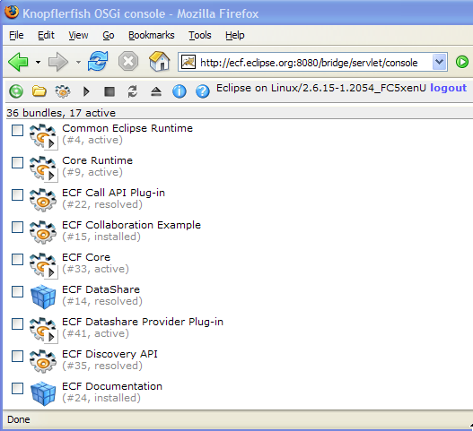
Running Now: ECF 'Generic' server at ecf.eclipse.org
Tomcat+servlet bridge+Equinox+ECF plugins

Slide 3
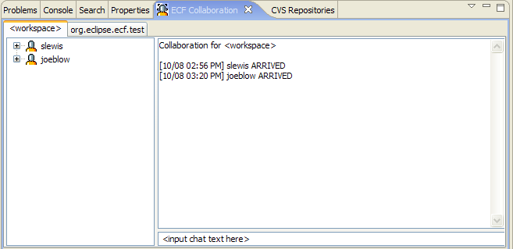
ECF Collaboration Example Application
Chat, URL sharing/co browsing, file transfer, remote control

Slide 4
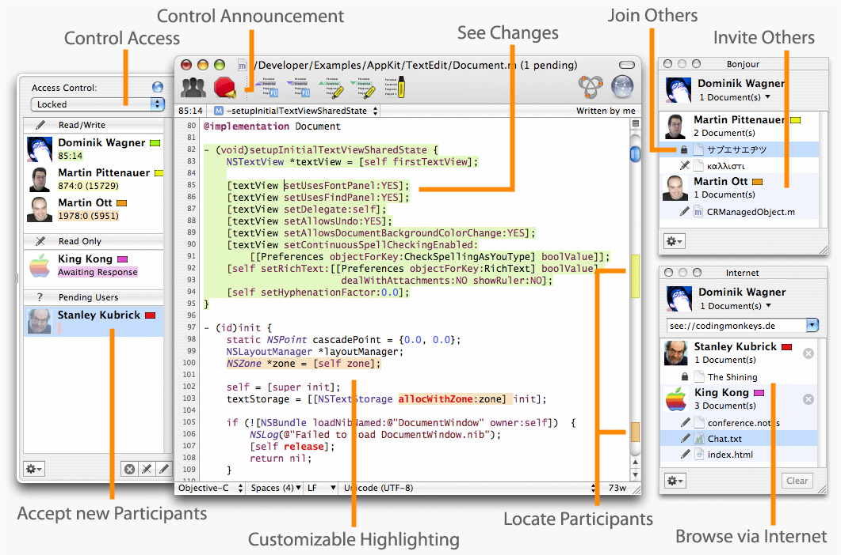
Eclipse and RCP Client/Server and Peer-to-Peer Applications coming
Subthaedit for Eclipse, EMF, editor X?

Slide 5
ECF + Bundles = Common Messaging APIs for Servers, RCP apps, Eclipse plugins
Everything is bundle. Dynamically loaded/unloaded, developed/tested/debugged with PDE
High-level Messaging API bundles
  Service Discovery
  Presence and Chat
  Data Channels
  File Transfer
  Remote (OSGi) Services
+ Multiple Transport bundles
  Raw TCP
  JMS/ActiveMQ
  XMPP
  JXTA
  Zeroconf

Slide 6
ECF Remote Service API ^{(new!)}
On the 'Service' OSGi process
  Register remote service
    IRemoteServiceContainer.registerService
  Underlying service registry is replicated to all participating clients (using ECF provider)
  Separate from OSGi service registry

Slide 7
ECF Remote Service API...on Client
On the 'Client' OSGi Processes
  IRemoteServiceReference[] refs = getRemoteServiceReferences(...);
  IRemoteService rservice = getRemoteService(refs[0]);
  THEN, 4 explicit options for remote service invocation
    1. Object proxy = IRemoteService.getProxy()
      Call/return. Blocks until result
    2. Object result = IRemoteService.callSynch(IRemoteCall)
      Call/return. Blocks until result
    3. IRemoteService.callAsynch(IRemoteCall, listener)
      Call/return. No blocking (listener notified)
    4. IRemoteService.fireAsynch(IRemoteCall)
      'Fire and go'. No block (no success/failure info)

Slide 8
ECF Remote Service API: Summary
Looks very similar to OSGi services
  BundleContext.registerService
  BundleContext.getServiceReferences(...)
  BundleContext.getService(ref)
Remote Registry Separate from OSGi Registry (not transparent)
  Remote services explicitly identified as such (by registerRemoteService)
  Clients may invoke services synchronously or asynchronously...choice based upon desired runtime behavior, timing, need for failure info
  e.g. Axis 2
Transport can be: JMS, ECF generic, XMPP, RMI, XML-RPC, SOAP, others

Slide 9
API Introduction
Interoperability through protocol
  org.eclipse.ecf.core.IContainer
  Goal
    Simple API / Extensibility via OSGi model / getAdapter(…)
Clients use the IContainer API
  IContainer container = ContainerFactory.getDefault().createContainer(“ecf.xmpp.smack”);
  Container.connect(…)
Semantics
  Connection/Disconnection/LifeCycle
    c.connect(ID, IConnectContext)
    …
    c.disconnect()
  Protocol Adapters – getAdapter(…) abuse…
    container.getAdapter(<interface>);
    IFileshareContainer fsc = (IFileshareContainer) c.getAdapter(IFileshareContainer.class)

Slide 10
API Introduction
IAdaptable abuse (we love the adapter pattern)
  Presence/IM/Chat
  Dynamic Service Discovery (zeroconf, etc…)
  Datashare (channels)
  File sharing
  Call (SIP…)

Slide 11
API Introduction
Two Extension Points
  org.eclipse.ecf.containerFactory
    ECF providers can implement their own IContainer
      Current
        XMPP/Jabber, IRC, JMS, Yahoo
      Future
        SIP, JXTA, Jingle, Sametime, AIM, etc…
  org.eclipse.ecf.namespace
    ECF providers can implement their own addressing
      e.g., xmpp://zx@ecf.eclipse.org

Slide 12
Demos

Slide 13
Conclusion
Support from the community welcomed and appreciated!
  We need committed committers!
Website
  http://www.eclipse.org/ecf
Mailing List
  http://dev.eclipse.org/mailman/listinfo/ecf-dev
Newsgroup
  news://news.eclipse.org/eclipse.technology.ecf

