Slide 1

Get Ready to fight your technical debt
with Jacoco, Sonar & Jenkins
EclipseCon 2012, CC-BY 2.0

Slide 2
Presented by...
Xavier Seignard
POD Programming
@xavierseignard
Mickael Istria
JBoss, by Red Hat
@mickaelistria

Slide 3
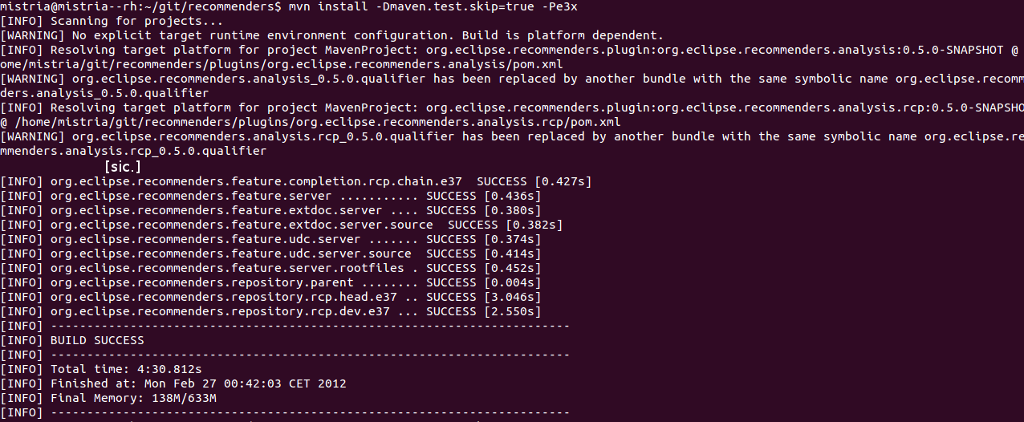
Where we start
A regular Tycho build:

Slide 4
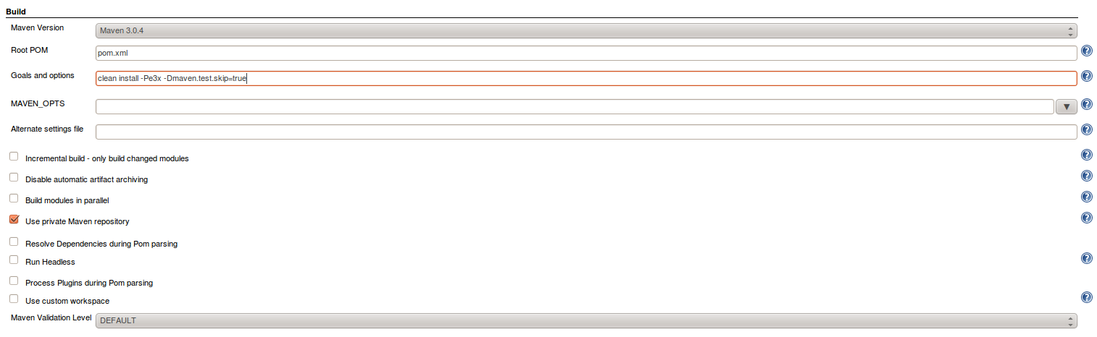
Put this job on Jenkins/Hudson

Slide 5
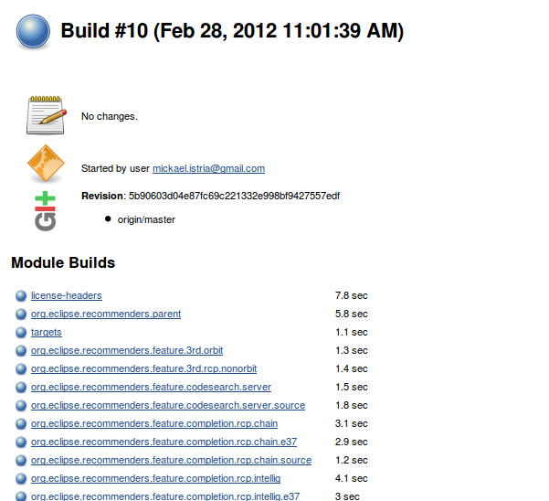
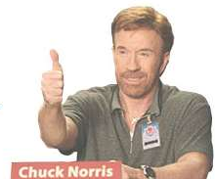
Achievement #1 unlocked!
Notes:
* Since we will re-set up job, we need to use a pre-filled maven repo to save time.
Avoid using a dedicated repo.

Slide 6
Towards static analysis
Official definition is “ Sonar is an open platform to manage code quality. As such, it covers the 7 axes of code quality: … “
It is shipped as a webapp and provides nice Maven and Jenkins plugins to ease integration.
Our definition is “ Sonar is a Maven plugin to produce Quality Metrics, and a dashboard to analyze them all ”

Slide 7



Infrastructure and orchestration
mvn install
Jenkins Sonar plugin
Mvn Sonar plugin
Go!
Mvn sonar:sonar
Perform checks
(PMD, checkstyle...)
Go!
Send results

Slide 8
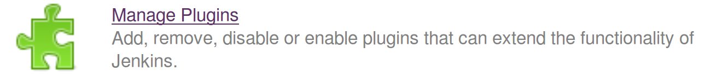
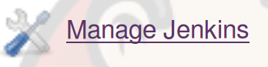
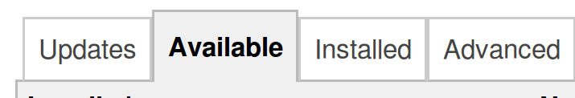
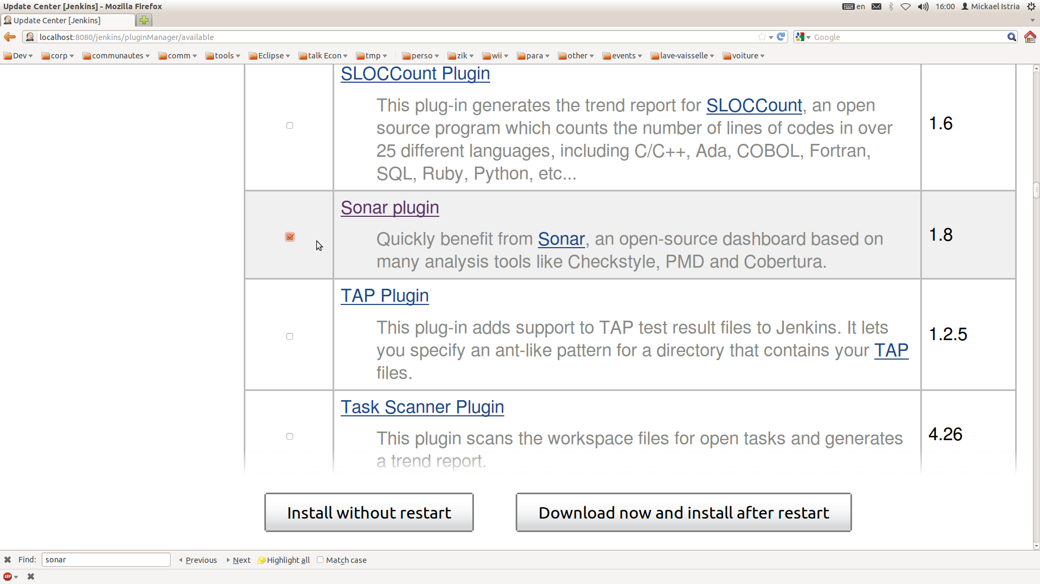
Maven, Jenkins and Sonar: step #1

Slide 9
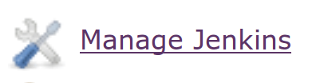

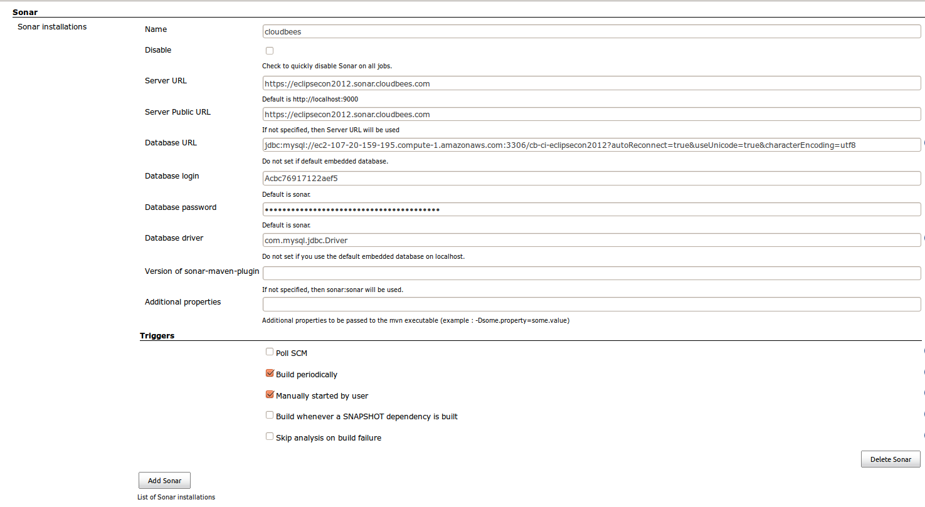
Maven, Jenkins and Sonar: step #2
followed by

Slide 10

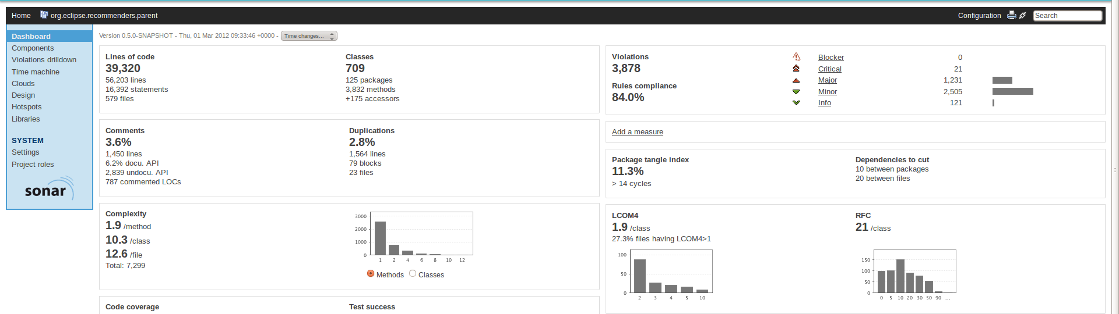
Achievement #2 Unlocked !
then
for static analysis reports in Sonar

Slide 11
Re-enable tests
Think about Xvnc/Xvfb UI tests
Other tips (swtbot test require metacity?)

Slide 12
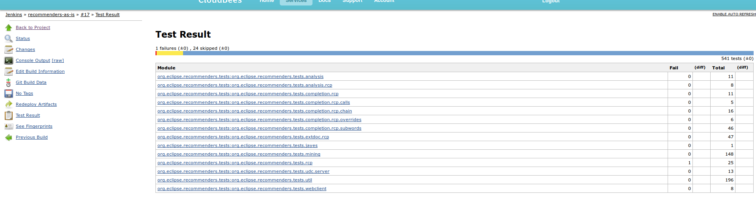
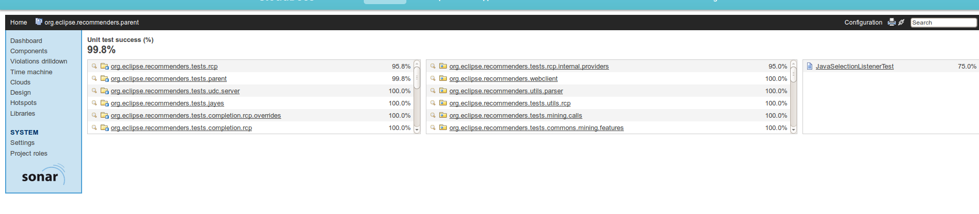
Achievement #3 Unlocked!
Jenkins
Sonar

Slide 13
But I want code coverage...
Jacoco is a code coverage engine. It requires no additional instrumentation, setting is up is just about setting a JVM property: -Djavaagent=jacoco.jar=[option1=value1[,optionN=valueN]*]
It has almost no effect on performance, and does not require specific build steps or specific builds.

Slide 14
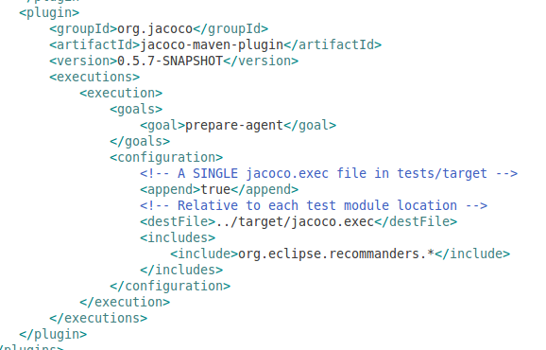
In your Tycho build...
Jacoco provides a Maven plugin that presets the value of
${argLine} or ${tycho.testArgLine} value in build to use the required javaagent.

Slide 15
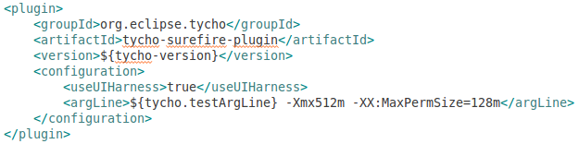
Pro-tip
When you override tycho-surefire-plugin configuration, be sure to repeat ${tycho.testArgLine} when useful. Same is true for maven surefire plugin and ${argLine}

Slide 16
Config Sonar
Config Sonar to consume tests/jacoco.exec

Slide 17
Achievement #4 Unlocked!
then
to enjoy...
Screenshots Coverage report in Jenkins

Slide 18
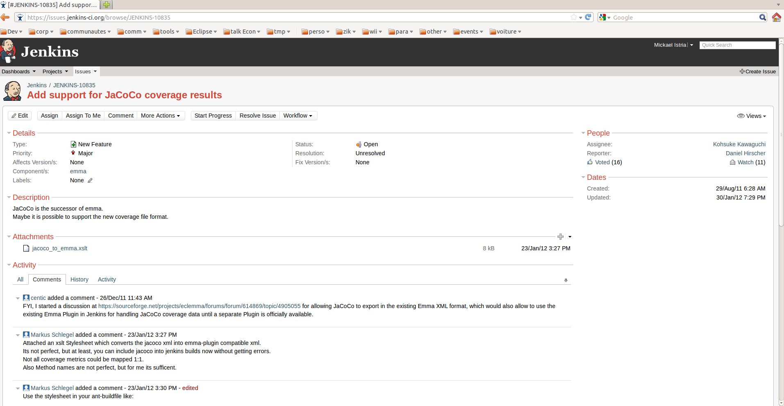
The missing integration...

Slide 19
Thanks...
To Nicolas De Loof and CloudBees for providing us a 1st-class Dev@Cloud instance for this demonstration.

Slide 20
Now it's your turn
Questions?

