Slide 1
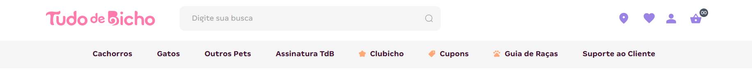



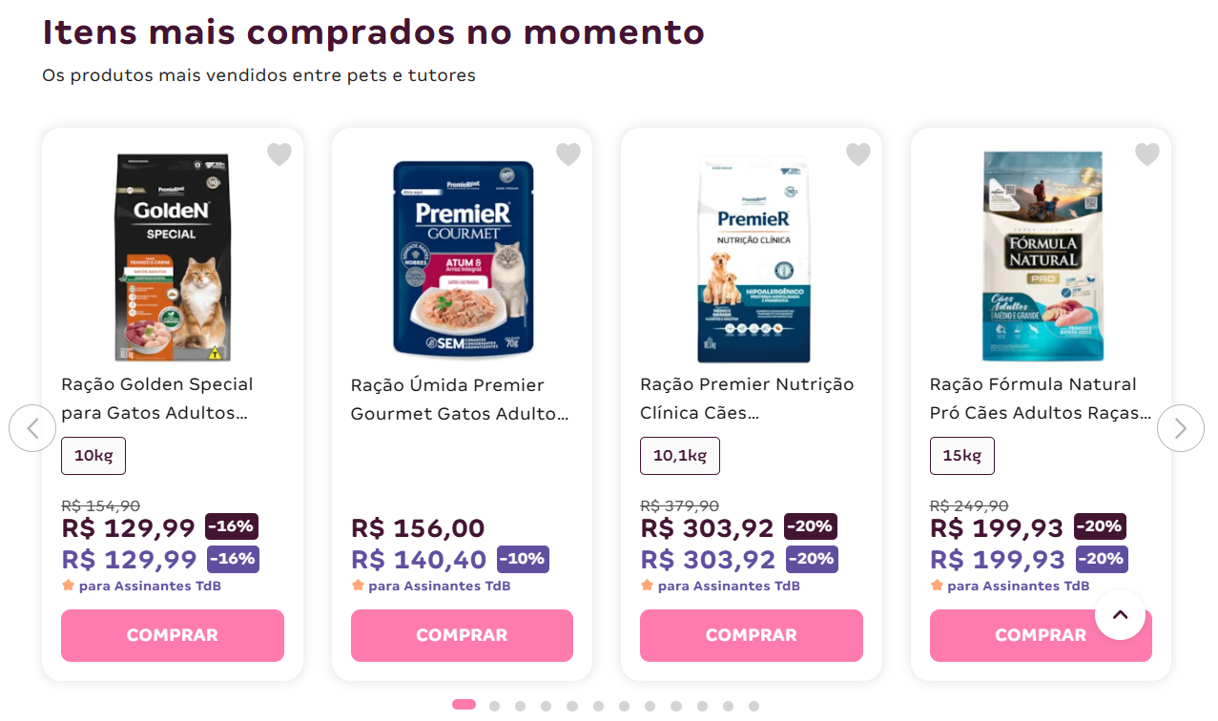
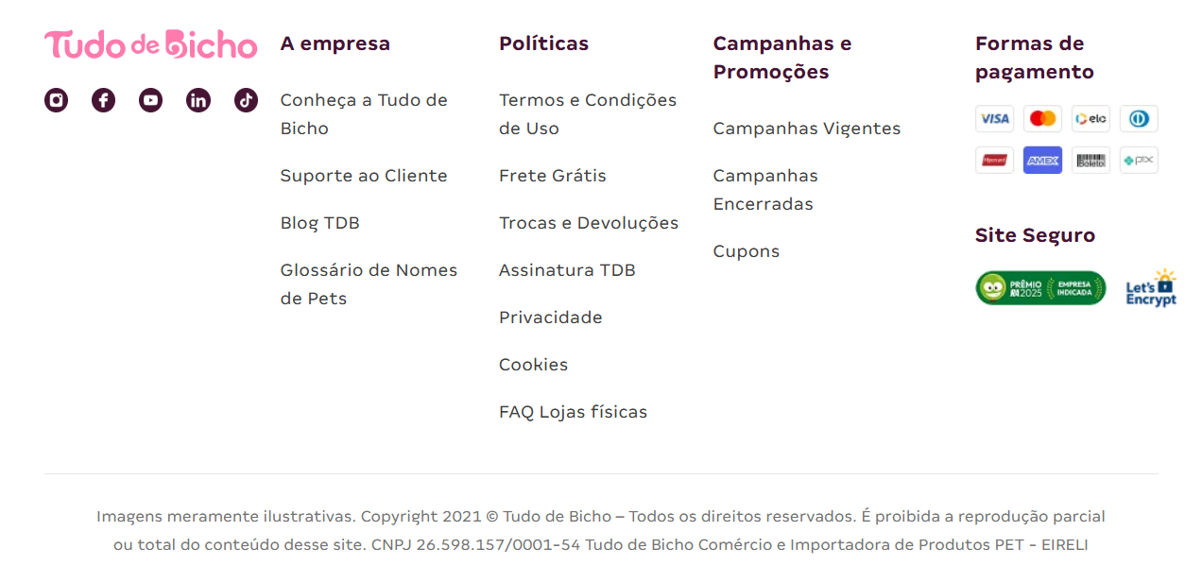
‹
›
logo
...

Slide 2
app-shel
top-header
‹
›
logo
...

Slide 3

Capi-
Shop

