Slide 1
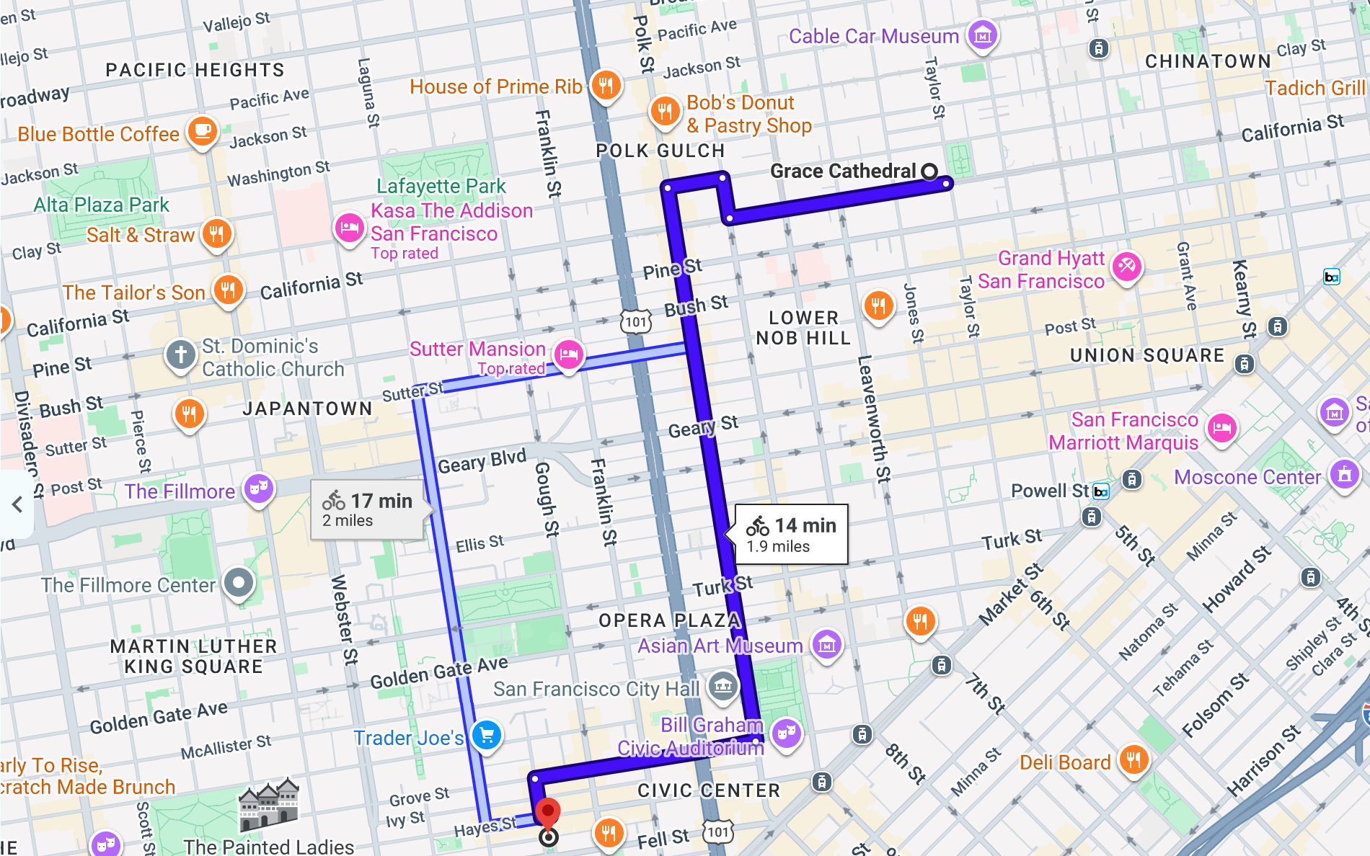
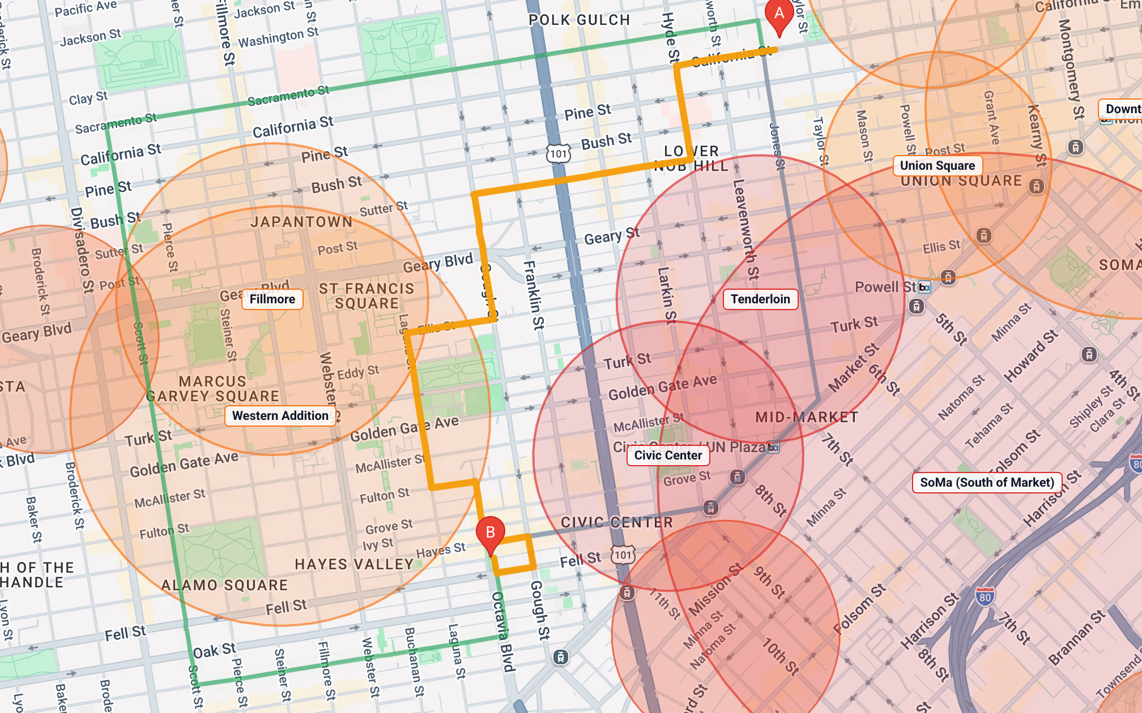
Google's bike route rides past the Tenderloin
…and straight through Civic Center. Same trip: Grace Cathedral → Patricia's Green, Hayes Valley
Google Maps · bicycling · 14 min, 1.9 mi
BetterRoutes · Safest · 22 min, 2.1 mi
39%
of the ride inside Severe areas: Civic Center 0.5 mi, Tenderloin 0.2 mi
67%
with no protected bike lane (only parts of Polk St are protected)
0%
inside Severe areas, and it avoids every crash hotspot
−25%
average street danger vs our fastest route, for +5 min
Notes:
SLIDE [≈20s] SAY: "Here's the problem in one picture. Ask Google Maps for bike directions from Grace Cathedral to Hayes Valley: it sends you straight down Polk Street, past the Tenderloin and right through Civic Center — 39% of the ride is inside areas we rate Severe, and two-thirds of it has no protected bike lane. BetterRoutes' Safest route goes around both, avoids every crash hotspot, and costs five extra minutes."
▶ DEMO [20s]
DO: In a browser tab, Google Maps → bicycling directions "Grace Cathedral" → "Patricia's Green". Then in BetterRoutes: Start "Grace Cathedral", Destination "Patricia's Green", turn on Neighborhood view, click "Safest".
SAY WHILE DOING: "Google's route goes right down Polk into the red zones. Ours bends around them — and the checklist tells you it avoided every Severe area and every crash hotspot."
HOW THE NUMBERS WERE MEASURED (if asked):
- Google's route = Google Maps bicycling directions, Grace Cathedral → Patricia's Green, captured Oct 14, 2026: California St → Larkin → Sacramento → Polk St 0.9 mi → Grove St 0.4 mi → Octavia → Hayes. 14 min, 1.9 mi.
- 39%: that path measured against BetterRoutes' 17 flagged areas (Civic Center ≈870 m, Tenderloin ≈280 m of ≈2.7 km).
- 67%: each street's bike facility from SFMTA's official bike-network data (California, Larkin, Sacramento, Grove, Octavia: no facility; Polk: ~64% protected, ~36% painted or none).
- BetterRoutes numbers are shown in the app for that trip: Safest 2.1 mi, ~22 min, "Avoided every Severe area", "Avoided every crash hotspot", "25.1% less average danger than the fastest route", +5 min.
- Honest caveat: BetterRoutes' Safest still passes through Western Addition and Fillmore (High, not Severe) — it says so on screen, because staying out of everything would make the trip 246% longer.

Slide 2




More than safety: real SF data, shaped by you
Avoid hills
Data: USGS elevation at 112,492 points on the street map
Fewer traffic lights
Data: 1,314 SFMTA traffic signals
21.8% → 8.6%
35 → 12 lights
steepest climb; climbing 1,027 → 518 ft, and 7 min quicker
Try it: Ocean Beach → Ferry Building, Safest
Fastest 35, Safest 17, Safest + Fewer lights 12 (2 min quicker than Safest)
Try it: Ocean Beach → Ferry Building
Honest ride time
Data: Every estimate counts each climb and ~12 s per red light
Customize with AI
Data: Same controls you use, plus 3,712 real places
Fastest ≤ Safest
1 sentence
Because times include hills and lights, "Fastest" is never slower than a safer option — checked by automated tests
Try it: Any trip: compare the Est. time on each route
"Flat ride please, with boba and a park on the way" → a For you ride, 5.4 mi, 2 stops
Try it: Noe Valley → North Beach
Danger scores come from our trained model; hills, lights and ride time come straight from measured city data.
Notes:
SLIDE [≈20s] SAY: "Safety is the core, but it's not the only thing we optimise. Everything here runs on measured San Francisco data: real elevation at every intersection, so Avoid hills turns a 22% climb into 8.6% and gets you there 7 minutes sooner. All 1,314 city traffic signals, so Fewer lights takes the same trip from 35 red lights down to 12. Ride times count every hill and every light. And you can customise all of it in one sentence with the AI."
▶ DEMO [20s]
SETUP: Ocean Beach → Ferry Building, "Safest" selected.
DO: Point at "Steepest climb 21.8%" and "Traffic lights 17". Turn on "Avoid hills" → show 8.6% and ~82 min. Turn Avoid hills off, turn on "Fewer traffic lights" → show 12 lights. (Then, if time: assistant → "Flat ride please, with boba and a park on the way".)
SAY WHILE DOING: "Avoid hills: steepest climb 21.8 down to 8.6 percent, and it's faster. Fewer lights: 17 down to 12. Or just tell the assistant what you want."
WHERE EACH NUMBER COMES FROM (all reproducible in the app, Oct 14, 2026):
- Avoid hills: Ocean Beach → Ferry Building, Safest. Off: steepest 21.8%, ▲1,027 ft, ~89 min. On: 8.6%, ▲518 ft, ~82 min. (Also Golden Gate Park → Ferry Building: 21.8% → 8.6%, 810 → 384 ft, 67 → 63 min.)
- Fewer lights: Ocean Beach → Ferry Building. Fastest 35 lights; Safest 17 (~89 min); Safest + Fewer traffic lights 12 (~87 min). Note: on some trips fewer lights costs time (Noe Valley → North Beach: 26 → 16 lights, +17 min) — it's for fewer stops, and never overrides safety.
- Honest ride time: every estimate = distance + 10 flat-equivalent metres per metre climbed + ~12 s per traffic light, and tests check Fastest ≤ Safest ≤ Safest + bike lanes in time across trips and settings. If asked why Google says 14 min where ours says ~17 for Grace Cathedral → Patricia's Green: we count the climb and the red lights.
- AI: Noe Valley → North Beach, prompt above, produced "For you · Safest rules · avoids hills · 5.4 mi, ~54 min" with 2 stops. AI replies vary slightly run to run.
- Wording: only the danger score comes from a trained model. Hills and lights are measured data, not "trained".

Slide 3
Safer routes cut time in flagged areas by 70%
Fastest
Safest + bike lanes
−70%
time spent inside flagged areas
Ride inside flagged areas
% of the ride
45.8
13.9
7 → 1
of 10 trips enter a Severe area
Average street danger
0–100 score
69.6
−28%
average street danger; 1.4× protected lanes
50.3
Ride on protected lanes
% of the ride
18.5
+33%
ride time — the honest cost, shown on every route
26.2
10 trips typed into the app (first address suggestion), averaged per trip, Oct 14, 2026. Full list in the appendix.
Notes:
REPLACES the old Results slide (62% / 30% / 2.1× / +28%). Those came from an earlier survey using raw map coordinates, which you can't reproduce by typing addresses. These come from 10 trips typed into the app, so any of them can be shown live.
SAY: "We didn't cherry-pick one trip. On 10 everyday San Francisco trips, our Safest plus bike lanes cuts time inside flagged areas by 70%, lowers average street danger by 28%, and puts 40% more of the ride on protected lanes. Fastest-first routes went into a Severe area on 7 of the 10 trips; ours on just 1. The cost is about a third more ride time — shown on every route."
▶ DEMO [20s]: open any trip from the appendix (e.g. Golden Gate Park → Ferry Building), click "Compare routes side by side", read the Inside flagged areas, Danger and Protected lanes rows.
Honest notes: the 1 trip where Safest still enters a Severe area is Union Square → Lower Haight: "Union Square" geocodes to the Tenderloin's edge, and the route clips SoMa for 0.12 mi. On short trips Safest can have fewer protected lanes than Fastest, because it uses quiet residential streets instead — that's why "Safest" and "Safest + bike lanes" are separate options.

Slide 4
Appendix: where every number comes from
Number in the deck | Source | Show it live (From → To, as typed)
1,103 cyclists killed, 52,887 injured (US, 2024) | NHTSA Traffic Safety Facts, 2024 Data: Bicyclists | —
4% of SF street miles hold 55% of severe/fatal bike injuries | SFMTA Vision Zero High Injury Network (cyclist corridors) | Neighborhood view on any trip
About half of big-city adults want to bike but worry about safety | Dill & McNeil, Transportation Research Record 2587 (2016) | —
Google route: 39% in Severe areas, 67% unprotected | Google Maps bicycling directions, captured Oct 14, 2026; SFMTA bike-network data | Grace Cathedral → Patricia's Green
−70% flagged, −28% danger, 1.4× lanes, +33% time, 7→1 of 10 | BetterRoutes, 10 trips (next slide) | Any trip on the next slide
Danger 62 → 32, protected 11% → 53%, +26 min | BetterRoutes, Safest + bike lanes vs Fastest | Ocean Beach → Ferry Building
Steepest 21.8% → 8.6%, climbing 1,027 → 518 ft, −7 min | BetterRoutes, Safest with Avoid hills off/on | Ocean Beach → Ferry Building
Traffic lights 35 → 17 → 12 | BetterRoutes: Fastest / Safest / Safest + Fewer traffic lights | Ocean Beach → Ferry Building
3,558 crashes · 5,455 lane segments · 5,566 highways · 1,314 signals | DataSF crashes 2019+; SFMTA bike network & signals; OpenStreetMap | lib/data/*.json in the repo
211,221 street segments · 3,712 places · 177,023 buildings | OpenStreetMap; DataSF building footprints (LiDAR) | 3D tour shows the building count
411 automated tests, all passing | Vitest suite in the repo | npm test
Notes:
Appendix — keep it at the back for Q&A. Every app number here can be reproduced by typing the From → To addresses into BetterRoutes and picking the FIRST suggestion. Numbers measured Oct 14, 2026 with model gbt-baseline-2026-10-05.
Links:
- NHTSA 2024 bicyclists: https://rosap.ntl.bts.gov/view/dot/92690
- SFMTA Vision Zero High Injury Network: https://sfmta.com/media/4894/download
- Dill & McNeil 2016: https://jenniferdill.net/types-of-cyclists/
- EPA transportation emissions (if you use it): https://www.epa.gov/system/files/documents/2024-05/420f24022.pdf
Fix on your existing slide 3: it says 5,457 SFMTA bike-lane segments; the app uses 5,455 (5,457 was the raw file's line count).

Slide 5
Appendix: the 10 trips behind the results
From → To (as typed) | Fastest: in flagged areas | Safest + lanes: in flagged areas | Danger | Protected lanes | Time
Ocean Beach → Ferry Building | 23.9% | 0% | 62.1 → 31.9 | 10.6% → 53.1% | 70 → 96 min
Pacific Heights → Mission Street & 17th Street | 53.7% | 54% | 74.6 → 56.8 | 1.5% → 27.2% | 25 → 42 min
Marina Green → Dolores Park | 27.2% | 17.1% | 56.6 → 45.3 | 0.9% → 18.3% | 37 → 43 min
Noe Valley → North Beach | 45.2% | 14.5% | 71 → 48.5 | 32.9% → 1.3% | 43 → 53 min
Grace Cathedral → Hayes Valley | 78.3% | 0% | 88.6 → 69.9 | 11.8% → 8.4% | 15 → 17 min
Chinatown → Dolores Park | 58.1% | 14.6% | 74.1 → 67 | 39.2% → 19.7% | 34 → 41 min
Union Square → Lower Haight | 57.2% | 13.5% | 74 → 68 | 30.2% → 1.7% | 21 → 30 min
Clement Street & 6th Avenue → Potrero Hill | 36.8% | 12.7% | 66.6 → 49.4 | 4.2% → 12.5% | 53 → 66 min
Marina Green → Potrero Hill | 47.3% | 12.7% | 63.6 → 34.7 | 33.7% → 65% | 55 → 72 min
Golden Gate Park → Ferry Building | 29.8% | 0% | 65.3 → 31.9 | 20.2% → 54.9% | 56 → 84 min
Pick the first address suggestion. "Safest + lanes" is the app's "Safest + bike lanes" option. Measured Oct 14, 2026.
Notes:
Appendix — the raw data behind the Results slide. Any row can be demoed live: type From and To, pick the first suggestion, then "Compare routes side by side".
Averages: in flagged areas 45.8% → 13.9% (−70%); danger 69.6 → 50.3 (−28%); protected 18.5% → 26.2% (1.4×); total time +33%; trips entering a Severe area 7/10 → 1/10.
Two rows to be ready for: Pacific Heights → Mission Street & 17th Street — the destination sits inside a flagged area, so the safe route can't avoid much there (use it to show the problem, not the fix). Union Square → Lower Haight — the start sits at the Tenderloin's edge, so the safe route still clips SoMa for 0.12 mi.

