Slide 1
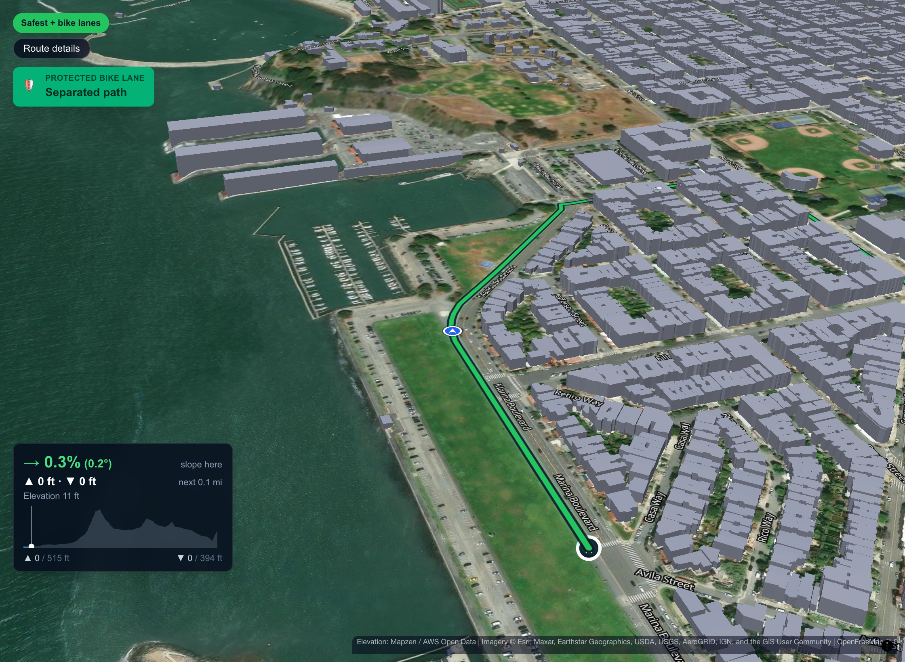
BetterRoutes
The bike map that optimizes routes in San Francisco for safety and custom preferences over speed
Notes:
[≈15s] SLIDE ONLY — no demo. Look at the judges.
SAY: "Every map app will tell you the fastest way to bike across San Francisco. We built the one that finds the safest way, makes the ride one you'll actually enjoy, and proves it street by street. We're BetterRoutes."
(Optional 5s B-roll behind you: the 3D tour playing on the Marina.)

Slide 2
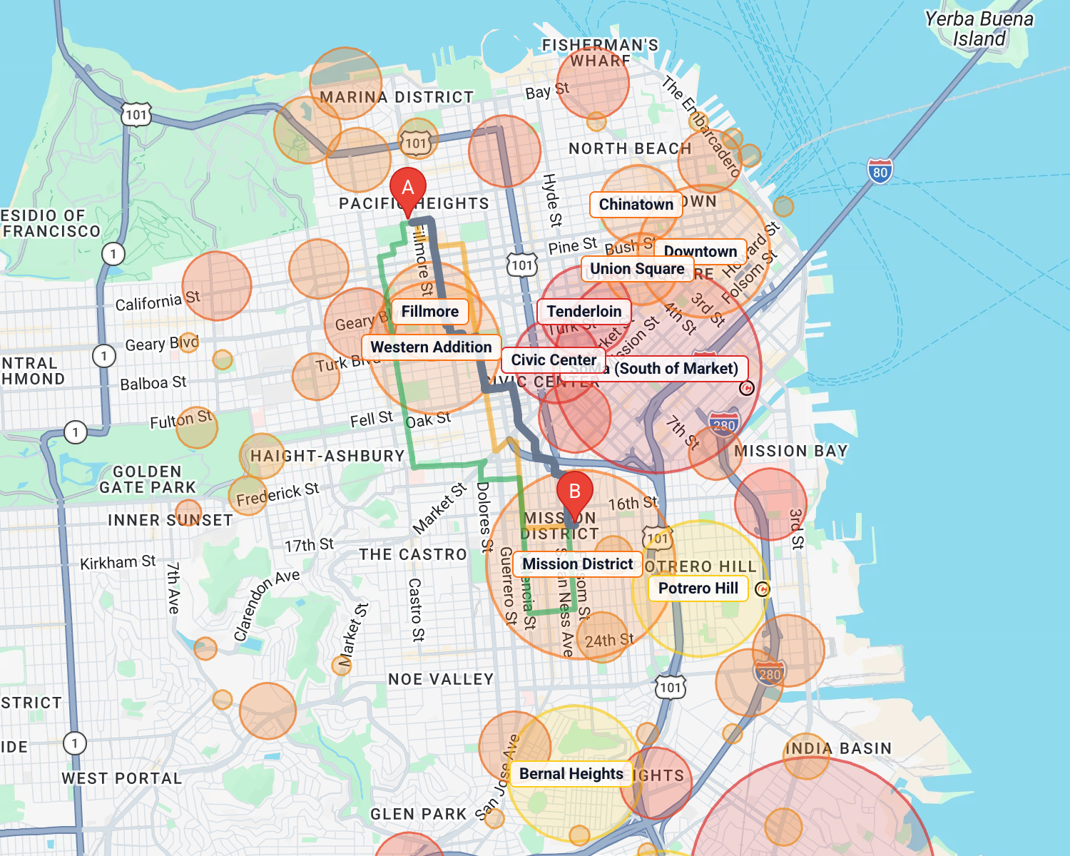
Bike danger is concentrated
1,103
cyclists killed on US roads in 2024
52,887
cyclists injured in 2024 — up 6% from 2023
4% → 55%
4% of SF street miles hold 55% of severe and fatal bike injuries
Sources: NHTSA Traffic Safety Facts, 2024 Data: Bicyclists; SFMTA Vision Zero High Injury Network (cyclist corridors)
Notes:
SLIDE [≈20s] SAY: "1,103 cyclists were killed on US roads in 2024, and almost 53,000 were injured — up 6%. But in San Francisco, just 4% of street miles hold 55% of the severe and fatal bike injuries. Danger is concentrated, so it can be routed around."
▶ DEMO [20s]
SETUP: app open at localhost:3000, nothing typed.
DO: Start = "Pacific Heights" (first suggestion). Destination = "Mission Street & 17th Street" (pick the 17th St / Mission one). Leave it on Fastest. Click "Neighborhood view".
SAY WHILE DOING: "Here's what fastest-first looks like. Every circle is a flagged neighbourhood or a cluster of real crashes. The fastest route goes straight through SoMa and Civic Center — both rated Severe. More than half this ride is inside flagged areas."

Slide 3
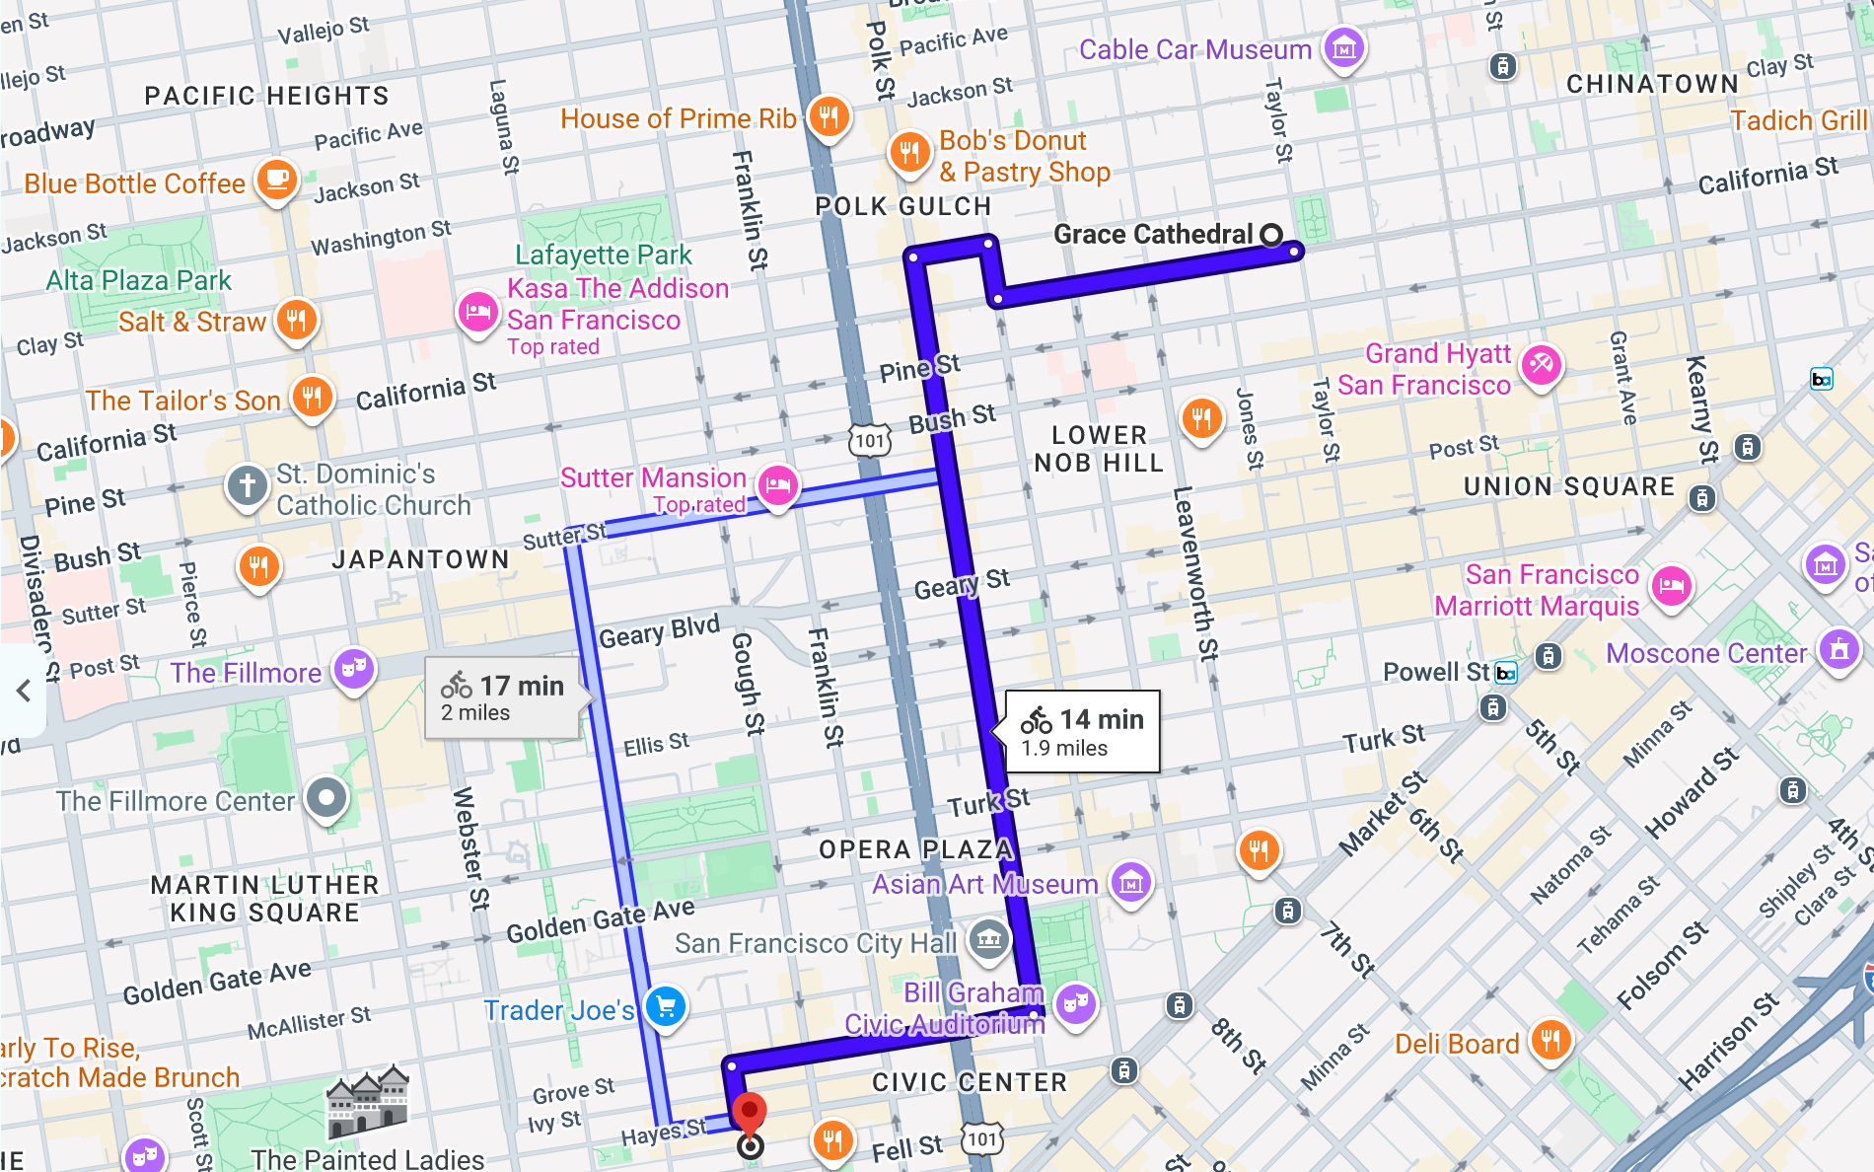
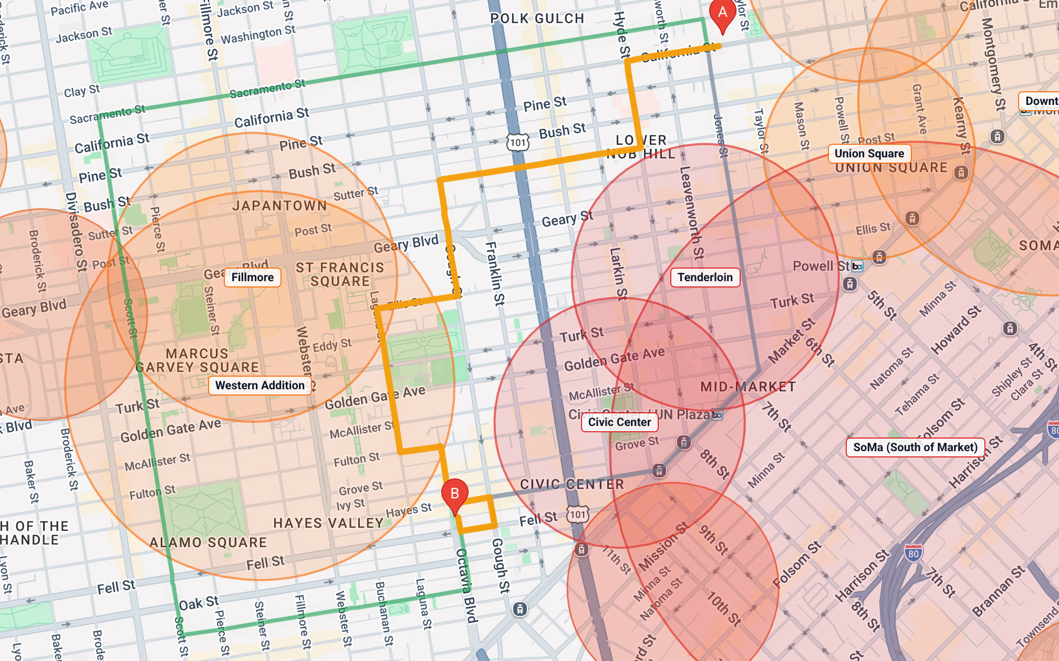
Google's bike route rides past the Tenderloin
…and straight through Civic Center. Same trip: Grace Cathedral → Patricia's Green, Hayes Valley
Google Maps · bicycling · 14 min, 1.9 mi
BetterRoutes · Safest · 22 min, 2.1 mi
39%
of the ride inside Severe areas: Civic Center 0.5 mi, Tenderloin 0.2 mi
67%
with no protected bike lane (only parts of Polk St are protected)
0%
inside Severe areas, and it avoids every crash hotspot
−25%
average street danger vs our fastest route, for +5 min
Notes:
SLIDE [≈20s] SAY: "Here's the problem in one picture. Ask Google Maps for bike directions from Grace Cathedral to Hayes Valley: it sends you straight down Polk Street, past the Tenderloin and right through Civic Center — 39% of the ride is inside areas we rate Severe, and two-thirds of it has no protected bike lane. BetterRoutes' Safest route goes around both, avoids every crash hotspot, and costs five extra minutes."
▶ DEMO [20s]
DO: In a browser tab, Google Maps → bicycling directions "Grace Cathedral" → "Patricia's Green". Then in BetterRoutes: Start "Grace Cathedral", Destination "Patricia's Green", turn on Neighborhood view, click "Safest".
SAY WHILE DOING: "Google's route goes right down Polk into the red zones. Ours bends around them — and the checklist tells you it avoided every Severe area and every crash hotspot."
HOW THE NUMBERS WERE MEASURED (if asked):
- Google's route = Google Maps bicycling directions, Grace Cathedral → Patricia's Green, captured Oct 14, 2026: California St → Larkin → Sacramento → Polk St 0.9 mi → Grove St 0.4 mi → Octavia → Hayes. 14 min, 1.9 mi.
- 39%: that path measured against BetterRoutes' 17 flagged areas (Civic Center ≈870 m, Tenderloin ≈280 m of ≈2.7 km).
- 67%: each street's bike facility from SFMTA's official bike-network data (California, Larkin, Sacramento, Grove, Octavia: no facility; Polk: ~64% protected, ~36% painted or none).
- BetterRoutes numbers are shown in the app for that trip: Safest 2.1 mi, ~22 min, "Avoided every Severe area", "Avoided every crash hotspot", "25.1% less average danger than the fastest route", +5 min.
- Honest caveat: BetterRoutes' Safest still passes through Western Addition and Fillmore (High, not Severe) — it says so on screen, because staying out of everything would make the trip 246% longer.

Slide 4
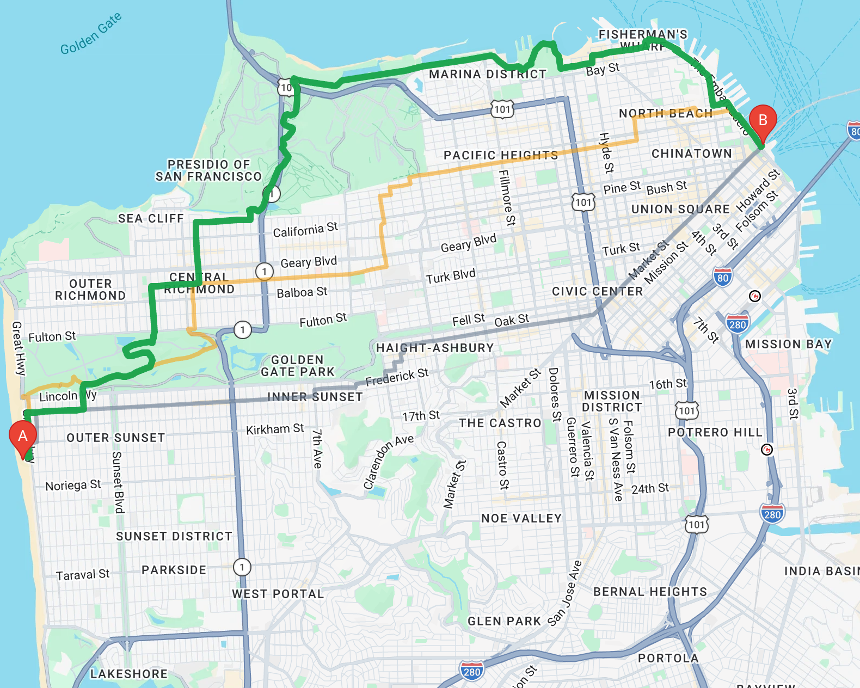






Our own bike router, built on SF's real data
3,558
real bike-injury crashes (DataSF, 2019+)
5,455
SFMTA-surveyed bike-lane segments
5,566
highways and fast arterials scored
1,314
traffic signals that stop a rider
Every corner
terrain elevation, so hills are real
177,023
LiDAR-measured buildings for 3D
Notes:
SLIDE [≈15s] SAY: "We didn't wrap Google Maps. We built our own router on San Francisco's real open data — 3,558 real bike crashes, the city's official survey of every bike lane, every highway, every traffic light, and the elevation of every intersection. 211,000 street segments, searched in a tenth of a second."
▶ DEMO [20s]
SETUP: Neighborhood view off.
DO: Start = "Ocean Beach", Destination = "Ferry Building". Let Fastest appear, then the two safer routes stream in. Click the GREEN line on the map to open its popup, then click "Safest + bike lanes" in the sidebar.
SAY WHILE DOING: "Two addresses in — and Fastest appears straight away, then two safer options stream in. Click any line and it tells you what it is and what it promised. Fastest, Safest, and Safest plus bike lanes."

Slide 5
Safer routes cut time in flagged areas by 70%
Fastest
Safest + bike lanes
−70%
time spent inside flagged areas
Ride inside flagged areas
% of the ride
45.8
13.9
7 → 1
of 10 trips enter a Severe area
Average street danger
0–100 score
69.6
−28%
average street danger; 1.4× protected lanes
50.3
Ride on protected lanes
% of the ride
18.5
+33%
ride time — the honest cost, shown on every route
26.2
10 trips typed into the app (first address suggestion), averaged per trip, Oct 14, 2026. Full list in the appendix.
Notes:
REPLACES the old Results slide (62% / 30% / 2.1× / +28%). Those came from an earlier survey using raw map coordinates, which you can't reproduce by typing addresses. These come from 10 trips typed into the app, so any of them can be shown live.
SAY: "We didn't cherry-pick one trip. On 10 everyday San Francisco trips, our Safest plus bike lanes cuts time inside flagged areas by 70%, lowers average street danger by 28%, and puts 40% more of the ride on protected lanes. Fastest-first routes went into a Severe area on 7 of the 10 trips; ours on just 1. The cost is about a third more ride time — shown on every route."
▶ DEMO [20s]: open any trip from the appendix (e.g. Golden Gate Park → Ferry Building), click "Compare routes side by side", read the Inside flagged areas, Danger and Protected lanes rows.
Honest notes: the 1 trip where Safest still enters a Severe area is Union Square → Lower Haight: "Union Square" geocodes to the Tenderloin's edge, and the route clips SoMa for 0.12 mi. On short trips Safest can have fewer protected lanes than Fastest, because it uses quiet residential streets instead — that's why "Safest" and "Safest + bike lanes" are separate options.

Slide 6
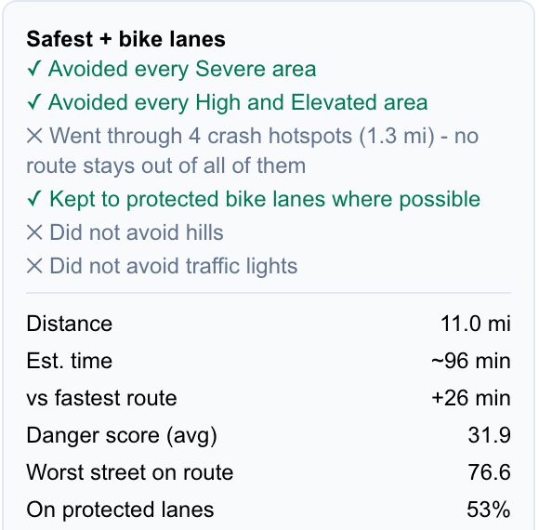
It says what it avoided — and what it cost
Rules a rider can read
Never enters a Severe area
Avoids High and Elevated areas unless that makes the ride 40%+ longer — then says where and why
Only claims it "avoided" an area if the fastest route actually goes through it
Avoid hills — Ocean Beach → Ferry Building
21.8% → 8.6%
steepest climb
1,027 → 518 ft
total climbing
7 min
quicker, too
▶ 20s demo: Route checklist, then Avoid hills
Notes:
SLIDE [≈15s] SAY: "A safety app that over-promises is worse than none. Our rules are simple: never a Severe area; avoid the rest unless the detour gets 40% longer — and then say where and why. And this is San Francisco: the safest street can be a wall."
▶ DEMO [20s]
SETUP: Ocean Beach → Ferry Building.
DO: Click the "Safest" card. Point at the ✓/✕ list, then "Steepest climb 21.8%" and "Hard climbs: Green Street". Click "Avoid hills". When it re-plans, click "Safest" again and point at the new steepest climb.
SAY WHILE DOING: "It tells you what it avoided and what it didn't — even 'went through 2 crash hotspots, because no route avoids them all'. But it climbs Green Street at almost 22%. Avoid hills on… and the steepest climb is 8.6%, half the climbing — and it's 7 minutes quicker."

Slide 7
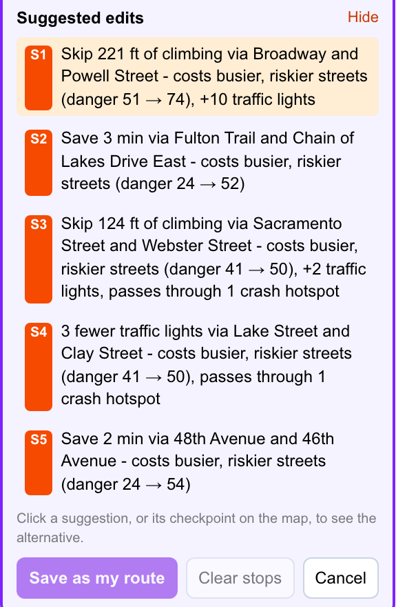
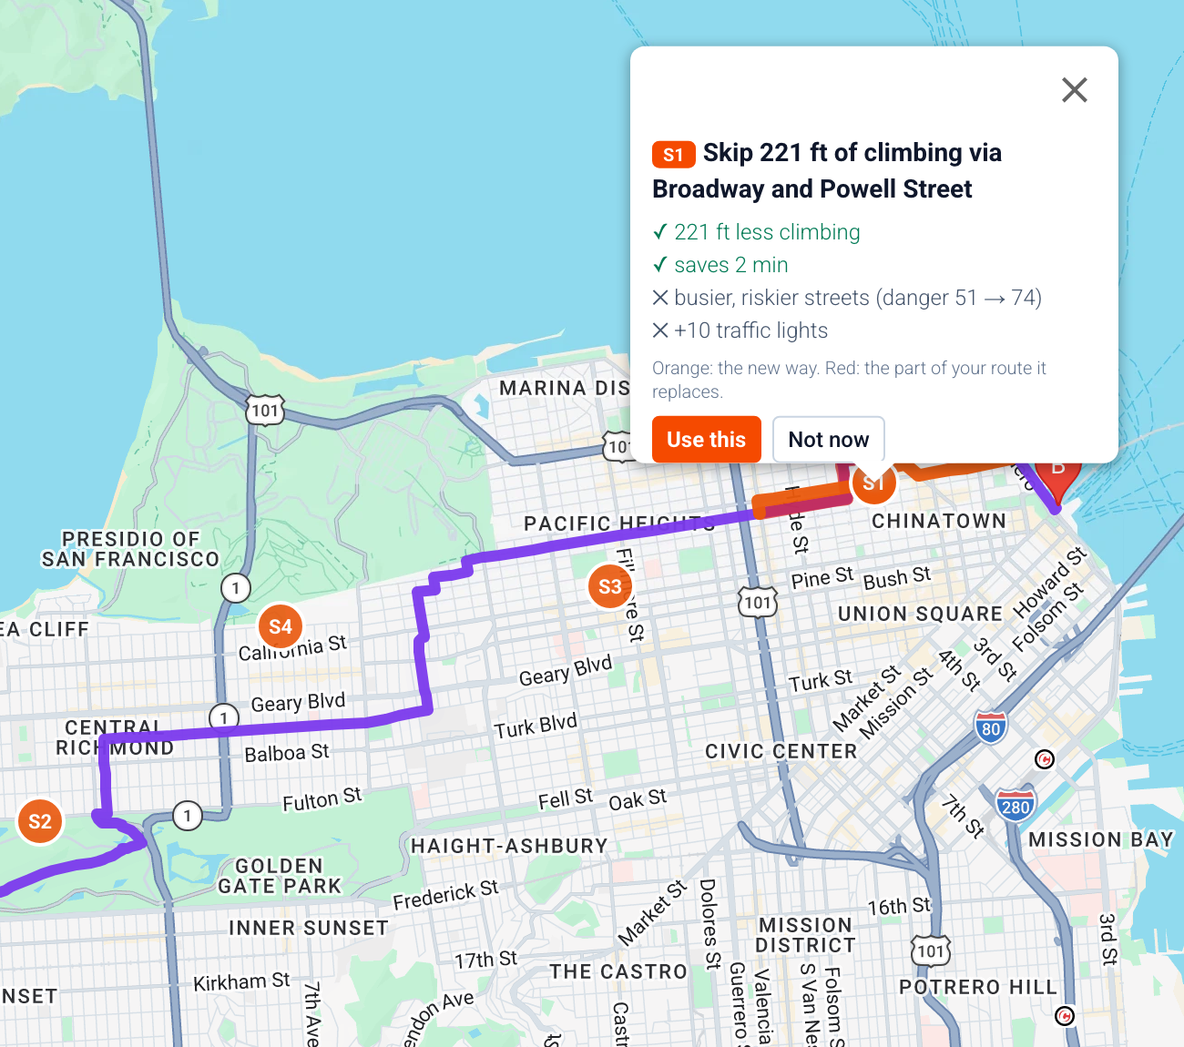



Make it your route, with every trade-off spelled out
Add, drag or remove stops
It re-plans through them with the same safety rules
Suggested edits
"Skip 221 ft of climbing via Broadway: costs busier streets, +10 lights"
Fewer traffic lights
Fewer stops, and it never overrides safety
Compare side by side
Every stat, one hill scale, best value starred
▶ 20s demo: Edit route + suggested edits
Notes:
SLIDE [≈10s] SAY: "Once you've picked a route, it's yours to shape — and the app tells you exactly what every change costs."
▶ DEMO [20s]
SETUP: Ocean Beach → Ferry Building, "Safest" selected, Avoid hills OFF.
DO: "Select this route" → "Edit route". Click once on the map to add a stop and drag it a block. Click "Show suggested edits" (it takes a few seconds — cut this wait in your edit). Click "S1" on the map, then "Not now".
SAY WHILE DOING: "Click to add a stop, drag to move it — it re-plans with the same safety rules. Suggested edits find every local trade-off: skip 221 feet of climbing via Broadway, but it costs busier streets and ten more lights. Your call, with the cost spelled out."
(Mention, don't demo: "Fewer traffic lights" trades a little distance for fewer stops and never overrides safety.)

Slide 8


More than safety: real SF data, shaped by you
Avoid hills
Data: USGS elevation at 112,492 points on the street map
Fewer traffic lights
Data: 1,314 SFMTA traffic signals
21.8% → 8.6%
35 → 12 lights
steepest climb; climbing 1,027 → 518 ft, and 7 min quicker
Try it: Ocean Beach → Ferry Building, Safest
Fastest 35, Safest 17, Safest + Fewer lights 12 (2 min quicker than Safest)
Try it: Ocean Beach → Ferry Building
Honest ride time
Data: Every estimate counts each climb and ~12 s per red light
Customize with AI
Data: Same controls you use, plus 3,712 real places
Fastest ≤ Safest
1 sentence
Because times include hills and lights, "Fastest" is never slower than a safer option — checked by automated tests
Try it: Any trip: compare the Est. time on each route
"Flat ride please, with boba and a park on the way" → a For you ride, 5.4 mi, 2 stops
Try it: Noe Valley → North Beach
Danger scores come from our trained model; hills, lights and ride time come straight from measured city data.
Notes:
SLIDE [≈20s] SAY: "Safety is the core, but it's not the only thing we optimise. Everything here runs on measured San Francisco data: real elevation at every intersection, so Avoid hills turns a 22% climb into 8.6% and gets you there 7 minutes sooner. All 1,314 city traffic signals, so Fewer lights takes the same trip from 35 red lights down to 12. Ride times count every hill and every light. And you can customise all of it in one sentence with the AI."
▶ DEMO [20s]
SETUP: Ocean Beach → Ferry Building, "Safest" selected.
DO: Point at "Steepest climb 21.8%" and "Traffic lights 17". Turn on "Avoid hills" → show 8.6% and ~82 min. Turn Avoid hills off, turn on "Fewer traffic lights" → show 12 lights. (Then, if time: assistant → "Flat ride please, with boba and a park on the way".)
SAY WHILE DOING: "Avoid hills: steepest climb 21.8 down to 8.6 percent, and it's faster. Fewer lights: 17 down to 12. Or just tell the assistant what you want."
WHERE EACH NUMBER COMES FROM (all reproducible in the app, Oct 14, 2026):
- Avoid hills: Ocean Beach → Ferry Building, Safest. Off: steepest 21.8%, ▲1,027 ft, ~89 min. On: 8.6%, ▲518 ft, ~82 min. (Also Golden Gate Park → Ferry Building: 21.8% → 8.6%, 810 → 384 ft, 67 → 63 min.)
- Fewer lights: Ocean Beach → Ferry Building. Fastest 35 lights; Safest 17 (~89 min); Safest + Fewer traffic lights 12 (~87 min). Note: on some trips fewer lights costs time (Noe Valley → North Beach: 26 → 16 lights, +17 min) — it's for fewer stops, and never overrides safety.
- Honest ride time: every estimate = distance + 10 flat-equivalent metres per metre climbed + ~12 s per traffic light, and tests check Fastest ≤ Safest ≤ Safest + bike lanes in time across trips and settings. If asked why Google says 14 min where ours says ~17 for Grace Cathedral → Patricia's Green: we count the climb and the red lights.
- AI: Noe Valley → North Beach, prompt above, produced "For you · Safest rules · avoids hills · 5.4 mi, ~54 min" with 2 stops. AI replies vary slightly run to run.
- Wording: only the danger score comes from a trained model. Hills and lights are measured data, not "trained".

Slide 9
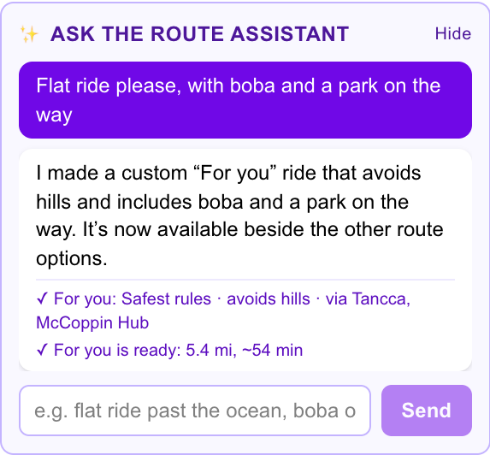
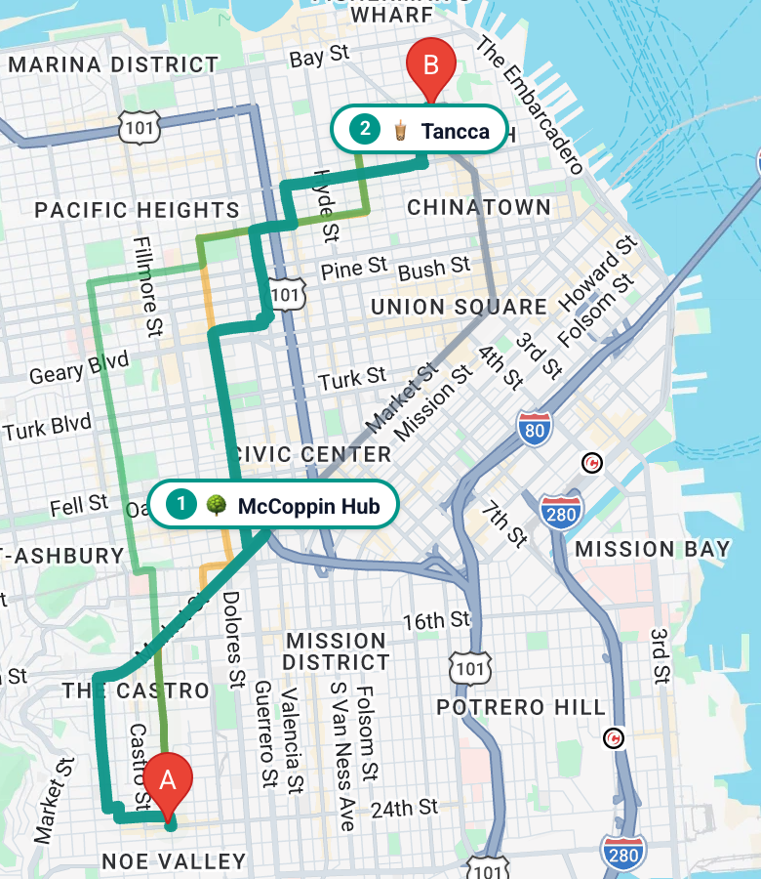



Just say what kind of ride you want
Same controls as you
The AI can't break a safety rule — it can only flip the switches a rider can
Visible and undoable
Every change it makes shows up in the sidebar
Real places
3,712 spots from OpenStreetMap — never one inside a Severe area
One sentence → a "For you" ride: Safest rules, no big hills, a boba stop and a park, 5.4 mi
▶ 20s demo: Ask the route assistant
Notes:
SLIDE [≈10s] SAY: "Routing apps make you learn their settings. Ours lets you just say what you want."
▶ DEMO [20s]
SETUP: Start = "Noe Valley", Destination = "North Beach" (plan before recording).
DO: In the assistant box type "Flat ride please, with boba and a park on the way" → Send. Wait for "For you is ready". Click the "For you ✨" card; point at the numbered stops on the map.
SAY WHILE DOING: "One sentence. The assistant builds a For you ride — Safest rules, no big hills, a boba stop and a park, pinned on the map. The AI never draws the route itself: it can only use the same controls you do, so it can't break a safety rule, and every change shows up right here."

Slide 10
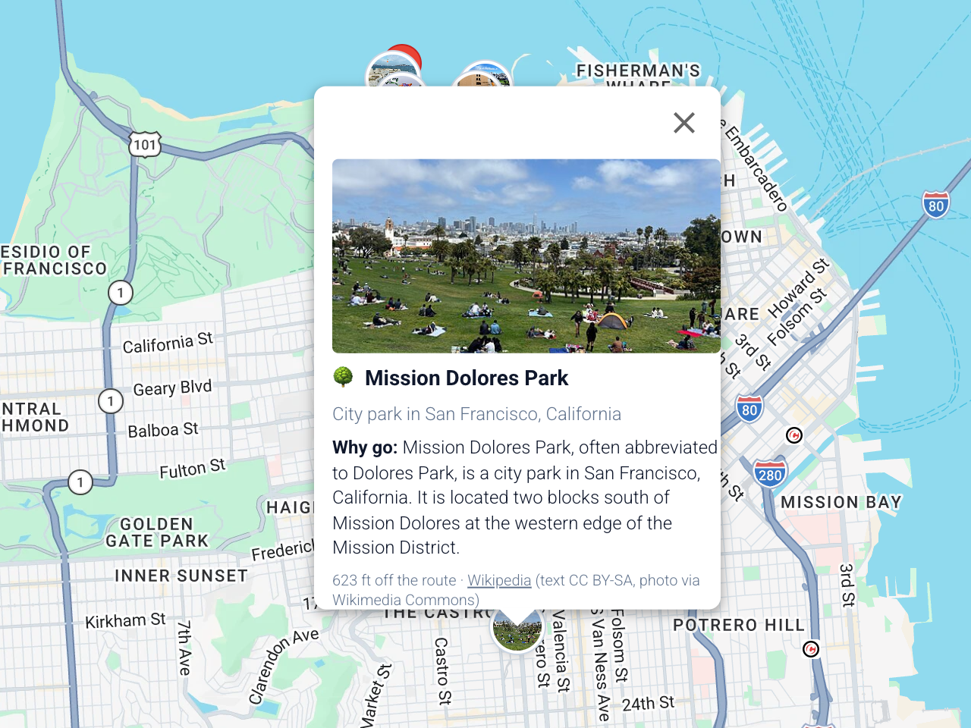
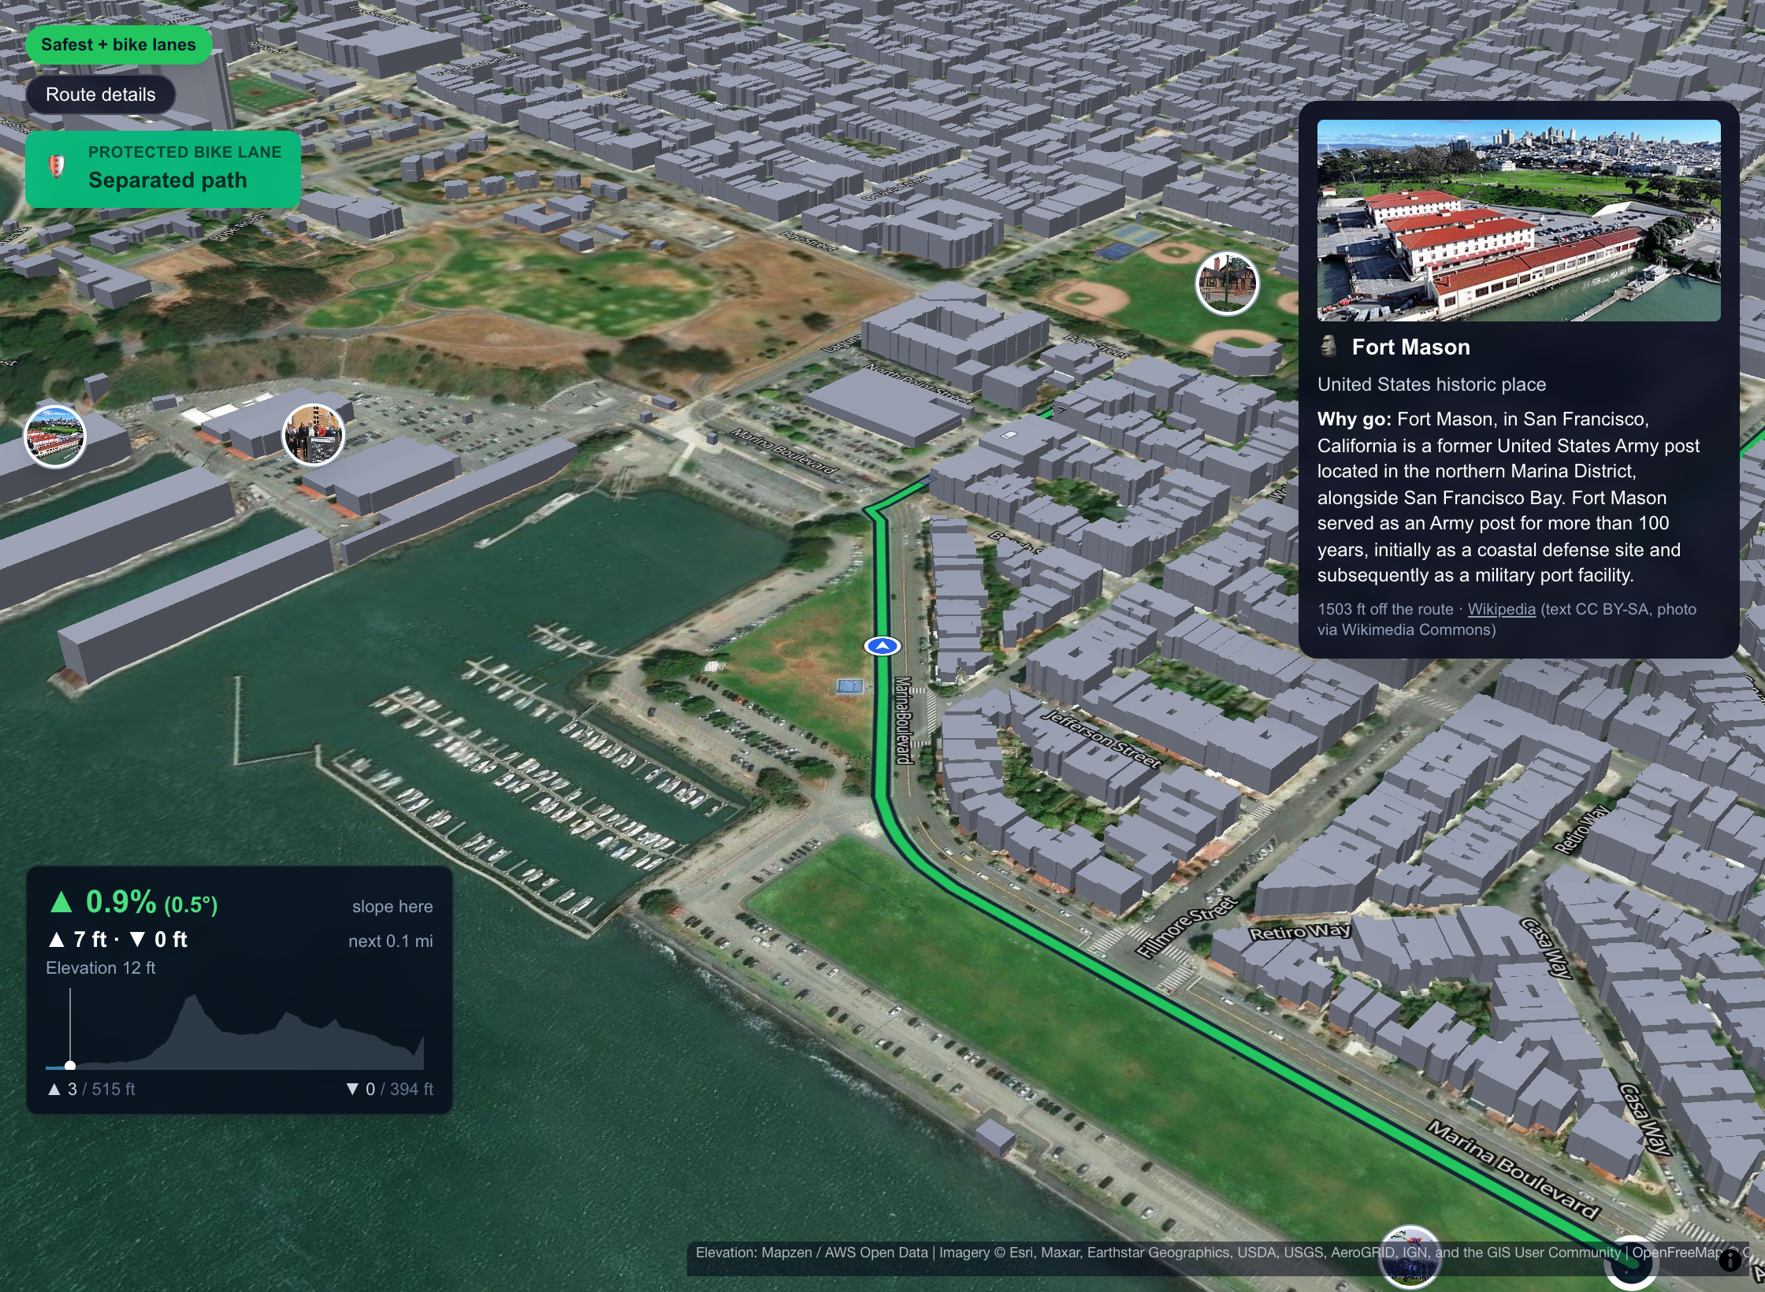



Rides around places worth seeing
A photo and a reason to stop
Picture, what it is, and why go
Pick what you like
Beaches, boba, coffee, parks, views: a For you ride
Pinned in the 3D tour
A card pops up as the tour reaches each one
▶ 20s demo: Interests + place photos
Notes:
SLIDE [≈10s] SAY: "A ride should be something you look forward to. Pick what you like, and see what's along the way before you go."
▶ DEMO [20s]
SETUP: Start = "Marina Green", Destination = "Dolores Park"; clear the assistant's For you ride first (planning a new trip does it).
DO: Click the "Beaches" and "Boba" chips → a "For you" card appears; flip "Quick" / "Relaxed". Then click "Places along the way" and click the Dolores Park photo pin to open its card.
SAY WHILE DOING: "Tap beaches and boba and you get a For you ride — quick with two stops, or relaxed with up to five, never inside a Severe area. Turn on Places and every landmark along the route shows up with a photo and why it's worth a stop."

Slide 11
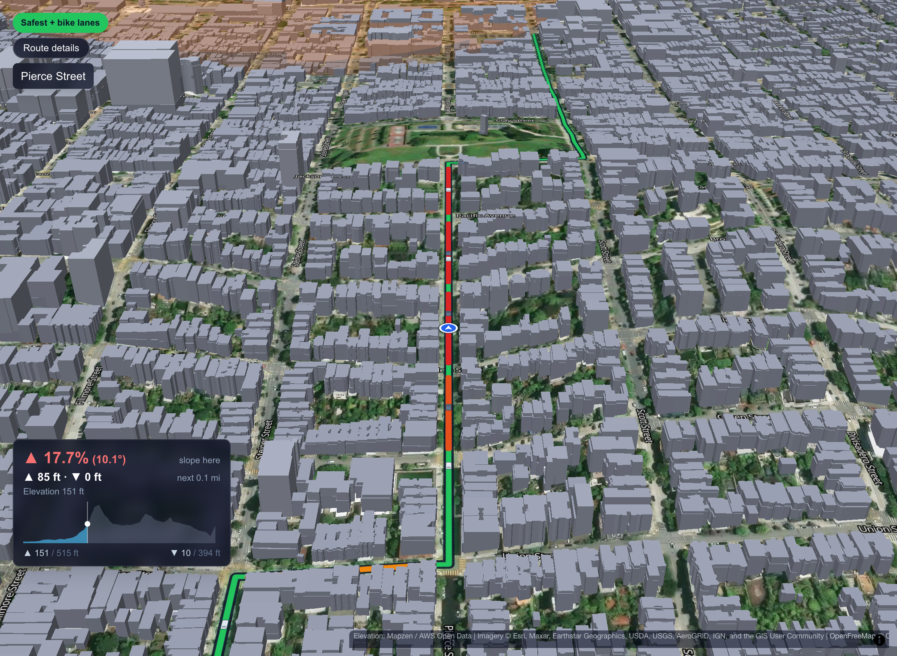
Preview the ride before you ride it
Calls out protected lanes the moment you reach them
Shows the slope ahead — this block is a 17.7% climb
Real aerial photos · real terrain · San Francisco's own LiDAR building heights
▶ 20s demo: 3D tour with Places on
Notes:
SLIDE [≈10s] SAY: "And before you ride it, you can fly it."
▶ DEMO [20s]
SETUP: Marina Green → Dolores Park, "Safest + bike lanes" selected.
DO: "View 3D tour" → click "Places" (top right) → press play. Let it run: the PROTECTED BIKE LANE callout, the Fort Mason card, the slope panel. Click "Close 3D tour".
SAY WHILE DOING: "Real aerial photos, real terrain, the city's own LiDAR building heights. It calls out protected lanes as you reach them, pops up the places you'll pass, and shows the slope ahead — so a 17% block on Pierce Street never surprises you."
NEW: the play bar has 1× / 2× / 3× speed buttons. Move the mouse to bring the bar back after it fades, then click 2× or 3× to skip ahead without restarting.

Slide 12
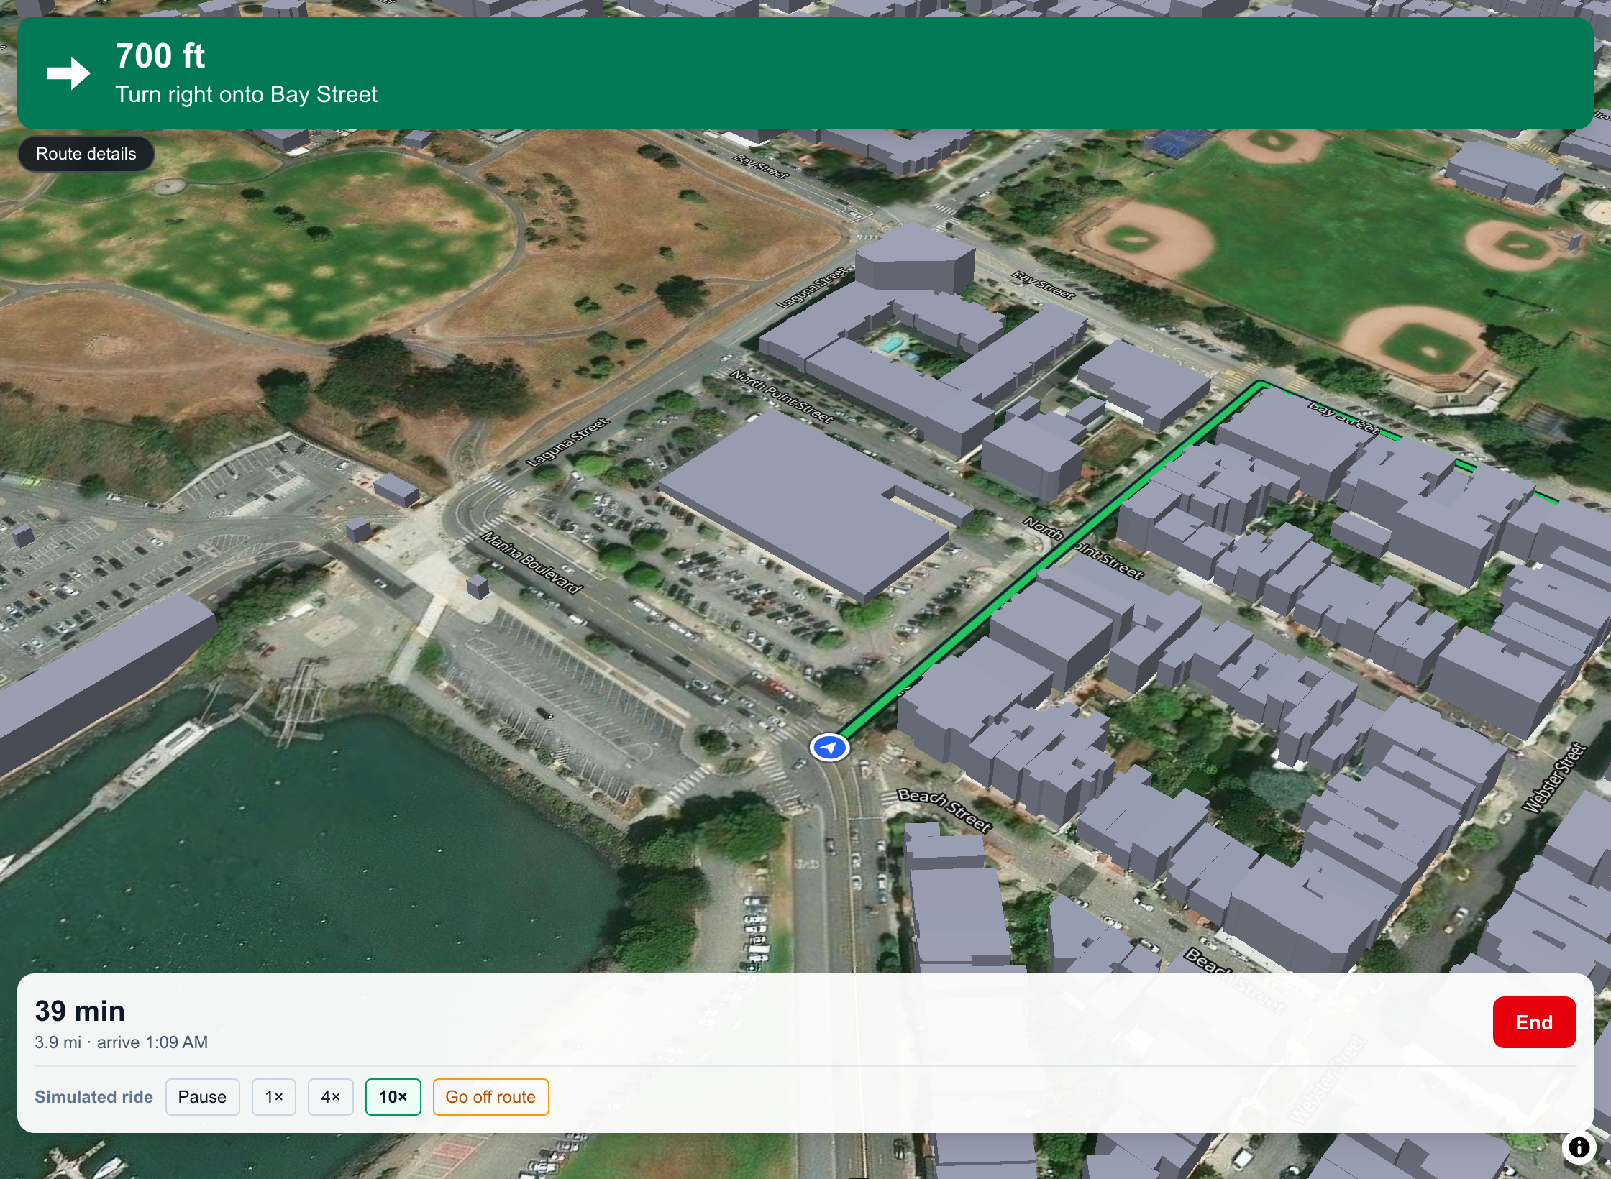


From plan to the street
Turn-by-turn with live GPS
Works in a phone browser today
Reroutes keep your choice
Go off route and it still plans the safe way back
Compare side by side
Every stat, one shared hill scale, best value starred
Save rides, add photos
Routes, stops and ride photos kept together
▶ 20s demo: Confirm, simulate, reroute, save
Notes:
SLIDE [≈10s] SAY: "And it's not a slideshow — you can ride it today."
▶ DEMO [20s]
SETUP: open the app at localhost:3000/?testmode (this shows "Simulate ride"). Marina Green → Dolores Park, "Safest + bike lanes".
DO: "Confirm route" → "Simulate ride" → "10×". After a few turns, click "Go off route" and let it reroute. Click "End", then "Save route".
SAY WHILE DOING: "Confirm, and you get turn-by-turn directions with live GPS in a phone browser. Miss a turn and it reroutes from where you are — keeping the safe route you picked. Save it, and every detail of the ride is kept."

Slide 13




Built like a product — and ready for the next city
What's next
411 automated tests, all passing
Crash rates, not counts
Adjust for how many people ride each street, and learn area risk instead of hand-setting it
Near-miss reports
Add rider reports (BikeMaps.org) to the crash data
~0.1 s to plan three routes
More cities
Any city with open crash and bike-lane data — Vision Zero cities first
6 open datasets, no paid data
Native app
Background GPS and alerts as you approach a danger spot
▶ 20s demo: 411 tests passing
Notes:
SLIDE [≈15s] SAY: "This is built like a product: 411 automated tests, three routes in a tenth of a second, all on open data — which is why it scales to the next city."
▶ DEMO [10s — short]
SETUP: a terminal in the All-Routes folder.
DO: run npm test and let it finish on "Tests 411 passed".
SAY WHILE DOING: "Every safety claim the app makes is checked by a test — 411 of them, all green."
(Honest answers if asked: the 17 area risk levels are hand-set today; the 3D cars are illustrative, and the app says so; GPS needs the page open until the native app.)

Slide 14
Safety shouldn't be a setting you have to find
BetterRoutes — the safe route, by default, with the trade-offs in plain sight
Notes:
[≈10s] SLIDE ONLY — stop talking after the last line.
SAY: "Google will always find you the fastest route. We think the safe route should be the default — and a ride you'll enjoy. We're BetterRoutes. Thank you."

Slide 15
Appendix: where every number comes from
Number in the deck | Source | Show it live (From → To, as typed)
1,103 cyclists killed, 52,887 injured (US, 2024) | NHTSA Traffic Safety Facts, 2024 Data: Bicyclists | —
4% of SF street miles hold 55% of severe/fatal bike injuries | SFMTA Vision Zero High Injury Network (cyclist corridors) | Neighborhood view on any trip
About half of big-city adults want to bike but worry about safety | Dill & McNeil, Transportation Research Record 2587 (2016) | —
Google route: 39% in Severe areas, 67% unprotected | Google Maps bicycling directions, captured Oct 14, 2026; SFMTA bike-network data | Grace Cathedral → Patricia's Green
−70% flagged, −28% danger, 1.4× lanes, +33% time, 7→1 of 10 | BetterRoutes, 10 trips (next slide) | Any trip on the next slide
Danger 62 → 32, protected 11% → 53%, +26 min | BetterRoutes, Safest + bike lanes vs Fastest | Ocean Beach → Ferry Building
Steepest 21.8% → 8.6%, climbing 1,027 → 518 ft, −7 min | BetterRoutes, Safest with Avoid hills off/on | Ocean Beach → Ferry Building
Traffic lights 35 → 17 → 12 | BetterRoutes: Fastest / Safest / Safest + Fewer traffic lights | Ocean Beach → Ferry Building
3,558 crashes · 5,455 lane segments · 5,566 highways · 1,314 signals | DataSF crashes 2019+; SFMTA bike network & signals; OpenStreetMap | lib/data/*.json in the repo
211,221 street segments · 3,712 places · 177,023 buildings | OpenStreetMap; DataSF building footprints (LiDAR) | 3D tour shows the building count
411 automated tests, all passing | Vitest suite in the repo | npm test
Notes:
Appendix — keep it at the back for Q&A. Every app number here can be reproduced by typing the From → To addresses into BetterRoutes and picking the FIRST suggestion. Numbers measured Oct 14, 2026 with model gbt-baseline-2026-10-05.
Links:
- NHTSA 2024 bicyclists: https://rosap.ntl.bts.gov/view/dot/92690
- SFMTA Vision Zero High Injury Network: https://sfmta.com/media/4894/download
- Dill & McNeil 2016: https://jenniferdill.net/types-of-cyclists/
- EPA transportation emissions (if you use it): https://www.epa.gov/system/files/documents/2024-05/420f24022.pdf
Fix on your existing slide 3: it says 5,457 SFMTA bike-lane segments; the app uses 5,455 (5,457 was the raw file's line count).

Slide 16
Appendix: the 10 trips behind the results
From → To (as typed) | Fastest: in flagged areas | Safest + lanes: in flagged areas | Danger | Protected lanes | Time
Ocean Beach → Ferry Building | 23.9% | 0% | 62.1 → 31.9 | 10.6% → 53.1% | 70 → 96 min
Pacific Heights → Mission Street & 17th Street | 53.7% | 54% | 74.6 → 56.8 | 1.5% → 27.2% | 25 → 42 min
Marina Green → Dolores Park | 27.2% | 17.1% | 56.6 → 45.3 | 0.9% → 18.3% | 37 → 43 min
Noe Valley → North Beach | 45.2% | 14.5% | 71 → 48.5 | 32.9% → 1.3% | 43 → 53 min
Grace Cathedral → Hayes Valley | 78.3% | 0% | 88.6 → 69.9 | 11.8% → 8.4% | 15 → 17 min
Chinatown → Dolores Park | 58.1% | 14.6% | 74.1 → 67 | 39.2% → 19.7% | 34 → 41 min
Union Square → Lower Haight | 57.2% | 13.5% | 74 → 68 | 30.2% → 1.7% | 21 → 30 min
Clement Street & 6th Avenue → Potrero Hill | 36.8% | 12.7% | 66.6 → 49.4 | 4.2% → 12.5% | 53 → 66 min
Marina Green → Potrero Hill | 47.3% | 12.7% | 63.6 → 34.7 | 33.7% → 65% | 55 → 72 min
Golden Gate Park → Ferry Building | 29.8% | 0% | 65.3 → 31.9 | 20.2% → 54.9% | 56 → 84 min
Pick the first address suggestion. "Safest + lanes" is the app's "Safest + bike lanes" option. Measured Oct 14, 2026.
Notes:
Appendix — the raw data behind the Results slide. Any row can be demoed live: type From and To, pick the first suggestion, then "Compare routes side by side".
Averages: in flagged areas 45.8% → 13.9% (−70%); danger 69.6 → 50.3 (−28%); protected 18.5% → 26.2% (1.4×); total time +33%; trips entering a Severe area 7/10 → 1/10.
Two rows to be ready for: Pacific Heights → Mission Street & 17th Street — the destination sits inside a flagged area, so the safe route can't avoid much there (use it to show the problem, not the fix). Union Square → Lower Haight — the start sits at the Tenderloin's edge, so the safe route still clips SoMa for 0.12 mi.

