Slide 1
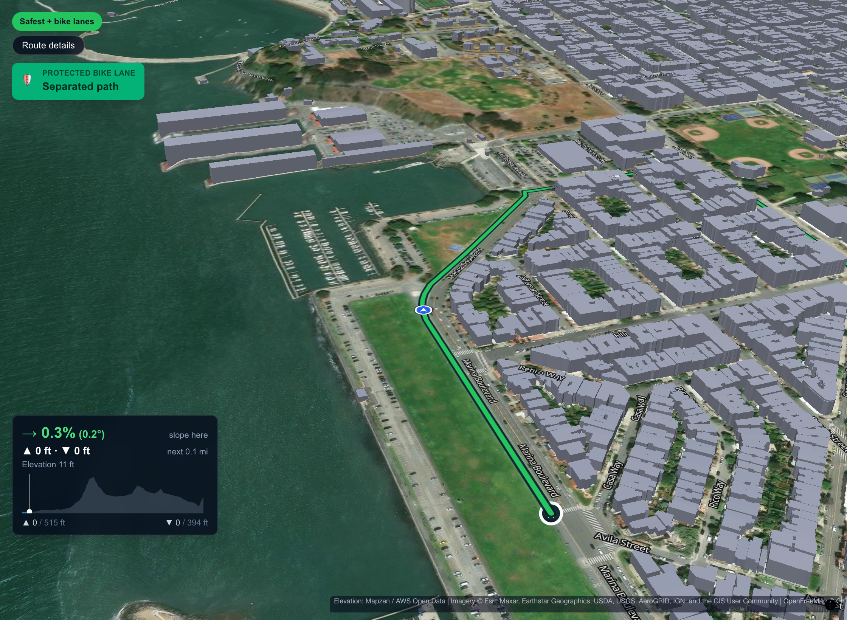
No Roll Models
The bike map that routes San Francisco for safety, not just speed
Real city crash data · our own router · AI you can talk to
Notes:
[0:00–0:15] OPEN — say it slowly, look at the judges, not the screen.
"Every map app will tell you the fastest way to bike across San Francisco. We built the one that tells you the safest way — and proves it, street by street. We're No Roll Models."
(The picture is our 3D preview of a real route: real aerial photos, real terrain, the city's own LiDAR buildings, and the route riding a protected bike path.)

Slide 2
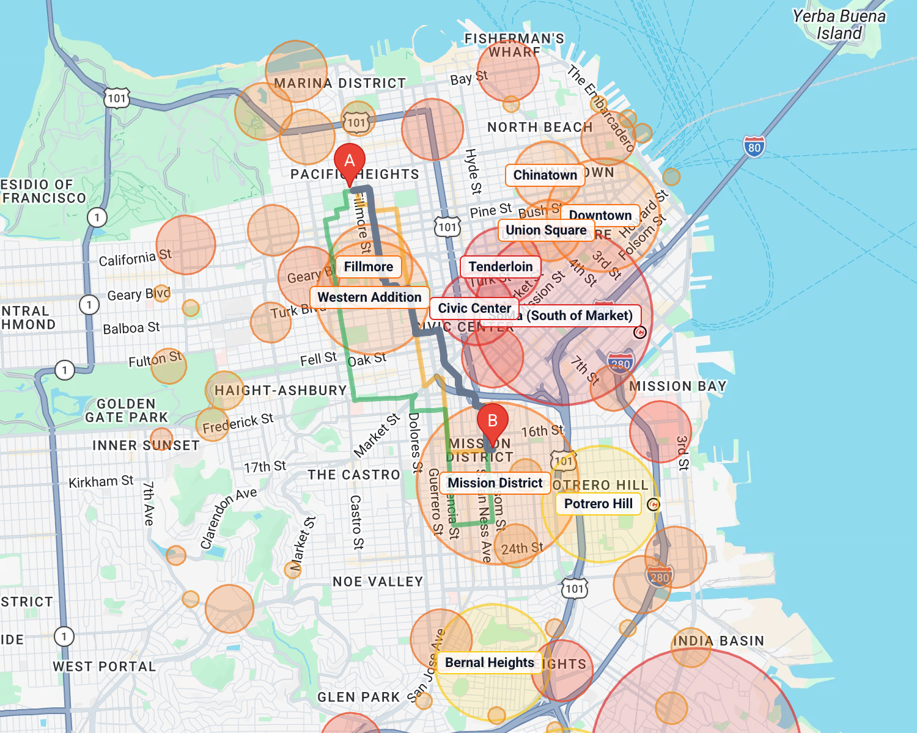
Bike danger is concentrated — so route around it
IMPACT
1,103
cyclists killed on US roads in 2024
52,887
cyclists injured in 2024 — up 6% from 2023
4% → 55%
4% of SF street miles hold 55% of severe and fatal bike injuries
Sources: NHTSA Traffic Safety Facts, 2024 Data: Bicyclists; SFMTA Vision Zero High Injury Network (cyclist corridors)
Fastest route, Pacific Heights → Mission: more than half the ride inside flagged areas
Notes:
[0:15–0:50] THE PROBLEM → THE INSIGHT (impact)
"In 2024, 1,103 cyclists were killed on US roads and almost 53,000 were injured — injuries went up 6%. 81% of cyclist deaths happen in cities.
But here's the insight our whole product is built on. San Francisco's own Vision Zero analysis found that just 4% of the city's street miles hold 55% of the severe and fatal bike injuries. Danger isn't everywhere. It's concentrated. And anything concentrated can be routed around.
Fastest-first navigation does the opposite. This is the fastest route from Pacific Heights to the Mission — more than half of it runs inside the neighbourhoods and crash hotspots you see in red and orange."

Slide 3
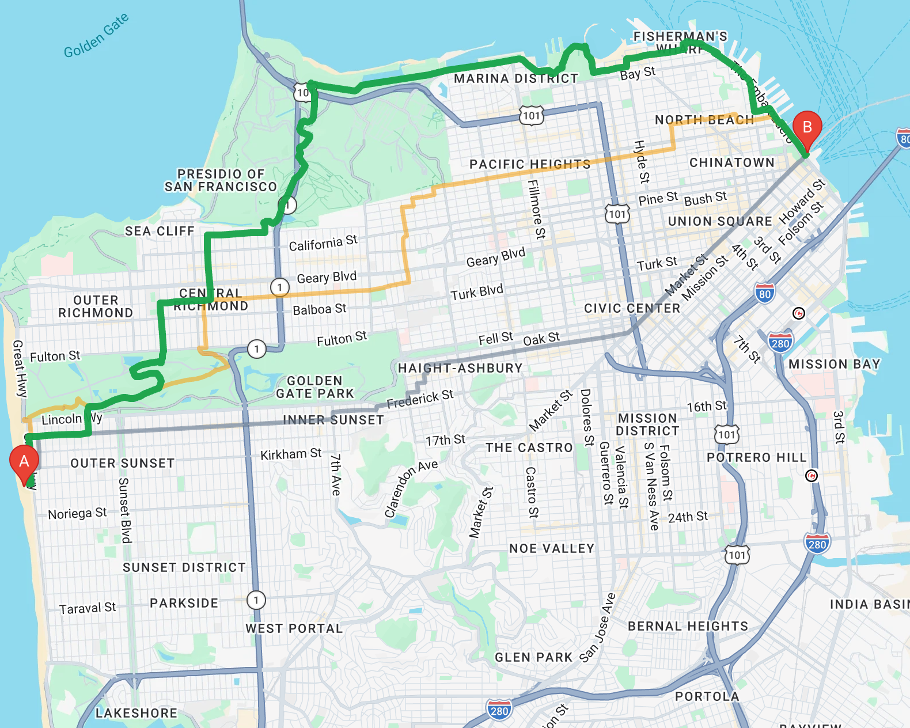






Our own bike router, built on SF's real data
PRACTICAL
3,558
real bike-injury crashes (DataSF, 2019+)
5,457
SFMTA-surveyed bike-lane segments
5,566
highways and fast arterials scored
1,314
traffic signals that stop a rider
Every corner
terrain elevation, so hills are real
177,023
LiDAR-measured buildings for 3D
→ a 211,000-segment street graph, searched in about 0.1 s per trip
One trip, three honest options: Fastest · Safest · Safest + bike lanes
Notes:
[0:50–1:20] HOW IT WORKS (practical + technical depth)
"So we didn't just wrap Google Directions. We built our own router on San Francisco's real open data: 3,558 real bike-injury crashes, SFMTA's official survey of every bike lane — which corrected OpenStreetMap on 32,000 street segments — every highway and fast arterial, every traffic signal, and terrain elevation at every intersection.
That becomes a 211,000-segment street graph we search in about a tenth of a second. You type two addresses and get three honest options: Fastest, Safest, and Safest plus bike lanes. Let me show you."
→ SWITCH TO THE LIVE APP.

Slide 4
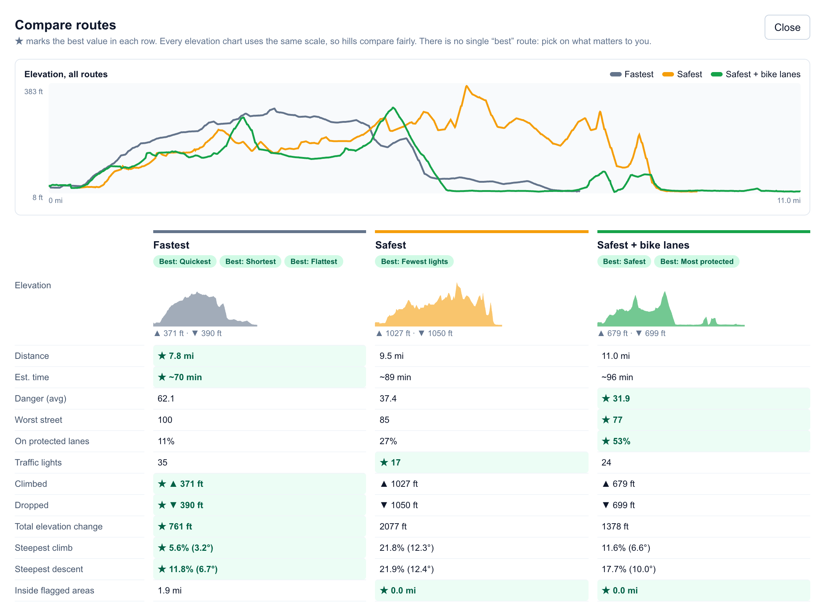
Live demo
1
Pacific Heights → 17th & Mission
Fastest route + Neighborhood view: the problem, live
2
Ocean Beach → Ferry Building
Safest + bike lanes: what it avoided, what it cost
3
Turn on Avoid hills
Steepest climb 21.8% → 8.6%, and 7 min quicker
4
Ask the assistant
"Flat ride please, with boba and a park on the way"
Wi-Fi down? Slides 6–9 show every step
5
Marina Green → Dolores Park
View 3D tour, then Confirm route → navigation
Notes:
[1:20–3:20] LIVE DEMO — about 2 minutes. Plan one trip before you go on stage so the engine is warm. Type the addresses exactly as below and check the suggestion before pressing Enter.
1. (25s) Type "Pacific Heights" → first suggestion. Type "Mission Street & 17th Street" → pick the 17th Street / Mission one. Leave it on Fastest. Click "Neighborhood view".
SAY: "Here's the fastest route — and here are the 17 flagged neighbourhoods and the clusters of real crashes. The fastest route runs straight through SoMa and Civic Center, both Severe."
2. (35s) Change to "Ocean Beach" → "Ferry Building". Click "Safest + bike lanes".
SAY: "Same trip, safer route. Average danger drops from 62 to 32, protected lanes go from 11% to 53% of the ride, and it never enters a flagged area. And look — it doesn't hide the cost: 26 minutes longer, and it tells you it still crossed 4 crash hotspots because no route avoids them all. A safety app that over-promises is worse than none."
Optional: click "Compare routes side by side" for 5 seconds, then Close.
3. (20s) Click "Safest", point at "Steepest climb 21.8%". Turn on "Avoid hills".
SAY: "This is San Francisco — the safest street can be a 22% wall. Avoid hills takes the steepest climb from 21.8% to 8.6%, halves the climbing, and the ride is actually 7 minutes quicker."
4. (25s) In the assistant box type: "Flat ride please, with boba and a park on the way" → Send.
SAY: "You can just say what ride you want. The AI doesn't draw a route itself — it uses the same controls you do, so it can't break a safety rule, and every change shows up right here where you can undo it." Point at the new "For you ✨" card and the numbered stops.
5. (25s) Change to "Marina Green" → "Dolores Park". Click "Safest + bike lanes" → "View 3D tour" → press play.
SAY: "And before you ride, you can preview it: real aerial photos, real terrain, the city's own LiDAR buildings. It calls out protected lanes as you reach them and shows the slope ahead." Close tour → "Confirm route" → point at turn-by-turn and "Start navigation".
→ BACK TO SLIDES (go to slide 5).

Slide 5
Safer routes cut time in flagged areas by 62%
IMPACT
−62%
time spent inside flagged areas
−30%
average street danger
2.1×
share of the ride on protected lanes
+28%
ride time — the honest cost, shown on every route
Measured through our router on 8 cross-town San Francisco trips, averaged per trip
Notes:
[3:20–3:45] RESULTS (impact)
"That wasn't one cherry-picked trip. We ran 8 cross-town trips through the router. On average, Safest plus bike lanes cuts the time you spend inside flagged areas by 62%, lowers average street danger by 30%, and doubles the share of the ride on protected lanes.
The cost is about 28% more ride time — and we show that cost on every single route, so riders choose with their eyes open."
(If asked: the 8 trips are Ocean Beach→Ferry Building, Pacific Heights→Mission, Marina Green→Dolores Park, Richmond→Potrero Hill, Noe Valley→North Beach, Ocean Beach→Mission, Marina Green→Potrero Hill, Richmond→Ferry Building. On a few short trips Safest matches Fastest closely — when there's no safer street nearby, we say so rather than inventing a detour.)

Slide 6
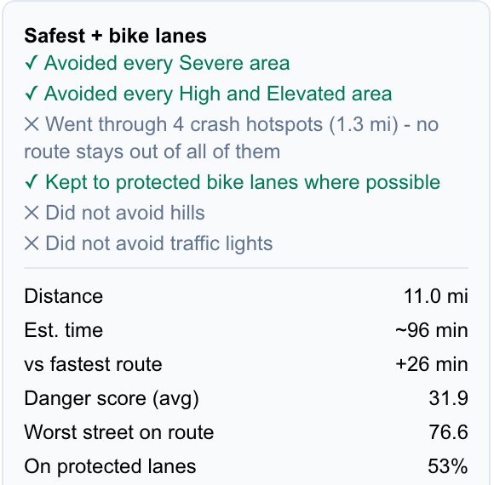
It says what it avoided — and what it cost
PRACTICAL
Rules a rider can read
Never enters a Severe area
Avoids High and Elevated areas unless that makes the ride 40%+ longer — then says where and why
Only claims it "avoided" an area if the fastest route actually goes through it
Avoid hills — Ocean Beach → Ferry Building
21.8% → 8.6%
steepest climb
1,027 → 518 ft
total climbing
7 min
quicker, too
Notes:
BACKUP FOR DEMO STEPS 2–3 (practical). Use if the live demo fails, or in Q&A.
"Every route comes with a checklist of what it did and didn't do. Our rules are simple enough to read: never a Severe area; avoid the others unless the detour gets more than 40% longer, and then tell you where and why. And it only says it 'avoided' somewhere if the fastest route actually goes there — no fake safety claims.
San Francisco also has hills. Left alone, the safest route here climbs a 21.8% wall on Green Street. Turn on Avoid hills and the steepest climb is 8.6%, total climbing halves, and the ride is 7 minutes quicker. Low danger isn't the same as rideable."

Slide 7
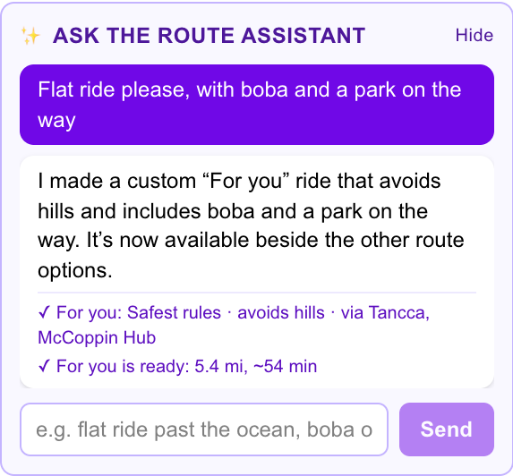
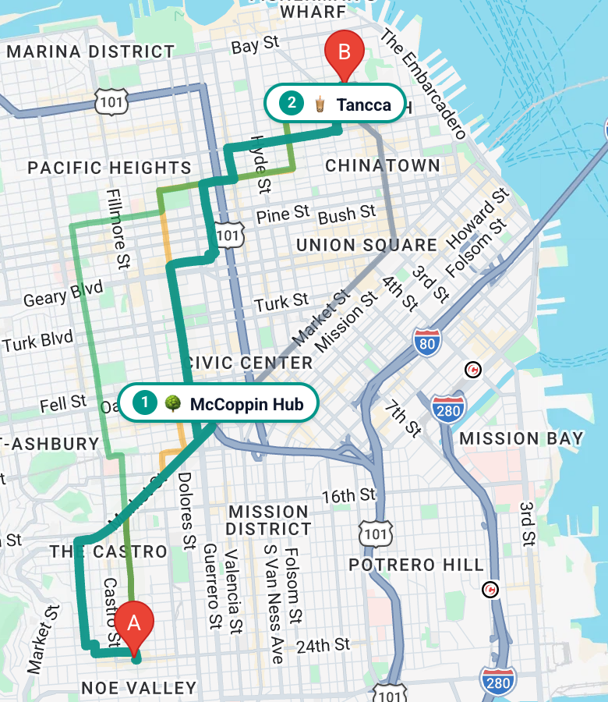



Just say what kind of ride you want
CREATIVE
Same controls as you
The AI can't break a safety rule — it can only flip the switches a rider can
Visible and undoable
Every change it makes shows up in the sidebar
Real places
3,712 spots from OpenStreetMap — never one inside a Severe area
One sentence → a "For you" ride: Safest rules, no big hills, a boba stop and a park, 5.4 mi
Notes:
BACKUP FOR DEMO STEP 4 (creative).
"Routing apps make you learn their settings. Ours lets you just say it: 'Flat ride please, with boba and a park on the way.' The assistant builds a 'For you' ride — Safest rules, avoids hills, with a boba stop and a park pinned on the map.
The creative part is how it's wired: the AI never draws a route. It can only use the same controls a rider uses, so it physically can't talk its way around a safety rule — and everything it changes is right there in the sidebar to inspect or undo."

Slide 8
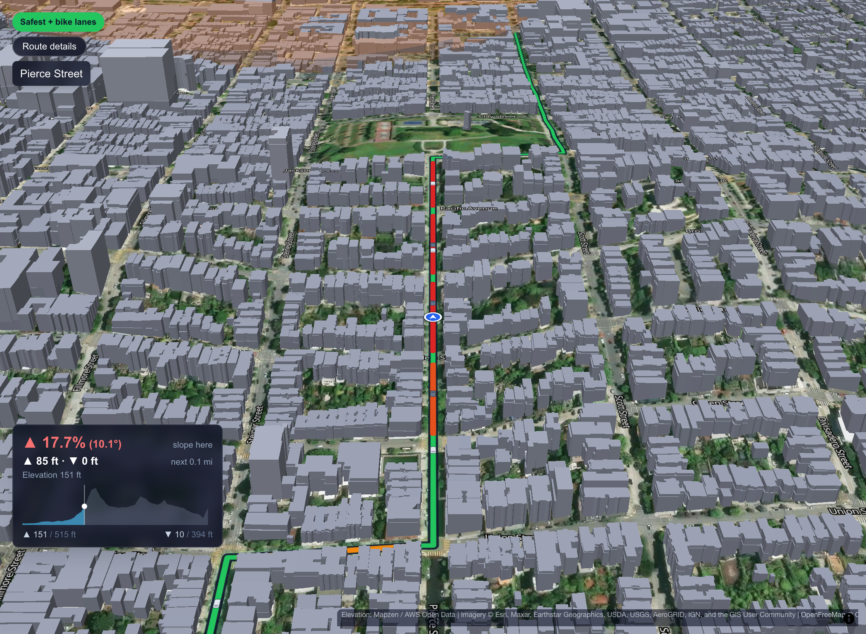
Preview the ride before you ride it
CREATIVE
Calls out protected lanes the moment you reach them
Shows the slope ahead — this block is a 17.7% climb
Real aerial photos · real terrain · San Francisco's own LiDAR building heights
Notes:
BACKUP FOR DEMO STEP 5 (creative — your wow moment; let the image breathe for a second before talking).
"Before you ride a route, you can fly it. Real aerial photography, real terrain, and the city's own LiDAR building heights. The tour calls out protected bike lanes as you reach them, and the panel shows the slope right here and what's coming — on the right that's a 17.7% block on Pierce Street, so you know before you're halfway up it."

Slide 9
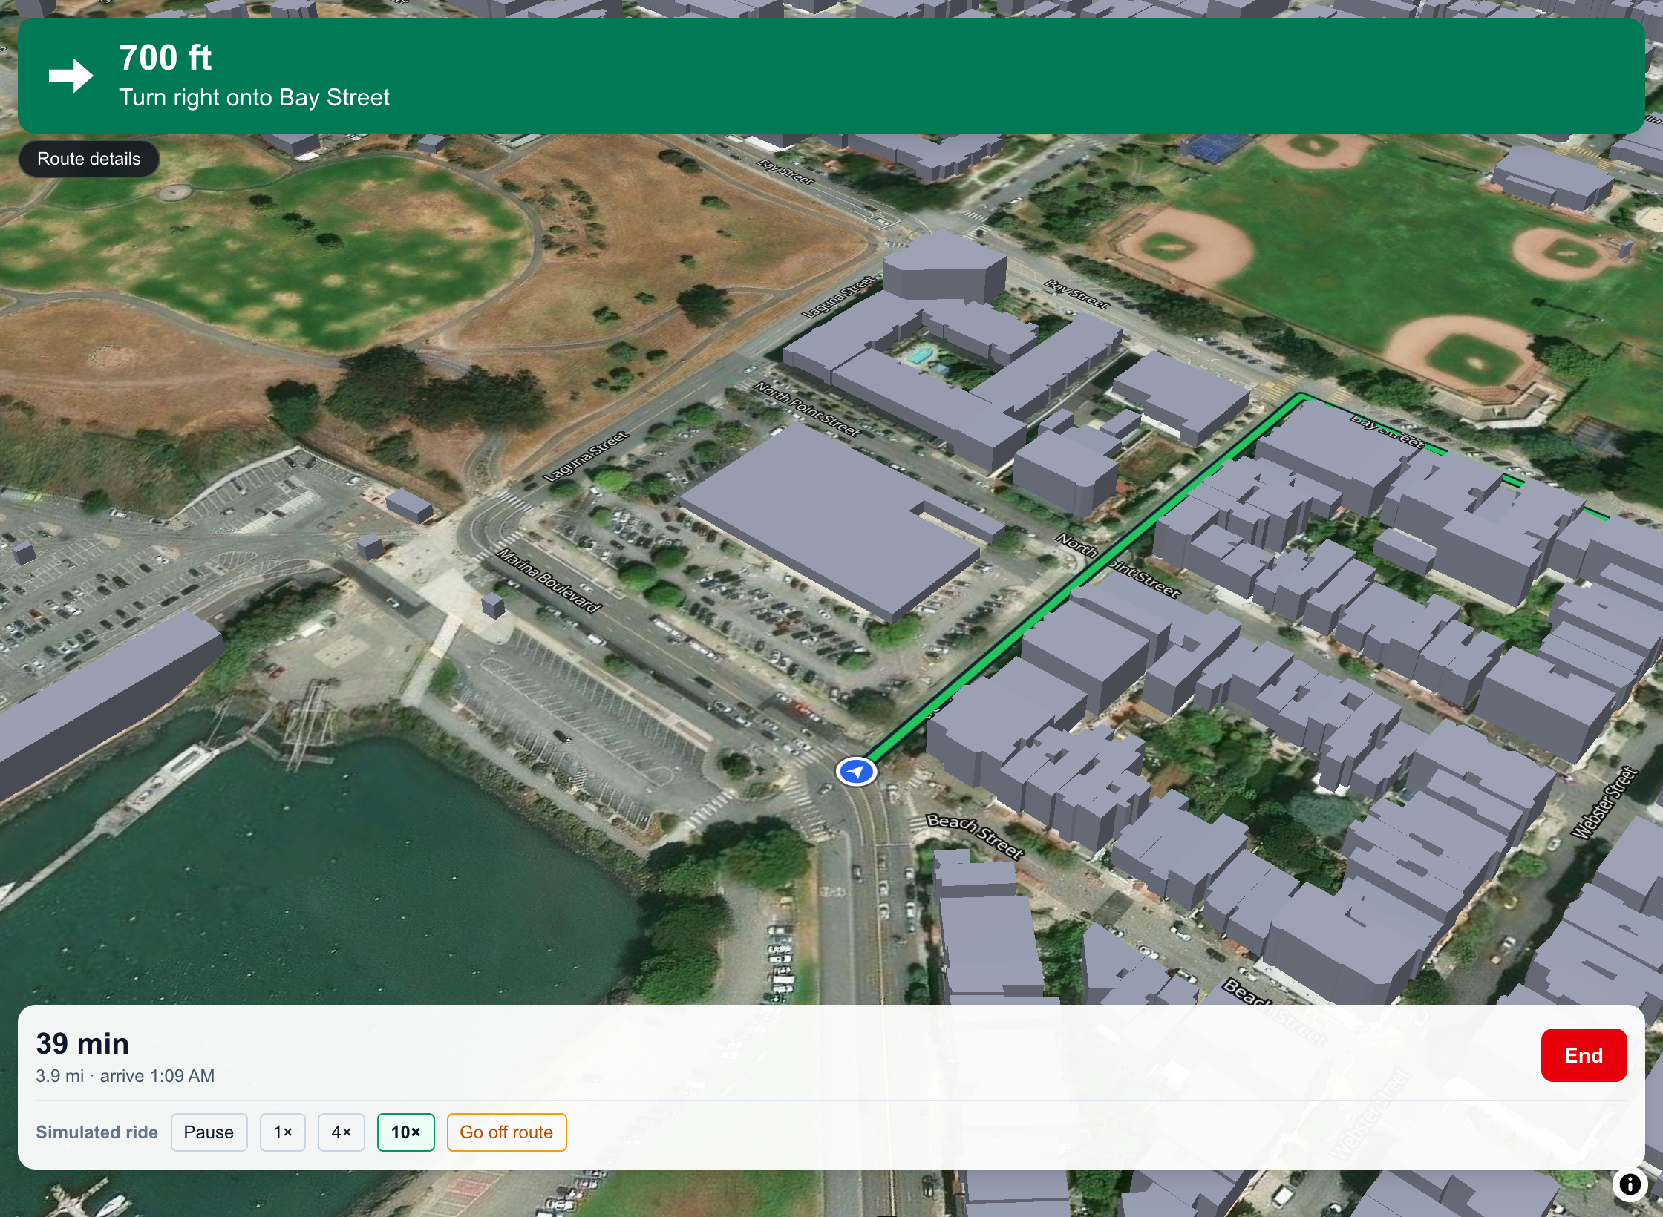




From plan to the street
PRACTICAL
Turn-by-turn with live GPS
Works in a phone browser today
Reroutes keep your choice
Go off route and it still plans the safe way back
Compare side by side
Every stat, one shared hill scale, best value starred
Save rides, add photos
Routes, stops and ride photos kept together
Notes:
BACKUP / RECAP (practical).
"And it's not a slideshow — you can ride it today. Confirm a route and you get turn-by-turn directions with live GPS in a phone browser. Miss a turn and it reroutes using the same safety choice you picked. You can compare every route side by side, save rides, and add photos from the stops."

Slide 10




Built like a product — and ready for the next city
411 automated tests, all passing
What's next
Crash rates, not counts
Adjust for how many people ride each street, and learn area risk instead of hand-setting it
~0.1 s to plan three routes
Near-miss reports
Add rider reports (BikeMaps.org) to the crash data
More cities
Any city with open crash and bike-lane data — Vision Zero cities first
6 open datasets, no paid data
Native app
Background GPS and alerts as you approach a danger spot
Notes:
[3:45–4:10] CREDIBILITY + NEXT (impact at scale)
"This is built like a product: 411 automated tests, all passing, three routes in about a tenth of a second, and it runs entirely on open data — no paid datasets.
That's also why it scales. Next we'll switch from crash counts to crash rates, so a busy, well-protected lane isn't punished for being popular; add rider near-miss reports; and bring it to the next city — any city with open crash and bike-lane data, starting with Vision Zero cities."
(Honest answers if asked: the 17 neighbourhood risk tiers are hand-set today; the cars in the 3D tour are illustrative, and the app says so on screen; GPS needs the page open — background GPS needs the native app.)

Slide 11
Safety shouldn't be a setting you have to find
No Roll Models — the safe route, by default, with the trade-offs in plain sight
Notes:
[4:10–4:20] CLOSE — stop talking after the last line.
"Google will always find you the fastest route. We think the safe route should be the default — with the trade-offs in plain sight. We're No Roll Models. Thank you."

