Slide 1

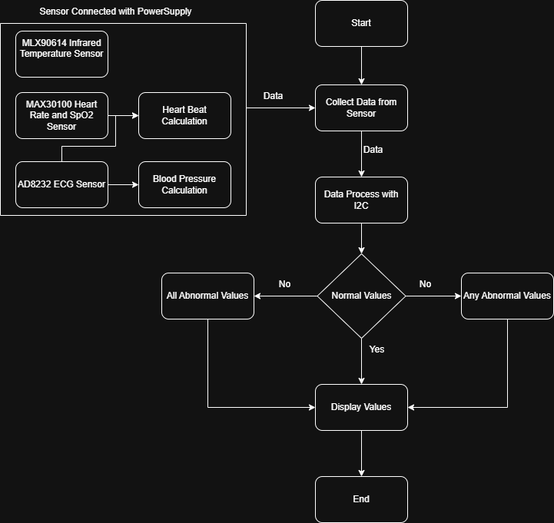
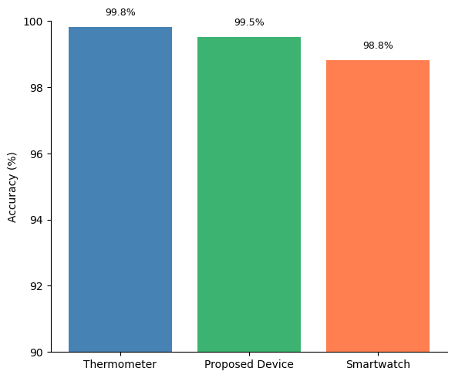
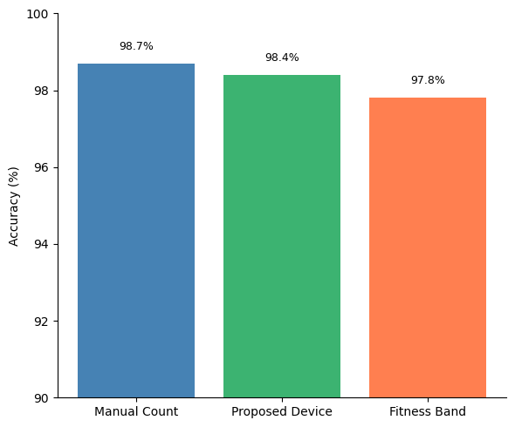
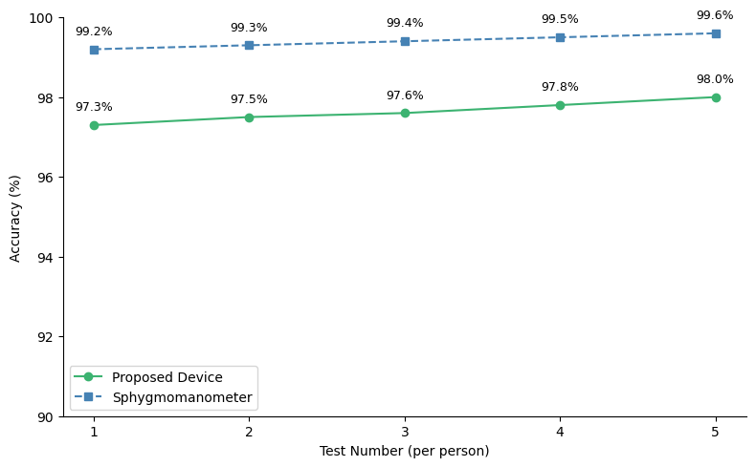
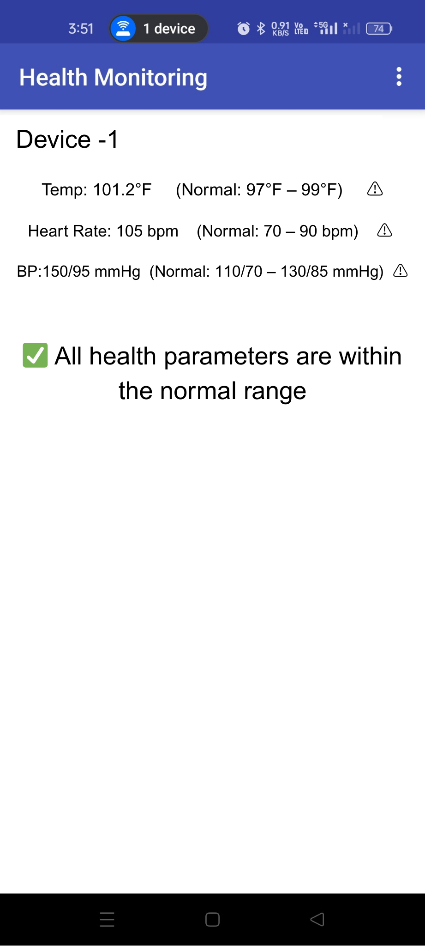
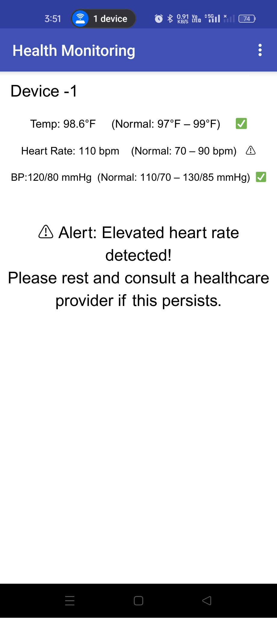
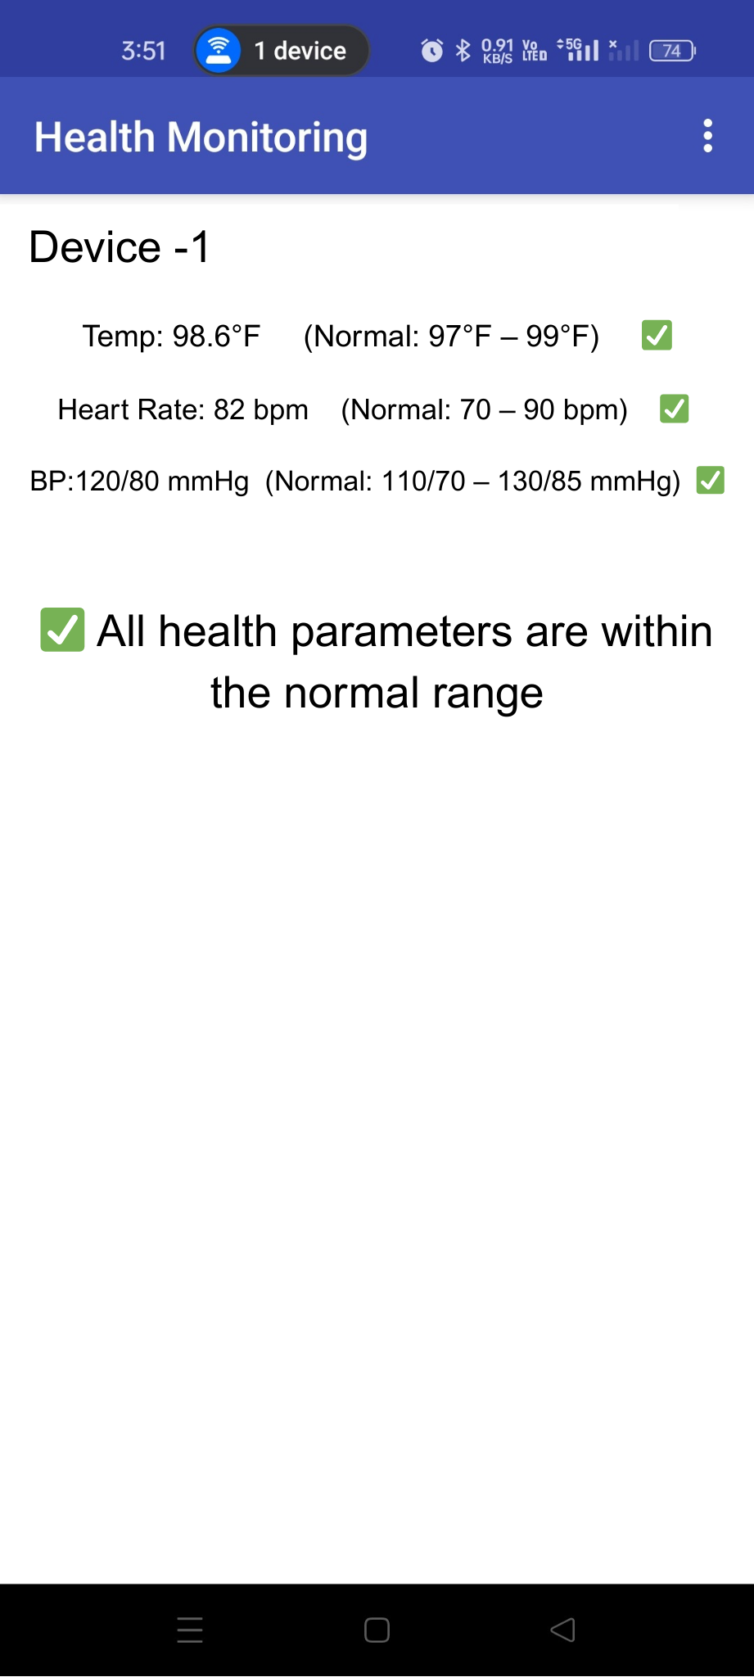
IOT BASED HEALTH MONITORING SYSTEM
Arjun M P, Gabriel Prince D , Kharihara Sudhan K , - II Year ME-CSE
Dr. R. Kanchana- Associate Professor
Department of Computer Science and Engineering
IFSP
STIRS
Academic Year – 2023-2024
Project Description
System Architecture
Conclusion
In the realm of healthcare, ensuring continuous and accessible patient monitoring presents significant challenges, especially for aging populations and underserved rural areas.
Therefore, the development of a cost-effective and scalable remote health monitoring system assumes paramount intrusion importance.
Leveraging IoT technologies in conjunction with wearable sensors and microcontrollers such as ESP32 offers a promising solution.
This system monitors vital signs including heart rate, body temperature, and blood pressure —by employing a Pulse Transit Time (PTT)-based algorithm, a widely studied method for cuffless blood pressure estimation.
It transmits physiological data wirelessly to a cloud platform and enables real-time visualization through an intuitive dashboard, empowering both patients and healthcare providers with timely and accessible health insights.
This project addresses critical challenges in accessible and continuous healthcare delivery, particularly in underserved and remote regions. By integrating low-cost biomedical sensors with Arduino UNO and ESP32 microcontrollers, the system facilitates real-time, non-invasive monitoring of vital signs such as heart rate, body temperature, and blood pressure.
The use of a modular architecture, local display interface, and a Pulse Transit Time (PTT)-based algorithm enhances the system’s reliability, usability, and diagnostic capability. Through thoughtful implementation of hardware, signal processing, and wireless communication, the project underscores the potential of IoT-driven solutions in transforming traditional healthcare models and lays a robust foundation for future advancements in remote health monitoring.
Objectives
Results & Discussion
Outcome
The objectives of the project include the following:
To design and implement a compact, non-invasive vital signs monitoring system using Arduino UNO and ESP32 microcontrollers.
To integrate the trained models with Raspberry Pi and web cameras to enable on-site intrusion detection.
To establish secure communication to transmit alerts from Raspberry Pi to the user's mobile application providing real-time intrusion details
To utilize MongoDB to securely store all intrusion event data in the cloud for reference and analysis, enabling historical tracking of intrusions.
Heart Rate Estimate:
A combined ECG (AD8232) and PPG (MAX30102) approach was used. Fused readings gave more stable results, especially in motion or noisy conditions. Manual verification showed deviations within 2–5 BPM compared to smart bands and manual counting.
Blood Pressure Estimation:
Blood pressure was indirectly inferred from ECG waveform features. Observed changes in RR intervals and amplitudes matched digital sphygmomanometer readings, demonstrating correlation.
Body Temperature Monitoring:
The MLX90614 infrared sensor delivered accurate contactless readings, with average deviation within pm 0.3 C when compared to clinical thermometers.
The proposed system delivers several impactful outcomes across both the healthcare sector and broader technological applications:
Real-time monitoring of vital signs via. Wearable , non-invasive sensors for proactive healthcare.
Robust heart rate estimation using a fused ECG-PPG model in dynamic conditions.
Cuffless blood pressure estimation using ECG waveform analysis, enabling user comfort and long-term tracking.
ESP32 based integrated display and alert system enabling offline use and instant.
low-cost, scalable, and portable system using Arduino UNO and ESP32 IoT components.
Suitable for rural and resource-limited areas, providing affordable healthcare solution.
Comparison Highlights:
HR: Aligned with Fire-Bolt and Redmi Band 5
Temp: Matches digital thermometer values
BP: ECG waveform variations match BP monitor trends
Contribution
This work introduces a modular, dual-microcontroller architecture for non-invasive vital sign monitoring, incorporating signal-quality-weighted heart rate estimation and ECG-only blood pressure inference, combined with real-time local feedback mechanisms. These design choices address key gaps in usability, connectivity, and affordability, often overlooked in prior works.
HR Temp BP
Future Development
Applications
Real-time Alerts:
System tested for various conditions:
Normal: All readings stable – no alert
One Abnormal: Alert triggered for that parameter.
Multiple Abnormal: All alerts triggered.
Future work entails several key areas of advancement to enhance the existing system’s efficacy and scalability.
This involves ensuring a stable internet connection for steady camera usage in processing images, thus improving prediction accuracy.
Presently, our setup relies on a single network, but we aim to update it to accommodate multiple networks.
Additionally, integrating GPS into our mobile app will improve user navigation from their current position.
Deep learning-based intrusion detection systems, initially developed for agricultural field security, find versatile applications across various sectors as follows :
Wildlife Conservation and Monitoring
Forest Protection and Fire Prevention
Urban Security and Surveillance
Border Security
Industrial Facilities Monitoring
Perimeter Security for Residential and Commercial Properties
Maritime Security
Environmental Monitoring
Normal One Abnormal Multiple Abnormal

