Slide 1
California Fish and Game Commission Activity
For ECOL-592: The Science and Policy of Species Conservation

Slide 2

Background on the CFGC
Founded in 1870 as Board of Fish Commissioners
1st wildlife conservation agency in the US
Expanded to include game in 1909
1940: California Constitutional Amendment
  6 year staggered terms
  Appointed by governor
  Confirmed by California State Senate
Interesting responsibilities:
  CESA listing and delisting
  Establishing protected lands/waters
  Leasing kelp beds and water-bottoms for shellfish cultivation

Slide 3
Public Participation & Transparency
Administrative Procedure Act (APA)
  Governs the regulatory process
  Allows any interested person to petition a state agency to change a regulation
Bagley-Keene Open Meeting Act
  Requires meetings of state boards and commissions to be open to the public
  Promotes transparency and public scrutiny
Public Comment
  The Commission must provide an opportunity for the public to comment on each agenda item before or during discussion

Slide 4
California Wildlife Agencies
Fish & Game Commission
  Sets wildlife and fisheries regulations and policy
Department of Fish & Wildlife (CDFW)
  Implements and enforces regulations
  Provides biological data and scientific expertise
Wildlife Conservation Board (WCB)
  Funds habitat conservation, land acquisition, restoration, and public recreation
In short: Commission = sets policy → CDFW = implements policy → WCB = funds conservation

Slide 5


Structure of the Committee
President: Eric Sklar (2015)
CEO of a cannabis company, former local elected official, and also big in the vineyard industries
Hunter, scuba diver, etc.
Vice President: Darius W. Anderson (2024)
“Entrepreneur” in investment firms
“Passionate” about conservation with a consumptive-recreational slant

Slide 6



Structure of the Committee
Commissioner 1: Jacque Hostler-Carmesin (2013)
  Tribal representative; National Ocean Council Governance Coordinating Committee under Obama; Key focus: transportation and land-use planning
Commissioner 2: Samantha Murray (2019)
  Faculty at UCSD, Ocean Law and Policy professor; NGO engagement, e.g., Audubon Society, Ocean Conservancy; Key focus: marine policy and law
Commissioner 3: Erika Zavaleta (2021)
  Faculty at UCSC; Coastal Science and Policy; Society for Conservation Biology; ESA Sustainability Science award for work on community responses to climate change; Key focus: evolutionary biology and sustainability

Slide 7
CFGC Strategic Planning
New Strategic Plan introduced in 2018
Highlights from Mission/Vision Statements
“transparent and open dialogue” -> Collaboration at multiple organizational levels
“abundant, healthy, and diverse fish and wildlife that thrive within dynamic ecosystems, managed with public confidence and participation, through actions that are thoughtful, bold, and visionary in an ever-changing environment”
Core Values: Integrity, Transparency, Innovation, Excellence, Collaboration, Stewardship
… and they ensure these values are adopted by their constituents by throwing down the hammer on folks that take don’t comply…

Slide 8
CFGC Strategic Planning
New Strategic Plan introduced in 2018
Highlights from Mission/Vision Statements
“transparent and open dialogue” -> Collaboration at multiple organizational levels
“abundant, healthy, and diverse fish and wildlife that thrive within dynamic ecosystems, managed with public confidence and participation, through actions that are thoughtful, bold, and visionary in an ever-changing environment”
Core Values: Integrity, Transparency, Innovation, Excellence, Collaboration, Stewardship
… and they ensure these values are adopted by their constituents by throwing down the hammer on folks that don’t comply…

Slide 9
California vs Colorado
Number of commissioners
  CO: 13
  CA: 5
Structure of Decision Making
  Both have a commision that makes the rules and a DFG that enforced them (generally?)
Public Involvement
  Pretty good for both… more obvious for California? But can submit public comments and see/attend meetings
  For both, public can submit proposals for resolutions

Slide 10
Commission Structure

Slide 11
How often and which committees?
Wildlife Resources Committee (WRC)
Tribal Committee (TC)
Marine Resources Committee (MRC)
Commissioners vote on which actions to undertake
Meet ~ monthly

Slide 12
Which policies and legislative procedures?
Reviews how the Department of Fish and Wildlife implements its policies and reports
Doesn't take formal positions on state or federal legislation. It instead endorses goals or concepts
Summarizes how state legislation affects CA state wildlife
Implements Justice, Equity, Diversity, and Inclusion
  Ensures wildlife is managed with public trust and inclusive decision making
  Acknowledges past injustice against indigenous tribes

Slide 13
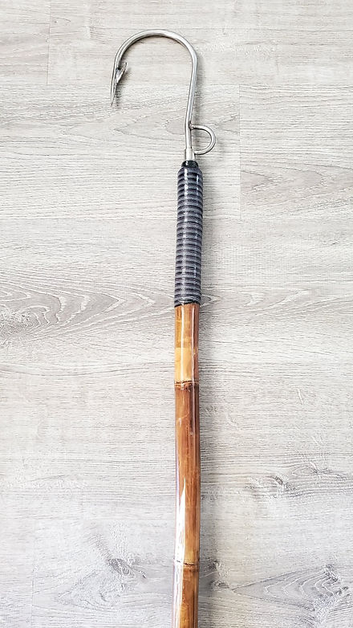
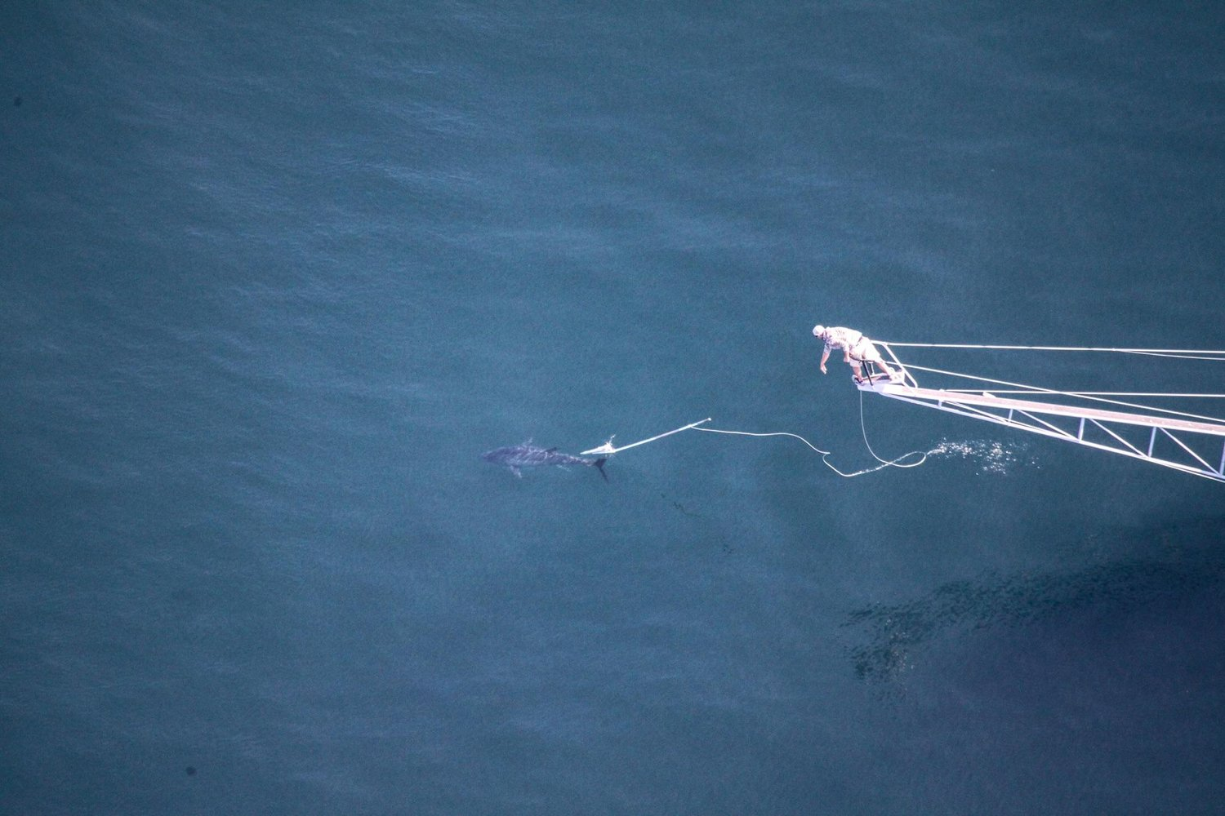
e.g. Proposed legislation being considered
Allowing the use of harpoons and flying gaffs in assisting with landing tuna and swordfish

Slide 14
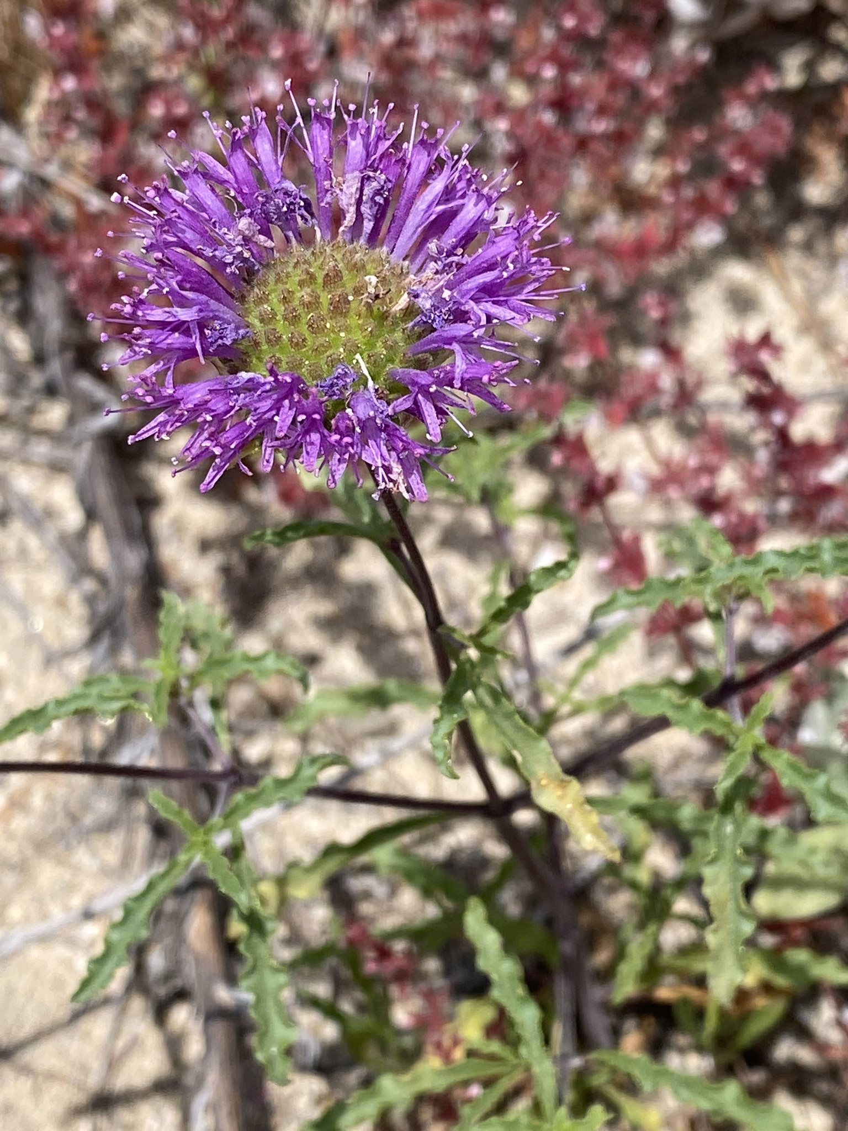
Group 3: California Endangered Species Act
Becca H, Clark H, Camilla P, Libby M

Slide 15
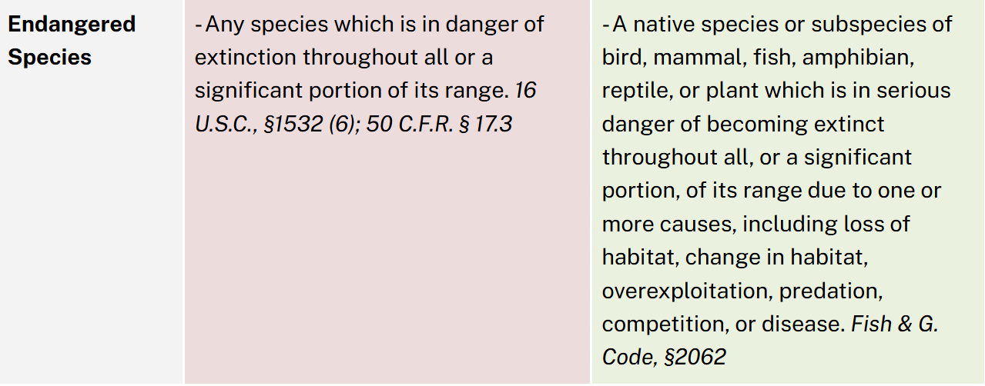
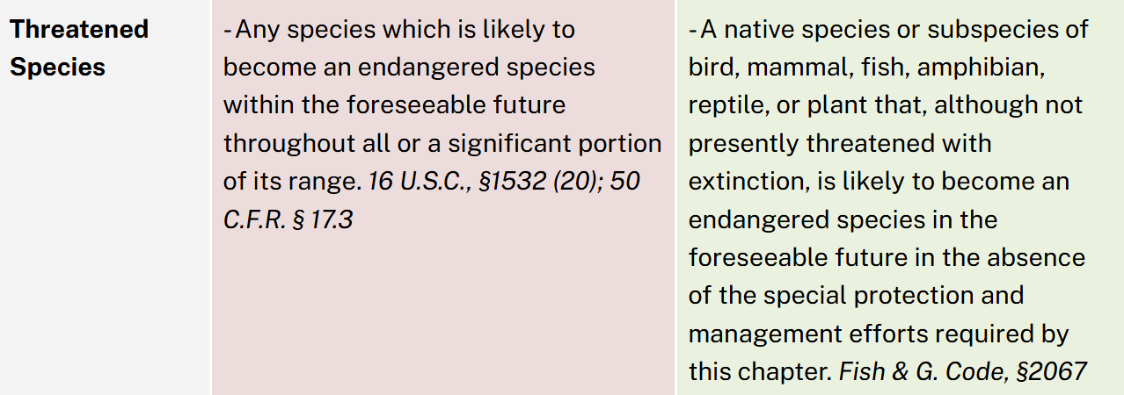
What is the California Endangered Species Act?
Federal
California
Law that conserves and protects plant and animal species at risk of extinction.
Plant and animal species (or evolutionary significant units or distinct population segments) may be designated threatened or endangered under CESA after a formal listing process by the California Fish and Game Commission
Encoded in CA Game and Fish Code
First created 1970
~250 species currently listed as State-level threatened or endangered

Slide 16

ESA CESA
ESA includes “harass,” “harm,” and “incidental take” in prohibited actions
Expressly allows for wildlife populations to be listed as Evolutionarily Significant Unit (ESU)s and Distinct Population Segments in addition to species and subspecies (California has borrowed from this in the Courts, Commissions, and Department to authorize DPS listings)
Has “Accidental take” instead: “Accidental (unintended or unforeseen) take of candidate, threatened, or endangered species is not prohibited if it is the result of an act that occurs on a farm or ranch in the course of an otherwise lawful routine and ongoing agricultural activity.”
Unique program: Voluntary Local Program (VLP) encourages farmers and ag ranchers to voluntarily enhance/maintain habitat for listed species; incidental take occurring while following specific management practices is okay
“Candidate” species are afforded full protections until a decision is made
Also includes a “Consistency Determination” where applicants who get an incidental take statement for a listed species can request determination from the Director that the federal document is consistent with CESA
Act is limited to species and subspecies officially
I was listed as a DPS in Central CA!

Slide 17
How to Submit a Petition
What should the Petition include? (Categories are ours, requirements are CESA’s)
Species Description:
  Population trends
  Range and Distribution
  Abundance
  Life History
  Kind of Habitat Necessary for Survival
Threats and Management Recommendations:
  Factors affecting ability to survive and reproduce
  Degree and immediacy of threat
  Impact of existing management efforts
  Suggestions for future management
Additional Information:
  Availability of sources of information
  Detailed distribution map
Fill out the following form: Complete FGC Form 670.1 (PDF)
Complete a CESA petition that should include:
  Statement explaining why petitioned action is being recommended (executive summary)
Submit the completed Form 670.1 and petition to the California Fish and Game Commission to the Commission's email at fgc@fgc.ca.gov or mail to P.O. Box 944209, Sacramento, CA 94244-2090.

Slide 18
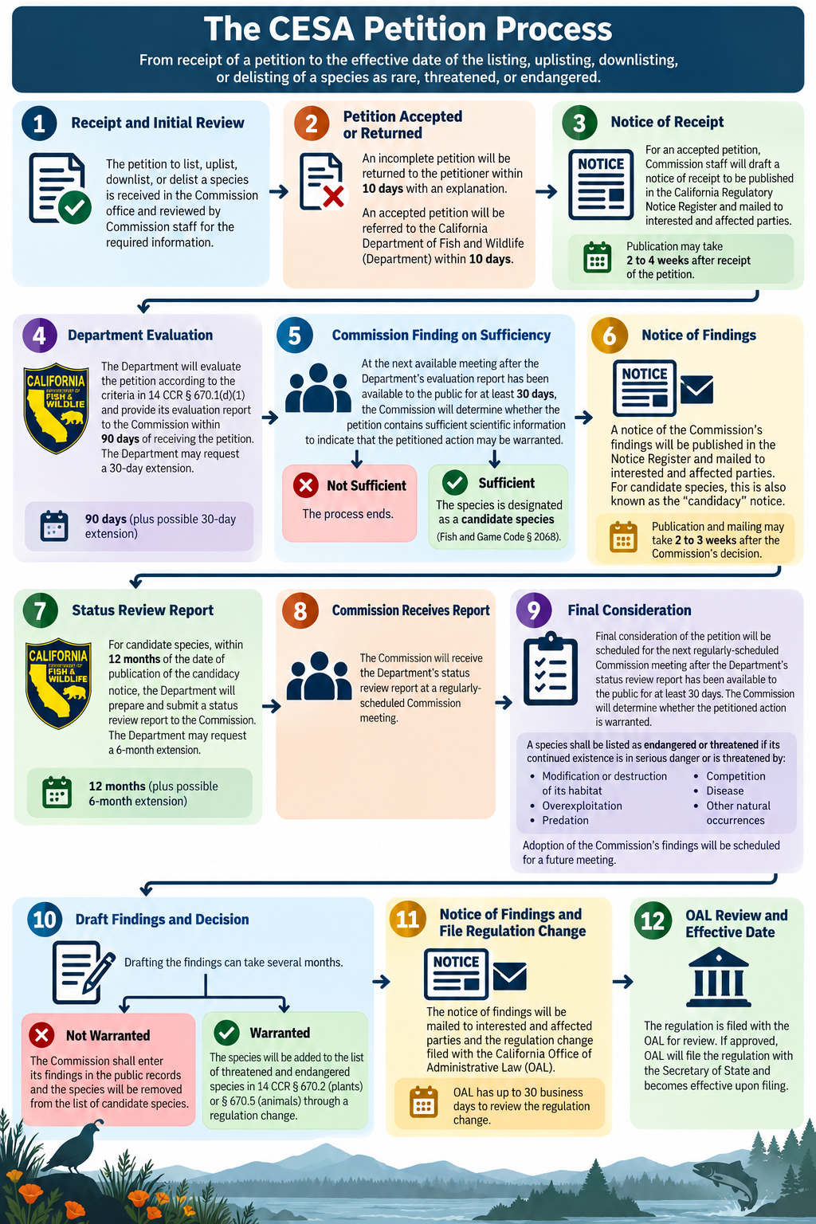

Slide 20
What is the Petition Process
Commission receives and reviews petition. If complete, forwarded to Department staff within 10d.
Department evaluates petition for state listing criteria. Publishes report within 90d.
Commission reviews report and petition. Determines if petition moves forward and can designate as “candidate species” until listing process completed.
Department publishes species status report within 12 mo.
Commission reviews and makes final listing determination.

