Slide 1
Global Policy

Slide 2

Convention On Biodiversity
international legal treaty from the United Nations created to protect Earth's plant, animal, and microbial life and promote sustainable development
three main goals:
  the conservation of biological diversity;
  the sustainable use of its components;
  the fair and equitable sharing of the benefits arising from the use of genetic resources.
Notes:
Contracting Parties are required to create and enforce national strategies and action plans to conserve, protect and enhance biological diversity. They are also required to undertake action to implement the thematic work programmes on ecosystems and a range of cross-cutting issues which have been established to take forward the provisions of the Convention.
The Kunming-Montreal Global Biodiversity Framework (GBF) was adopted during the (2022) fifteenth meeting of the Conference of the Parties (COP 15) following a four year consultation and negotiation process.
ets out an ambitious pathway to reach the global vision of a world living in harmony with nature by 2050. Among the Framework’s key elements are 4 goals for 2050 and 23 targets for 2030.

Slide 3
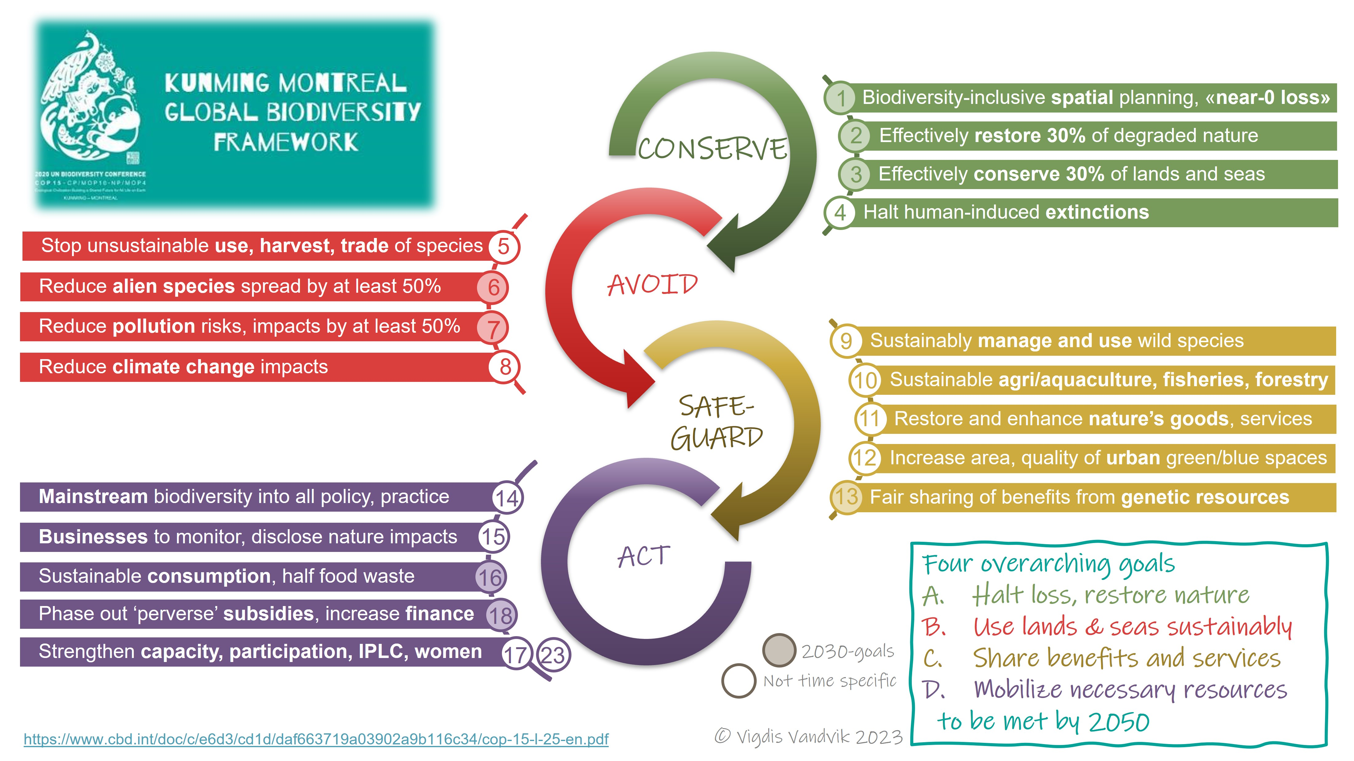
Global Biodiversity Framework

Slide 4
Global Biodiversity Framework
4 Goals for 2050
The GBF needs measurable indicators to determine whether countries and the international community are actually making progress toward these goals.
23 Targets for 2030
Headline + component + complementary indicators

Slide 5
How does the IUCN Red List fit into the GBF?

Slide 6
Where the Red List fits
Goal A
Maintain ecosystem integrity, reduce extinction risk, increase abundance of native species, and maintain genetic diversity.
Target 4
Halt species extinction, protect genetic diversity, and manage human–wildlife conflicts.
A.3 — Red List Index
Are extinction risks across species improving or worsening?
Notes:
A.3 looks primarily at species-level extinction risk.
A.4 looks below the species level at population genetic vulnerability.

Slide 7
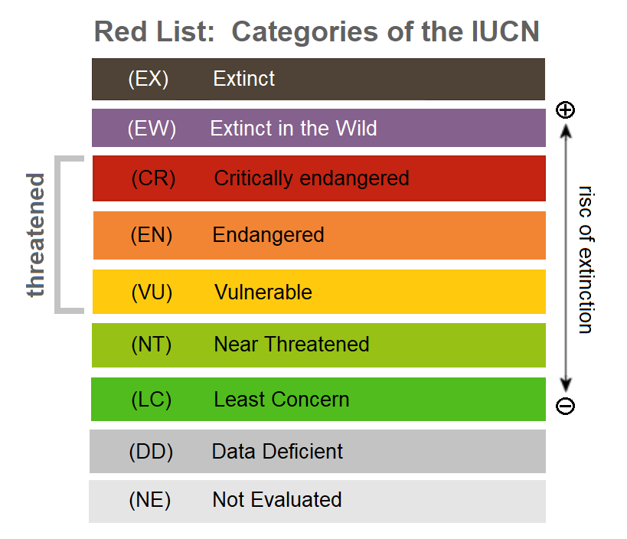
What is the IUCN Red List
Global system for assessing the extinction risk of species
Uses standardized, quantitative criteria
Assessments also compile information on distribution, population, ecology, threats, use/trade, and conservation actions
Important distinction: Red List status is an assessment of extinction risk, not itself a legal protection

Slide 8
IUCN Categorization
Taxa Assessed:
  Species
  Subspecies
  Varieties (only for plants)
  Subpopulations (provided certain conditions are met)
The IUCN criteria are designed for global taxa assessments
A species only needs to meet one criterion to qualify for a threatened category
Criterion | Broadly asks…
A | Is the population declining substantially?
B | Is its geographic range small/restricted and declining or fragmented?
C | Is the population small and declining?
D | Is the population or distribution extremely small?
E | What does a quantitative extinction-risk analysis predict?

Slide 9
Flow of Information
Available Evidence
Species Assessment Against Criteria A-E
Assessments are generally prepared by specialists, Species Survival Commission groups, Red List Authorities, partners, or other qualified assessors; they are reviewed and checked before publication.
Proposed Red List Category
Expert/ Red List Authority Review
IUCN Red List Unit quality checks
Published Assessment

Slide 10
The Red List is not law but it informs policy
IUCN Red List feeds into
  conservation planning
  national and regional conservation priorities
  international agreements
  global biodiversity indicators
Examples of international agreements
  CITES - Red List information can inform decisions concerning international trade and revisions to CITES appendices
  CMS - Red List information can inform decisions concerning migratory species and their conservation
  GBF
Notes:
CITES: Convention on International Trade in Endangered Species of Wild Fauna and Flora
CMS: Convention on Migratory Species
GBF: Global Biodiversity Framework

Slide 11
How do genetic indicator fit in?
Goal A
Maintain ecosystem integrity, reduce extinction risk, increase abundance of native species, and maintain genetic diversity.
Target 4
Halt species extinction, protect genetic diversity, and manage human–wildlife conflicts.
A.3 — Red List Index
Are extinction risks across species improving or worsening?
A.4 — Proportion of populations with Ne > 500
Are populations maintaining sufficient effective population sizes?
Notes:
A.3 looks primarily at species-level extinction risk.
A.4 looks below the species level at population genetic vulnerability.

Slide 12

Genetic Diversity in the Global Biodiversity Framework
Goal A
The genetic diversity within populations of wild and domesticated species, is maintained, safeguarding their adaptive potential.
Target 4
…maintain and restore the genetic diversity within and between populations of native, wild and domesticated species to maintain their adaptive potential.

Slide 13
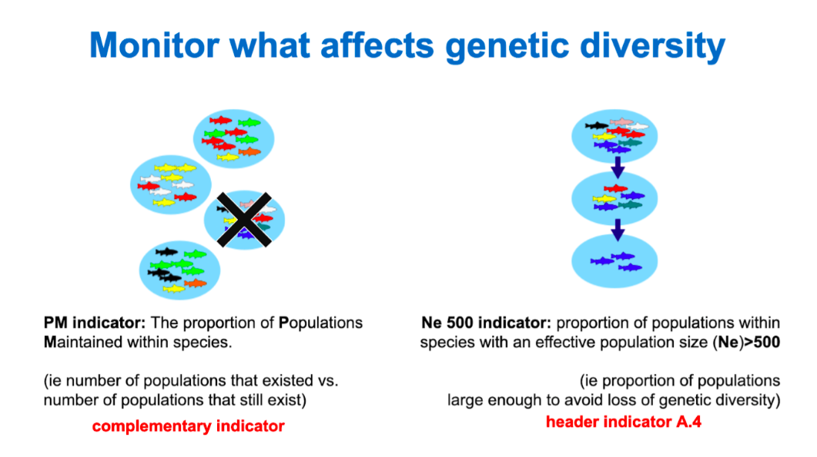
What are the genetic indicators?

Slide 14
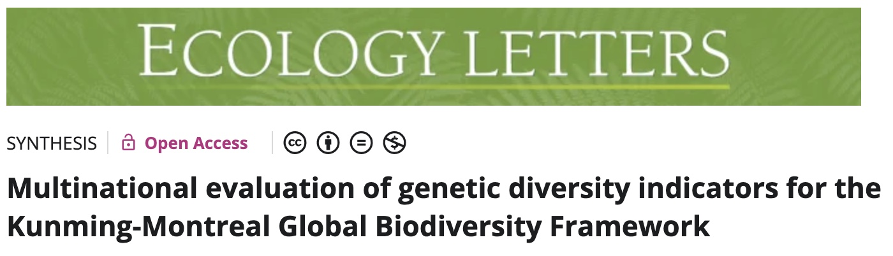







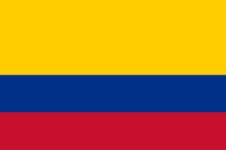
How we’ve used the indicators

Slide 15
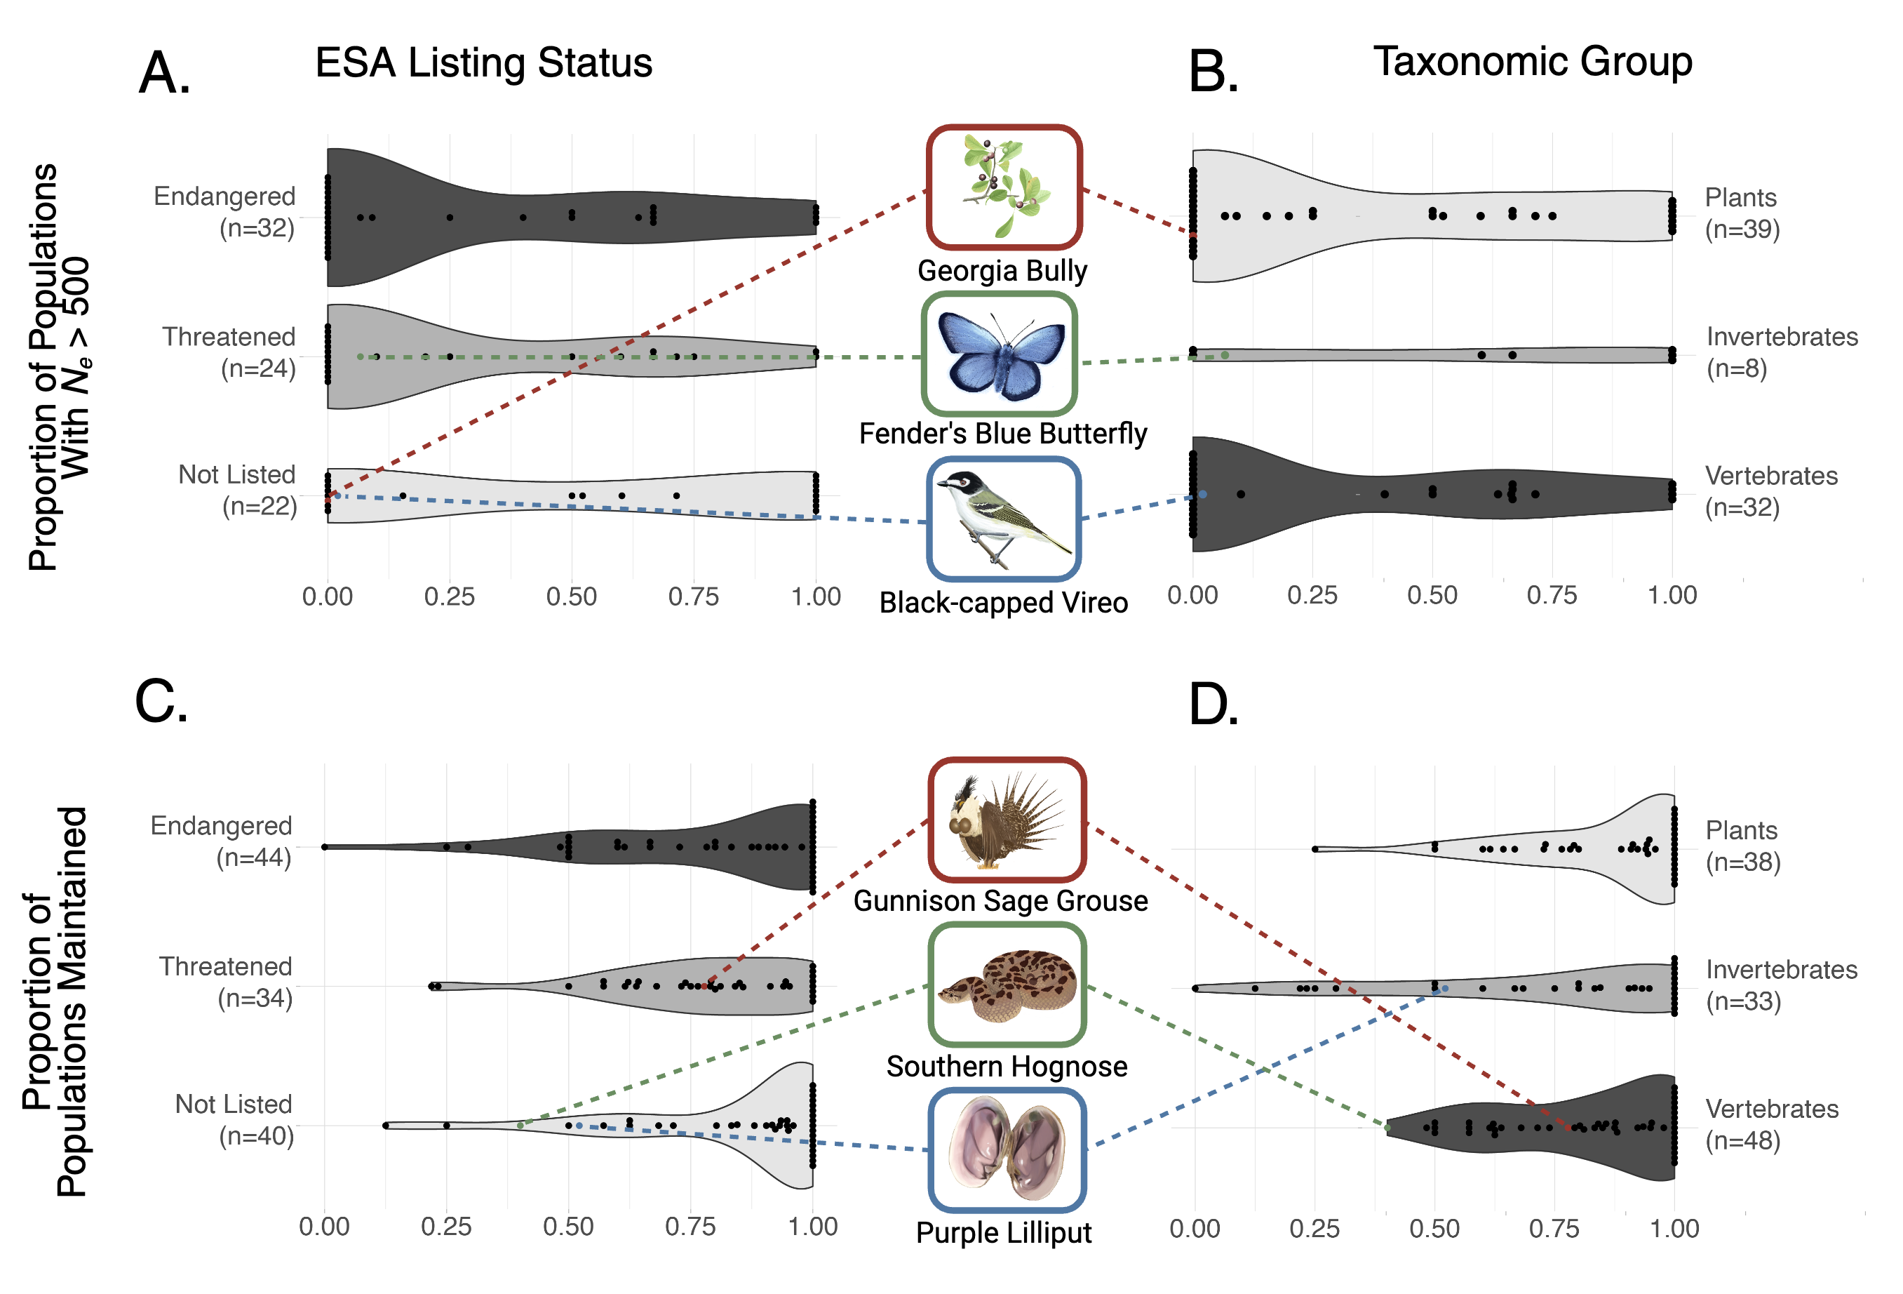
How we’ve used the indicators

Slide 16
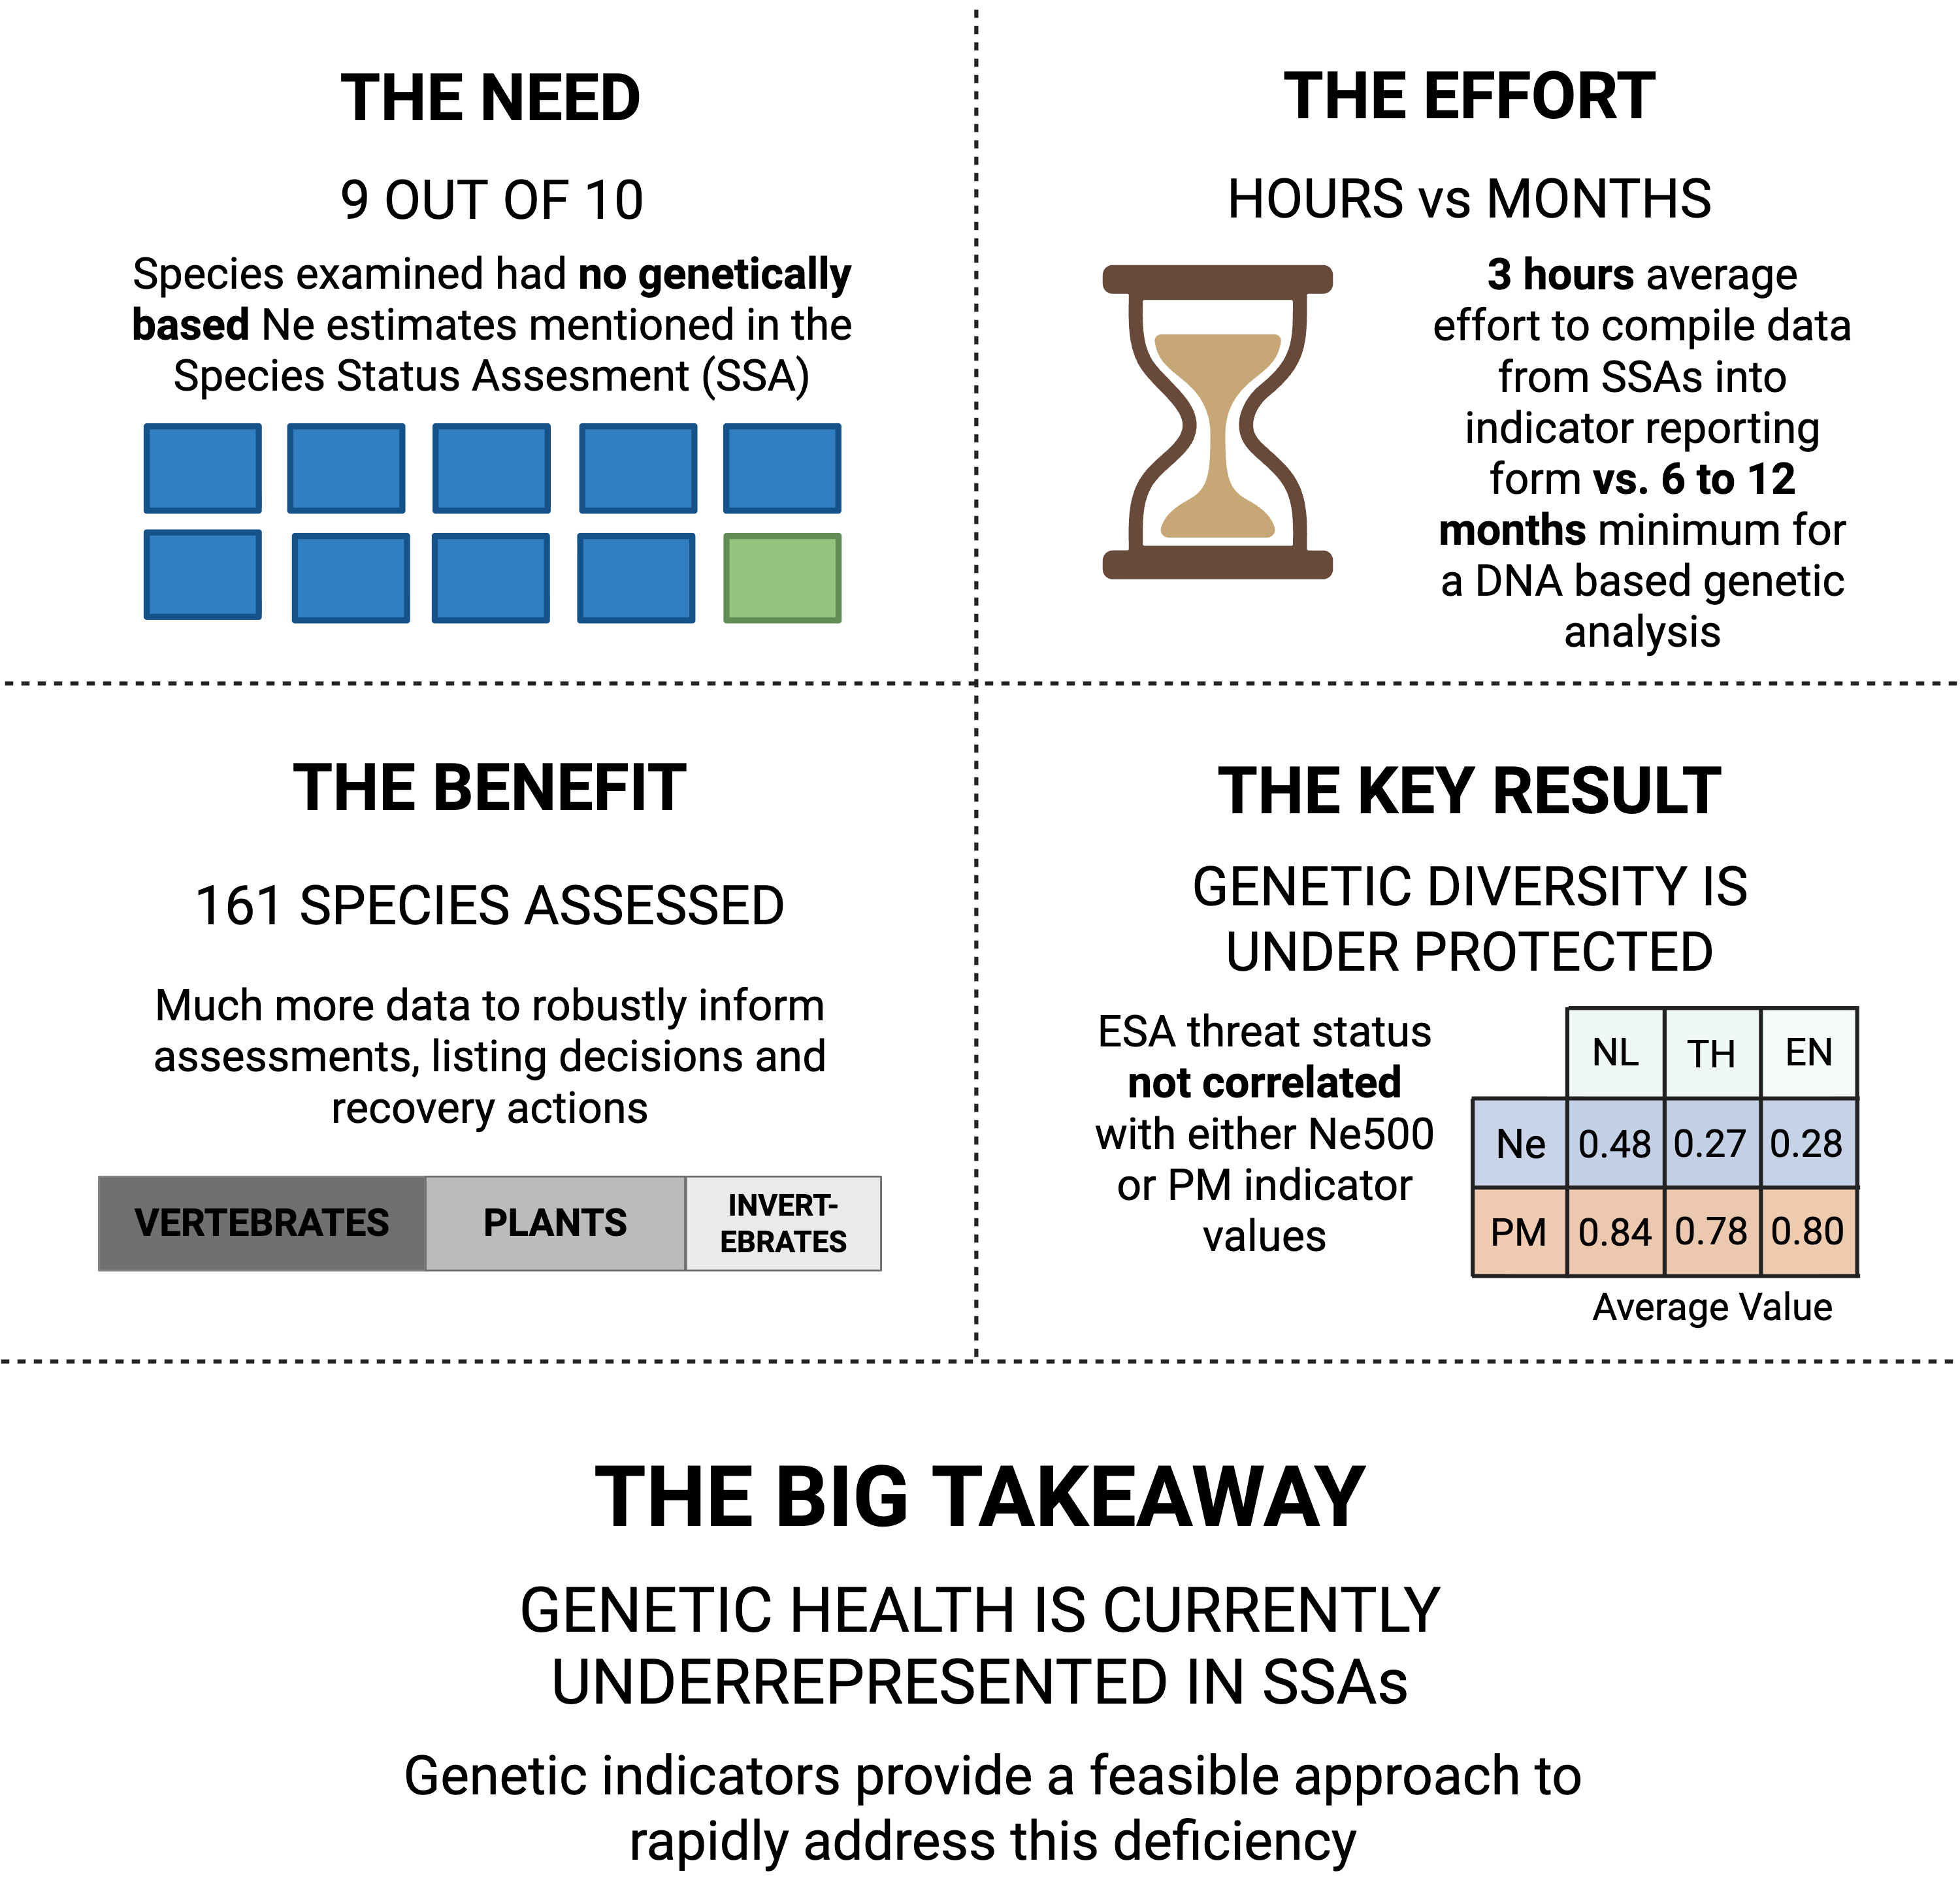
How we’ve used the indicators

