Slide 1
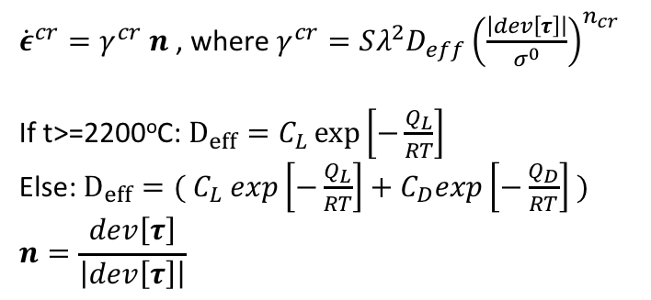
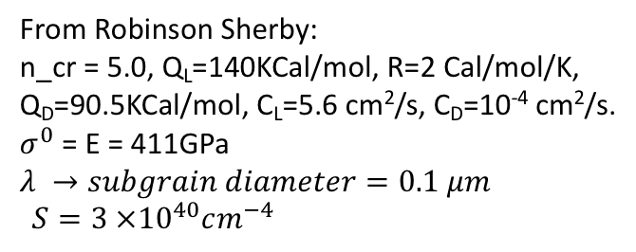
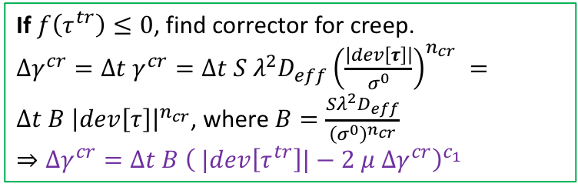
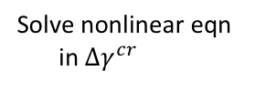
Creep (Norton creep model):
Result:
${\dot{ε}}^{cr}=γ^{cr} n$ , where $γ^{cr}=Sλ^{2}D_{eff}{\left(\frac{\left|dev\left[τ\right]\right|}{σ^{0}}\right)}^{n_{cr}}$
If t>=2200ºC: $D_{eff}=C_{L}\exp\left[−\frac{Q_{L}}{RT}\right]$
Else: $D_{eff}=( C_{L} exp\left[−\frac{Q_{L}}{RT}\right]+C_{D}exp\left[−\frac{Q_{D}}{RT}\right] )$
$$n=\frac{dev\left[τ\right]}{\left|dev\left[τ\right]\right|}$$
From Robinson Sherby:
n_cr = 5.0, Q_{L}=140KCal/mol, R=2 Cal/mol/K,
Q_{D}=90.5KCal/mol, C_{L}=5.6 cm²/s, C_{D}=10⁻⁴ cm²/s.
$σ^{0}$ = E = 411GPa
$$λ →subgrain diameter=0.1 μm$$
$${S=3 ×{10}^{40}cm^{−4}}$$
If $f\left(τ^{tr}\right)≤0$, find corrector for creep.
$Δγ^{cr}=Δt γ^{cr}=Δt S λ^{2}D_{eff}{\left(\frac{\left|dev\left[τ\right]\right|}{σ^{0}}\right)}^{n_{cr}} =Δt B {\left|dev\left[τ\right]\right|}^{n_{cr}}$, where $B=\frac{{Sλ}^{2}D_{eff}}{{\left(σ^{0}\right)}^{n_{cr}}}$
$$⇒Δγ^{cr}=Δt B {\left( |dev\left[τ^{tr}\right]|−2 μ Δγ^{cr}\right)}_{ }^{c_{1}}$$
Solve nonlinear eqn
in $Δγ^{cr}$

