Slide 1
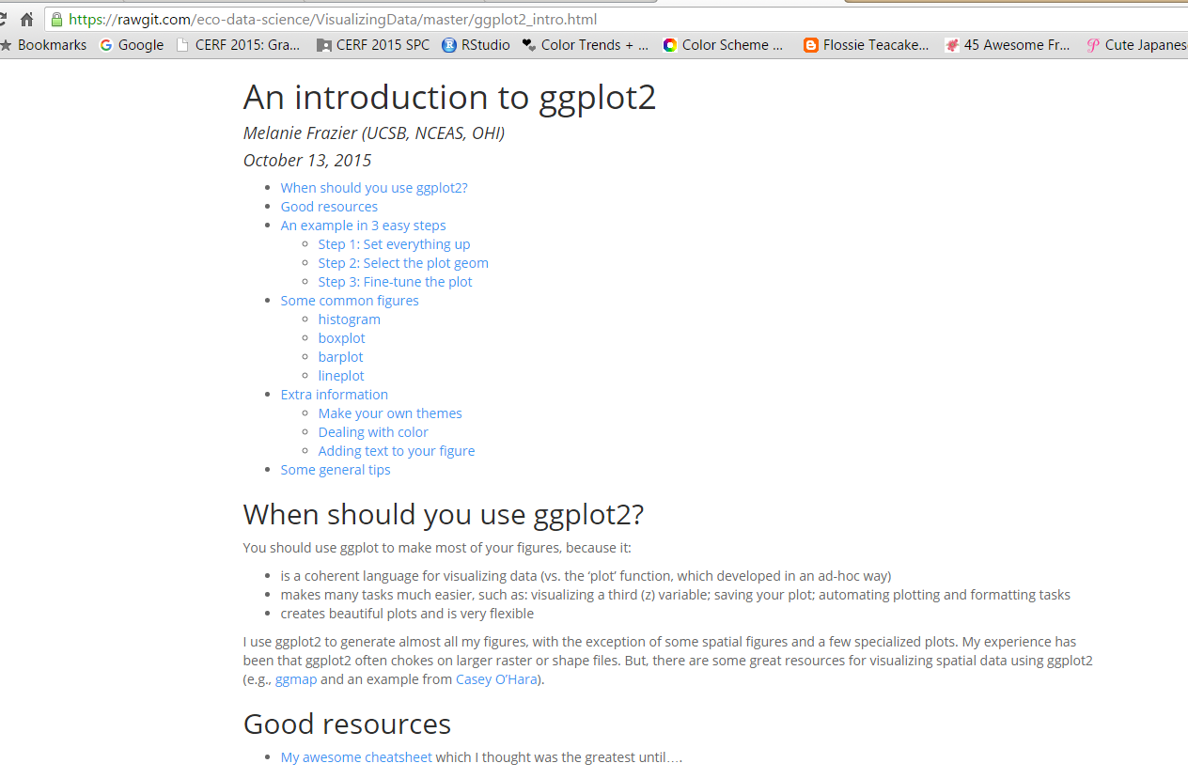

Slide 2
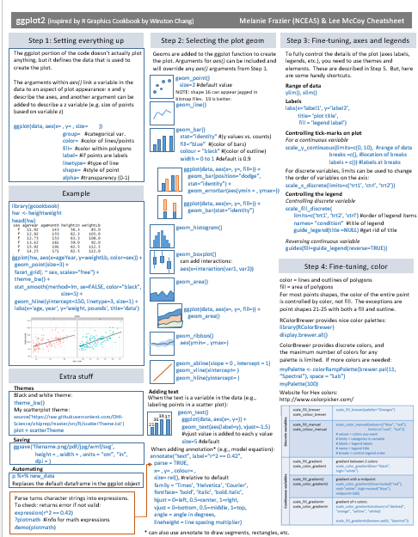
My cheatsheet

Slide 3
When should you use ggplot2?
Almost always!
Coherent language
Easier to do complicated things
Beautiful figures

Slide 4
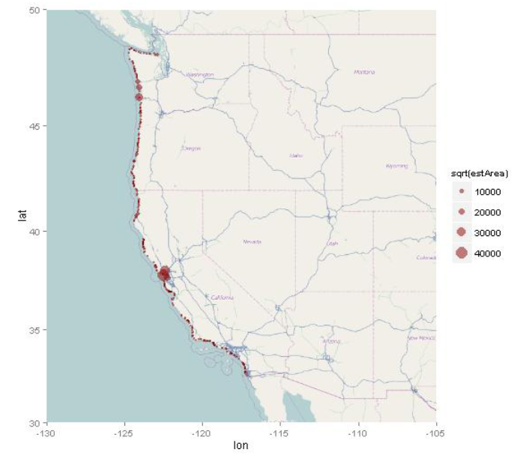
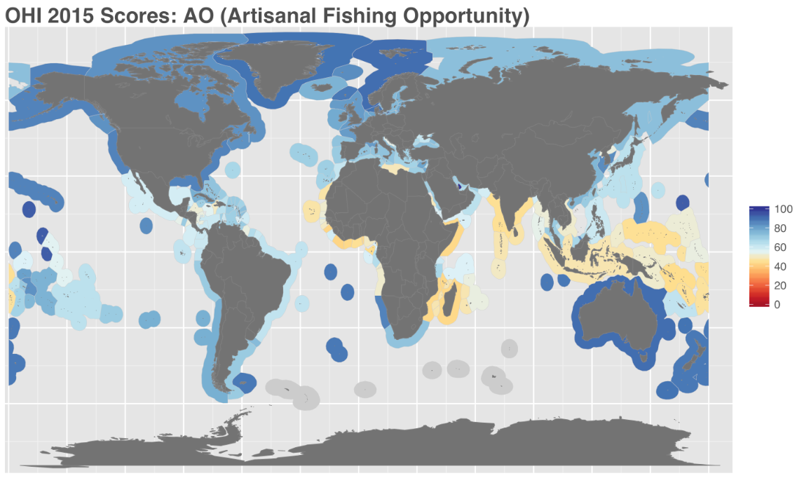
Exceptions?
Specialty plots and spatial data
Casey O'Hara

Slide 5
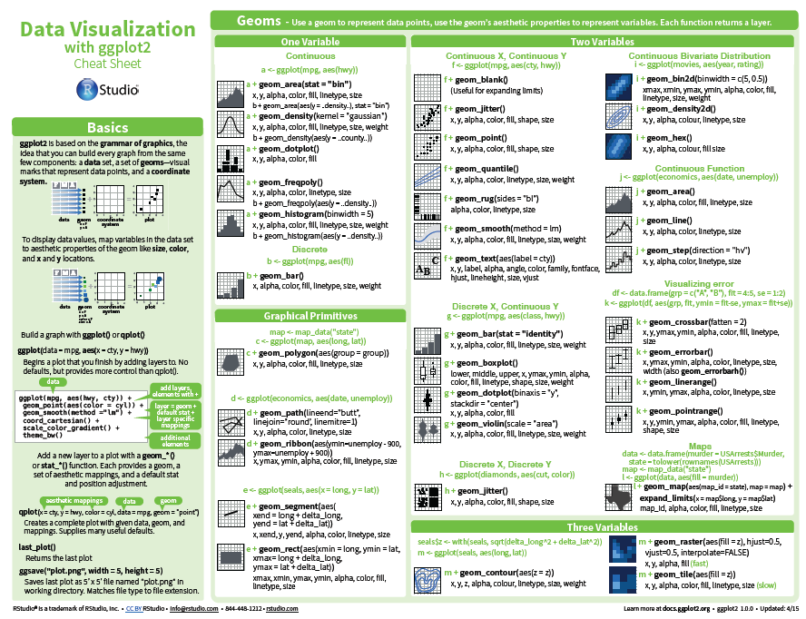
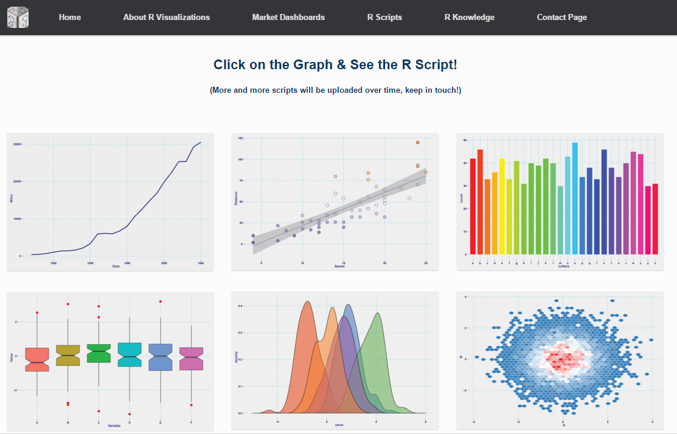
Resources
Winston Chang's book
(very awesome)
Official ggplot2 cheatsheet (very handy)
rvisualization.com

Slide 6
Today's goals
Simple scatterplot example
- setting everything up
- defining the geom
- fine-tuning
Some example plots
- histogram
- boxplot
- barplot
- lineplot
Extra information
- themes
- color
- text

Slide 7
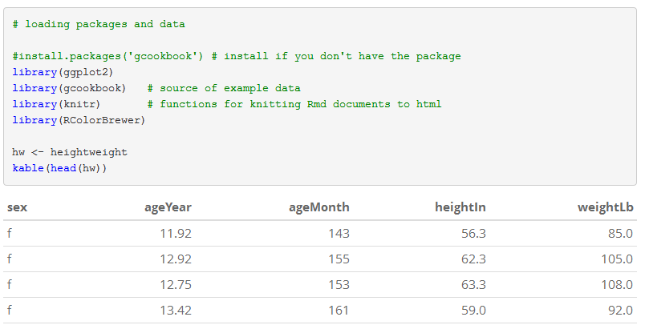
Simple scatterplot: In 3 easy steps!

Slide 8
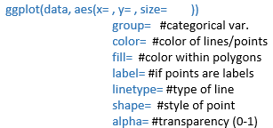
STEP 1:
Set things up with ggplot
ggplot(hw, aes(x = ageYear, y = weightLb))

Slide 9
STEP 2:
Select plot geom
ggplot(hw, aes(x = ageYear, y = weightLb)) +
geom_point()

Slide 10
STEP 3:
Fine-tuning
point size, shape, transparency
axes labels
fitting a model
fitting reference line
changing the theme
adding a z-variable
faceting

Slide 11
Some more examples (more geoms)
histogram
boxplot
barplot
lineplot

Slide 12
Extra information
themes
color
text

Slide 13
Other information: color
Important #1: Use existing color themes like RColorBrewer!!
Important #2: Determine whether you are dealing with a discrete or continuous variable.
Important #3: colour vs. fill:
For the most part, 'color' is used to color lines and outlines of polygons (e.g., histograms, bar plots, shapes 21-25), and 'fill' is used to color the rest of the area. However, point shapes are treated a bit differently and `color` is used to color the entire point.

Slide 14
Other information: color
random assignment of color brewer color
scale_colour_brewer
Discrete variable
(e.g., gender, eye color)
controlling color assignment
scale_colour_brewer
gradient
scale_color_gradient
Continuous variable
(e.g., height, weight)
divergent
scale_color_gradient2
scale_color_gradientn
scale_color_gradient2

Slide 15
Parting tips
qplot: NO!!!
Hadley Wickham's qqplot book: NO!
If the colour aesthetic doesn't seem to be working, try the fill version
When plotting points, use shape=19 (the default is jagged when saved as bitmap files)
Use the "group" aesthetic when you want separate lines/analyses for different subsets of data.

