Slide 1



Forecast scoring and synthesis

Slide 2
Workshop overview
Objectives:
Introduce NEON and the Forecasting Challenge
Provide tools and resources to contribute to the Challenge
Introduce the Challenge cyberinfrastructure
Explore the existing forecast catalogue and scores

Slide 3
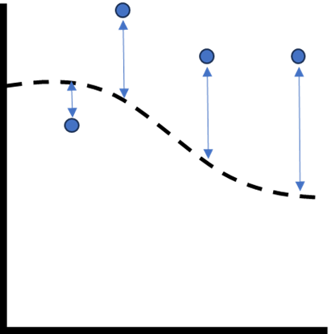
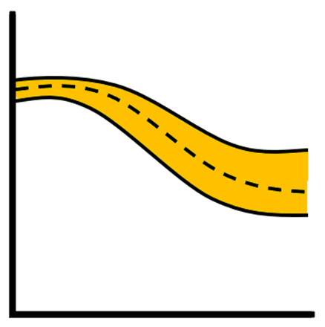
Bias or error
Uncertainty/spread
e.g.
MAE
RMSE
e.g.
Standard deviation
Variance
Notes:
Two characteristics to think about when scoring a probabilistic forecast

Slide 4
Automated Challenge scoring
Implementation of the ScoringRules package (Jordan, Krueger & Lerch, 2019)
All forecasts rescored with new data
Probabilistic scoring rules (proper??)
Alexander Jordan, Fabian Krueger, Sebastian Lerch (2019). Evaluating Probabilistic Forecasts with scoringRules. Journal of Statistical Software, 90(12), 1-37. DOI 10.18637/jss.v090.i12​
Notes:
Two characteristics to think about when scoring a probabilistic forecast

Slide 5
Bias or error
Uncertainty/spread
CRPS

Slide 6
Continuous Rank Probability Score (CRPS)
Key characteristics:
0 is lowest and best possible score
Lower = better
Expressed in native units
Considers the full forecast distribution

Slide 7
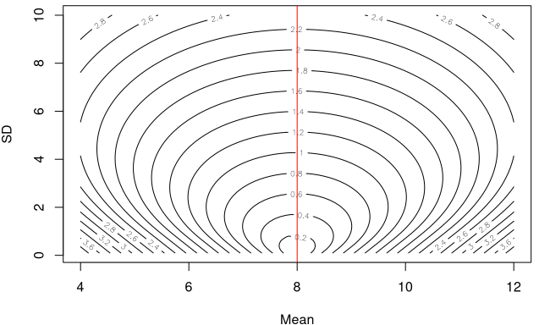
You can score just as well by having a higher bias but a smaller spread!
"True" value = 8
Notes:
Explanation of the tradoff between bias and spread. When you are closer to the mean you can have a wider spread. But can score equally as well by haing a larger bias but smaller spread

Slide 8
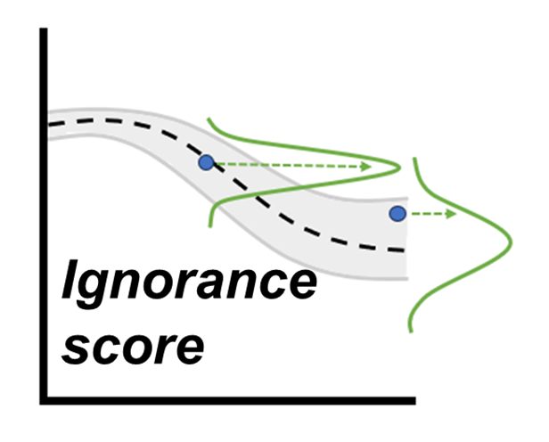
Ignorance score (logs)
How much probability is placed on the outcome?
Similar to the CRPS metric
Can be infinitely bad
Notes:
Another score?

Slide 9
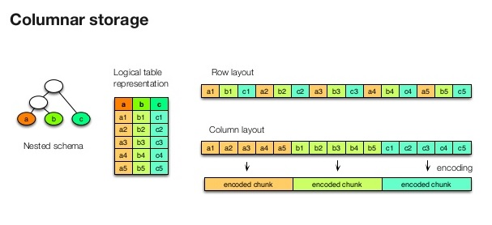
Scores database
STAC catalog
Parquet file structure
Levels of partitions
Query-able
Fast access
Notes:
Would an image like this be helpful

Slide 10

Database structure
Forecasts: data table with all ensemble members or parametric parameters (multiple rows per forecast). This is the largest database and slowest to access.
Summaries: data table with a single row per datetime + reference_datetime combination. Forecasts are collapsed down to statistical descriptions (mean, median) and forecast quantiles (2.5%, 97.5%, etc.). This is quicker to access and require less data transfer than the full forecasts.
Scores: data table with the summaries along with the observations and the scores that require analysis of the full ensemble or parametric forecast. These include the crps or log score. Other model performance statistics (such as RMSE) can be calculated from the columns in the scores table.

Slide 11
Structure of database (forecasts and summaries)
project_id: this allows the separation of different forecasting challenges (neon4cast, vera4cast, etc.)
duration: this allows the separation of variables with the same name but different scales of aggregation (i.e. daily carbon fluxes vs 30 minute carbon fluxes)
variable: this is the forecasted variable
model_id: this is the individual forecast model
reference_datetime: this is the date that a forecast was generated
The actual parquet file sits within the last partition and contains all the site_ids that were forecasted

Slide 12
Structure of database (scores)
project_id: this allows the separation of different forecasting challenges (neon4cast, vera4cast, etc.)
duration: this allows the separation of variables with the same name but different scales of aggregation (i.e. daily carbon fluxes vs 30 minute carbon fluxes)
variable: this is the forecasted variable
model_id: this is the individual forecast model
datetime: this is the date that a forecast applies too
The actual parquet file sits within the last partition and contains all the site_ids that were forecasted

Slide 13
Example of a path
scores/parquet/project_id=neon4cast/duration=P1D/variable= temperature/model_id=flareGLM/datetime=2024-01-01/part-0.parquet
Note: You can also query further using the dplyr functions like we did for the NOAA data
e.g.
… |>
filter(site_id=='BARC') |> collect()
Or
…|>
distinct(model_id) |> collect()

Slide 14
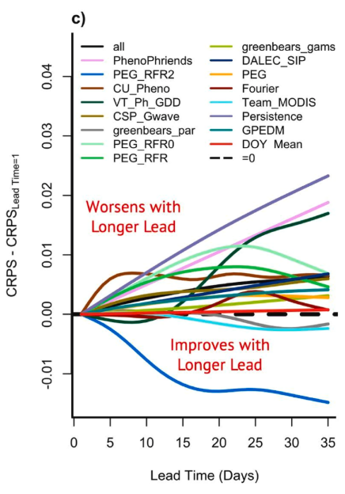
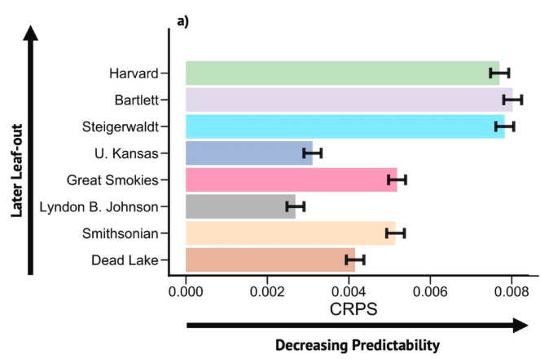
What to do with the scores?
Synthesize!
Predictability
Variables
Models
Sites
Horizon, lead time
Example from a synthesis of the phenology theme

Slide 15
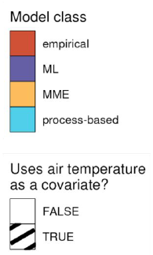
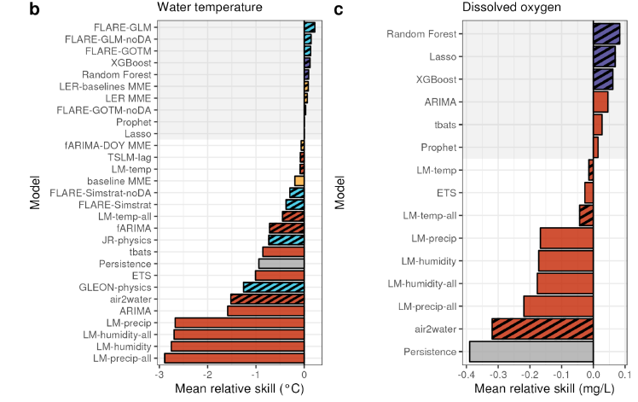
What to do with the scores?
Synthesize!
Predictability
Variables
Models
Sites
Horizon, lead time
Example from a synthesis of the aquatics theme

Slide 16
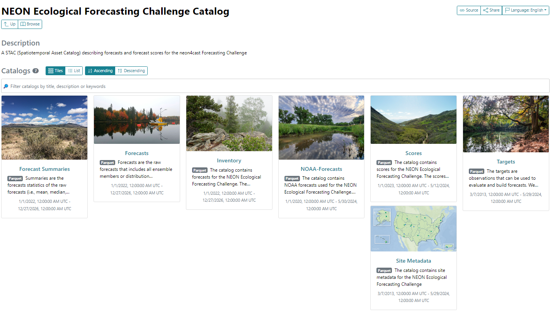
Navigating to the STAC
https://radiantearth.github.io/stac-browser/#/external/ raw.githubusercontent.com/eco4cast/neon4cast-ci/main/catalog/catalog.json

